Slide 1
Chapter 14: Consumer Health
Lecture Outlines by
Sloane Burke Winkelman
California State University, Northridge

Slide 2
Did You Know?
Approximately 75% of Internet users have sought health information online.
Medical errors account for a significant number of deaths in the United States—about 250,000 per year.
About 6.1 million young American adults aged 19 to 25 have gained health insurance since 2010.

Slide 3
Learning Outcomes
LO 14.1 Describe different aspects of self-care.
LO 14.2 Explain how to determine when it’s time to seek professional health care.
LO 14.3 Discuss the basis of conventional medicine, how to choose a provider, and how to be a smart patient.
LO 14.4 Describe common types of complementary and alternative medicine, and explain how to evaluate them.
LO 14.5 Identify multiple methods of paying for health care.
LO 14.6 Discuss the genomic revolution and the future of personal health.
LO 14.7 Explain how to create your personal health-care plan.

Slide 4
Consumer Health
An umbrella term encompassing topics related to the purchase and consumption of health-related products and services.

Slide 5
CHOOSING SELF-CARE

Slide 6
Practicing Prevention
Eat nutritiously.
Exercise.
Refrain from unhealthful behaviors such as smoking and excessive drinking.
Brush and floss your teeth regularly.
Make sure you get enough sleep.
Keep your stress level under control.
Maintain good relationships.
Engage in common-sense behaviors (e.g., wear a seat belt, wear a helmet, practice safe sex).

Slide 7
Finding Accurate Health Information
The Internet as a health resource is very common.
Nicknamed “Dr. Google.”

Slide 8
Evaluating Health Information and Tools
What is the source?
What does the source have at stake? Is the information provider relatively unbiased?
Is the information or tool supported by facts?
Does the information or tool come with a “time stamp”?
Is the information presented in a balanced manner? Does it include and discuss other options or points of view?
Does the information or tool offer something that sounds too good to be true?

Slide 9
Understanding Research Studies
Evidence-based medicine: Health-care policies and practices based on systematic, scientific study.
Is the study valid and reliable?
Is the description of the research specific and detailed?
Who published the research?
Who were the study participants?
How many people participated?
What were the profiles of the participants?
Is the study the first of its kind?
Do the people behind the study have any conflicts of interest?

Slide 10
OPTIONS FOR SELF-CARE

Slide 11
Evaluating Over-the-Counter (OTC) Medications
Approximately 80% of U.S. adults currently take at least one type of medication.
More than $40 billion worth of OTC drugs is sold in the United States each year.
Approximately 74% of college students take at least 1 OTC a week.

Slide 12
Taking Home Health Tests
A range of medical tests can be performed at home.
The most common types:
Pregnancy tests.
Blood pressure tests.
Fertility thermometers and apps.
Cholesterol tests.
Blood glucose monitors.
Colon cancer risk tests.
HIV tests: See disclaimer in textbook

Slide 13
Taking Home Health Tests (cont.)
Notes:
FIGURE 14.2 Home Health Tests. These are now available for everything from fertility testing to HIV detection.

Slide 14
WHEN TO SEE A DOCTOR

Slide 15
Checkups and Preventive Care
By working with your health-care providers to get regular screenings and checkups, you can prevent problems or catch them early, when they are often far easier to treat.
Oral health.
Vision.
Vaccinations.

Slide 16
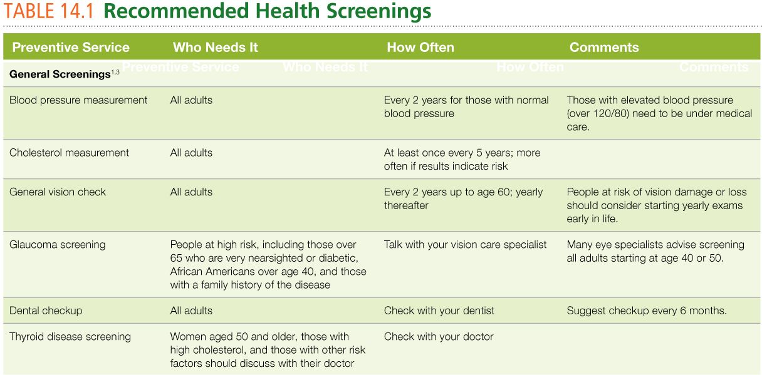
Recommended Health Screenings
Notes:
Sources: 1. Centers for Disease Control and Prevention. (2015). CDC prevention checklist. www.cdc.gov. 2. Centers for Disease Control and Prevention. (2015). Adolescent and adult vaccine quiz. www.cdc.gov. 3. American Optometric Association. (n.d.). Recommended eye examination frequency for pediatric patients and adults. www.aoa.org.

Slide 17
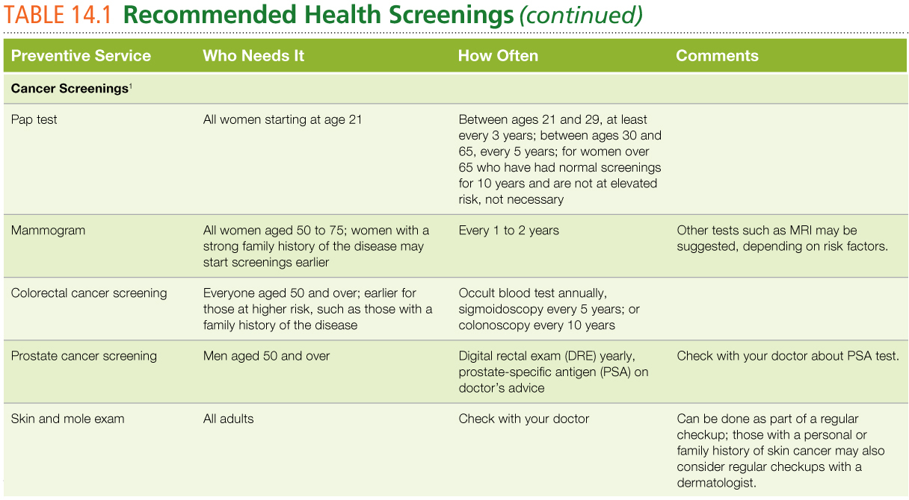
Recommended Health Screenings (cont.)
Notes:
Sources: 1. Centers for Disease Control and Prevention. (2015). CDC prevention checklist. www.cdc.gov. 2. Centers for Disease Control and Prevention. (2015). Adolescent and adult vaccine quiz. www.cdc.gov. 3. American Optometric Association. (n.d.). Recommended eye examination frequency for pediatric patients and adults. www.aoa.org.

Slide 18
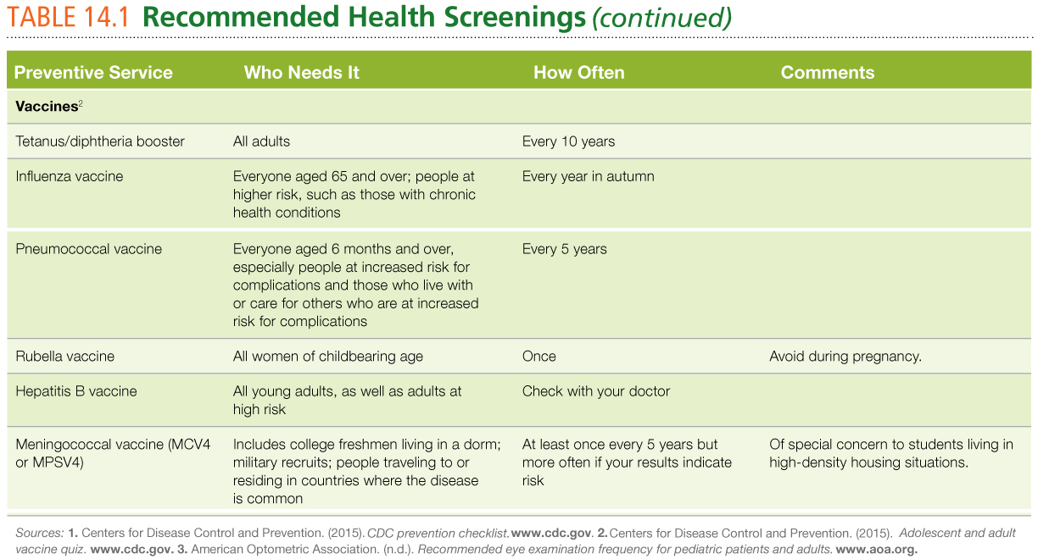
Recommended Health Screenings (cont.)
Notes:
Sources: 1. Centers for Disease Control and Prevention. (2015). CDC prevention checklist. www.cdc.gov. 2. Centers for Disease Control and Prevention. (2015). Adolescent and adult vaccine quiz. www.cdc.gov. 3. American Optometric Association. (n.d.). Recommended eye examination frequency for pediatric patients and adults. www.aoa.org.

Slide 19
Health Problems Beyond Self-Care
Severe injury (e.g., car accident)
Serious burns
Sudden, severe pain anywhere
Adverse reactions to a medication or insect bite
Other severe allergic reactions
Heavy bleeding
Difficulty breathing
Signs of a heart attack
Signs of a stroke
Sudden worsening of a chronic health condition (e.g., diabetes and asthma)

Slide 20
When to See a Health-Care Provider
Vomiting, inability to keep fluids down, painful swallowing
Persistent cough, earache
Black or bloody stools
A feeling that food is stuck in the throat, heartburn, persistent or severe abdominal pain or nausea
Unexplained weight loss; dizziness; persistent fatigue; sweating, especially heavy or cold sweats

Slide 21
When to See a Health-Care Provider (cont.)
Severe headache
Palpitations, chest pain
Pain or swelling in the legs
Uncommon periods, a sudden feeling of illness while using tampons, severe cramps
Fever of 100.4oF (38oC) or above
Swelling or redness in or around the eye
Moderate or severe abdominal pain

Slide 22
CONVENTIONAL MEDICINE

Slide 23
Conventional Medicine
Also called allopathic or Western medicine.
Based on the use of science and the scientific method.
Focuses on physical causes and symptoms.
Emphasizes physical exams such as X-rays or blood tests, or treatment of physical causes through drugs, surgery, or other interventions.
Focus on public health.

Slide 24
Types of Providers
Medical Doctor (M.D.): Physician trained in conventional medicine, with many years of additional formal education and training and a professional license.
Doctor of Osteopathic Medicine (D.O.): A licensed physician with similar training as an M.D. with additional training in osteopathic manipulative treatment; usually has a holistic focus.
Physician Assistant (P.A.): Licensed health professional who practices under the supervision of a physician and provides a broad range of care.

Slide 25
Types of Providers (cont.)
Dentist (D.D.S.): Conventional medicine practitioner who specializes in care of the teeth, gums, and mouth.
Optometrist (O.D.): Licensed professional who provides vision care.
Podiatrist (D.P.M.): Licensed professional who specializes in the care of the feet.
Nurse (R.N., B.S.N.): Licensed professional who provides a wide range of health-care services and supports the work of medical doctors.
Nurse Practitioner (F.N.P.): Registered nurse who has undergone additional training and can perform some of the care provided by an M.D.

Slide 26
Where to Find Conventional Health Care
Student health centers
Primary care facilities
Nonprofit clinics
Retail clinics
Urgent care centers
Specialist centers
Hospitals

Slide 27
Choosing a Provider
Is this provider accepting new patients?
What insurance plans does this office accept?
Is the doctor board-certified?
How does the office handle lab work?
Is this a group practice?
Who will care for you if your provider is unavailable?
Is the practice affiliated with any particular hospitals or specialty centers?

Slide 28
Being a Smart Patient
Talk to your provider.
Ask questions.
Take information home with you.
Follow up with your provider.
Prevent medical errors through active communication.

Slide 29
Handling Prescription Medications Properly
Approximately 14% of college students report having taken a prescription medication not prescribed to them.
Opioid painkillers are of special concern.
Prescription drugs are now the leading cause of overdose deaths in the United States.

Slide 30
COMPLEMENTARY AND ALTERNATIVE MEDICINE (CAM)

Slide 31
Complementary and Alternative Medicine (CAM)
Health practices and traditions not typically part of conventional Western medicine.
May be used alone (alternative medicine).
May be used in conjunction with conventional medicine (complementary medicine).

Slide 32
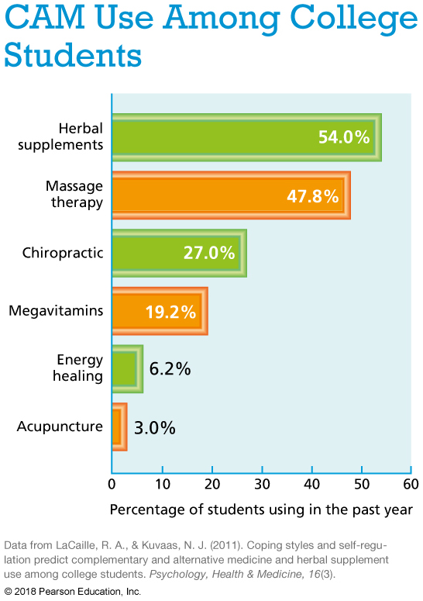

Slide 33
Five Major Domains of CAM
Whole medical systems
Mind-body medicine
Natural products
Manipulative and body-based practices
Energy therapies

Slide 34
Evaluating Complementary and Alternative Therapies
Be an informed consumer—evaluate the safety and effectiveness of each therapy.
Be aware that each person responds differently to treatments.
“Natural” does not necessarily mean “safe.”
Learn about factors that affect safety.
Tell your health-care providers about any CAM practices you use.

Slide 35
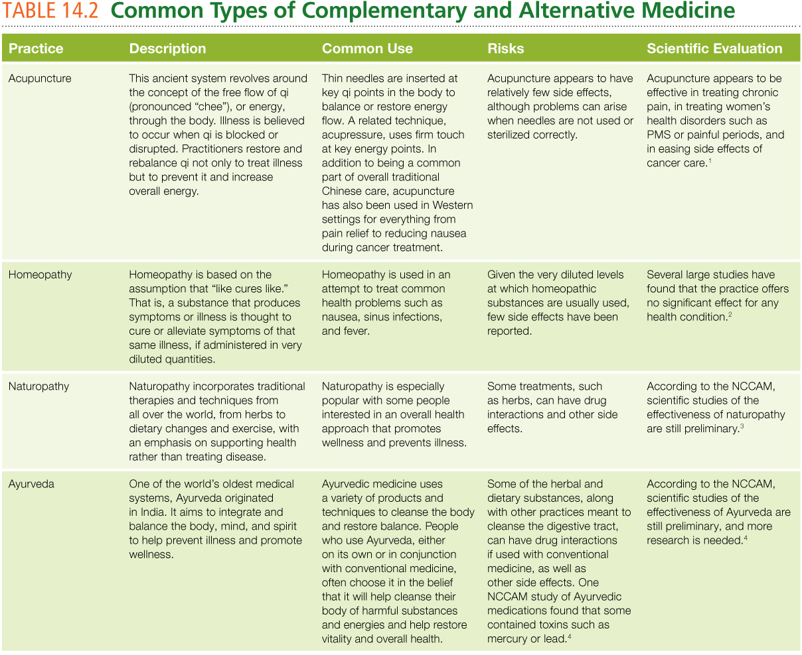
Common Types of Complementary and Alternative Medicine
Notes:
Sources: 1. National Center for Complementary and Integrative Health. (2016). Acupuncture: In depth. https://nccih.nih.gov. 2. National Center for Complementary and Integrative Health. (2015). Homoeopathy. https://nccih.nih.gov. 3. National Center for Complementary and Integrative Health. (2016). Naturopathy. https://nccih.nih.gov. 4. National Center for Complementary and Integrative Health. (2016). Ayurvedic medicine: In depth. https://nccih.nih.gov. 5. Arias, A., Steinberg, K., Banga, A., & Trestman, R. (2006). Systematic review of the efficacy of meditation techniques as treatments for mental illness. The Journal of Alternative and Complementary Medicine, 12(8), 817–832. 6. Chou, R., Qaseem, A., Snow, V., Casey, D., Shekelle, K., et al. (2007). Diagnosis and treatment of low back pain: A joint clinical practice guideline from the American College of Physicians and the American Pain Society. Annals of Internal Medicine, 147(7), 478–491. 7. National Center for Complementary and Integrative Health. (2015). Tai chi and qi gong: In depth. https://nccih.nih.gov.
8. Lee, M., Pittler, R., Guo, M., & Ernst, E. (2007). Qigong for hypertension: A systematic review of randomized clinical trials. Journal of Hypertension, 25(8), 1525–1532.

Slide 36
Common Types of Complementary and Alternative Medicine (cont.)
Notes:
Sources: 1. National Center for Complementary and Integrative Health. (2016). Acupuncture: In depth. https://nccih.nih.gov. 2. National Center for Complementary and Integrative Health. (2015). Homoeopathy. https://nccih.nih.gov. 3. National Center for Complementary and Integrative Health. (2016). Naturopathy. https://nccih.nih.gov. 4. National Center for Complementary and Integrative Health. (2016). Ayurvedic medicine: In depth. https://nccih.nih.gov. 5. Arias, A., Steinberg, K., Banga, A., & Trestman, R. (2006). Systematic review of the efficacy of meditation techniques as treatments for mental illness. The Journal of Alternative and Complementary Medicine, 12(8), 817–832. 6. Chou, R., Qaseem, A., Snow, V., Casey, D., Shekelle, K., et al. (2007). Diagnosis and treatment of low back pain: A joint clinical practice guideline from the American College of Physicians and the American Pain Society. Annals of Internal Medicine, 147(7), 478–491. 7. National Center for Complementary and Integrative Health. (2015). Tai chi and qi gong: In depth. https://nccih.nih.gov.
8. Lee, M., Pittler, R., Guo, M., & Ernst, E. (2007). Qigong for hypertension: A systematic review of randomized clinical trials. Journal of Hypertension, 25(8), 1525–1532.

Slide 37
Video: Acupuncture Wonders

Slide 38
Video: Acupuncture Wonders
Discussion Questions
What health concern is being addressed with acupuncture in this video?
What are the benefits reported by some patients?
Have you ever tried acupuncture to address a health concern? If so, did you find it helpful? If not, would you be willing to try it? Why or why not?

Slide 39
PAYING FOR HEALTH CARE

Slide 40
Discount Programs
Health discount program: A system of health discounts given to members of groups such as employees of a particular company or students attending a particular college.

Slide 41
Health Insurance
A contract between an insurance company and a group or an individual who pays a fee to have some level of health-care costs covered by the insurer.
Most college students have health insurance, although coverage varies widely.
Pre-existing condition: A health issue that existed prior to application to or enrollment in an insurance plan, which insurers sometimes use to restrict care or set the price paid for insurance.

Slide 42
Health Insurance: Managed-Care Plans
HMO: A type of managed care plan in which most health care is funneled through and must be approved by the primary care doctor.
PPO: A type of managed care plan in which the consumer is encouraged to stay within an approved network of providers but can obtain care outside the network.
POS: Point-of-service plan; HMO consumers see a broader list of providers for an additional fee.
Mini-med plan: Managed care for younger people.

Slide 43
Public Programs
Medicaid: Joint federal-state public insurance program; covers low-income individuals and families.
Medicare: Federal public insurance program; covers people with long-term disabilities and people who are 65 and older.

Slide 44
Fee-for-Service Programs
Fee-for-service plan: You choose your providers; you and your insurer divide the costs of care.
Health savings account (HSA): Consumer-controlled account; high deductible, for approved items.
Flexible spending account (FSA): Consumer-controlled account; uses pre-tax dollars to cover approved health-related purchases.

Slide 45
Health Insurance and the Affordable Care Act
Passed in 2010, remains a politically controversial issue even as it has helped bring health insurance to millions of Americans.
Health exchanges
State and federal options

Slide 46
Students and Health Insurance
Some states have not created their own health-care exchanges as part of the Affordable Care Act, or have not expanded state-level Medicaid coverage for low-income adults.
2.9 million adults under the age of 65 are without insurance in 2016, and almost half those people are between the ages of 19 and 34.

Slide 47
What Happens When I Graduate?
If you are insured through your parents, that coverage can be continued until you are 26.
If you are insured through your school, that coverage will likely end once your student status ends.
COBRA may be costly.

Slide 48
PERSONALIZED MEDICINE AND THE FUTURE OF CONSUMER HEALTH

Slide 49
A Short Course in Genetics and Genomics
Genomics: The study of genomes and their effects on health and development.
Genome: The genetic material of any living organism.
Genome sequencing: The full decoding and readout of an entire genome.

Slide 50
Uses of Genomic Information
Family health history: Detailed record of health issues in one’s family, highlighting shared health risks.
Single-gene testing: Used to identify the risk for a particular genetic illness.
Whole genome sequencing: A form of genetic testing that analyzes a person’s exome, or the sections of their genome that carry the codes for making proteins.

Slide 51
Change Yourself, Change Your World
Personal choices:
Practice prevention.
Make informed choices.
Find the right care before you need it.
Know when you need help.
Know how you’ll pay.

