Slide 1
Chapter 13: Diabetes, Cardiovascular Disease, and Cancer
Lecture Outlines by
Sloane Burke Winkelman
California State University, Northridge

Slide 2
Did You Know?
More than 29 million Americans have diabetes.
Cardiovascular disease is the number-one cause of death in the United States.
The five-year survival rate for Americans with cancer has now increased to 69%.

Slide 3
Learning Outcomes
LO 13.1 Discuss the burden of chronic disease in terms of personal health and costs to society.
LO 13.2 Identify the types, symptoms, complications, and risk factors associated with diabetes and explain how the disease is managed.
LO 13.3 Describe the cardiovascular system, the process of atherosclerosis, the four major types of cardiovascular disease, and the risk factors they share.

Slide 4
Learning Outcomes (cont.)
LO 13.4 List the nine factors associated with cardiometabolic risk.
LO 13.5 Describe the initiation and progression of cancer and the most common types of cancer.
LO 13.6 Identify the personal choices you can take to reduce your risk for chronic disease and its burden within your community.

Slide 5
OVERVIEW OF CHRONIC DISEASES

Slide 6
Chronic Disease
A disease that comes on gradually and lasts a long time; many chronic diseases can be managed but resist a complete cure.
Chronic diseases cause 7 out of 10 deaths in the United States each year.
About 1/2 of all adults in the United States have at least one chronic disease, and about 1/4 have two or more.

Slide 7
Chronic Disease (cont.)
Some 86% of the $700 billion in annual health-care expenditures in the United States goes toward the treatment of chronic diseases.
Chronic diseases generally reduce health-related quality of life.

Slide 8
Influence of Four Key Behaviors
Diabetes, cardiovascular disease, and cancer share underlying physiological mechanisms and risk factors.
Four high-risk behaviors increase the likelihood of chronic inflammation and developing chronic disease:
Poor nutrition, especially a diet high in saturated and trans fats and low in fruits and vegetables.
Lack of physical activity.
Tobacco use—the single most avoidable cause of disease, disability, and death in the United States.
Excessive alcohol consumption.

Slide 9
DIABETES

Slide 10
Diabetes Terms
Diabetes mellitus: A group of diseases in which the body does not make or use insulin properly, resulting in elevated blood glucose.
Insulin: A hormone necessary for glucose transport into cells.
Pancreas: An abdominal organ that produces insulin as well as certain compounds helpful in digestion.

Slide 11
Types of Diabetes
Type 1 diabetes: A form of diabetes that usually begins early in life and arises when the pancreas produces insufficient insulin.
Blood sugar must be monitored and insulin injections are needed.
Type 2 diabetes: A form of diabetes that begins as insulin resistance and increased demand for insulin; as it progresses, the ability of the pancreas to produce insulin declines.
Hyperglycemia: A persistent state of elevated levels of blood glucose.

Slide 12
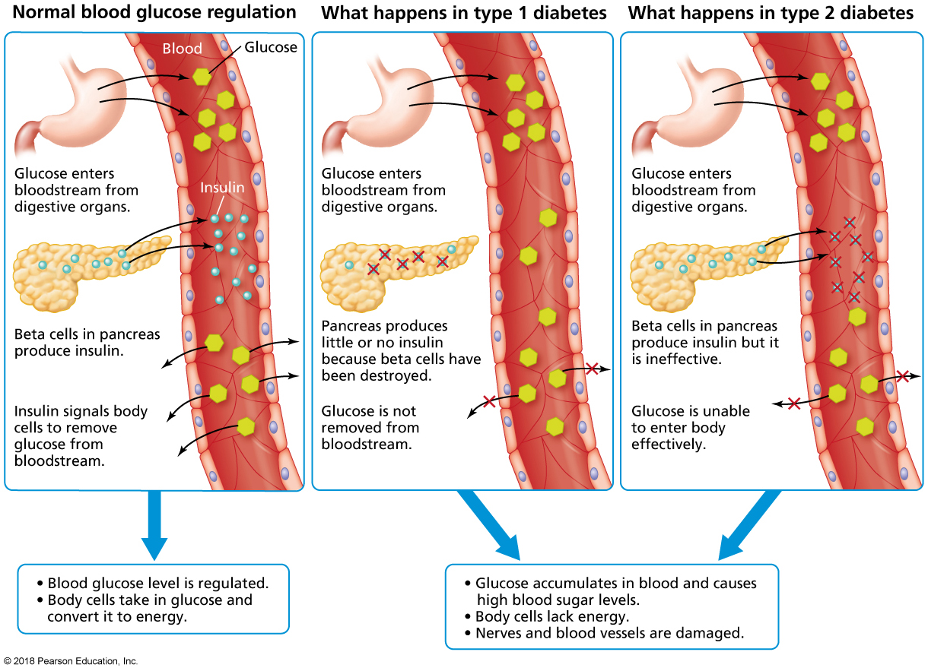
Two Types of Diabetes
Notes:
FIGURE 13.1 Two Types of Diabetes. In type 1 diabetes, the beta cells of the pancreas stop producing insulin entirely or produce an amount insufficient for normal body functioning. In type 2 diabetes, the body is unable to use insulin properly. In advanced cases, the pancreas becomes exhausted and, as with type 1 diabetes, stops producing insulin. In either case, the body’s cells are unable to take in glucose from the bloodstream.

Slide 13
Other Forms of Diabetes
Gestational diabetes: Develops in almost 6% of pregnant women, but usually disappears after childbirth but women at increased risk for type 2.
Type 1.5 diabetes: Several varieties of diabetes blending aspects of type 1 and type 2.
Researchers estimate that perhaps 5% of all diagnoses of type 2 diabetes are actually due to type 1.5.

Slide 14
Detecting Diabetes
Physical signs and symptoms of diabetes include:
Frequent urination
Excessive thirst
Hunger
Tendency to tire easily
Numbness or tingling in the hands and feet
A tendency to develop vaginal yeast infections (in women)
Prediabetes: A persistent state of blood glucose level being higher than normal, but not high enough to qualify as diabetes.

Slide 15
Complications of Diabetes
Persistent hyperglycemia can lead to:
Increased risk of heart attack or stroke
Kidney disease and failure
Loss of sensation and tissue breakdown
Poor wound healing that can lead to amputations
Vision loss and blindness
Sexual dysfunction
Gum disease

Slide 16
Risk Factors for Type 2 Diabetes
Overweight and obesity
Diet
Lack of exercise
Chronic stress
Genetic factors

Slide 17
Controlling Diabetes
Notes:
FIGURE 13.3 Controlling Diabetes. Insulin pumps allow many people to control their blood glucose levels throughout the day without painful injections.

Slide 18
Clinical Management of Diabetes
Glucose monitoring
Weight loss
Exercise
Oral medications
Insulin therapy

Slide 19
CARDIOVASCULAR DISEASE

Slide 20
Cardiovascular Disease (CVD)
A large group of disorders affecting the heart of blood vessels.
CVD is the leading cause of adult mortality in the United States, responsible for more than 3 in every 10 deaths.

Slide 21
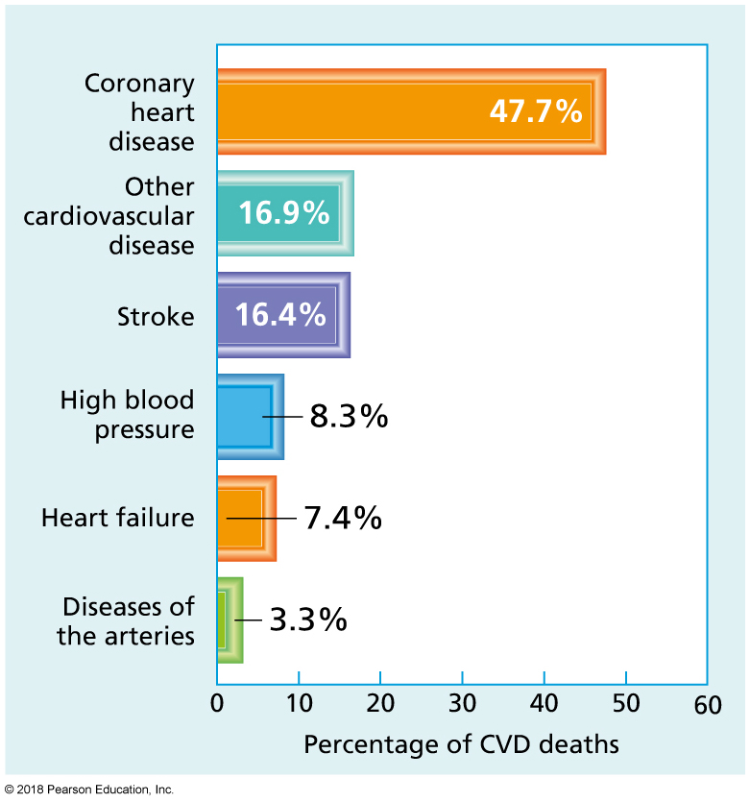
Deaths from Cardiovascular Disease in the United States
Notes:
FIGURE 13.6 Deaths from Cardiovascular Disease in the United States. The majority of deaths result from coronary heart disease.

Slide 22
Cardiovascular Terms
Arteries: Vessels that transport blood away from the heart, delivering oxygen-rich blood to the body periphery and oxygen-poor blood to the lungs.
Veins: Vessels that transport blood toward the heart, delivering oxygen-poor blood from the body periphery or oxygen-rich blood from the lungs.
Myocardium: The heart’s muscle tissue.
Atria: The two upper chambers of the heart, which receive blood from the body periphery and lungs.
Ventricles: The two lower chambers of the heart, which pump blood to the body and lungs.

Slide 23
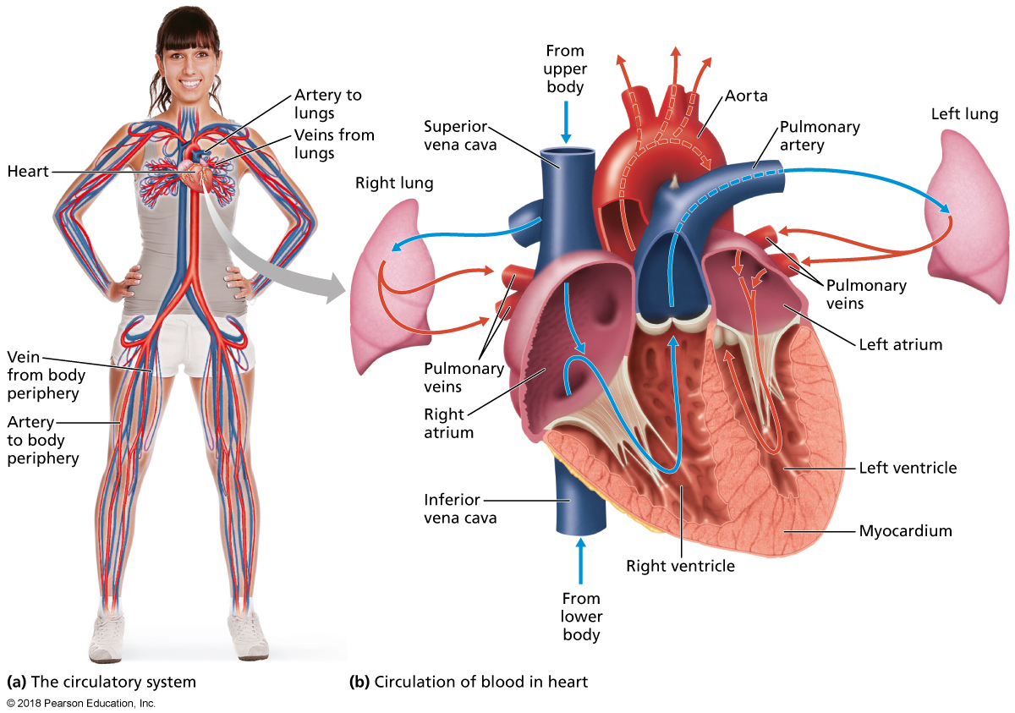
The Cardiovascular System
Notes:
FIGURE 13.4 The Cardiovascular System.

Slide 24
The Healthy Cardiovascular System
Capillaries: The smallest blood vessels, which deliver blood and nutrients to individual cells and pick up wastes from the same cells.
Blood pressure: Force of the blood moving against the arterial walls.

Slide 25
Atherosclerosis
A condition characterized by narrowing of the arteries because of inflammation, scarring, and the buildup of fatty deposits.

Slide 26
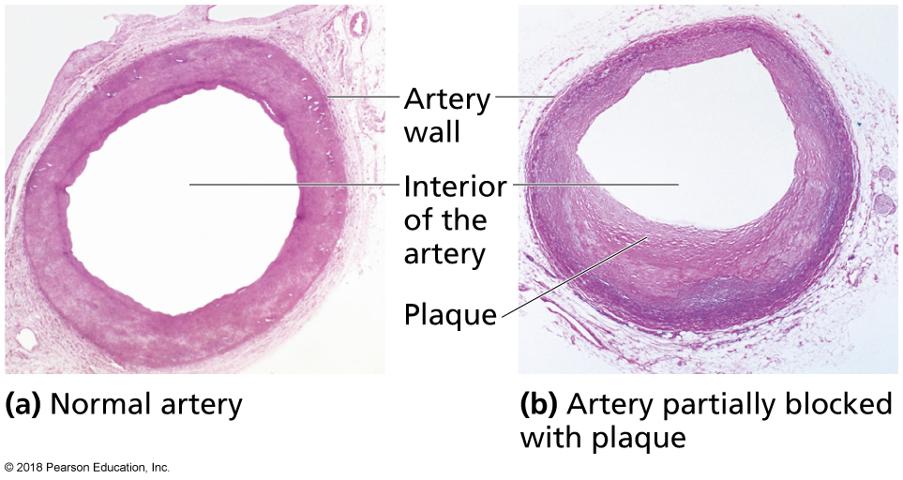
Atherosclerosis (cont.)
Notes:
FIGURE 13.5 Atherosclerosis. These light micrographs show a cross section of (a) a normal artery allowing adequate blood flow and (b) an artery that is partially blocked with plaque, which can lead to heart attack or stroke.

Slide 27
Hypertension (High Blood Pressure)
Hypertension: A persistent state of elevated blood pressure.
Signs and symptoms of hypertension:
None in most people—hence the name “silent killer.”
Long-term effects of hypertension:
Other forms of CVD, vision loss, kidney disease, lowered capacity to think clearly and learn.
Hypertension is generally a result of many contributing factors, possibly including age, weight, ethnic background, and diet.
Clinical management: low-sodium diet, exercise, don’t smoke, drink in moderation, medication management.

Slide 28
Coronary Heart Disease
Also called coronary artery disease.
Plaque in the coronary arteries builds up to the point that it impairs the heart’s ability to function.
The single leading cause of death in the United States.
Angina pectoris: Chest pain due to coronary heart disease.
Angina is not life-threatening, but it does signal a greater risk of a life-threatening cardiac event.
Myocardial infarction (heart attack): Cardiac crisis in which a region of heart muscle is damaged or destroyed by reduced blood flow.

Slide 29
Coronary Heart Disease (cont.)
Arrhythmia: Any irregularity in the heart’s rhythm.
Bradycardia: A slow arrhythmia.
Tachycardia: A fast arrhythmia.
Sudden cardiac arrest: A life-threatening cardiac crisis marked by loss of heartbeat and unconsciousness.
Electrocardiogram (ECG): A test that measures the heart’s electrical activity.

Slide 30
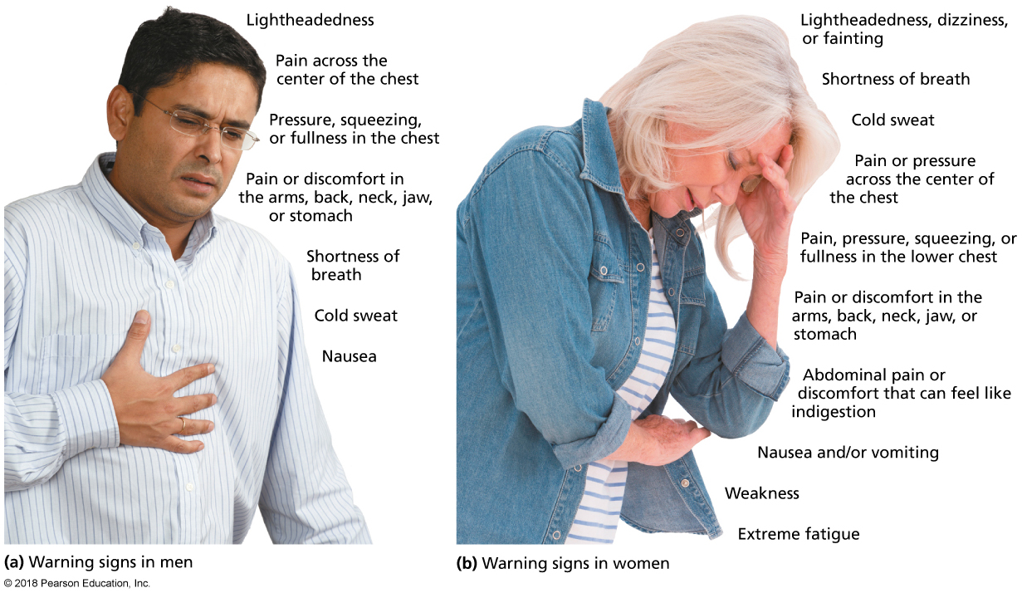
Warning Signs of a Heart Attack Differ Somewhat in Men and Women
Notes:
FIGURE 13.7 Warning Signs of a Heart Attack Differ Somewhat in Men and Women. These warning signs can occur individually, or several can occur simultaneously.

Slide 31
Myocardial Infarction (Heart Attack)
A cardiac crisis in which a region of heart muscle is damaged or destroyed by reduced blood flow.
Also known as heart attack.

Slide 32
Stroke
A medical emergency in which blood flow to or in the brain is impaired.
Ischemic stroke: A stroke caused by a blocked blood vessel.
Hemorrhagic stroke: A stroke caused by a ruptured blood vessel.
Transient ischemic attack (TIA): A temporary episode of stroke-like symptoms, indicative of high stroke risk.

Slide 33
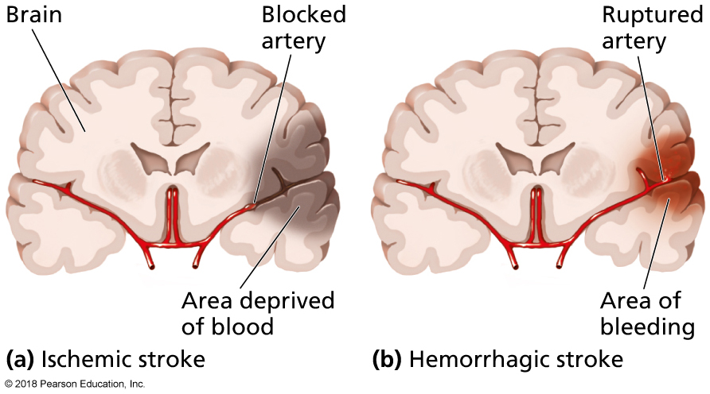
Two Types of Stroke
Notes:
FIGURE 13.8 Two Types of Stroke. (a) In an ischemic stroke, a blocked artery damages brain tissue by depriving it of blood. (b) In a hemorrhagic stroke, a weakened artery leaks or ruptures, releasing blood into and damaging the brain tissue as well as depriving brain cells beyond the rupture.

Slide 34
Signs and Symptoms of an Impending Stroke
The person may feel weak, numb, or paralysis in the arm, leg, or face—especially on one side of the body.
Blurred vision.
Slurred speech.
Sudden and severe headache, sometimes accompanied by dizziness or vomiting.
Confusion or delusions.

Slide 35
Long-Term Effects of a Stroke
Paralysis, especially on one side of the body.
Impaired speaking, swallowing, and chewing.
Aphasia: a difficulty in understanding and expressing ideas in spoken or written words.
Loss of memory, impaired decision making, and personality changes.
Pain, cold, and other uncomfortable sensations.
Clinical management: medication, neurologist, speech, and physical therapists.

Slide 36
Other Forms of CVD
Congenital heart disease
Heart valve disorders
Hypertrophic cardiomyopathy
Rheumatic heart disease

Slide 37
Risk Factors for Cardiovascular Disease
Weight
Diet
Physical activity
Smoking
Alcohol
Drug abuse
Stress
Sleep
Income
Blood pressure
Blood lipids
LDL: Bad cholesterol
HDL: Good cholesterol
Blood glucose
Inflammatory markers
Homocysteine
Age, sex, and genetics cannot be controlled, but do contribute to risk.

Slide 38
Cardiometabolic Risk
Metabolic syndrome: A set of five unhealthy physical and metabolic conditions together linked to an increased risk for type 2 diabetes and other metabolic disease.
Cardiometabolic risk (CMR): A cluster of nine modifiable factors that identify individuals at risk for type 2 diabetes and cardiovascular disease.

Slide 39
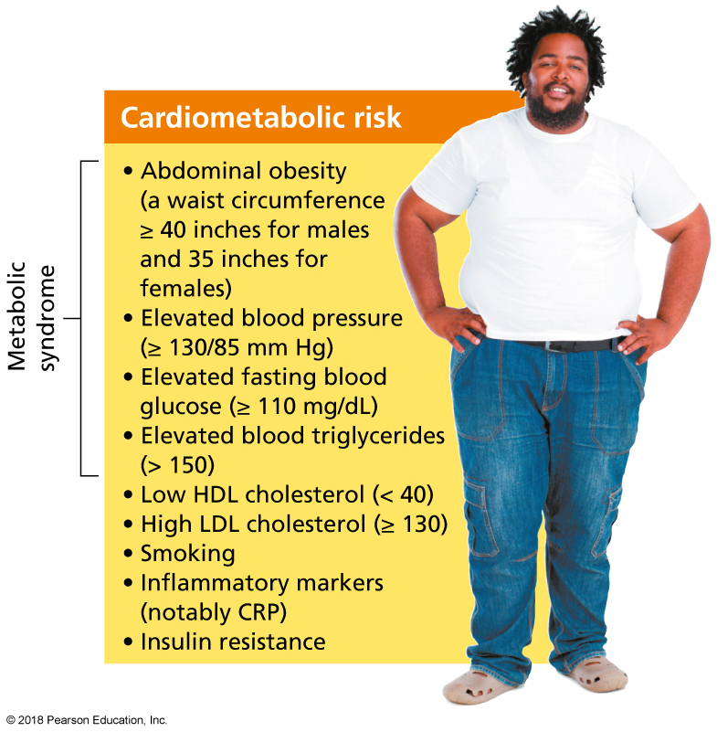
Cardiometabolic Risk (cont.)
Notes:
FIGURE 13.9 Cardiometabolic Risk. These nine factors dramatically increase your risk of developing type 2 diabetes and cardiovascular disease.

Slide 40
Video: Importance of Heart Health in Your Youth

Slide 41
Video: Importance of Heart Health in Your Youth
Discussion Questions
What are the benefits and drawbacks of Americans only sticking to the checklist presented in the video to determine heart health and risk factors?
What other risk factors might the checklist ignore with respect to determinants of heart health?
What other factors would you add to the risk factors? Discuss the impact of healthy lifestyle, weight management, and age on heart health.

Slide 42
CANCER

Slide 43
What Is Cancer?
Cancer is a group of diseases marked by the uncontrolled multiplication of abnormal cells.

Slide 44
Cancer Terms
Carcinogen: A substance known to trigger DNA mutations that can lead to cancer.
Oncogene: A mutated gene that encourages the uncontrolled cell division that results in cancer.
Tumor: An abnormal growth of tissue with no physiological function.
Benign tumor: A tumor that grows slowly, does not spread, and is not cancerous.
Malignant tumor: A tumor that grows aggressively, invades surrounding tissue, and can spread to other parts of the body; all cancers are malignant.
Metastasis: The process by which a malignant tumor spreads to other body sites.

Slide 45
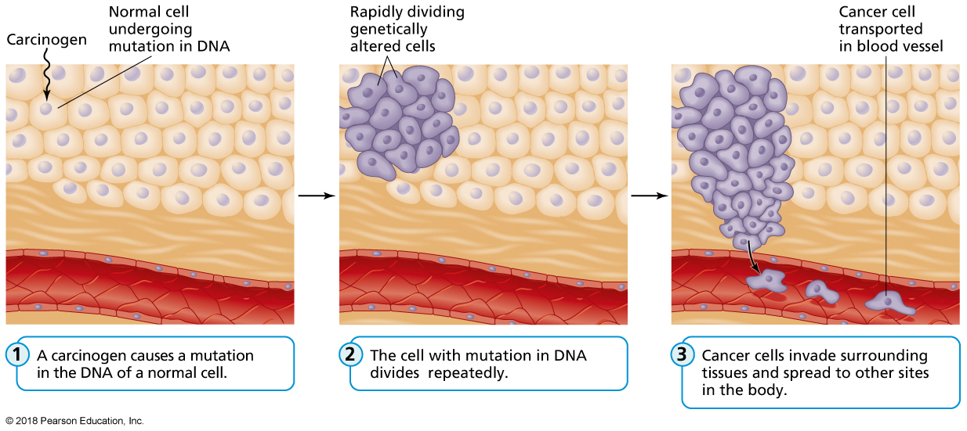
Progression of Cancer
Notes:
FIGURE 13.10 Progression of Cancer.
Source: From Thompson, J., Manore, M. & Vaughan, L. (2017). The science of nutrition, 4th ed., p. 405. © 2017. Reprinted and electronically reproduced by permission of Pearson Education, Inc., Upper Saddle River, NJ.

Slide 46
Risk Factors for Cancer
Genetic and biological factors
Lifestyle factors
Environmental exposures
Job with exposure to radiation or chemicals
Residence in an area characterized by high pollution
Exposure to infectious agents
Helicobacter pylori
Hepatitis B and C
HIV
HPV

Slide 47
Detecting Cancer
No single test can detect all cancers.
Screening tests such as a mammogram and a colonoscopy can detect cancers at specific sites.
A biopsy is a test for cancer in which a small sample of the abnormal growth is removed and studied.
Lab tests of blood and other body fluids can detect the presence of tumor markers that suggest cancer.
Imaging technologies can be used to detect cancers.
Ultrasound, magnetic resonance imaging (MRI), computed tomography (CT), positron emission tomography (PET).

Slide 48
General Symptoms of Cancer
Unexplained weight loss
Fever
Fatigue
Pain
Skin changes, including darkened skin, yellowed skin and eyes (jaundice), reddened skin, itching, and excessive hair growth

Slide 49
Types of Cancer
Carcinoma: Cancer of the tissues that line or cover the body.
Sarcoma: Cancer of muscle or connective tissues.
Central nervous system cancer: Cancer of the brain or spinal cord.
Lymphoma: Cancer of the lymph system.
Myeloma: Cancer arising in plasma cells, which are a type of immune cells, and invading the bone marrow.
Leukemia: Cancer of blood-forming tissue.
Malignant melanoma: An especially aggressive form of skin cancer.

Slide 50
Malignant Melanoma
Notes:
FIGURE 13.11 Malignant Melanoma. This lesion shows the distinctive characteristics of malignant melanoma, the deadliest form of skin cancer.

Slide 51
Common Cancers
Skin
Lung
Colorectal
Oral
Men
Prostate
Testicular
Women
Breast
Ovarian
Cervical and uterine

Slide 52
Treating Cancer
Surgery offers the greatest chance for cure, especially if performed before the cancer has metastasized.
Chemotherapy: Drugs to kill cancer cells.
Radiation therapy uses high-energy subatomic particles to kill cancer cells or damage their DNA so that they can no longer reproduce.
Targeted therapy uses drugs or other substances to precisely locate cancer cells.
Immunotherapy stimulates the patient’s immune system.

Slide 53
Video: How Effective Is Breast Cancer Early Detection?

Slide 54
Video: How Effective Is Breast Cancer Early Detection?
Discussion Questions
According to the research, did increased frequency of mammograms correlate to fewer cases of breast cancer?
What percent of biopsies turn out to be non-cancerous?
What are the new recommendations for mammograms?

Slide 55
Change Yourself, Change Your World
Don’t smoke.
If you chose to drink alcohol, go easy.
Shed any extra pounds.
Pile your plate with plants.
Decrease your sodium intake.
Eat yogurt.
Limit your exposure to pesticides.
Exercise.
Sleep.
Manage your emotions.
Reduce environmental risks.
Know your history.
Get screened.

