Slide 1
Chapter 8: Addictions and Drug Use
Lecture Outlines by
Sloane Burke Winkelman
California State University, Northridge

Slide 2
Did You Know?
More than 27 million Americans aged 12 and older currently use illicit drugs.
Drug overdose deaths, escalating for the past decade, have reached “epidemic” levels, claiming more than 125 American lives every day.
Despite the dangers of “drugged driving,” driving after marijuana use is more common among college students than driving after drinking.

Slide 3
Learning Outcomes
LO 8.1 Describe the characteristics of addiction.
LO 8.2 Identify four common behavioral addictions.
LO 8.3 Compare the prevalence of drug use among college students and in the general population.
LO 8.4 Discuss the physical and psychological effects of initial and chronic drug use.
LO 8.5 Identify commonly abused drugs and describe their mechanisms, effects, and health risks.
LO 8.6 Discuss common drug-prevention strategies used throughout the United States.
LO 8.7 List community, campus-based, and clinical options for treatment of drug abuse.
LO 8.8 Outline personal strategies for overcoming addictions and preventing drug abuse.

Slide 4
An Overview of Addiction
Addiction: A chronic, progressive disease of brain reward, motivation, memory, and related circuitry characterized by uncontrollable craving for a substance or behavior despite both negative consequences and diminished or loss of pleasure associated with the activity.
Without treatment, addiction is progressive.

Slide 5
What Are Behavioral Addictions?
A form of addiction involving a compulsion to engage in an activity such as gambling, sex, or shopping, rather than a compulsion to use a substance.

Slide 6
What Are Some Behavioral Addictions?
Pathological gambling
Hypersexual disorder
Compulsive spending
Technology addiction

Slide 7
PATTERNS OF DRUG USE

Slide 8
Terms
Drug: A chemical substance that alters the body physically or mentally for a non-nutritional purpose.
Includes caffeine, pain relievers, and sleeping and allergy medications.
Psychoactive: Capable of altering feelings, mood, perceptions, or psychological functioning.
Illicit drugs: Drugs regulated by the U.S. Drug Enforcement Agency (DEA) as unlawful substances, including prescription medications used unlawfully.

Slide 9
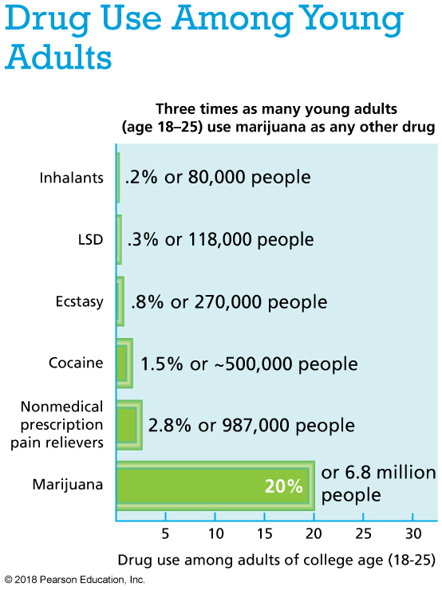
Notes:
Data from Substance Abuse and Mental Health Services Administration. (2015). Behavioral health trends in the United States: Results from the 2014 National Survey on Drug Use and Health (HHS Publication No. SMA 15-4927, NSDUH Series H-50). www.samhsa.gov.

Slide 10
HOW THE BODY RESPONDS TO DRUGS

Slide 11
Drug Misuse and Abuse
Drug misuse: The inappropriate use of a legal drug, either for a reason for which it was not medically intended or by a person without a prescription.
Drug abuse: The use (most often the excessive use) of any legal or illegal drug in a way that is detrimental to your health.

Slide 12
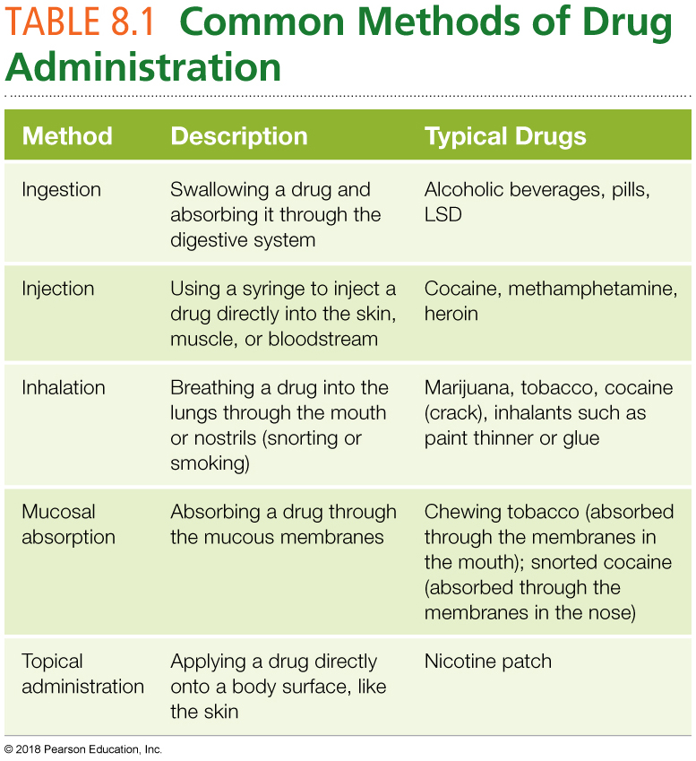
Drug Misuse and Abuse (cont.)

Slide 13
Effects of Chronic Use
Psychological dependence: A mental attachment to a drug; the belief that the drug is needed to relieve stress, anxiety, or another mental discomfort.
Physical dependence: The regular use of a substance to function.
Physical withdrawal symptoms develop when a person stops using a drug.
Tolerance: Reduced sensitivity to a drug so that increased amounts are needed to achieve the usual effect.
Toxicity: The dosage level at which a drug becomes poisonous to the body.

Slide 14
Substance Use Disorder
A pattern of substance use that ranges from mild to severe and that is characterized by 2-3 of the following within a one-year period:
Developing tolerance to the substance.
Using the substance in larger quantities or over a longer period than intended.
Becoming unable to cut down or control one’s use of the substance.
Spending an inordinate amount of time on activities aimed at obtaining the substance, using it, or recovering from its effects.

Slide 15
Substance Use Disorder (Cont.)
Sacrificing important social, occupational, or recreational activities due to the substance use.
Continuing to use the substance despite knowledge that the substance has either caused or is exacerbating a physical or psychological problem.
Experiencing withdrawal symptoms.

Slide 16
How Drugs Leave the Body
Metabolism of drugs varies depending on the person’s weight and ethnicity (generally takes longer for Asian individuals).
The organs that metabolize drugs are the same organs that break down and eliminate nutritional wastes (liver and kidneys).
Some drugs leave the body through other means.
Eliminated through exhaled breath, sweat, saliva, or breast milk.

Slide 17
COMMONLY ABUSED DRUGS

Slide 18
Prescription and Over-the-Counter Medications
Almost 14% of college students report using prescription drugs (Ritalin, Adderall, and others) that were not prescribed to them.
There are now more than 700 OTC products available that contain ingredients that were available only by prescription three decades ago some at greater dosage strength.

Slide 19
Over-the-Counter Drugs
Over-the-counter (OTC) drugs are available for purchase without a prescription.
They include aspirin, allergy pills, and cough and cold medicines.
OTC drugs pose many of the same challenges as prescription drugs.
They are not meant to be taken in higher doses or for longer periods than directed on the label.
Improper use can result in liver and kidney damage.
If you are pregnant, consult your health care provider before taking an OTC drug.

Slide 20
Opioid Abuse
More than 4.3 million Americans report abusing prescription pain medications in the past year.
Examples of these opioids include Vicodin, Percodan, and OxyContin.

Slide 21
Heroin
An illicit, highly addictive opioid.
In a 2014 study, about 435,000 people in the United States reported heroin use in the past year.
Heroin is particularly addictive because it crosses into the brain quickly, producing an intense “rush” of pleasure accompanied by a sensation of heaviness.

Slide 22
Heroin (cont.)
The most widely abused nonprescription opiate.
Fast acting and highly addictive.
Can be injected or smoked.
Typically sold as a white or brown powder or as a sticky black substance known as “black tar heroin,” “smack,” “H,” or “junk.”
Withdrawal includes drug craving, restlessness, muscle and bone pain, diarrhea, and vomiting.
One fourth of users become dependent.

Slide 23
Video: New Report Shows Surge in Heroin Deaths

Slide 24
Video: New Report Shows Surge in Heroin Deaths
Discussion Questions
Why is heroin use on the rise? Who is likely to turn to using heroin?
How much did deaths from heroin overdose increase between 2010 and 2013?

Slide 25
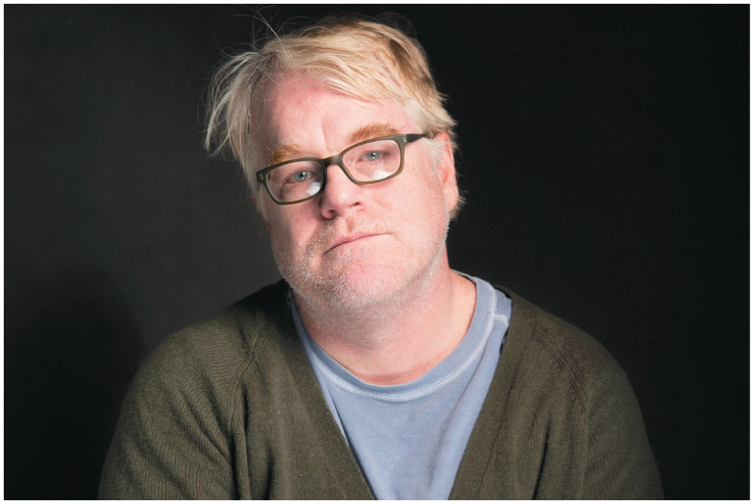
A lethal combination of drugs caused the death of actor Philip Seymour Hoffman.

Slide 26
Marijuana
Marijuana is the most commonly used illicit drug in the United States.
It grows wild and is farmed in many parts of the world.
How is marijuana (“pot”) used?
Rolled in a “joint” and smoked.
Smoked in a “bong” (water pipe).
Sometimes mixed in food such as brownies.
Brewed in tea.

Slide 27
Marijuana: Short-Term Effects
Inhaled THC takes minutes to move from the lungs to the bloodstream to the brain.
Ingested THC takes longer for the body to process.
Cellular reactions in the brain cause the “high,” ultimately through the release of the chemical dopamine, which boosts the sensation of pleasure.
The heart beats faster; bronchi in the lungs become enlarged; blood vessels in the eyes expand (reddening the whites of the eyes); and dry mouth, hunger, and sleepiness may result.
Mental effects vary among users—some are relaxed, others euphoric.

Slide 28
Marijuana: Long-Term Effects
Chronic use:
Can lead to addiction.
Increases the risk for chronic cough and bronchitis.
Increases the risk for schizophrenia among already at-risk persons.
Increases the risk of anxiety, depression, psychosis, and personality disturbances.
Impairs attention, memory, and learning.

Slide 29
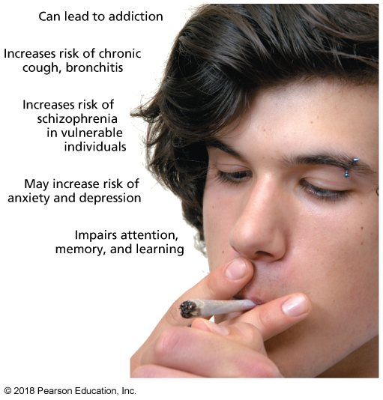
Marijuana: Long-Term Effects (cont.)
Notes:
FIGURE 8.1 Long-Term Effects of Marijuana Use. Smoking marijuana can cause health problems throughout the body.

Slide 30
STIMULANTS

Slide 31
Stimulants
A class of drugs that stimulate the central nervous system, causing acceleration of mental and physical processes in the body.

Slide 32
Caffeine
Caffeine is a widely used stimulant found in coffee, tea, soft drinks, chocolate, and some medicines.
It is the most popular psychoactive drug in the world.
Some people enjoy the effects of caffeine.
Feel more alert and energetic.
Have improved concentration and athletic performance.
Excessive consumption can cause restlessness, anxiety, dehydration, and irritability.
Caffeine can trigger headaches and insomnia and raise blood pressure.
Regular users can suffer withdrawal symptoms for 2–9 days.

Slide 33
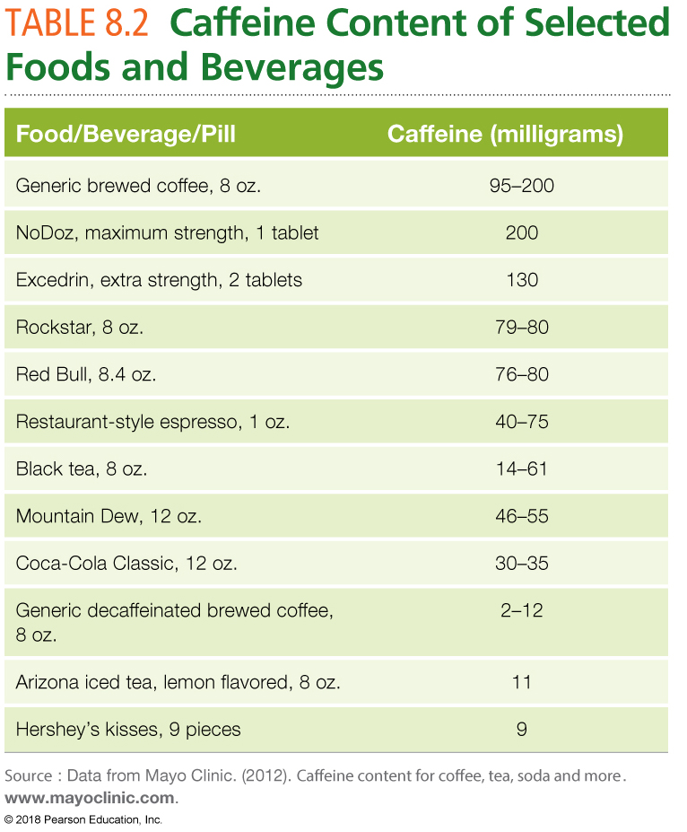

Slide 34
Cocaine
A potent and addictive stimulant that triggers the release of dopamine, causing a rush of euphoria.
Effects typically disappear within a few minutes or hours.
Users must continue use to retain the feelings of euphoria.
Cocaine (“coke”) can be snorted, injected, or smoked/inhaled (“crack”), depending on the preparation of the drug.
Users feel energetic and mentally alert.
Side effects include increased heart rate and blood pressure, respiration, temporary reduced appetite, confusion, paranoia, chest pain, seizures, coma, and death.

Slide 35
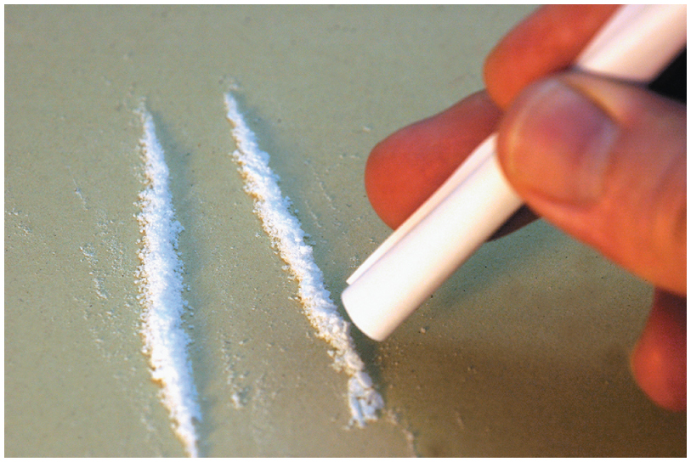
Cocaine (cont.)
Cocaine use can result in heart damage, stroke, and sudden death

Slide 36
Amphetamines
Central Nervous System stimulants that are chemically similar to the natural stimulants adrenaline and noradrenalin.
Effects:
Increase the sense of alertness.
Decrease appetite and the need for sleep.
Enhance physical performance.
Induce feelings of well-being and euphoria.

Slide 37
Methamphetamine
A highly addictive and dangerous stimulant that is chemically similar to amphetamine, but more potent and harmful.
Most methamphetamine sold on the street is made in illegal labs from household materials.
It can be smoked, snorted, and injected.
“Crystal meth” is methamphetamine in its clear, chunky, crystal form.

Slide 38
Methamphetamine (cont.)
Short-term effects:
From smaller doses: Rapid or irregular heartbeat, increased blood pressure, and reduced appetite, irritability, anxiety, insomnia, confusion, and tremors.
From larger doses: Elevated body temperature, convulsions, cardiovascular collapse, and death.
Long-term effects: Aggressiveness, anorexia, memory loss, hallucinations, paranoia, of hallucination of feelings of bugs crawling all over the body.
Physical changes: “Meth mouth,” acne, open sores.

Slide 39
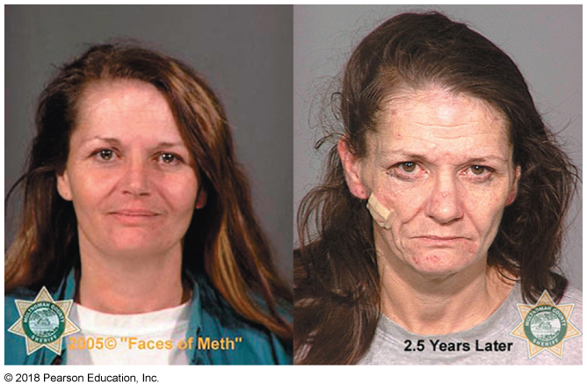
Methamphetamine (cont.)
Notes:
FIGURE 8.2 Methamphetamine.
Methamphetamine use can take a dramatic physical toll.

Slide 40
Bath Salts
Drugs containing a synthetic compound similar to cathinone, an amphetamine-like stimulant.
Users ingest, inhale, or inject them.
May be 10 times more potent than cocaine.
Effects include hallucinations, extreme agitation, panic attacks, paranoia, delirium, suicidal thoughts, heart attack, stroke, seizures, and kidney failure.
Responsible for many emergency room visits.

Slide 41
HALLUCINOGENS

Slide 42
Hallucinogens
Alter perception and are capable of causing auditory and visual hallucinations.
LSD (lysergic acid diethylamide): A powerful hallucinogen manufactured from lysergic acid, a substance found in a fungus that grows on rye and other grains.
PCP (phencyclidine): A dangerous synthetic hallucinogen that reduces and distorts sensory input and can unpredictably cause both euphoria and dysphoria.
Psilocybin (magic mushrooms): A hallucinogenic substance obtained from certain types of mushrooms that are indigenous to tropical regions of South America.

Slide 43
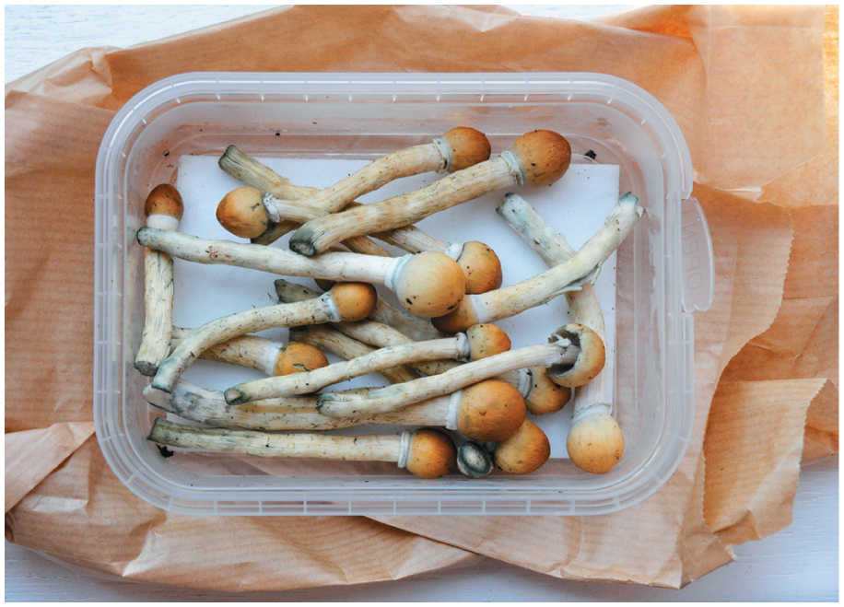
Hallucinogens (cont.)
Psilocybin, also called “magic mushrooms,” induces hallucinations and can cause psychosis in some users

Slide 44
Club Drugs
Tend to be used at bars, nightclubs, and parties.
MDMA: Ecstasy, “E,” “X,” “XTC.”
GHB: The “date rape drug.”
Rohypnol: Roofies; also a “date rape drug.”

Slide 45
Club Drugs (cont.)
MDMA (methylenedioxymethamphetamine): A synthetic drug, commonly called “ecstasy,” that works as both a stimulant and a hallucinogen.
Negative effects are similar to those of amphetamines and cocaine.
Used by 0.8% of young adults in 2014.
GHB (gamma-hydroxybutyric acid): A central nervous system depressant.
Rohypnol: A powerful sedative known as a “date rape drug” because of its use to impair potential victims of sexual assault.

Slide 46
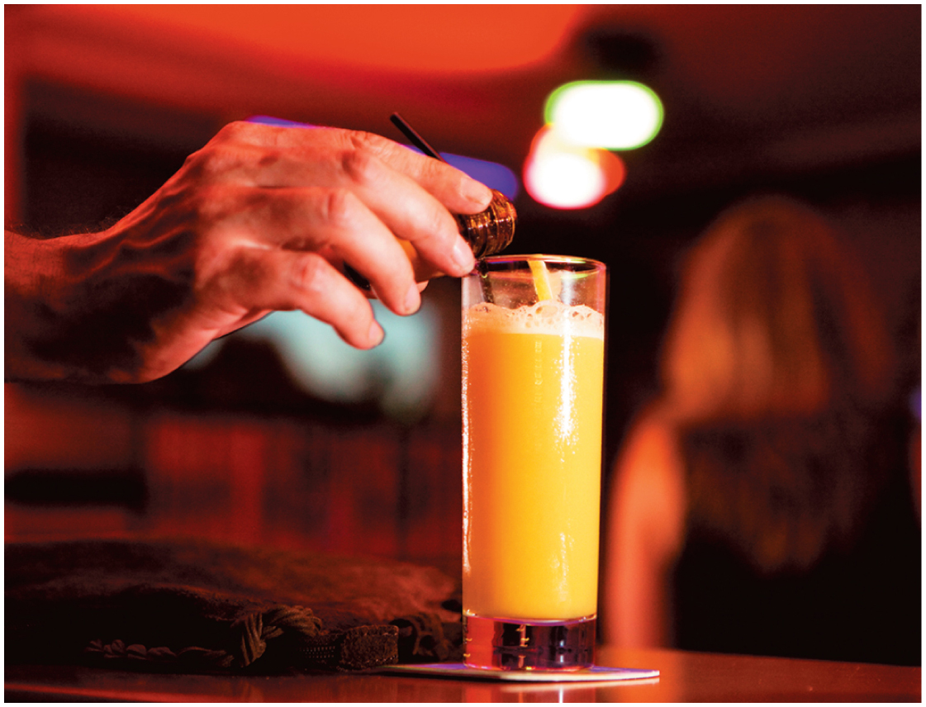
Club Drugs (cont.)
Tend to be used at bars, nightclubs, and parties

Slide 47
Inhalants
Chemical vapors that, when inhaled, produce mind-altering effects.
Common inhalants include paint, glue, felt-tip markers.
Effects: Feeling of intoxication similar to alcohol, but lasts for only a few minutes; must inhale repeatedly to sustain it.
Some users cover their heads with a paper or plastic bag to inhale a higher concentration of chemical. This can cause suffocation.

Slide 48
Depressants
Substances that depress the activity of the central nervous system and slow brain activity.
Alcohol.
Barbiturates: Often prescribed to induce sleep.
Sedation can range from mild and short term to severe and long term (including coma).
Benzodiazepines: Often prescribed to treat anxiety and panic attacks.
Include Ativan, Xanax, and Valium.
Effects: Calmness, muscle relaxation, slurred speech, loss of motor coordination, coma, and death.

Slide 49
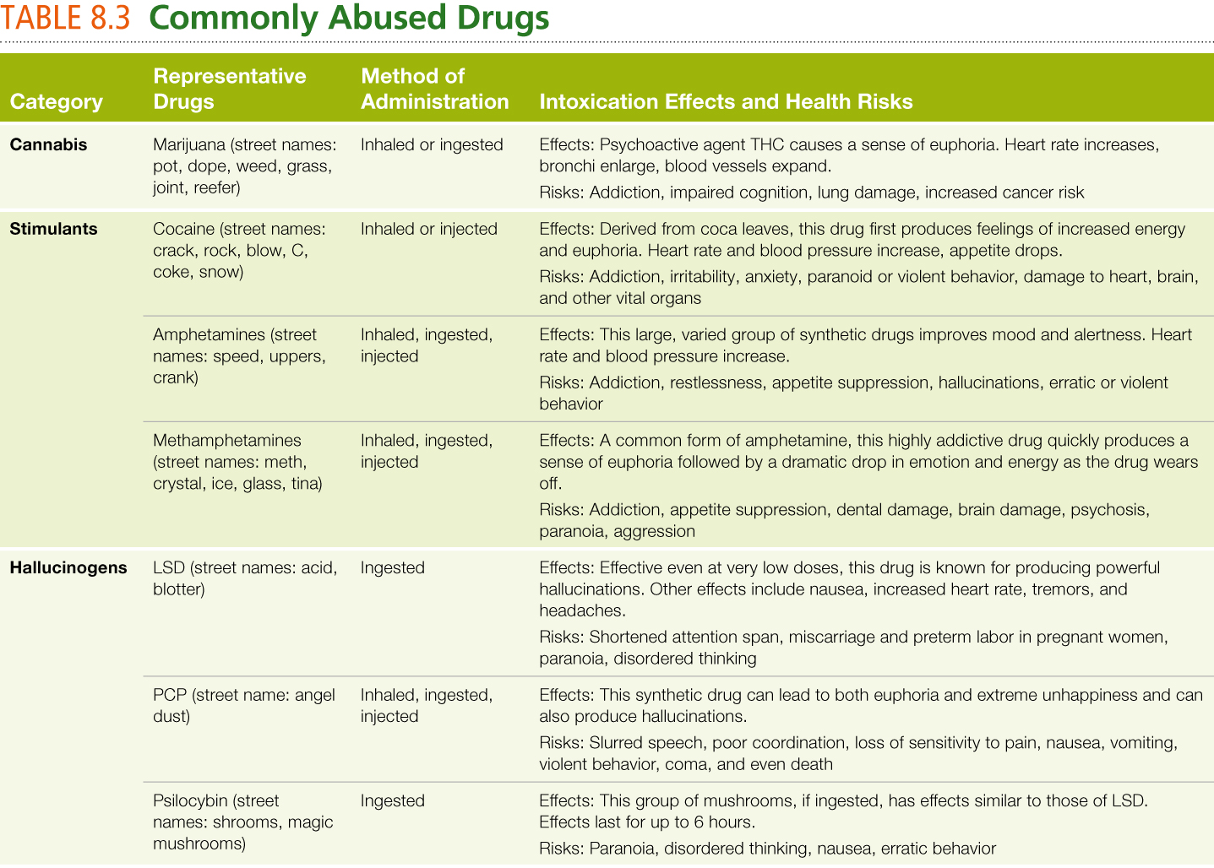

Slide 50
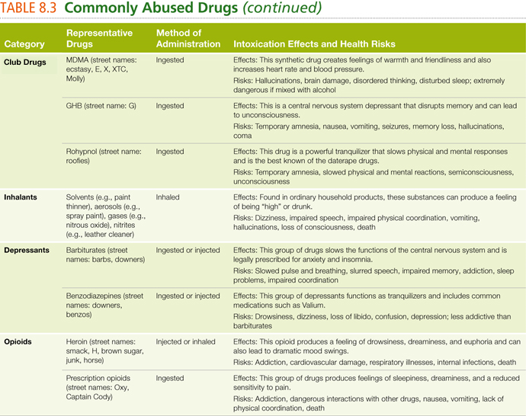

Slide 51
PREVENTING DRUG ABUSE

Slide 52
Prevention Strategies
Prevention strategies are in use throughout the United States:
Public awareness campaigns.
Drug testing (random and other).
Federal policies

Slide 53
Getting Help for a Drug Problem
Campus and community-based options:
12-step programs: Addiction recovery self-help programs based on the principles of Alcoholics Anonymous.
Clinical options:
Residential programs/detoxification.
Outpatient programs.
More complex for a polyabuser—a person who abuses multiple drugs, often.

Slide 54
Change Yourself, Change Your World
Consider your personal choices.
Value your values.
Make some trade-offs.
Build a healthier lifestyle.
Nutrition
Exercise
Ask for help.
Deal with relapse (more than half of drug abusers experience it).

Slide 55
Helping a Friend
Intervention: A technique used by family and friends of an addict to encourage the addict to seek help for a drug problem.

