Slide 1
Chapter 3: Stress Management
Lecture Outlines by
Sloane Burke Winkelman
California State University, Northridge

Slide 2
Did You Know?
Year after year, college students report stress as the number-one obstacle to their academic achievement.
Money is the greatest source of stress among American adults in general, and the second greatest source of stress (after academics) among college students.
Millennials (those aged 18−35) report the highest levels of stress of any age group in the United States.

Slide 3
Learning Outcomes
LO 3.1 Distinguish between stress, stressor, eustress, and distress.
LO 3.2 Describe the body’s stress response.
LO 3.3 Explain why severe, longstanding stress is harmful.
LO 3.4 Discuss the influence of personality and biology on the stress response.
LO 3.5 Distinguish common sources of stress among college students.
LO 3.6 Identify social, campus, and medical resources for managing stress.
LO 3.7 Summarize strategies for effectively managing stress.

Slide 4
WHAT IS STRESS?

Slide 5
What Is Stress?
Stress: The collective psychobiological condition that occurs in response to a disruptive, unexpected, or exciting stimulus.
Stressor: Any physical or psychological event or other change that causes positive or negative stress.

Slide 6
Types of Stress
Eustress: Stress resulting from changes that are perceived as advantageous.
Distress: Stress resulting from changes that are perceived as threatening.

Slide 7
THE BODY’S STRESS RESPONSE

Slide 8
Homeostasis
The physiological processes by which the body maintains its internal conditions within a narrow, healthful range.

Slide 9
Alarm Stage: The Fight-or-Flight Response
A set of physical reactions that prepares you to deal with a perceived threat.
Can be unhelpful or even harmful.
Most modern-day stressors are not the extreme physical threats the fight-or-flight response is designed for.
When experienced too often, the fight-or-flight response can take a powerful toll on the body and health.

Slide 10
Nervous System Response
Your lung passages widen and your breathing rate increases.
Your liver releases into your bloodstream its stores of a simple sugar called glucose.
Your heart rate and blood pressure rise to increase the flow of blood.
Your pulse quickens.
Blood vessels in your body core constrict, slowing your digestion, while blood vessels serving your muscles dilate, further boosting the delivery of oxygen and glucose.
Nerve stimulation to your muscles also increases.
Your pupils dilate to let in more light.
Your circulatory system, anticipating injury, starts producing blood-clotting proteins.

Slide 11
Hormonal Response
Hormone is a chemical secreted by a gland and transported through the bloodstream to a distant target organ, the activity of which it then regulates.
The second wave of the alarm stage begins when a region of your brain called the hypothalamus signals the nearby pituitary gland to release into the bloodstream a hormone called ACTH (adrenocorticotropin hormone).

Slide 12
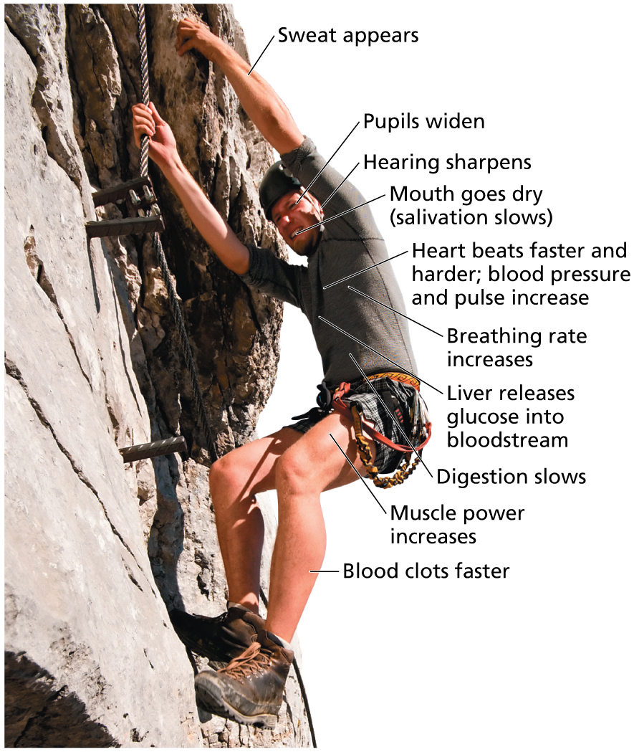
The Fight-or-Flight Response
Notes:
FIGURE 3.2 The Fight-or-Flight Response.
The fight-or-flight response is a set of physical reactions that prepares you to deal with a perceived threat.

Slide 13
General Adaptation Syndrome (GAS)
Developed by Hans Selye
Commonly called “the stress response”
A homeostatic response to a stressor consisting of three stages:
Alarm
Resistance
Exhaustion

Slide 14
General Adaptation Syndrome: Stage 1
Alarm
When first confronted by a stressor, your body activates the fight-or-flight response, boosts levels of stress hormones, and increases heart rate.

Slide 15
General Adaptation Syndrome: Stage 2
Resistance
As the stressor continues, your body mobilizes homeostatic mechanisms that make it more resistant to the stressor.

Slide 16
General Adaptation Syndrome: Stage 3
Exhaustion
When the degree of stress is not manageable—when stressors are severe or persistent—the homeostatic mechanisms that formerly helped you adapt become depleted.
Allostatic overload
A harmful state resulting from the cumulative burden of adapting, again and again, to stress.

Slide 17
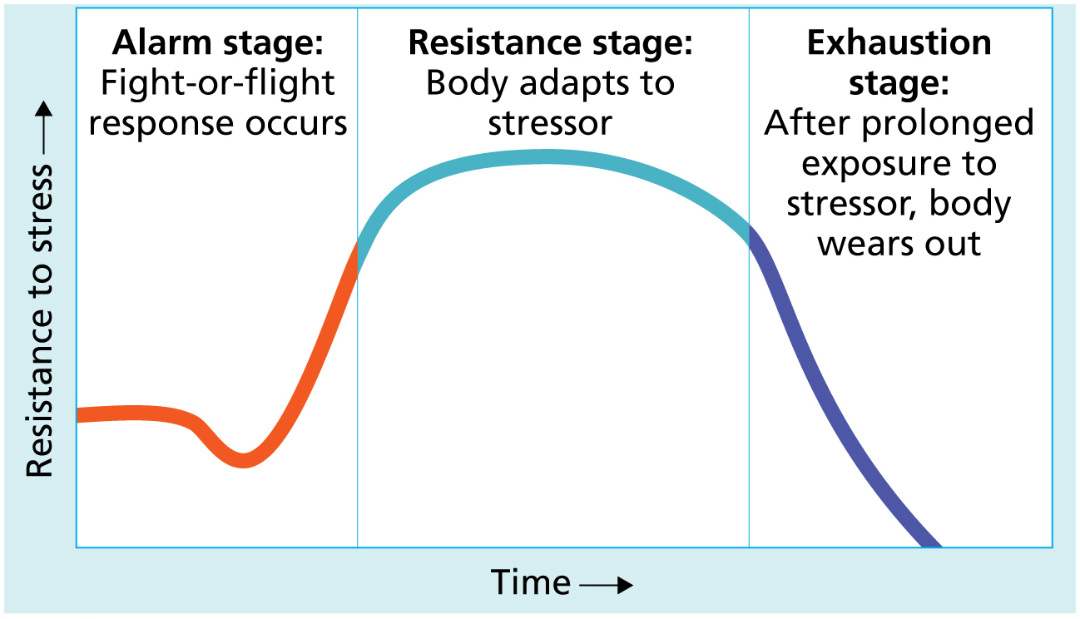
The General Adaptation Syndrome
Notes:
FIGURE 3.1 The General Adaptation Syndrome.
The general adaptation syndrome, developed by Hans Selye, is a theory that attempts to explain the biology of stress.

Slide 18
HEALTH EFFECTS OF CHRONIC STRESS

Slide 19
Effects on the Cardiovascular System
Increases one’s risk of heart disease.
Increases blood pressure and inflammation in one’s cardiovascular system.
May cause one to overeat and exercise less in response to stress, thereby increasing one’s risk for heart disease and diabetes.

Slide 20
Effects on Digestion, Glucose Regulation, and Body Weight
Can result in digestive problems (stomachache, constipation, diarrhea).
Stress hormones affect the body’s ability to regulate sugar, placing one at risk for diabetes.

Slide 21
Effects on Digestion, Glucose Regulation, and Body Weight
Can reduce one’s appetite or cause an upset stomach.
Stress can also contribute to overall weight gain by inducing a longing for sweets, chips, or other “comfort foods” high in calories.
Both children and adults who are overweight or obese report that they experience more stress compared with people of normal weight.

Slide 22
Effects on the Immune System
Psychoneuroimmunology is the study of the interactions among psychological processes, the nervous system, hormones, and the immune system.
Stress may increase white blood cell production.
It may leave you at risk for colds, cold sores, and asthma flare-ups, and place you at risk for developing more serious diseases.

Slide 23
Stress and Headaches
In two recent studies, one involving adults and one with teens, a high stress or anxiety score was significantly associated with an increased incidence of both recurrent tension headaches and chronic migraines.

Slide 24
Effects on Sleep
Stress impacts sleep.
4.6% of college students were diagnosed with insomnia in the past year.
20% said that sleep problems affected their academic performance.

Slide 25
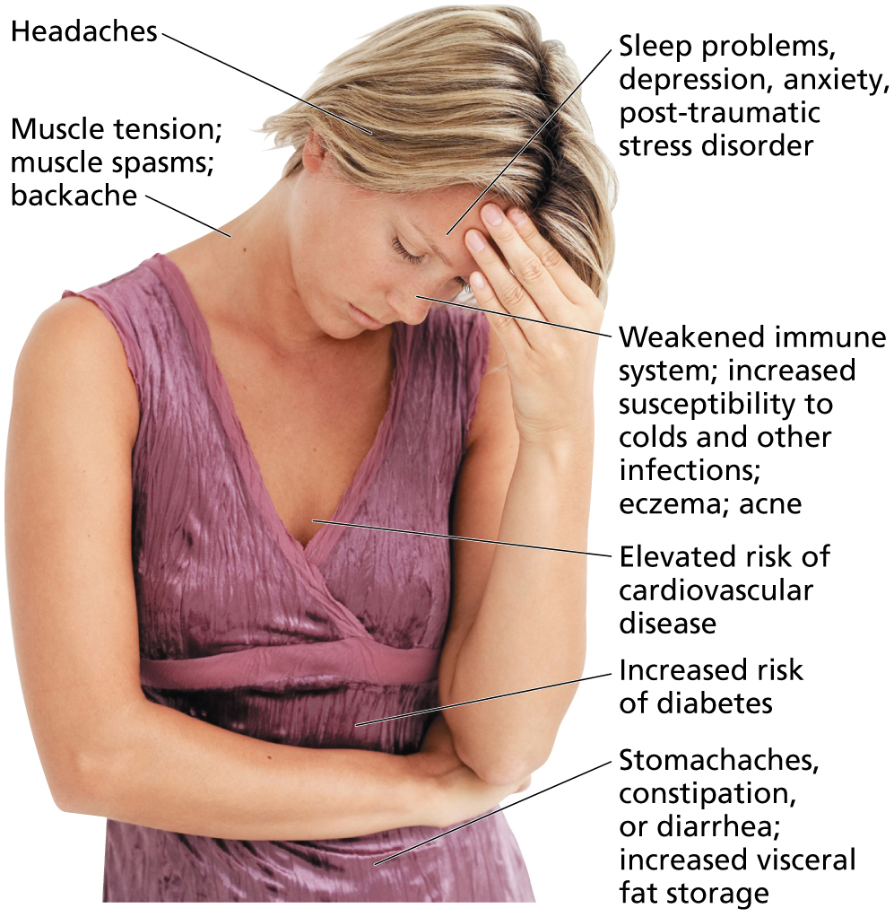
Health Effects of Long-Term Stress
Notes:
FIGURE 3.3 Health Effects of Severe, Long-Term Stress.

Slide 26
Video: Stress Can Damage Women’s Health

Slide 27
Video: Stress Can Damage Women’s Health
Discussion Questions
Discuss symptoms of increased cortisol production and the physiological process of the body’s production of cortisol.
Discuss the signs and symptoms of stress and ways to decrease stress.

Slide 28
Effects on Relationships and Sexual Functioning
Supportive relationships can help you cope with stress.
Chronic stress can damage relationships causing you to feel irritable, impatient, or too fatigued to accommodate a partner’s needs.
Chronic stress can also have a negative effect on sexual functioning, frequency, and satisfaction—for both men and women.

Slide 29
Effects on Mind and Mental Health
Anxiety
Depression

Slide 30
The Role of Personality Traits
Optimism: Stressors are transient.
Hardiness: Commitment to relationships and ideals, self-efficacy, and internal locus of control.
Resiliency: Ability to experience success and satisfaction following trauma or other stressors. Resilient people are optimistic, are hardy, and have a strong internal locus of control.

Slide 31
Video: Generation Stress: Tips for Millennials to Reduce Stress

Slide 32
Video: Generation Stress: Tips for Millennials to Reduce Stress
Discussion Questions
Why might Millennials experience a great deal of stress?
Name four of the stress reduction techniques that were used on this college campus.
Which of these methods would you choose and why?

Slide 33
WHAT ARE COLLEGE STUDENTS’ COMMON STRESSORS?

Slide 34
Common Stressors for College Students
Academic pressure
Financial stressors
Job-related stressors
Social stressors (friends, relationships)
Minor hassles and major life challenges (miss a class, bad break ups, death of family member, getting married, etc.)
Environmental stressors (pollution, noise)
Internal stressors (worries, critical thoughts, etc.)
Social support

Slide 35
Help on Campus
Ask for help
Consider counseling
Campus may offer peer tutoring or peer counseling
Look into the program called, The Transition Year

Slide 36
Change Yourself, Change Your World
Manage your time effectively
Improve your test-taking skills
Live a healthier lifestyle
Get adequate, restful sleep
Eat well
Exercise
Avoid alcohol, nicotine and other drugs
Take time for hobbies and leisure
Keep a journal

Slide 38
STRATEGIES FOR REDUCING STRESSORS AND MANAGING YOUR STRESS

Slide 39
Relieve Your Tension
Progressive muscle relaxation (PMR)
Yoga
Massage
Deep Breathing
Meditation
Music

Slide 40
Change Your Thinking
Rewrite internal messages: how do you talk to yourself?
Set realistic expectations.
Build your self-esteem.
Have a sense of humor.
Take the long view.
Accept that you cannot control everything.

Slide 41
Create a Personalized Stress Management Plan
Complete the self-assessment in the textbook.
Remember that:
Not all stress is harmful.
If the stress management technique that you pick requires adjusting your schedule, do it.
Managing stress is a lifelong commitment.

