Slide 1
Chapter 2: Psychological Health
Lecture Outlines by
Sloane Burke Winkelman
California State University, Northridge

Slide 2
Did You Know?
More than 58% of college students report having felt overwhelming anxiety at some time within the past year.
During the college years (late adolescence/young adulthood), the first symptoms of panic disorder, bipolar disorder, and obsessive-compulsive disorder may begin to appear.
More than 1 in 10 college students report being recently diagnosed with or treated for depression.
The second leading cause of death among 15- to 24-year-olds is suicide.

Slide 3
Learning Objectives
LO 2.1 Identify two components and six facets of psychological health.
LO 2.2 Discuss a variety of factors that influence psychological health.
LO 2.3 Describe common psychological challenges and ways to address them.
LO 2.4 List reasons for the high prevalence of mental disorders in the United States.
LO 2.5 Discuss the characteristics, possible causes, and treatment of mood disorders.

Slide 4
Learning Objectives (cont.)
LO 2.6 Discuss the characteristics, possible causes, and treatment of anxiety disorders.
LO 2.7 Discuss the characteristics, possible causes, and treatment of other disorders.
LO 2.8 Define non-suicidal self-injury and discuss suicide warning signs and prevention strategies.
LO 2.9 Describe different options for the treatment of mental disorders.
LO 2.10 Identify strategies for improving your psychological health and for helping a friend.

Slide 5
WHAT IS PSYCHOLOGICAL HEALTH?

Slide 6
Psychological Health
A broad dimension of health and wellness that encompasses both mental and emotional health.

Slide 7
Components of Psychological Health
Mental health: The “thinking” component of psychological health that allows you to perceive reality accurately and respond rationally and effectively.
Emotional health: The “feeling” component of psychological health that influences your interpretation of and response to events.

Slide 8
Ryff’s Facets of Psychological Health
Notes:
FIGURE 2.1 Ryff’s Facets of Psychological Health. Each of these characteristics is a hallmark of psychological health.

Slide 9
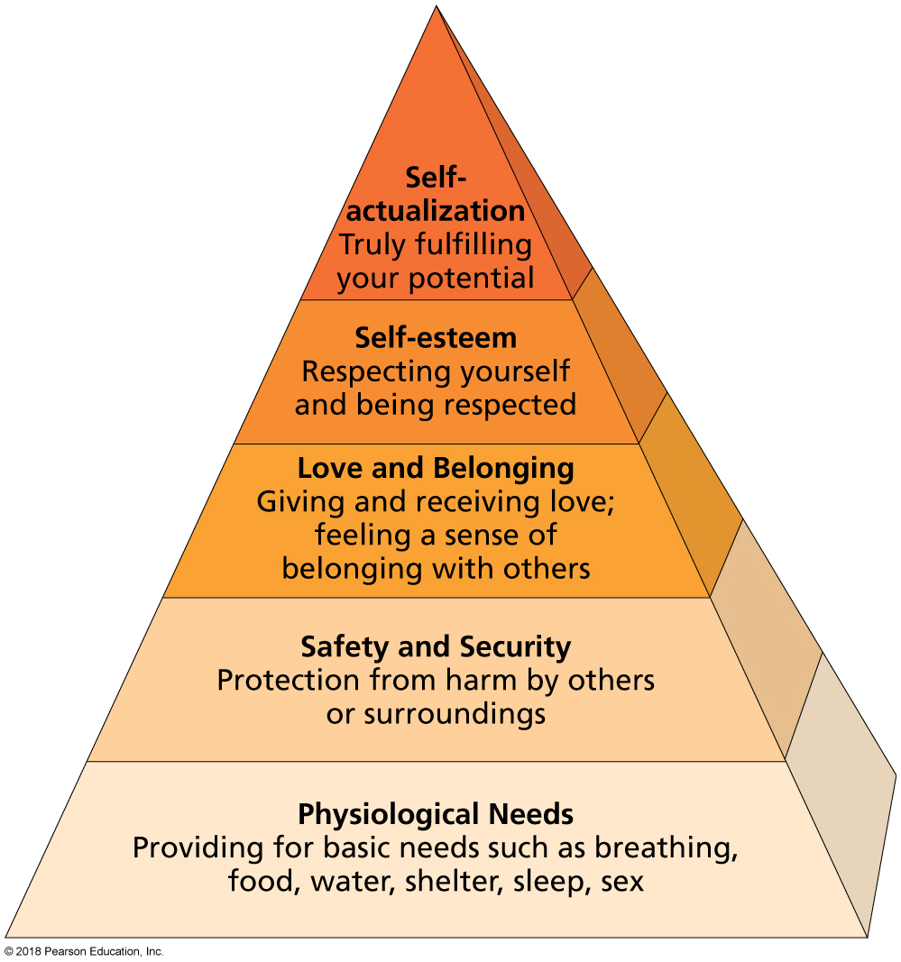
Maslow’s Hierarchy of Needs
Notes:
FIGURE 2.2 Maslow’s Hierarchy of Needs Pyramid. Basic, physiological needs appear at the base of the pyramid. As you move upward, you address needs that are less urgent to satisfy, developing greater psychological health, until you realize self-actualization.

Slide 10
The Role of Emotional Intelligence
The capacity to perceive, express, and reason accurately with emotion and emotional information.
Four key abilities:
Perceive and express emotion
Incorporate emotion in thought
Understand and reason with emotion
Regulate emotion in oneself and others

Slide 11
The Value of Optimism
The psychological tendency to have a positive interpretation of life's events.
Resiliency: The innate capacity to experience success and satisfaction following trauma or other stressors.

Slide 12
FACTORS AFFECTING PSYCHOLOGICAL HEALTH

Slide 13
Family History
Rejection, abuse, abandonment, shaming, and other stresses experienced in childhood could manifest in adulthood as mental disorders.
In one study of college students, social support was identified as a significant factor in improving the psychological adjustment of students to college life.

Slide 14
Social Support
A sufficient quantity of relationships that provide emotional concern, help with appraisal, information, and even goods and services.

Slide 15
The Role of Spiritual Health
A sense of connection to a larger purpose, coupled with a system of core values that provide direction and meaning in life.
Religion is a system of beliefs and practices related to the existence of a transcendent power.
Approximately 76.5% of American adults say they are affiliated with a particular religion.

Slide 16
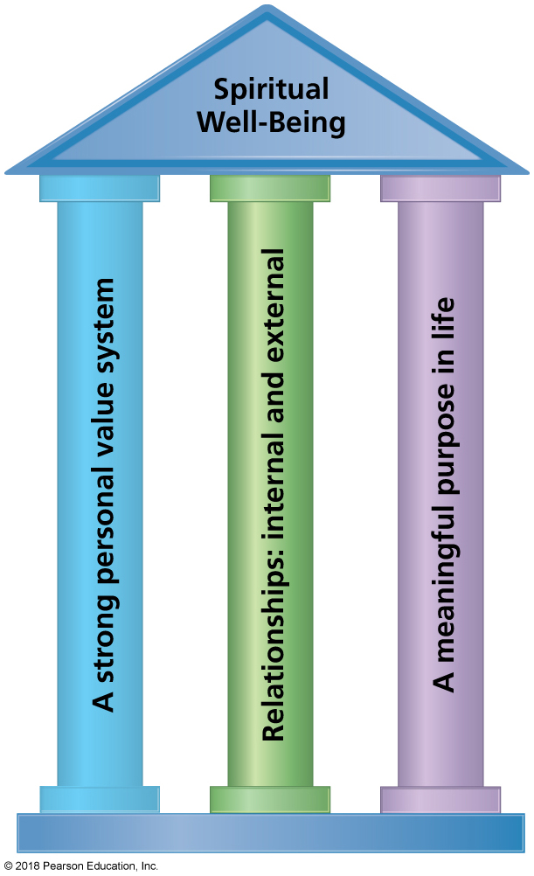
Seaward’s Pillars of Spiritual Well-Being
Notes:
FIGURE 2.3 Seaward’s Pillars of Spiritual Well-being.
A strong sense of values, meaningful relationships, and a sense of purpose together support spiritual well-being.
Source: Adapted from Health of the Human Spirit: Spiritual Dimensions for Personal Health, 2nd ed., by B. L. Seaward, 2013, Burlington, MA: Jones & Bartlett Learning.

Slide 17
COMMON PSYCHOLOGICAL CHALLENGES

Slide 18
Common Psychological Challenges
There may come times when you face challenges to your psychological well-being.
This vulnerability does not mean there is something “wrong” with you.
Challenges can include shyness, loneliness, anger, or a bad mood.

Slide 19
Shyness
The feeling of apprehension or intimidation in social situations, especially in reaction to unfamiliar people or new environments.
May be due to shy gene, life experiences, and/or other environmental factors.
Mild forms of shyness can usually be overcome with practice, more severe with cognitive-behavior therapy.

Slide 20
Loneliness
A feeling of isolation from others is a feeling of isolation from others, a sense that you don’t have—and don’t know how to make—meaningful connections.
Take advantage of social opportunities offered on campus or in your community.
Express yourself openly and honestly.
Look into college counseling center resources.

Slide 21
Anger
Anger is a normal and healthy human emotion.
Recognizing factors that make you angry can help you understand your values and assert yourself.
The key is to express anger in a constructive way.
Try to relax—a few deep breaths can often do the trick.
Explain, as calmly as you can, what’s upsetting you.
Speak honestly but avoid criticism, blame, and threats.
If necessary, walk away from the person or situation and give yourself time to think.
Once you’re calmer, you may see solutions to the problem that you didn’t notice before.

Slide 22
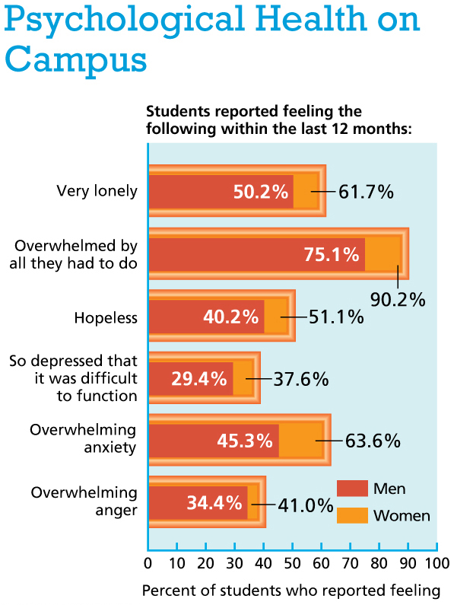
Notes:
Data from ACHA-NCHA II: Undergraduate reference group executive summary, fall 2015, by the American College Health Association, 2015.

Slide 23
MENTAL DISORDERS UNITED STATES: AN OVERVIEW

Slide 24
Mental Disorders
Significant behavioral and psychological disorders that disrupt thoughts and feelings, impair ability to function, and increase risk of pain disability or even death.
NIMH estimates that more than 1 in 4 Americans over the age of 18 have experienced a DSM-diagnosable mental disorder at some point in the past year.
In 2015, 1 in 4 U.S. college students reported being treated for or diagnosed with some type of mental disorder in the past year.

Slide 25
Mood Disorders
Any chronic, pervasive emotional state that significantly alters a person's thoughts, behaviors, and normal functioning.

Slide 26
Depressive Disorders
A depressive disorder is usually characterized by profound, persistent sadness or loss of interest that interferes with daily life and normal functioning.
Approximately 18 million adult Americans suffer from a depressive disorder every year.
Notes:
TD: bolded “depressive disorder” to highlight key term

Slide 27
Depressive Disorders: Symptoms
In addition to persistent sadness, symptoms include:
Feeling of being slowed down or lacking energy.
Feeling helplessness, hopelessness, meaninglessness, or “emptiness.”
Feelings of worthlessness or guilt.
Loss of interest in school, work, or activities once enjoyed.
Social withdrawal.
Difficulty thinking or clearly making decisions.
Sleep disturbances.
Changes in eating habits, eating more or less than formerly.
Restlessness, irritability.
In most severe cases, recurring thoughts of death/suicide.

Slide 28
Types of Depressive Disorders
Major depressive disorder (unipolar depression): A type of depressive disorder characterized by experiencing five or more symptoms of depression, including either depressed mood or loss of interest or pleasure, for at least two weeks straight.

Slide 29
Types of Depressive Disorders (cont.)
Dysthymic disorder (dysthymia): A milder, chronic type of depressive disorder that lasts two years or more.

Slide 30
Causes of Depressive Disorders
Reasons for depressive disorders tend to be complex and interrelated.
Genetics or learned behaviors can contribute to depression passing through multiple generations of a family.
Physical or biochemical problems can affect moods.
External factors can contribute: traumatic events, grief, financial problems, stress, and substance abuse.

Slide 31
Depressive Disorders in Men and Women
More women than men suffer from depressive disorders in a given year.
Causes and symptoms vary between the sexes.
Until adolescence, girls and boys experience depressive disorders at the same rate.

Slide 32
Women and Depression
Hormonal shifts appear to increase the risk of depressive disorders.
A number of social and interpersonal factors increase women’s stress, which contributes to depression.
Women still tend to play a larger role than men in child care, while also pursuing professional careers.
Women also experience higher rates of poverty and sexual abuse than men do.

Slide 33
Men and Depression
Depression in men is underdiagnosed and undertreated.
The disparity in rates of disorders in men and women may not be as great as reported.
Expression of depression as irritability, fatigue, or physical problems may prevent proper diagnosis.
Many also believe that “real men” should not admit to feeling sad.
Depressed men are more likely than women to self-medicate or engage in risky behavior.

Slide 34
Treatment of Depressive Disorders
Psychotherapy
Antidepressants

Slide 35
Treatment of Depressive Disorders: Psychotherapy
Psychotherapy: Talking with a trained counselor or psychologist can encourage depressed people to open up about thoughts, feelings, and experiences.
Talk therapy may be the best treatment for mild to moderate depressive disorders.

Slide 36
Treatment of Depressive Disorders: Antidepressants
Antidepressants prompt a change in the levels of neurotransmitters—typically serotonin—in the brain.
SSRIs are the most commonly prescribed.
SSRIs are not addictive, but stopping them abruptly can cause withdrawal.
People sometimes stop taking antidepressants when they start feeling better, leading to a relapse.
Medications do come with risks, including the possible risk of suicide, so asking questions is important.

Slide 37
Bipolar (Manic-Depressive) Disorder
A mental disorder characterized by occurrences of abnormally elevated mood (or mania), often alternating with depressive episodes, with periods of normal mood in between.

Slide 38
Bipolar Disorder
Approximately 5.7 million American adults are affected.
Both sexes are equally affected, and bipolar disorder occurs in all races and ethnic groups.
Bipolar disorder usually develops in the late teen or early adult years, with at least half of all cases starting before age 25.
Genes, along with external factors, are suspected to increase the likelihood of developing the illness.

Slide 39
Video: What Are the Causes of Depression?

Slide 40
Video: What Are the Causes of Depression?
Discussion Questions
Discuss the potential link between being a comedian and suicide.
What are the physical warning signs of suicide risk?
What are emotional symptoms that might indicated increased risk of suicide?
What are two simple questions you can ask to determine if a person is at increased risk for suicide?
Identify one positive outcome of Robin William’s suicide.

Slide 41
ANXIETY DISORDERS

Slide 42
Anxiety Disorders
A category of mental disorders.
Characterized by persistent feelings of fear, dread, and worry.
More than 40 million American adults each year suffer from an anxiety disorder.
They are the most common mental disorder among college students.

Slide 43
Generalized Anxiety Disorder (GAD)
Chronic worry and pessimism about everyday events that last at least six months.
A person with GAD often overreacts with little provocation.
May be accompanied by physical symptoms (fatigue, headaches, muscle aches, nausea).
Strikes about twice as many women as men.

Slide 44
Panic Attacks and Panic Disorder
Panic attacks: Episodes of sudden terror that strike without warning.
Physical symptoms include chest pain, shortness of breath, dizziness, weakness, and nausea.
Symptoms generally go away on their own in less than 10 minutes.
Many people have one panic attack and never have another.
Panic disorder: Reoccurring panic attacks and the fear of a panic attack occurring.
Affects 6 million adults in the United States.

Slide 45
Social Anxiety Disorder
An intense fear of being judged by others and of being humiliated by your own actions, which may be accompanied by physical symptoms.
Physical symptoms include sweating, blushing, increased heart rate, trembling, and stuttering.
Symptoms may arise only in certain situations, or they may happen in all social situations.
Women and men are equally likely to be among the 15 million U.S. adults who suffer from social anxiety disorder.

Slide 46
Phobias
An extreme, disabling, irrational fear of something that poses little or no actual danger.
The most common type of anxiety disorder.
Onset often occurs in childhood or adolescence.
Nearly 9% of adults experience some kind of phobia.
APA classified phobias into five categories:
Animal
Natural environment (e.g., heights, water)
Situation (e.g., confined spaces, darkness)
Blood, injection, or injury
Other

Slide 47
Treating Anxiety Disorders
Cognitive and behavioral therapies can help people recognize and redirect anxiety-producing thought patterns.
Exposure therapy or systematic desensitization encourages people to face their fears head-on.
Use of biofeedback is increasing .

Slide 48
OTHER DISORDERS

Slide 49
Obsessive-Compulsive Disorder (OCD)
Repeated and unwanted thoughts (obsessions) that lead to rituals (compulsions) in an attempt to control anxiety.
Obsessions tend to be overblown or unrealistic worries.
Rituals provide brief relief from anxiety but can end up controlling the individual’s life.
Checking or touching things, hoarding, or counting can disrupt normal living.
Approximately 2.2 million men and women in the United States suffer from OCD.

Slide 50
Post-Traumatic Stress Disorder (PTSD)
Recurrent fear, anger, and depression occurring after a traumatic event.
Precipitators include war, child abuse, natural disasters, auto accidents, and being the victim of a violent crime.
Persons with PTSD often startle easily, feel numb emotionally, can become irritable or violent, relive trauma in flashbacks or dreams, or avoid certain places or experiences.

Slide 51
Attention Disorders
A category of mental disorders characterized by problems with mental focus.
Additional problems may include forming social connections and durable friendships.
Attention-deficit/hyperactivity disorder (ADHD) is characterized by inattention, hyperactive behavior, fidgeting, and a tendency toward impulsive behavior.

Slide 52
Attention Disorders (cont.)
5.8 % of college students have ADHD.
Boys are twice as likely as girls to be diagnosed.
Majority of diagnosis are in children from teacher complaints.

Slide 53
Attention Disorders: Treatment
Behavioral and cognitive therapies.
Prescription medications:
ADHD is often treated with amphetamines (Ritalin) or amphetamine/dextroamphetamine (Adderall).
These stimulants have the opposite effect on people with ADHD.

Slide 54
Schizophrenia
A severe mental disorder characterized by delusions, hallucinations, and other aspects of psychosis.
About 1% of adults in the United States are affected.
Usually diagnosed in late teens to early 30s.
To manage symptoms, medications may be used.
Many people recover with medication management and go on to lead independent and satisfying lives.

Slide 55
Schizophrenia (cont.)
Primary symptoms include:
Delusions
Hallucinations
Thought disorders
Movement disorders
Reduction in professional and social functioning
Inappropriate emotions
Men are likely show symptoms in their late teens/early 20s, and women about a decade later.
Both sexes and all ethnic groups are equally affected.

Slide 56
SELF-INJURY AND SUICIDE

Slide 57
Non-Suicidal Self-Injury
Occurs in the form of intentional, self-inflicted cuts, burns, bruises, or other injuries, without suicidal intent.
Often performed in an effort to deal with negative or overwhelming feelings.
Moments of calm after self-injury are often followed by feelings of guilt and shame.
More than 6.5% of college students in the United States admit to performing self-injury in the past year.
The reliability of these statistics is questionable because most who injure themselves conceal it.

Slide 58
Non-Suicidal Self-Injury (cont.)
Most self-injury begins or occurs in adolescence and the teen years.
Rates of self-injury are similar across the sexes and ethnic groups.
Therapy and medication can help people deal with difficult feelings in more appropriate, healthy ways.

Slide 59
Suicide
More than 41,000 people in the United States take their own lives every year.
At least another 11 unsuccessful attempts are made for each death that occurs.

Slide 60
Suicide Among College Students
College students are more likely than the general population to attempt suicide.
Suicide is the second leading cause of death on college campuses.

Slide 61
Suicide Among Different Groups
Women attempt suicide more often than men do.
Men are four times as likely as women to actually die by suicide.
Native Americans and Alaska Natives are the ethnic groups with the highest overall rates.
Adult Caucasian males over age 85 have the highest suicide rate of any group in the United States.
LGBT individuals are especially vulnerable.

Slide 62
Causes and Warning Signs of Suicide
Statements that indirectly imply suicidal thoughts:
“You won't have to worry about me much longer.”
An inability to let go of grief.
Changes in behavior and personality that focus on hopeless, negative thoughts and feelings.
A noticeable downturn in mood within the first few weeks of starting a new antidepressant medication.

Slide 63
Causes and Warning Signs of Suicide (cont.)
Loss of interest in classes, work, and hobbies, or spending time with friends and loved ones.
Expressions of self-hatred, excessive risk taking, and apathy toward one's own well-being.
Disregard for personal appearance.
Changes in sleep patterns or eating habits.
A preoccupation with thoughts or themes of death.

Slide 64
Preventing Suicide
Most suicide attempts are expressions of extreme distress.
Don't assume talk of suicide is just a result of a bad day or attention-seeking.
If you suspect someone is suicidal, let him or her know you care and are available to help.
Offer to call a crisis hotline together, go to a counseling center, or go to the nearest emergency room.

Slide 65
National Suicide Prevention Lifeline
Notes:
FIGURE 2.4 National Suicide Prevention Lifeline.
Source: U.S. Department of Health and Human Services, Substance Abuse and Mental Health Services Administration.

Slide 66
GETTING HELP FOR A PSYCHOLOGICAL PROBLEM

Slide 67
Options on Campus
Approximately 60% of all students who stop attending college do so because of a mental health-related reason.
Most campuses offer counseling and mental health services for students.
Licensed professionals will offer different types of therapy.
These services are usually provided free or at low cost or are covered by your insurance plan.
Your campus health clinic or counseling center is a good place to start looking for help.

Slide 68
Types of Mental Health Professionals
Counselors:
Have a master's degree in counseling.
Focus on talk therapy (group or individual therapy sessions).
Psychologists:
Have a doctoral degree.
Focus on talk therapy (group or individual therapy sessions).

Slide 69
Types of Mental Health Professionals (cont.)
Psychiatrists:
Have a medical degree.
Usually focus on medical aspects of psychological issues.
Can prescribe medication.
May have admitting privileges at local hospitals.
Often work with talk therapy professionals to provide a full range of care.

Slide 70
Types of Therapy: Cognitive-Behavioral
Emphasizes the role of thinking (cognition) in how we feel and what we do.
The therapist and the patient work together to identify negative thinking and replace it with positive thinking.
Most effective in treating depressive and anxiety disorders, but can be helpful for bipolar disorder and schizophrenia.

Slide 71
Types of Therapy: Behavioral
Focuses on changing a patient’s behavior and thereby achieving psychological health.
Exposure therapy: Gradual exposure to an anxiety-provoking situation paired with relaxation techniques.
Aversion therapy: Negative reinforcement discouraging unwanted behavior.
Often used for anxiety and attention disorders.

Slide 72
Types of Therapy: Psychodynamic
Founded on the unconscious sources of a person's behavior and psychological state.
Patients and therapists explore unresolved conflicts buried in the unconscious.
They talk through the buried conflicts, understand them, and change how they affect the patient.

Slide 73
Types of Therapy: Positive Psychology
Focuses on increasing psychological strengths and improving happiness.
Aims to highlight traits such as kindness, originality, humor, optimism, generosity, and gratitude.
Goal is to generate a more positive outlook.
Involves activities such as noting the number of good things that happen each day.

Slide 74
Types of Therapy: Acceptance and Commitment Therapy (ACT)
An outgrowth of cognitive-behavioral therapy that increases patients’ ability to engage in values-based, positive behaviors while experiencing difficult thoughts, emotions, or sensations.

Slide 75
Change Yourself, Change Your World
Basic tasks of daily life can feel overwhelming if you are under mental or emotional distress.
Take Care of Yourself
If feeling mentally or emotionally on edge, take the following actions:
Eat well.
Get the right amount of sleep.
Get some exercise.
Set realistic goals.
Take steps to build your self-esteem.
Reach out.

Slide 76
Helping Others
Get informed.
Listen.
Offer your help.

