Slide 1
Chapter 7: Body Image, Body Weight
Lecture Outlines by
Sloane Burke Winkelman
California State University, Northridge

Slide 2
Did You Know?
An estimated 68.5% of American adults aged 20 and older are overweight or obese.
Obesity-related health-care costs in the United States add up to more than $270 billion per year.
Obesity is now responsible for more than 3 million deaths worldwide each year—triple the number of deaths due to malnutrition.
In the United States, 4.3% of college students report being underweight.

Slide 3
Learning Outcomes
LO 7.1 Identify important factors in body image and body weight.
LO 7.2 Describe alarming trends in weight gain.
LO 7.3 Explain the risks and costs of obesity.
LO 7.4 Identify factors that contribute to weight gain.
LO 7.5 Explain how to reduce excess body weight.
LO 7.6 Describe strategies for maintaining a healthy weight at college.
LO 7.7 Describe common body image and eating disorders.

Slide 4
Overweight and Obesity Defined
An estimated 68.5% of American adults over age 20 are overweight or obese.
Overweight: The condition of having a body weight that exceeds what is generally considered healthful for a particular height. A weight resulting in a BMI of 25–29.9.
Obese: A weight disorder in which excess accumulations of nonessential body fat result in increased risk of health problems. A weight resulting in a BMI of 30 or higher.

Slide 5
BODY IMAGE AND BODY WEIGHT

Slide 6
Body Image
Body image: A person’s perceptions, feelings, and critiques of his or her own body.
Research shows
children absorb ideas about thinness and ideal body type from the media.
more women are unhappy with their bodies than men.
70% of female college students and 35% of male college students are dissatisfied with their bodies.
Media images (thinness, attractiveness) can negatively impact one’s own body image.
Media literacy is important.

Slide 7
Body Mass Index
Body mass index (BMI): A numerical measurement, calculated from height and weight measurements, that provides an indicator of the person’s health risk category.

Slide 8
Body Mass Index (cont.)
Body mass index is based on the ratio between height and weight.
It is often used to predict the risk for health problems later in life.
BMI of 18.5–24.9 = healthful weight.
BMI less than 18.5 = underweight.
BMI of 25–29 = overweight.
BMI of 30 or greater = obese.

Slide 9
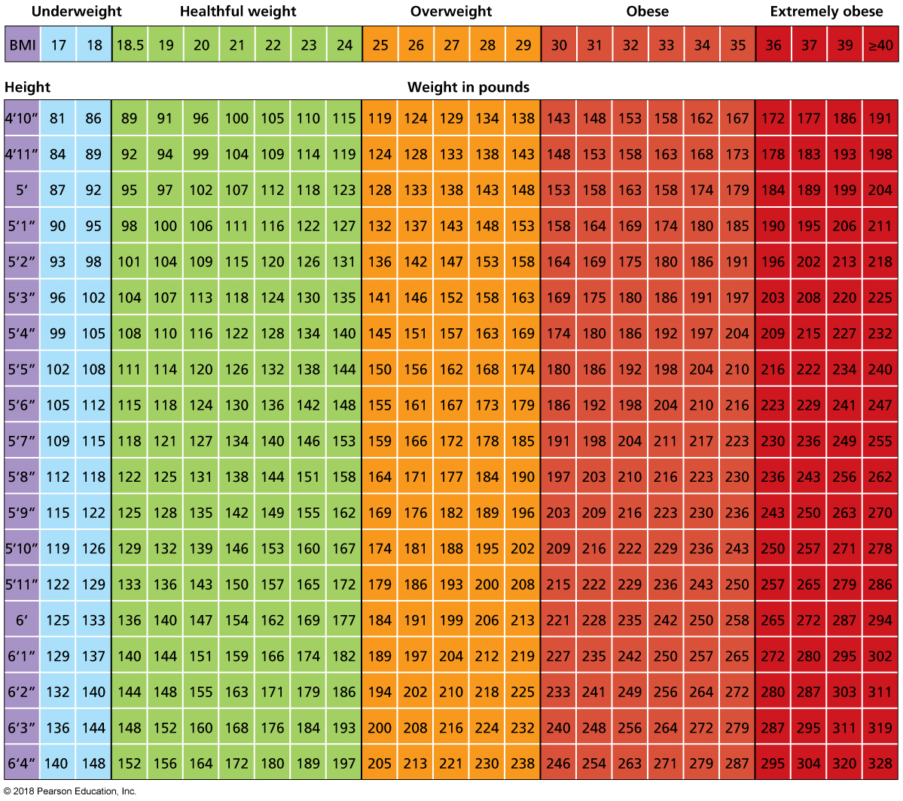
Body Mass Index (cont.)
Notes:
FIGURE 7.1 Body Mass Index (BMI). BMI is often used to predict risk factors for health problems later in life. To determine your BMI, find your height and then scan across to find your weight. Then scan up to find your BMI.

Slide 10
Personal Factors
What is a healthful range of weight for you?
What’s your body composition?
How old are you?
What’s going on in your life?
How does gender factor in?
What’s your body type?

Slide 11
ALARMING TRENDS IN BODY WEIGHT

Slide 12
Weight Trends in the United States
1990: No state had an obesity rate of 15% or more.
Today: Forty-five states have adult obesity rates above 25%.
Black women have the highest rate of obesity, at 56.6%, compared to a national average of 34.9.

Slide 13
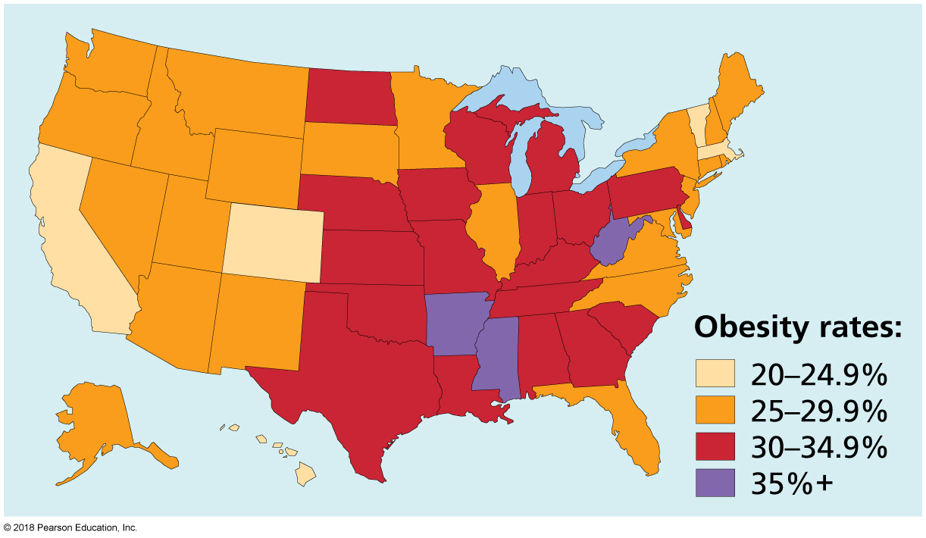
Obesity in the United States, 2014
Notes:
FIGURE 7.2 Obesity in the United States, 2014.

Slide 14
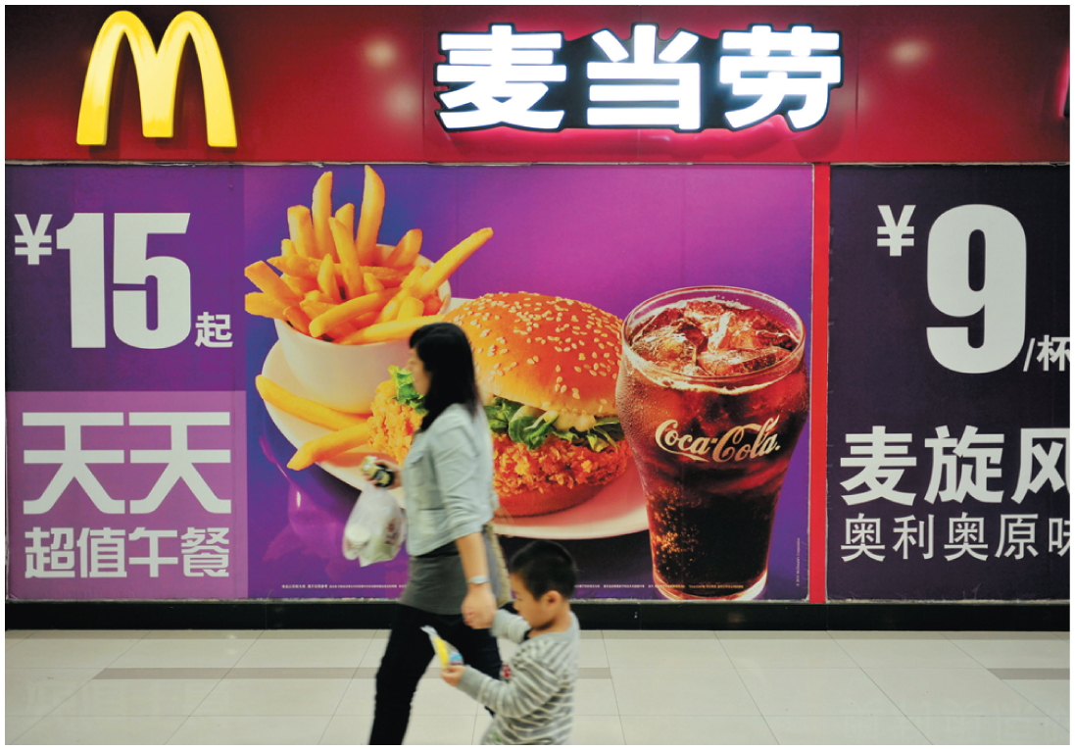
Weight Trends Around the World
Worldwide rates of obesity and overweight have increased alarmingly, rising from 857 million in 1980 to 2.1 billion in 2013. This represents a 28% increase among adults and a startling 47% increase among children since 1980.
Countries such as India and China are now experiencing increased rates of heart disease and diabetes.
Notes:
As developing countries adopt more Westernized diets, their rates of overweight and obesity are increasing.

Slide 15
Weight Trends on Campus
Most first-year college students gain 7 to 8 pounds.
The “Freshman 15.”
Many students gain a few pounds during each year of college.
Excess calories.
A decline in physical activity.
Many students are entering college at heavier weights than ever before.
Overweight children are far more likely to carry extra pounds into adulthood.

Slide 16
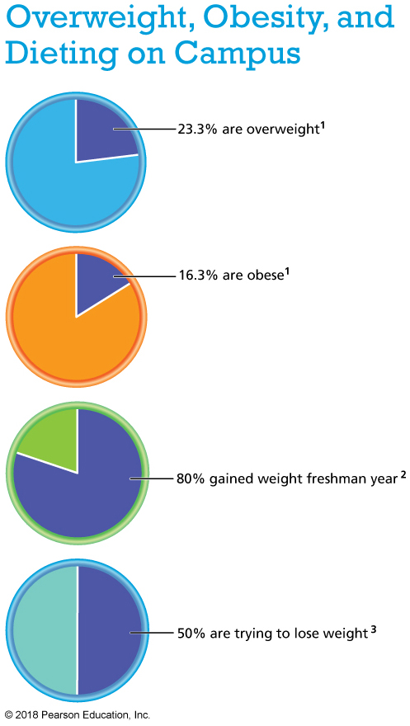
Notes:
References: 1. American College Health Association. (2015). ACHA-NCHA II: Undergraduate reference group executive summary, fall 2015. www.acha-ncha. org. 2. Bondenlos, J. S., Gengarelly, K., & Smith, R. (2015). Gender differences in freshmen weight gain. Eating Behaviors, 19, 1–4.

Slide 17
Risks and Costs of Obesity
Type 2 diabetes
Abnormal levels of blood lipids (LDL versus HDL)
Coronary heart/artery disease
Stroke
High blood pressure (hypertension)
Metabolic syndrome (having three or more of the following):
A waistline of 40” (men) or 30” (women) or more

Slide 18
Risks and Costs of Obesity
Cancer
Osteoarthritis
Sleep apnea
Gallbladder disease
Fatty liver disease
Pregnancy complications
Excess weight is also linked to physical discomfort, social and emotional troubles, and (with obesity) lower overall life expectancy.

Slide 19
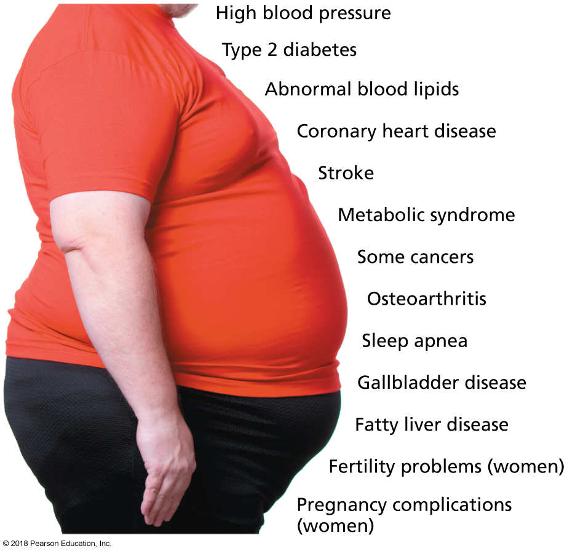
Major Health Risks Associated with Overweight and Obesity
Notes:
FIGURE 7.3 Major Health Risks Associated with Overweight and Obesity.

Slide 20
Financial Burden of Obesity
Overweight and obesity are estimated to cost the United States $270 billion per year in health-care costs and lost productivity.
An obese woman spends on average $4,870 more per year to live in the United States and it costs an obese man about $2,646 more per year than a healthy-weight man.

Slide 21
FACTORS THAT CONTRIBUTE TO WEIGHT GAIN

Slide 22
Factors That Contribute to Weight Gain
Energy balance: The state achieved when energy consumed from food is equal to energy expended, maintaining body weight.
Increased calorie consumption, physical inactivity, and environmental factors have all contributed to Americans’ dramatic weight gain in recent years.

Slide 23
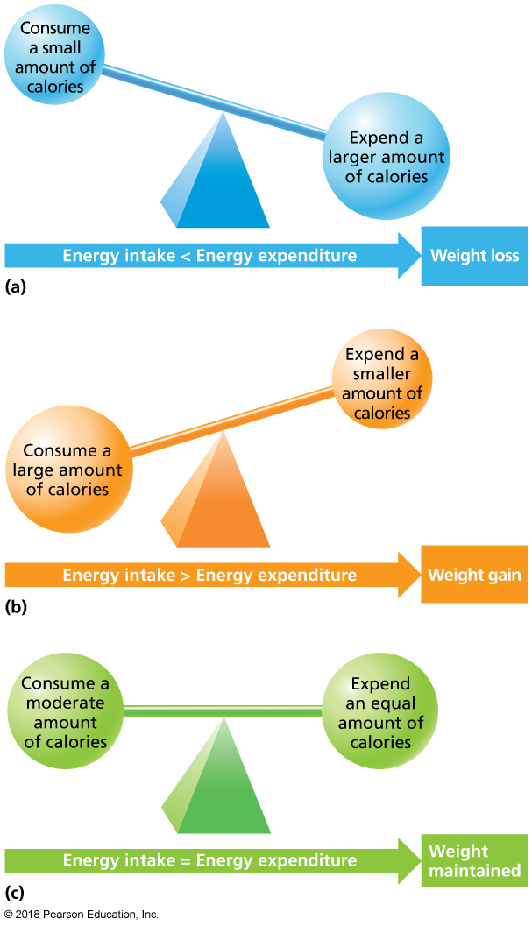
Energy Balance
Notes:
FIGURE 7.4 Energy Balance. Energy balance is attained when the calories you consume equal the calories you expend.
Source: Thompson, J., & Manore, M. (2014). Nutrition: An applied approach, 4th ed. Reprinted and electronically reproduced by permission of Pearson Education, Inc., Upper Saddle River, New Jersey.

Slide 24
BIOLOGY and GENETICS

Slide 25
Differences in Basal Metabolism
Two thirds of the energy a person needs each day goes toward basal metabolism—the body’s maintenance of basic physiological processes when at complete digestive, physical, and emotional rest.
Basal metabolic rate (BMR) and resting metabolic rate (RMR):
BMR: The rate at which the body expends energy for only the basic functioning of vital organs.
RMR: The rate of energy output when the person is awake and resting quietly.

Slide 26
Additional Differences
Age
Sex and gender differences
Genetics
Race and ethnicity
Health history

Slide 27
INDIVIDUAL BEHAVIORS

Slide 28
Increased Calorie Consumption
The average American today consumes about 570 more calories per day than in 1977.
Increased calories are from fats and sugars.
Portion sizes are larger.
People are dining away from home.

Slide 29
Lack of Physical Activity
Fewer than 1 in 3 Americans get the recommended minimum of 30 minutes of moderate activity a day, most days of the week.
One third of Americans over the age of 18 do not engage in any leisure time physical activity at all.
The average work week has greatly changed:
1860: 70 hours of heavy physical labor.
2012: 40 hours of sedentary work.
Americans also spend approximately 60 hours per week on average in front of a screen (television, computer, tablet, video, smart phone) and commuting.

Slide 30
Social Factors
Long work and school days and commuting.
Stress urging for comfort foods, which tend to be unhealthy choices.
Fast food = “fat food.”
“Food insecurity–obesity paradox.”

Slide 31
Physical Factors
Obesogenic and the built environment:
Lack of sidewalks and bike paths in neighborhoods.
Lack of supermarkets with fresh fruits and vegetables.
No access to gyms or places for physical activity or recreation such as parks.

Slide 32
Public Policy
Laws, regulations, and federally sponsored promotional programs around food also affect our nutritional environment—not always for the better.

Slide 33
Video: Fast-Paced Movies, Television Shows May Lead to More Snacking

Slide 34
Video: Fast-Paced Movies, Television Shows May Lead to More Snacking
Discussion Questions
Describe the types of films that may lead to more snacking when watched.
Explain how the study described in this video was conducted.
What types of TV shows lead to more snacking?

Slide 35
REDUCING EXCESS BODY WEIGHT

Slide 36
Can Dieting Work?
Hunger is the physiological sensation caused by a lack of food.
Appetite is the physiological response to the sight, smell, thought, or taste of food that prompts or postpones eating.
Satiety is when we’ve eaten and relieved or prevented hunger; it helps turn off the desire to eat more.
There are three common approaches to dieting:
Low-calorie diets
Low-fat diets
Low-carbohydrate diets

Slide 37
Low-Calorie, Low-Fat, Low-Carbohydrate Diets
Low-calorie diets build food guidelines around calorie reduction.
Weight Watchers is an example.
A healthful eating plan is needed for success.
Most low-fat diets aim to cut the dieter’s total fat intake to 25% of calories or less.
Cut trans fats from the diet.
Consume more “good” fats.
Low-carbohydrate diets greatly reduce sugar and starches.
Choose fiber-rich foods.
Watch your total calories.
Choose lean proteins.

Slide 38
Video: Low Carb Diet Trumps Low Fat in Weight Loss Study

Slide 39
Video: Low Carb Diet Trumps Low Fat in Weight Loss Study
Discussion Questions
Explain how this study was conducted.
What were the findings? Are you surprised?
Based on the study’s conclusions, how might you modify your current food choices if you are aiming to lose weight?

Slide 40
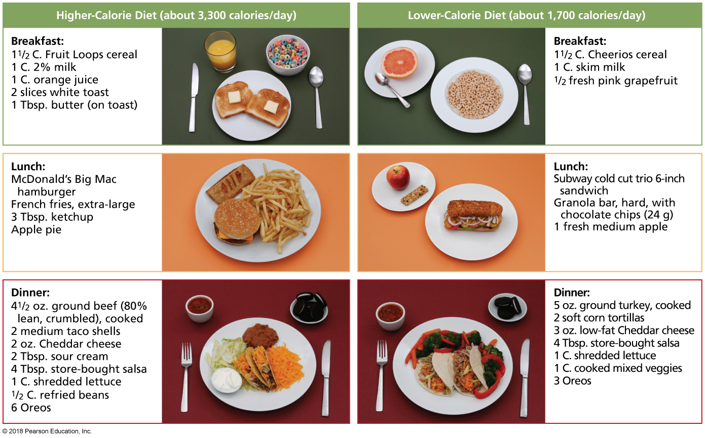
How to Cut Calories While Maintaining a Balanced Diet
Notes:
FIGURE 7.5 How to Cut Calories While Maintaining a Balanced Diet. The meals on the right show healthful alternatives to the higher-calorie meals on the left.
Source: Thompson, J., & Manore, M. (2014). Nutrition: An applied approach, 4th ed. Reprinted and electronically reproduced by permission of Pearson Education, Inc., Upper Saddle River, New Jersey.

Slide 41
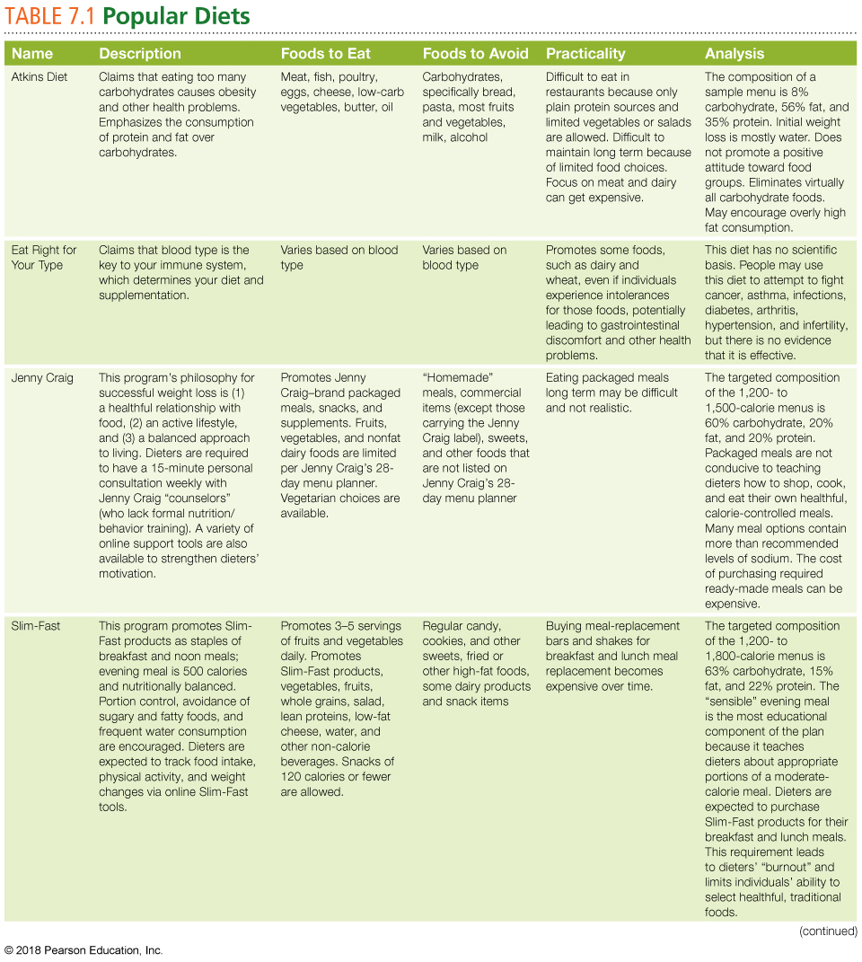
Notes:
Source: Based on “Best Diets Overall,” by U.S. News and World Report, January 2013; “Nutrition Fact Sheets: Fad Diets,” by the Northwestern University Feinberg School of Medicine website, January 2007; and “Top Diets Reviewed,” by Consumer Reports website, June 2007.

Slide 42
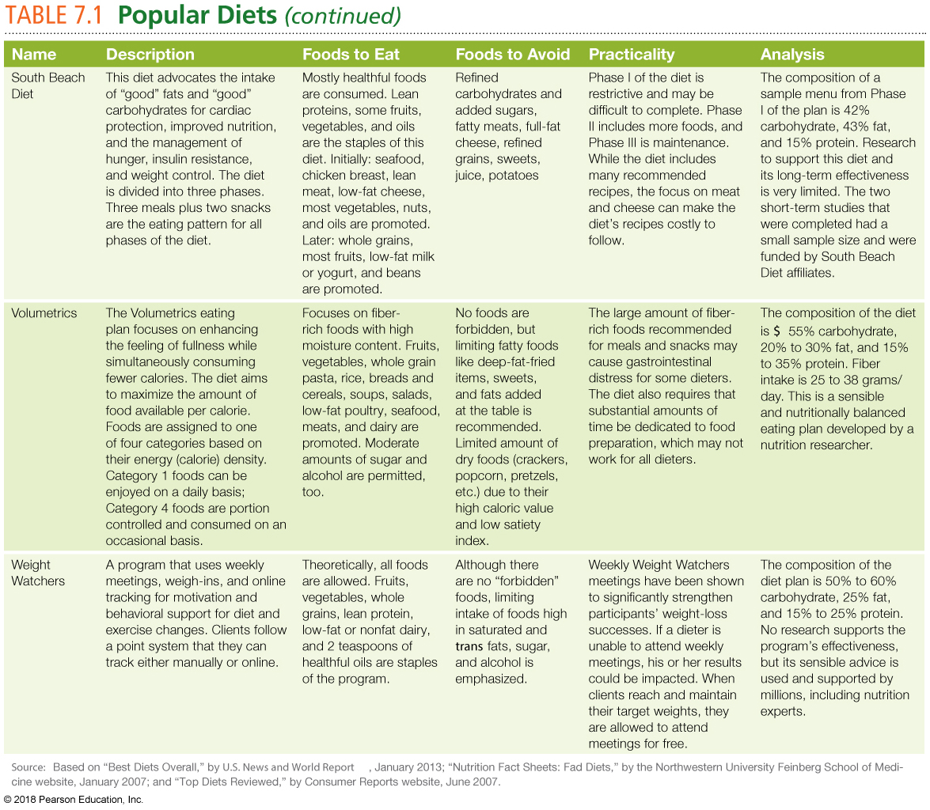

Slide 43
Diet “Aids”
In 2010, Americans spent $2.69 billion on over-the-counter diet aids.
In one study, college women who perceived themselves as having a higher BMI than they actually had were twice as likely to use a diet drug.
Most diet aids are considered dietary supplements, a category that the Food and Drug Administration (FDA) regulates to only a minimal extent.

Slide 44
Clinical Options for Obesity
Psychotherapy: Individual and group therapy may be helpful.
Prescription drugs may be offered to people for short-term use in weight loss, with one drug being available for long-term use.
The drugs by themselves are minimally effective.
Side effects can be unpleasant.

Slide 45
Surgical Options
Bariatric surgery, including gastric banding and gastric bypass, can lead to significant weight loss and health improvements.
It is appropriate for those who have a BMI of 40 or less, but a high risk for type 2 diabetes or joint pain.
Lap-band surgery was approved by the FDA in 2011 for persons who have a BMI of 30 or greater and at least one obesity-related condition.
Weight can still be gained after the surgery.
Some people cannot absorb nutrients properly.
These are major surgeries, carrying risks of complications.

Slide 46
The Importance of Physical Activity
If you are trying to maintain or lose weight, aim for 60–90 minutes of physical activity each day.
Chose an activity that you like.
At least two to three times per week, engage in muscle-building exercise.

Slide 47
What If You Want to Gain Weight?
Boost your calories, but in healthful ways.
Eat smaller meals more frequently throughout the day.
Add calories to your favorite meals.
Get regular exercise to build both appetite and muscle.

Slide 48
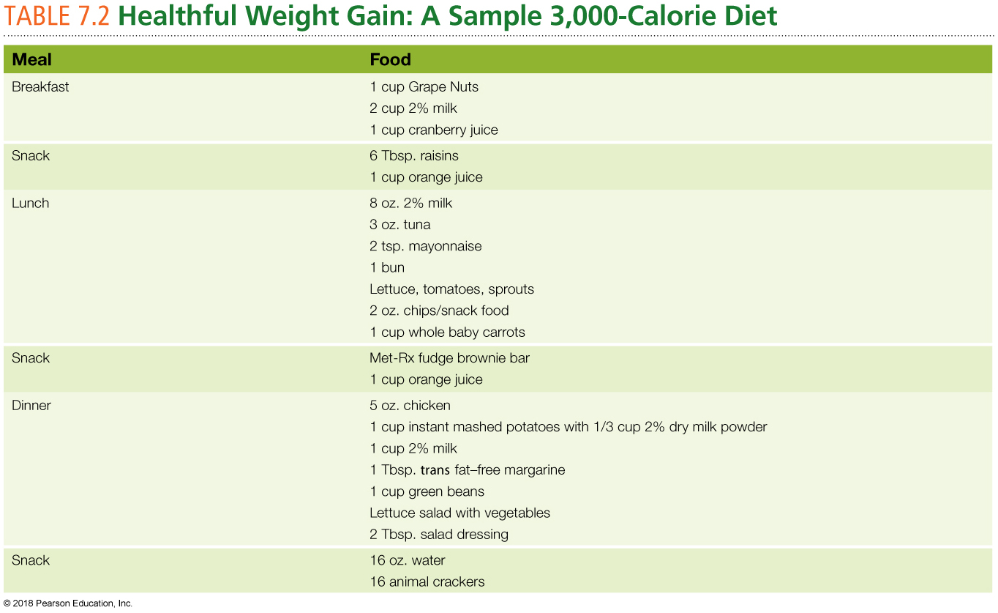

Slide 49
HOW DO YOU MAINTAIN A HEALTHFUL WEIGHT?

Slide 50
How Do You Maintain a Healthful Weight?
Your healthful weight is a range, not a fixed number.
Aim to be more active in your everyday life. When choosing physical activity, aim for consistency over intensity.
Snack smarter.
Find reasons to be active.
Don’t be too hard on yourself.

Slide 51
Helping a Friend
Find fun in something other than food (movies, catch a game, work out).
Don’t coach.
Let the slip-ups pass.

Slide 52
Campus Resources for Maintaining a Healthy Weight
Check out Real Food Challenge (realfood-challenge.org): 300 chapters at various colleges to advocate for healthier food on campus.
Start a cooking club.
Lobby for safe walking and biking options if your campus does not provide them.

Slide 53
Video: Experiment Shows Portion Control Is the Key to Healthy Eating

Slide 54
Video: Experiment Shows Portion Control Is the Key to Healthy Eating
Discussion Questions
How did the language used to refer to the meal affect the students’ behavior?
What do the results of the experiment suggest about portion size?
How does this news clip suggest that you determine your own particular portion size?

Slide 56
BODY IMAGE AND EATING DISORDERS

Slide 57
Body Image Disorders
Body dysmorphic disorder: A mental disorder characterized by obsessive thoughts about a perceived flaw in appearance.
Social physique anxiety: A mental disorder characterized by extreme fear of having one’s body judged by others.

Slide 58
Eating Disorders
When unhealthy eating behaviors produce drastic weight changes and put health and even life at risk, they are called eating disorders.
Teen women, young men, and athletes are at a higher risk for eating disorders.
Approximately 2.7% of 13- to 18-year olds (3.8% of girls and 1.5% of boys) suffer from an eating disorder.

Slide 59
Anorexia Nervosa
People with anorexia nervosa see food as an enemy that must be controlled.
They eat as little as possible, often setting up elaborate rituals and practices to control food intake.

Slide 60
Signs and Symptoms of Anorexia
Intense fear of gaining weight or being overweight.
A highly distorted body image; seeing fat where none exists.
An inability to maintain a normal body weight.
A refusal to eat or eating patterns that tightly restrict food intake.

Slide 61
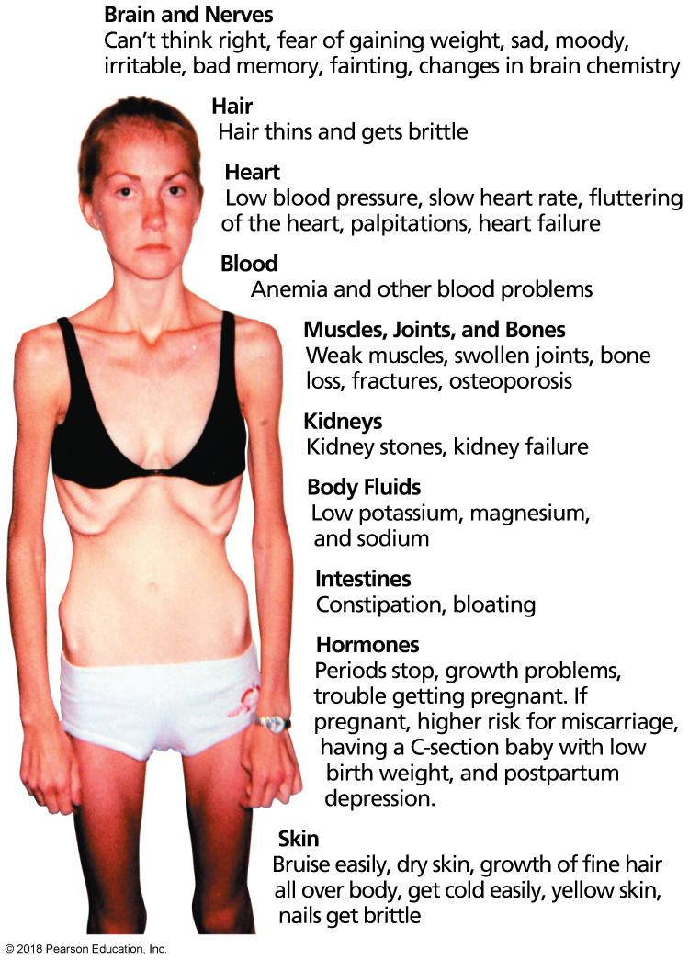
Major Physical and Health Effects Associated with Anorexia
Notes:
FIGURE 7.6 Major Physical and Health Effects Associated with Anorexia.
Source: Adapted from National Institute of Mental Health. (2014). Eating disorders: About more than food.

Slide 62
Bulimia Nervosa
People with bulimia often have elaborate food rituals that start with binge eating, the consumption of a large amount of food in a short amount of time.
After a binge, bulimics try to remove these calories.
Purging is done through self-induced vomiting, heavy laxative use, fasting, or excessive exercise.

Slide 63
Signs of Bulimia
Regular binge eating episodes, at a rate of two per week for several months.
Binges followed by purging, strict dieting, or excessive exercise to prevent weight gain.
Use of self-induced vomiting or laxatives as part of purging.
An obsession with weight and body shape.

Slide 64
Binge Eating Disorder
Binge eaters consume large amounts of calories quickly, but do little to burn off these calories.
Binge eating is repeated within a few days.
Binges lead to weight gain, which can lead to depression, worry, and concern about ability to control appetite.
This can lead binge eaters to eat in private or hide their eating from others.

Slide 65
Signs of Binge Eating Disorder
Eating large amounts of food in a short period of time, at least twice a week.
Eating until overly full.
Eating large amounts of food alone.
Choosing “comfort foods” during sessions of heavy eating.

Slide 66
Other Unhealthful Eating Behaviors
Disordered eating: Unhealthful eating behaviors where food is used to deal with emotional issues.
Night-eating syndrome: Eating little during the day, but food intake increases dramatically at night, often focusing on sugary or starchy foods; one may even eat throughout the night.

Slide 67
Female Athlete Triad
Disordered eating (weight control and calorie restriction)
Amenorrhea
Osteoporosis

Slide 68
Orthorexia Nervosa
Disordered eating characterized by a fixation with obsessively healthy eating.

Slide 69
Getting Help for a Body Image or Eating Disorder
Locate support and treatment resources on campus or in the community.
Have a compassionate conversation with the person you are concerned about.
Try not to talk to your friend or loved one about dieting, body size, or weight.
Provide information on the treatment resources you’ve found and offer to go along for support if desired.
Know that one conversation may not go far.
The person will know he or she can turn to you when ready to make a change.

Slide 70
Personal Choices: Develop a More Positive Body Image
Accept yourself for who you are.
Pay attention to your fitness rather than your appearance.
Be kind to yourself.
Know that the beauty and fitness industries are businesses designed to make money; they are not health-care providers.
Remember that your worth is not defined by your appearance and your health is not defined by the number on the scale.

