Slide 1
Chapter 6: Physical Activity For Fitness And Health
Lecture Outlines by
Sloane Burke Winkelman
California State University, Northridge

Slide 2
Did You Know?
People who are physically active for about 7 hours a week have a 40% lower risk of dying early than those who are active for less than 30 minutes a week.
Young adults with low cardiovascular fitness levels are two to three times more likely to develop diabetes in 20 years than those who are fit.
In a recent study, women who performed one year of strength training significantly improved their ability to maintain mental focus and resolve conflicts.

Slide 3
Learning Outcomes
LO 6.1 Identify the five components of health-related physical fitness.
LO 6.2 Explain the health benefits of physical activity.
LO 6.3 Identify the principles of fitness training.
LO 6.4 Consider different types of physical activity for your fitness plan.
LO 6.5 Assess how much physical activity you need.
LO 6.6 Discuss how to exercise safely.
LO 6.7 Design an effective, personalized fitness program.

Slide 4
WHAT IS PHYSICAL FITNESS?

Slide 5
What Is Physical Fitness?
Physical fitness is the ability to perform moderate to vigorous levels of activity and to respond to physical demands without excessive fatigue.
Physical activity is bodily movement that substantially increases energy expenditure.
Exercise is a type of physical activity that is planned and structured.

Slide 6
Two Types of Physical Fitness
Skills-related fitness: The capacity to perform specific physical skills related to a sport or other physically demanding activity.
Health-related fitness: The ability to perform activities of daily living with vigor.
We will focus on the five components of health-related fitness: cardiorespiratory fitness, muscular strength, muscular endurance, flexibility, and body composition.

Slide 7
Cardiorespiratory Fitness
The ability of your heart and lungs to effectively deliver oxygen to your muscles during prolonged physical activity.
The foundation for all other areas of fitness.
The best indicator of overall fitness.
Helps lower the risk of premature death and disease.
Boost through continuous, rhythmic exercise that works large muscle groups and increases heart rate.

Slide 8
Muscular Strength
The maximum force your muscles can apply in a single maximum effort of lifting, pushing, or pressing.
Helps keep the skeleton properly aligned, aids balance, protects your back, boosts athletic performance, increases metabolic rate.
Results in higher bone mineral density and stronger bones.
Increase strength through strength-training exercises with machines, free weights, resistance bands, or body weight.

Slide 9
Muscular Endurance
The capacity of muscles to repeatedly exert force, or to maintain a force, over a period of time.
Measured through:
Static muscular endurance: How long you can hold a force that is motionless.
Dynamic muscular endurance: How long you can sustain a force in motion.
Important for posture and for performing extended-duration activities.
Improved through gradual increase of duration of strength exercises.

Slide 10
Flexibility
The ability of joints to move through their full ranges of motion.
Depends on movement of muscle and connective tissues.
Benefits include relief of muscle tension, reduction of joint pain and back pain, and improved posture.
Improved through stretching exercises and activities such as yoga, Pilates, and tai chi.

Slide 11
Body Composition
The relative proportions of the body’s lean tissue and fat tissue.
A low ratio of fat to lean tissue is optimal.
Excessive body fat (especially in the abdominal area) increases the risk of heart disease, cancer, and stroke.
Body composition usually improves through physical fitness.

Slide 12
WHAT ARE THE BENEFITS OF PHYSICAL ACTIVITY?

Slide 13
Multiple Benefits of Physical Activity
Stronger heart and lungs.
Management and prevention of type 2 diabetes.
Reduced risk of some cancers.
Increased immune function.
Stronger bones (lower risk of osteoporosis).
Reduced risk of injury.
Healthful weight management.
Benefits to psychological health, stress management, and sleep.

Slide 14
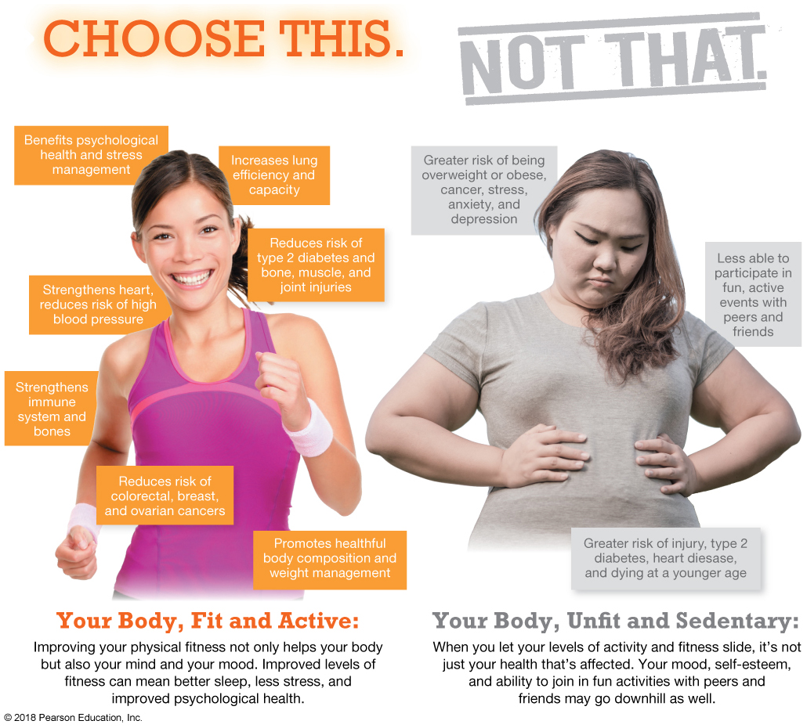

Slide 15
PRINCIPLES OF FITNESS TRAINING

Slide 16
Principles of Fitness Training
Overload: Increasing the stress placed on your body through exercise, resulting in improved fitness levels.
Progressive overload: Gradually overloading of the body over time in order to avoid injury.
FITT: Exercise variables that can be modified to accomplish progressive overload:
Frequency
Intensity
Time
Type

Slide 18
Principles of Fitness Training (cont.)
Specificity: A fitness component is improved only by exercises that address the specific component.
Reversibility: Fitness levels decline when the demand placed on the body is decreased.
Individuality: Individuals respond to fitness training in their own unique ways.
Diminishing Returns: The principle that individuals adapt to a constant, static fitness routine and receive fewer benefits as a result.

Slide 19
WHICH TYPES OF PHYSICAL ACTIVTY SHOULD YOU CONSIDER?

Slide 20
Which Types of Physical Activity Should You Consider?
Any type of regular, sustained physical activity is beneficial.
Look for activities that increase:
Cardiorespiratory fitness.
Muscular strength and endurance.
Flexibility.

Slide 21
Aerobic Exercise
Prolonged physical activity that raises the heart rate and works the large muscle groups.
Exercises can be categorized based on intensity.
Aerobic intensity is usually measured by heart rate.
Aim to raise your heart rate so it falls within your target heart rate range.
During exercise, a target heart rate range of 64–91% of your maximum heart rate is recommended.

Slide 22
Types of Aerobic Exercise
Running and jogging
Hiking or brisk walking for extended periods of time
Cycling and spinning
Swimming
Cardio classes, including dance and step aerobics
Vigorous martial arts, such as karate or cardio kickboxing
Notes:
TD: I added Zumba as so many of my students do this! Zumba is mentioned on page 106. May also want to include in this section of the textbook too.

Slide 24
Exercises for Muscular Strength and Endurance
Resistance training (or strength training): To build muscle, muscles must work against some form of resistance.
A variety of exercises can be performed with free weights, resistance bands, and body weight.
Machines are designed for limited specific exercises, but do promote correct movement and safe lifting.

Slide 25
Exercises for Muscular Strength and Endurance (cont.)
Anaerobic exercise: Short, intense exercise that causes an oxygen deficit in the muscles.
Isometric exercise: Exercise where the muscle contracts but the body does not move.
Isotonic exercise: Exercise where the muscle contraction causes body movement.

Slide 26
Resistance Training Terms
Repetitions: The number of times you perform an exercise repeatedly.
Sets: Separate groups of repetitions.
Recovery: The period necessary for the body to recover from exercise demands and adapt to higher levels of fitness.

Slide 27
Exercises for Improving Flexibility
Two major types of flexibility:
Static flexibility: The ability to reach and hold a stretch at one endpoint of a joint’s range of motion.
Dynamic flexibility: The ability to move quickly and fluidly through a joint’s entire range of motion with little resistance.

Slide 28
Stretching
Static stretching: Gradually lengthening a muscle to an elongated position and sustaining that position.
Active stretching: A type of static stretching in which you gently apply force to your body to create a stretch.
Passive stretching: Stretching performed with a partner who increases the intensity of the stretch by gently applying pressure to your body as it stretches.
Ballistic stretching: Performing rhythmic bouncing movements in a stretch to increase the intensity of the stretch.
Dynamic stretching: A type of slow movement in which activities from a workout or sport are mimicked in a controlled manner often to help “warm up” for a game.

Slide 29
Stretching Tips
Hold static stretches for 10–30 seconds.
Perform two to four repetitions of each stretch, accumulating 60 seconds per stretch.
Stretch at least two to three days per week.
Stretch until your muscle feels tight or until you feel slight discomfort.
Do not hold your breath while stretching. Try to relax and breathe deeply.
Do not lock your joints while stretching.
Notes:
TD: Please check the second bullet in the text- formatting issue we should fix. Thanks!

Slide 30
Video: The Do’s and Don’ts of Stretching

Slide 31
Video: The Do’s and Don’ts of Stretching
Discussion Questions
What are the benefits of stretching before exercise?
How can you keep your stretching safe?
Name some of the particular stretches suggested for warming up and slowing down.

Slide 32
Holistic Flexibility Programs
Yoga
Pilates
Tai chi

Slide 33
HOW MUCH PHYSICAL ACTIVITY DO YOU NEED?

Slide 34
Guidelines for Health Maintenance
Physical Activity Guidelines for Americans from USDHHS
At least 2 hours and 30 minutes (150 minutes) of moderate-intensity aerobic activity each week OR
At least 1 hour and 15 minutes (75 minutes) of vigorous-intensity aerobic activity each week OR
An equivalent mix of moderate- and vigorous-intensity aerobic activity each week AND
Resistance exercise 2 days a week or more for all major muscle groups, in sets of at least 8–12 repetitions

Slide 35
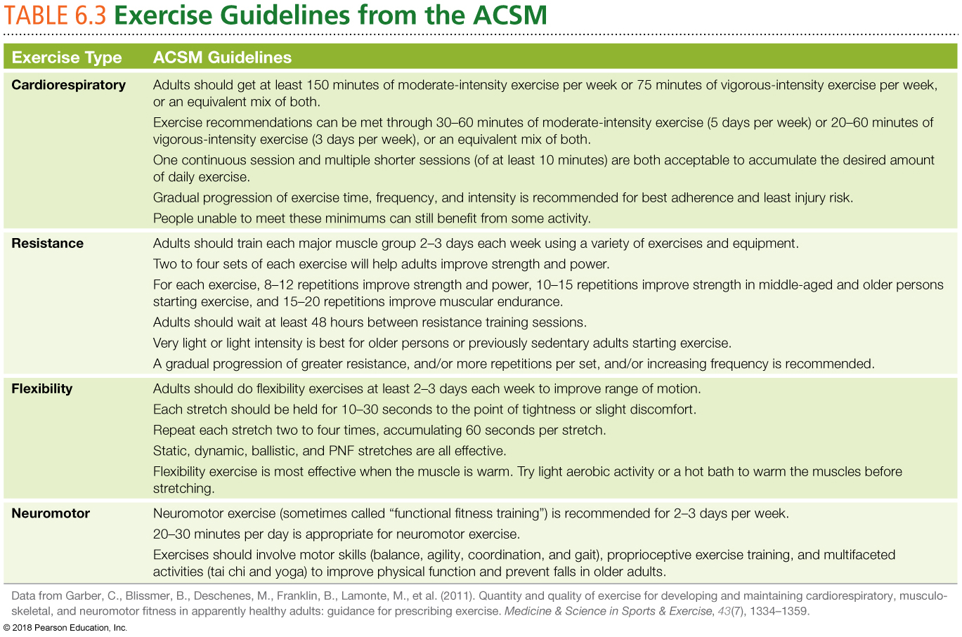

Slide 36
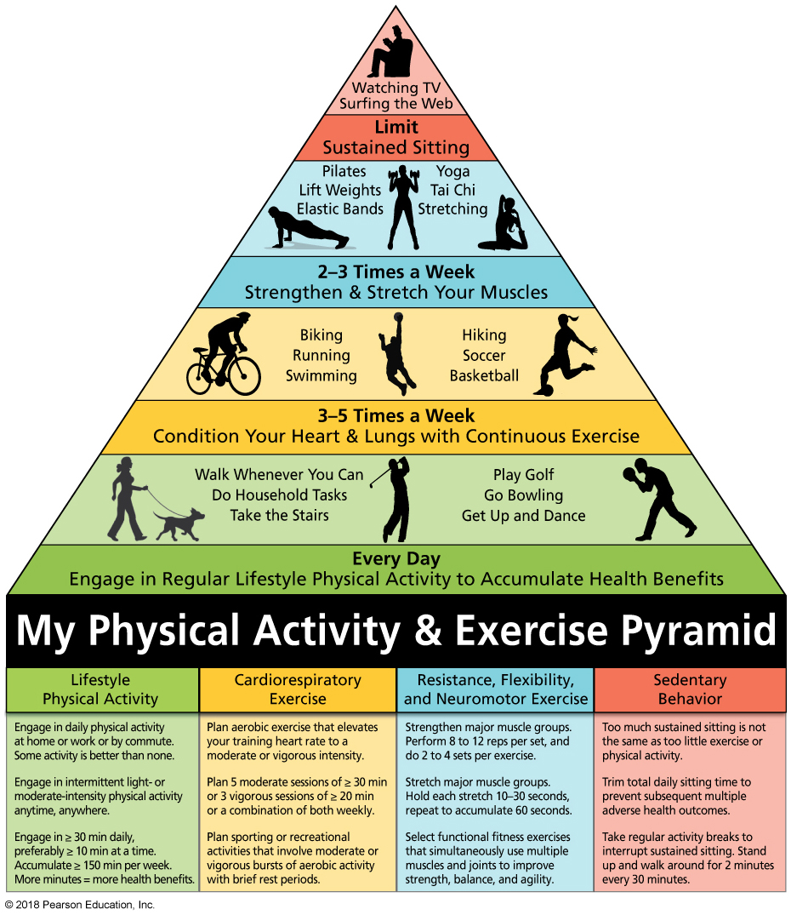
My Physical Activity & Exercise Pyramid
Notes:
FIGURE 6.4 My Physical Activity and Exercise Pyramid. This pyramid summarizes the different types of activities, each with unique benefits, recommended for adults to improve and maintain physical fitness and health. The recommendations link activities of daily living with a comprehensive exercise program.
Source: Dr. Jerome Kotecki, Ball State University. Reprinted with permission of Ball State University © 2015.

Slide 37
INCREASE YOUR LEVEL OF ACTIVITY

Slide 38
If You Aren’t Active Now
Start by doing what you can and look for ways to add more physical activity.
Work out in as little as 10-minute intervals.
Seek out simple ways to add activity to your life.
Park your car at the end of the parking lot.
Walk briskly or ride your bike to class.
Begin a new active hobby like tennis, yoga, or dance.
Don’t forget to include resistance and flexibility exercises at least two days per week.

Slide 39
If You Get Some Physical Activity Now
Focus on increasing your activity level.
Replace moderate-intensity activities with vigorous-intensity activities.
Be active longer.
Be active more often.
If you already meet the minimum recommendations for activity, strive for the elevated recommendations of 300 minutes of moderate-intensity activity or 150 minutes of vigorous-intensity activity per week.

Slide 40
If You Are Overweight
It is especially important to introduce activity into your life.
If necessary, choose non-weight-bearing exercises (swimming and water-based exercise classes) to avoid stressing joints.
Remember that everyday activity, including light housework, walking the dog, or washing the car, can get you moving.
If you haven’t worked out in a while, begin with light-intensity aerobic activity that gets your whole body moving.

Slide 41
EXERCISE SAFE, EXERCISE SMART

Slide 42
Basic Guidelines for Exercising Safely
Get medical clearance.
Warm up and cool down.
Get training.
Eat right.
Stay hydrated.
Prepare for hot or cold weather.
Start slowly and watch out for red flags.
Care for injuries.
Beware of performance-enhancing drugs.

Slide 43
Prepare for Hot or Cold Weather
Hypothermia: A potentially fatal condition in which your core body temperature becomes too low.
Heat exhaustion: A mild form of heat-related illness that usually occurs as a result of exercising in hot weather without adequate hydration.
Heatstroke: A life-threatening heat-related illness that occurs when your core temperature rises above 105 degrees Fahrenheit.
Cramp: An involuntary contracted muscle that does not relax, resulting in localized intense pain.

Slide 44
Be Wary of Performance-Enhancing Drugs
These substances are intended to increase physical strength, speed, or endurance.
Some change body composition to increase overall physical power.
As many as 3 million Americans have used performance-enhancing drugs.
Some cause serious side effects.
Some substances are illegal to use or sell in the United States.
Most have been banned for use by professional athletes.

Slide 45
Be Wary of Performance-Enhancing Drugs (cont.)
Anabolic steroids: Encourage muscle growth and build lean body tissue; pose serious health risks.
Creatine: Thought to help muscles during short, high-intensity activity, but benefits are inconclusive; should be used only under medical supervision.
Human growth hormone (HGH): Naturally occurring compound made by the body to fuel cell growth and regeneration; no proven benefits.
Androstenedione: Thought to enhance performance and boost testosterone; comes with significant health risks.
Ephedra: Taken to boost energy and promote weight loss; hasn’t been proved effective and can have dangerous side effects.

Slide 46
Be Wary of Performance-Enhancing Drugs (cont.)
Dehydroepiandrosterone: Often known as DHEA, this hormone, made in the body, helps lead to the production of male and female sex hormones and is sometimes taken in synthetic form to try to improve athletic performance or weight-lifting capability.
Chromium picolinate: Often referred to simply as “chromium,” this mineral is sometimes taken to try to build muscle tissue or boost energy, even though researchers have found it be ineffective.

Slide 47
CHANGE YOURSELF, CHANGE YOUR WORLD

Slide 48
Personal Choices
Set realistic goals.
Find activities you enjoy.
Schedule time.
Team up.
Overcome obstacles:
I don’t have time.
I don’t know how.
I don’t like the gym.
I am embarrassed about how I look.
I don’t have the money.
Assess your progress.

