Slide 1
Chapter 11: Sexuality, Contraception, and Reproductive Choices
Lecture Outlines by
Sloane Burke Winkelman
California State University, Northridge

Slide 2
Did You Know?
Approximately 37% of college students report that they have never engaged in vaginal intercourse.
Approximately 50% of college students report that they did not use contraception the last time they had vaginal intercourse.
In the United States, half of all pregnancies are unplanned—about 3 million each year.

Slide 3
Learning Outcomes
LO 11.1 Describe the primary structures in male and female sexual anatomy.
LO 11.2 Outline the key events in the female menstrual cycle.
LO 11.3 Identify the phases of the sexual response cycle and discuss common sexual dysfunctions.
LO 11.4 Define abstinence, non-intercourse sexual activity, and sexual intercourse.
LO 11.5 Discuss sexual orientation and gender identity.
LO 11.6 Compare and contrast different methods of contraception.
LO 11.7 Discuss surgical and medical abortion.
LO 11.8 Describe the key stages of pregnancy and childbirth.
LO 11.9 Discuss causes of and treatment of infertility.
LO 11.10 Consider ways of developing and promoting healthy sexuality.

Slide 4
Sexuality
Sexuality is the biological, physical, emotional, and psychosocial aspect of sexual attraction and expression.

Slide 5
SEXUAL ANATOMY AND HEALTH

Slide 6
Female Sexual Anatomy and Sexual Health
Vulva: All of the female external organs, collectively; also called genitals.
Mons pubis: The fatty, rounded areas of tissue in front of the pubic bone.
Labia: Two pairs (majora and minora) of fleshy lips surrounding and protecting the clitoris and the vaginal and urethral openings.
Clitoris: An organ composed of spongy tissue and nerve endings that is very sensitive to sexual stimulation.

Slide 7
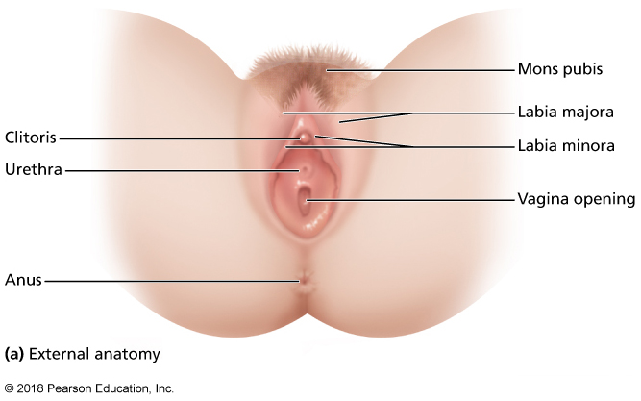
Female Sexual Anatomy: External
Notes:
FIGURE 11.1 Female Sexual Anatomy.

Slide 8
Female Sexual Anatomy: Internal
Vagina: The tube that connects a woman’s external sex organs with her uterus.
Uterus (womb): The pear-shaped organ where a growing fetus is nurtured.
Ovaries: The two female reproductive organs where ova (eggs) reside.
Menstrual cycle: A monthly physiological cycle marked by menstruation.
Fallopian tubes: A pair of tubes that connect the ovaries to the uterus.

Slide 9
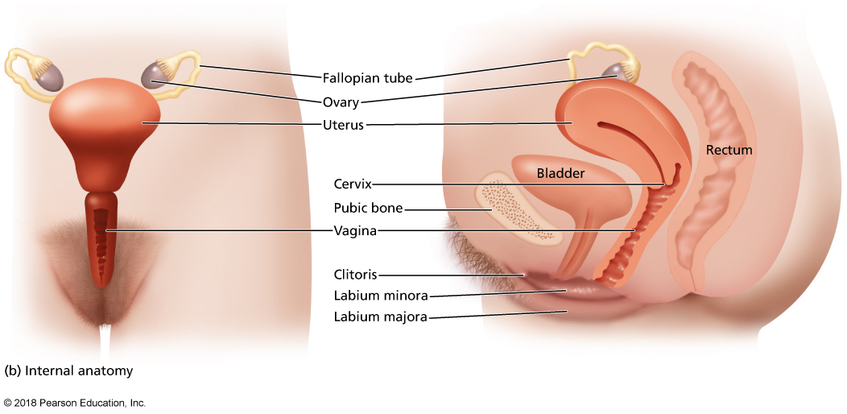
Female Sexual Anatomy: Internal (cont.)
Notes:
FIGURE 11.1 Female Sexual Anatomy.

Slide 10
Preventive Care
Girls should have their first gynecologic visit between ages 13 and 15.
A pelvic exam will most likely not be performed.
Women should have their first pelvic exam and Pap smear by age 21.
Most women younger than age 30 should receive cervical screening once every 2 years.
Most women age 30 and older can wait 3 years between Pap smears.
About half of all college-age women do not get screened regularly.

Slide 11
Common Sexual Health Problems in Females
Menstrual irregularities
Sexually transmitted infections
Vulvovaginal candidiasis (VVC), commonly referred to as a yeast infection

Slide 12
Male Sexual Anatomy and Sexual Health
Penis: The male sexual and reproductive organ.
Erection: The process of the penis filling up with blood as a result of sexual stimulation.
Circumcision: The surgical removal of the foreskin.
Scrotum: The skin sac at the base of the penis that contains the testes.

Slide 13
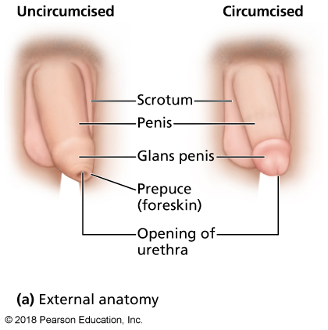
Male Sexual Anatomy: External
Notes:
FIGURE 11.2 Male Sexual Anatomy.

Slide 14
Male Sexual Anatomy and Sexual Health (cont.)
Testes (testicles): The two reproductive glands that manufacture sperm.
Epididymis: A coiled tube on top of each testicle where sperm are held until they mature.
Vas deferens: A tube ascending from the epididymis that transports sperm.

Slide 15
Male Sexual Anatomy and Sexual Health (cont.)
Accessory glands: Glands (seminal vesicles, prostate gland, and Cowper’s gland) that lubricate the reproductive system and nourish sperm.
Semen: Male ejaculate consisting of sperm and other fluids from the accessory glands.
Urethra: A duct that travels from the bladder through the shaft of the penis, carrying fluids to the outside of the body.
Prostate gland: A walnut-sized gland that produces part of the semen.

Slide 16
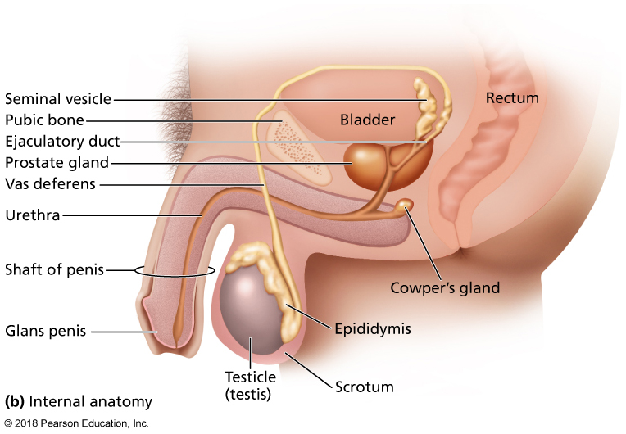
Male Sexual Anatomy: Internal
Notes:
FIGURE 11.2 Male Sexual Anatomy.

Slide 17
Common Sexual Health Problems in Males
Prostatitis (infection or inflammation of the prostate gland)
Prostate gland enlargement
Prostate cancer

Slide 18
THE MENSTRUAL CYCLE

Slide 19
Menstrual Cycle
Menarche: The first onset of menstruation.
Menstruation: The cyclical discharge of blood and tissue from the vagina.
Menopause: The time when a woman stops having menstrual cycles.
Menstrual phase: The phase of the menstrual cycle characterized by menstrual flow, the release of follicle-stimulating hormone from the pituitary gland to the brain, and the release of estrogen into the bloodstream.

Slide 20
Menstrual Cycle: Menstrual Phase
The phase of the menstrual cycle characterized by:
Menstrual flow (day 1).
The release of follicle-stimulating hormone from the pituitary gland to the brain.
The release of estrogen into the bloodstream and then to the uterus (day 6).

Slide 21
Menstrual Cycle: Proliferative Phase
Characterized by a thickening of the lining of the uterus and discharge of cervical mucus.
This phase ends when luteinizing hormone triggers the release of a mature egg.

Slide 22
Menstrual Cycle: Secretory Phase
Characterized by:
Degeneration of the follicle sac.
Rising levels of progesterone in the bloodstream.
Further increase of the endometrial lining.
Ovulate: To release an egg from the ovary.

Slide 23
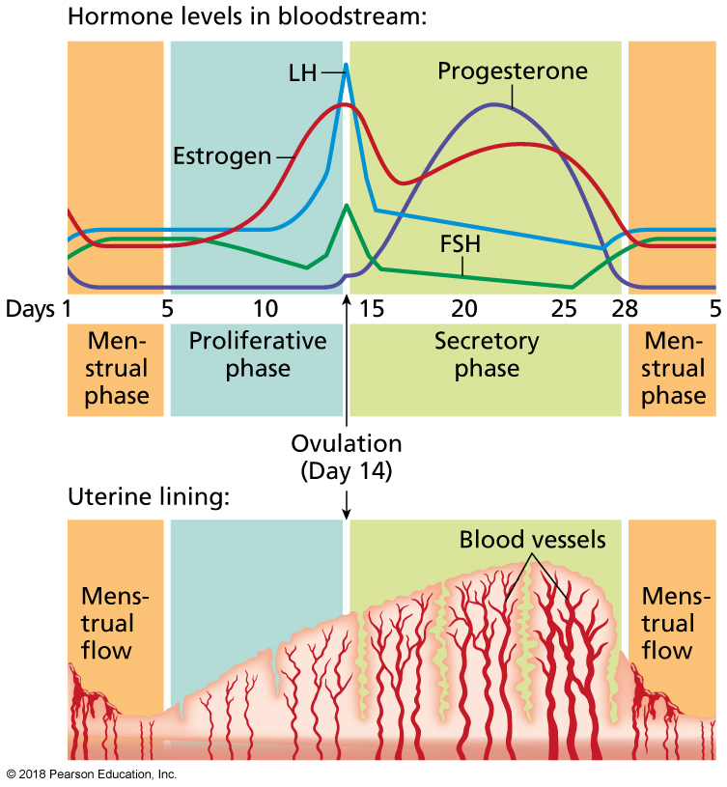
Phases of the Menstrual Cycle
Notes:
FIGURE 11.3 Phases of the Menstrual Cycle.
The menstrual cycle consists of a menstrual phase, a proliferative phase, and a secretory phase.

Slide 24
Disorders Associated with the Menstrual Cycle
Premenstrual syndrome (PMS): A collection of emotional and physical symptoms that occur just prior to menstruation; 85% of women experience PMS.
Premenstrual dysphoric disorder (PMDD): Severe, debilitating psychological symptoms experienced just prior to menstruation.
Dysmenorrhea: Pain during menstruation that is severe enough to limit normal activities or require medication.

Slide 25
Disorders Associated with the Menstrual Cycle (cont.)
Endometriosis: A condition in which endometrial tissue grows in areas outside of the uterus.
Amenorrhea: Cessation of menstrual periods.
Often traced to severe weight loss, hormonal imbalance, or significant stress.
Some medications can suppress menstruation.

Slide 26
THE SEXUAL RESPONSE CYCLE

Slide 27
The Sexual Response Cycle
The human sexual response cycle consists of distinct phases extending from the first moment of sexual desire until the calm after orgasm.

Slide 28
The Sexual Response Cycle: Excitement
The first phase of the sexual response cycle, marked by:
Erection in men.
Lubrication and clitoral swelling in women.

Slide 29
The Sexual Response Cycle: Plateau
The second phase of the sexual response cycle, characterized by:
Intense excitement.
Rapid heartbeat.
Genital sensitivity.
Secretion of pre-ejaculatory fluid in men.
Vaginal swelling in women.

Slide 30
The Sexual Response Cycle: Orgasm and Resolution
Orgasm: The peak/climax of sexual response, characterized by:
Rhythmic muscle contractions of genitals and surrounding areas.
Ejaculation in men.
Resolution: The stage of the response cycle in which the body returns to normal functioning.

Slide 31
Sexual Dysfunctions
Problems that can occur during any phase of the sexual response cycle.
At least one symptom of sexual dysfunction at some point has been experienced by an estimated 43% of women and 31% of men.

Slide 32
Female Sexual Dysfunctions
Painful Intercourse. Pain felt just before, during, or after intercourse.
Experienced by 20% of women.
Both physical and emotional issues can play a role.
Low levels of sexual desire.
Can result from physical and psychological reasons.
Experienced by 5–15% of women.
Inability to achieve orgasm.
Can result from physical and psychological reasons.
Affects 20% of women.

Slide 33
Male Sexual Dysfunctions
Erectile dysfunction (ED): The inability to obtain or maintain an erection firm enough for intercourse.
Most commonly results from physical injury or disease, but can stem from other reasons.
Treatment includes lifestyle modifications and/or medication.
Premature ejaculation (PE): A condition in which a male ejaculates earlier than he or his partner would like him to.
Most commonly due to psychological factors.

Slide 34
SEXUAL BEHAVIOR

Slide 35
Abstinence and Celibacy
Abstinence refers to the avoidance of sexual intercourse.
It can be by active choice or as a matter of circumstance.
Celibacy: Long-term abstinence.
Some choose celibacy for religious or moral reasons.
Others choose it out of a desire to avoid becoming pregnant or developing a sexually transmitted infection.

Slide 36
Sexual Intercourse
Vaginal intercourse is characterized by the insertion of the penis into the vagina.
Condoms are advised to avoid unintended pregnancy and reduce risk for STIs.
Anal intercourse is characterized by the insertion of the penis into a partner’s anus and rectum.
It has become increasingly acceptable, especially among younger generations.
It is one of the riskier sexual behaviors in terms of injury and transmission of infectious disease.

Slide 37
Oral Sex
Oral sex: Stimulation of the genitals by the tongue or mouth.
Fellatio: Oral stimulation of the penis.
Cunnilingus: Oral stimulation of the vulva or clitoris.

Slide 38
Communicating About Sex
Each year, more than 15 million STIs occur in the United States.
It’s important to communicate with a partner about your comfort level with:
Sexual behaviors
Frequency
Contraception and safe sex
Sexually transmitted infections
Other potentially sensitive issues

Slide 39
Non-Intercourse Sexual Activity
Sexual fantasies: Sexual or romantic thoughts, daydreams, and imagined scenarios.
Can be brief or detailed.
Can reflect personal desires a person doesn’t feel comfortable acting out in real life.
Masturbation is manipulation of one’s own genitals for sexual pleasure.
92% of male college students have masturbated.
48% of female college students have masturbated.

Slide 40
Non-Intercourse Sexual Activity (cont.)
Outercourse: Sexual intimacy without penetration of the vagina or anus.
No semen enters the vagina, so no pregnancy risk exists.
The risk of STIs is decreased, but transmission is still possible.
Sexting: Using cell phones or similar electronic devices to send sexually explicit text, photos, or videos.

Slide 41
SEXUAL ORIENTATION AND GENDER IDENTITY

Slide 42
Sexual Orientation
Sexual orientation is romantic and physical attraction toward others.
Experts believe our tendency to be attracted to men or women is shaped by biological, environmental, and cognitive factors.
Sexual orientation is neither a conscious choice nor something that can be readily changed.

Slide 43
Sexual Orientation: Heterosexuality
Heterosexuals are sexually attracted to partners of the opposite sex.
The majority of people throughout the world (96.6% of men and women in the United States) describe themselves as heterosexual.
This is the only sexual orientation that receives full social and legal legitimacy in most countries.
Those with a heterosexist view think their orientation is the only normal one.

Slide 44
Sexual Orientation: Homosexuality
Homosexuals are sexually attracted to people of the same sex.
Homophobia is the irrational fear of, aversion to, or discrimination against homosexuals or homosexuality.
Criminal violence can erupt as a result of homophobia.

Slide 45
Sexual Orientation: Bisexuality
Bisexuals are attracted to people of both the same and the opposite sex.
Some bisexuals choose not to act on their impulses; others have not had the opportunity to do so.

Slide 46
Gender Identity
Transgenderism is the state in which someone’s gender identity or gender expression is different from his or her assigned sex at birth.
A transsexual is a transgendered individual who lives as the gender opposite to his or her assigned sex.
Hormonal treatments and surgical procedures are sometimes used to complete the physical transformation from one sex to the other.

Slide 47
Video: Transgender Terms: Breaking Down Definitions and Do’s and Don’ts

Slide 48
Video: Transgender Terms: Breaking Down Definitions and Do’s and Don’ts
Discussion Questions
What is the difference between a person’s gender identity and their sexual orientation?
Name the term for people who identify with the gender they were assigned at birth.
What are the differences between the terms transvestite, transsexual, cross dresser, and drag? Which of these terms is outdated and now considered demeaning?
Describe what being in transition means.

Slide 49
CONCEPTION AND CONTRACEPTION

Slide 50
Conception
Conception: The fertilization of a female egg with male sperm.
Zygote: A fertilized egg.
Implantation: The lodging of a fertilized egg in the endometrium of the uterus.

Slide 51
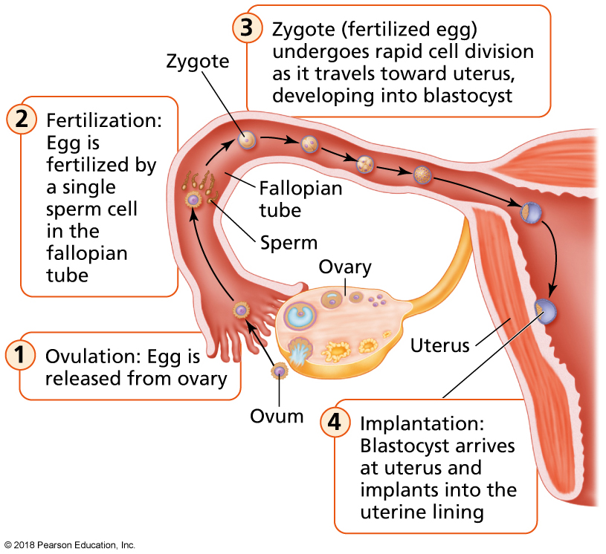
Conception (cont.)
Notes:
FIGURE 11.4 Events Involved in Conception.
The process of conception includes ovulation, fertilization, and implantation.
Source: Thompson, J., Manore, M., & Vaughan, L. (2011). The science of nutrition, 3rd ed. Reprinted and electronically reproduced by permission of Pearson Education, Inc., Upper Saddle River, New Jersey.

Slide 52
Contraceptive Options
Contraception: Any method used to prevent pregnancy.
Natural methods involve no pills or devices.
Barrier methods work to prevent sperm from reaching an egg.
Hormonal methods deliver hormones to a woman that prevent ovulation.
Surgical methods are the most permanent options.

Slide 53
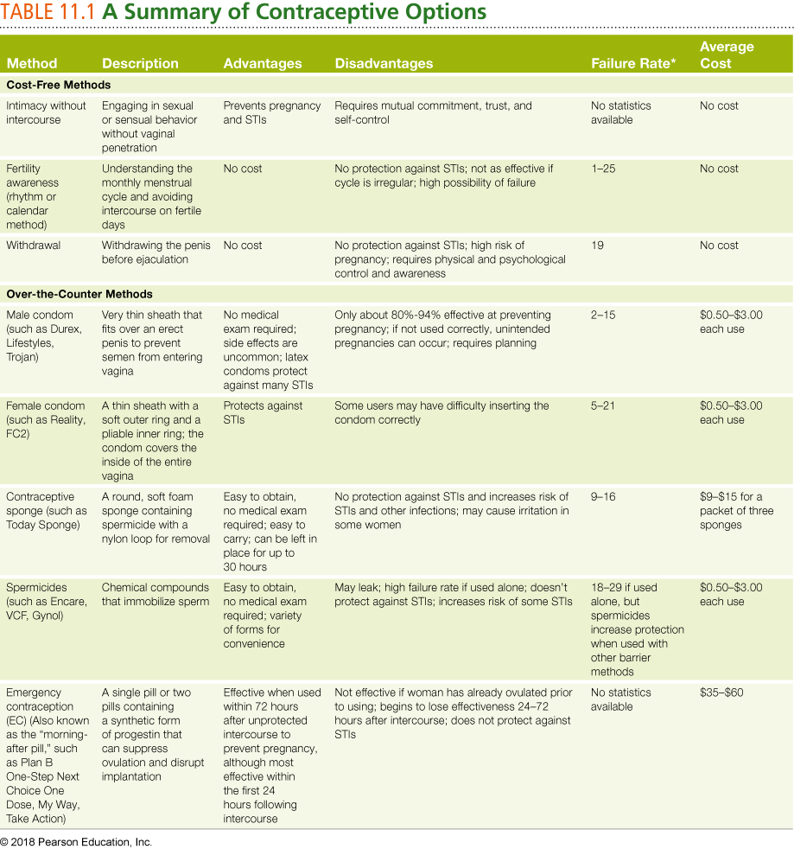
Contraceptive Options (cont.)
Notes:
*Number of women out of 100 likely to become pregnant during the first year of use. Number ranges indicate perfect versus typical use.
Source: Data from Planned Parenthood. (2013). Comparing effectiveness of birth control methods. www.plannedparenthood.org.

Slide 54
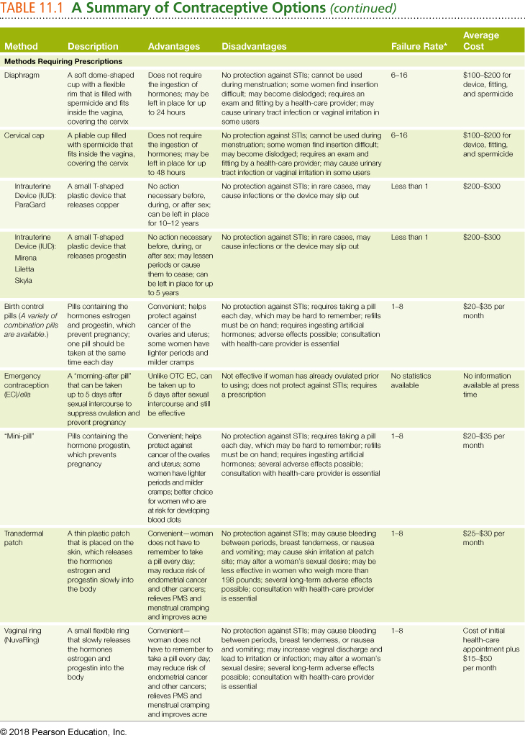
Contraceptive Options (cont.)
Notes:
*Number of women out of 100 likely to become pregnant during the first year of use. Number ranges indicate perfect versus typical use.
Source: Data from Planned Parenthood. (2013). Comparing effectiveness of birth control methods. www.plannedparenthood.org.

Slide 55
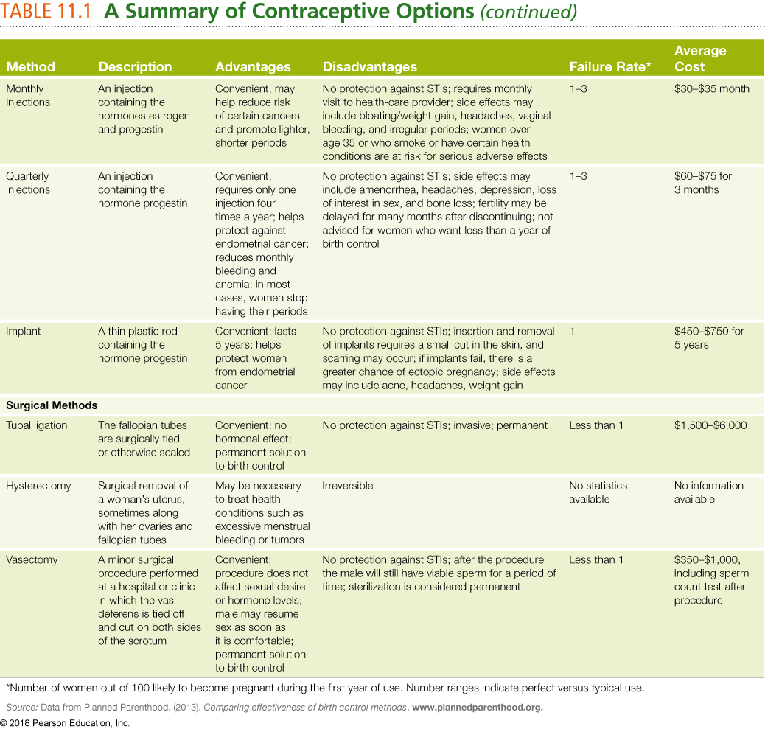
Contraceptive Options (cont.)

Slide 56
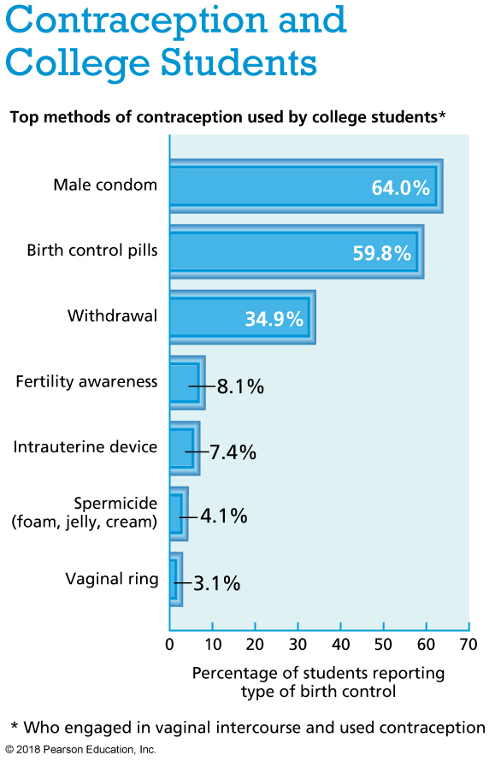

Slide 57
Cost-Free Methods of Contraception
Intimacy without intercourse can be fulfilling but requires commitment, self-discipline, and cooperation.
Fertility awareness (rhythm or calendar method) is the tracking of a woman’s monthly menstrual cycle.
It may be used to prevent pregnancy if the woman tracks carefully and has regular periods, but is not fail-safe.
Withdrawal (coitus interruptus) is the withdrawal of the penis from the vagina before ejaculation.
It is associated with a very high failure rate.

Slide 58
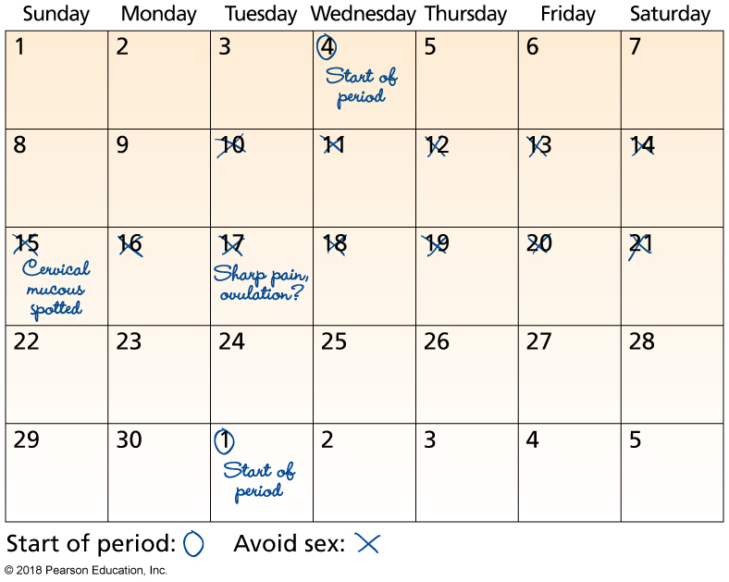
Fertility Awareness Tracking
Notes:
FIGURE 11.5 Fertility Awareness Tracking.
Jotting down key events in the menstrual and ovulatory cycles can help couples identify which dates to avoid intercourse.

Slide 59
Over-the-Counter Methods
Condom: A thin sheath typically made of latex, polyurethane, or lambskin that is unrolled over the erect penis prior to vaginal penetration.
When used properly, it provides excellent protection against pregnancy and sexually transmitted infections.
A female condom is also available.
It can be inserted several hours before sex.
Some women find it awkward to insert, and it can cause discomfort during sex.
It is associated with a higher pregnancy rate than the male condom.

Slide 60
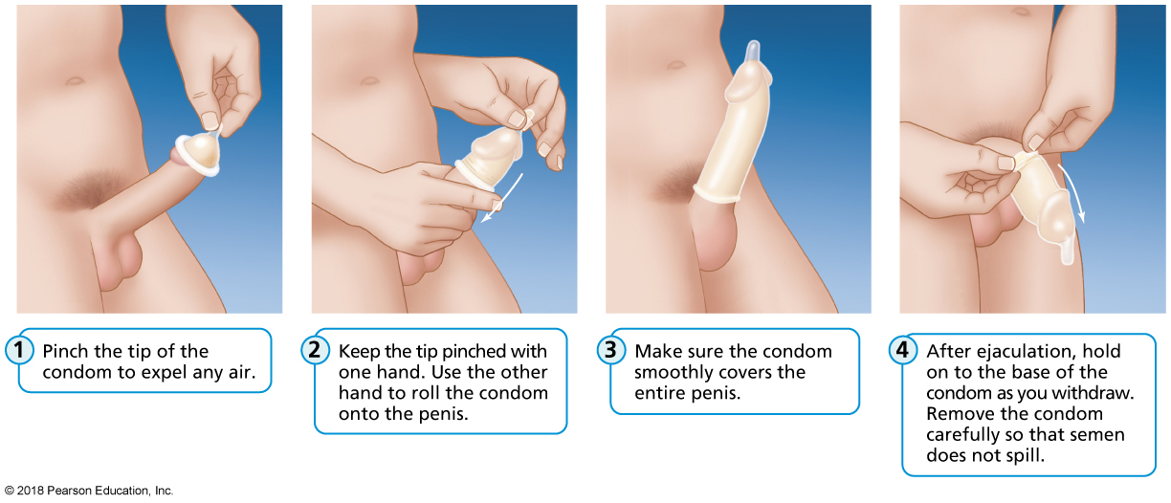
Applying a Male Condom
Notes:
FIGURE 11.6 Using a Male Condom.

Slide 61
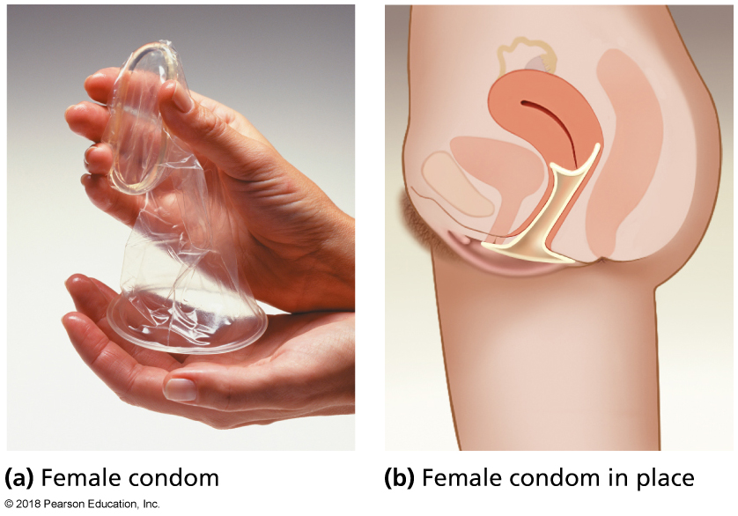
The Female Condom
Notes:
FIGURE 11.7 The Female Condom. (a) The FC2 is made of synthetic latex. (b) A female condom properly inserted.

Slide 62
Over-the-Counter Methods of Contraception
Contraceptive sponge: A flexible foam disk containing spermicide, inserted in the vagina prior to sex.
Spermicide: A substance containing chemicals that kill or immobilize sperm.
Emergency contraception (EC; “morning after” pill): A pill containing levonorgestrel, a synthetic hormone used to prevent pregnancy after unprotected sex.

Slide 63
Methods Available by Prescription
Diaphragm: A flexible silicone cup filled with spermicide and inserted in the vagina prior to sex to prevent pregnancy.
Intrauterine device (IUD): A plastic, T-shaped device that is inserted in the uterus for long-term pregnancy prevention.
Pharmaceutical hormones—birth control pills: Pills containing combinations of hormones that prevent pregnancy when taken regularly as directed.

Slide 64
Inserting a Diaphragm
Notes:
FIGURE 11.8 Inserting a Diaphragm.

Slide 65
Surgical Methods
These methods permanently prevent conception through surgical manipulation of the reproductive organs.
Tubal ligation: A woman’s fallopian tubes are tied off or sealed; this procedure can sometimes be reversed.
Hysterectomy: A woman’s uterus is surgically removed; this procedure leads to irreversible sterilization.
Vasectomy: A man’s vas deferens is tied off and cut on both sides of the scrotum; this procedure is difficult to reverse.

Slide 66
Which Method Is the Best?
It depends on each individual and the couple.
Failure rate: The percentage of women who typically get pregnant after using a given contraceptive method for 1 year.
Continuation rate: The percentage of couples who continue to practice a given form of birth control.
Couples will often stop using a method, and before starting use of a new method, they will have unprotected sex.

Slide 67
Video: Newer Birth Control Pills May Have Increased Risks of Blood Clots

Slide 68
Video: Newer Birth Control Pills May Have Increased Risks of Blood Clots
Discussion Questions
About how many American women use the pill?
What ingredient is associated with the risk of blood clots?
Name some of the benefits of birth control pills that might be weighed against the risks.

Slide 69
ABORTION

Slide 70
Abortion
Abortion is a medical or surgical procedure used to terminate a pregnancy.
It involves removing the embryo or fetus from the uterus.
In 2011, 23% of women who underwent an abortion, used the medical method.

Slide 71
Methods of Abortion: Medical
Intended for women in the earliest stages of pregnancy.
No surgery or anesthesia required.
Time-consuming, involving a multistep and multiday regimen of drugs.
Can be preferred because it allows the ending of a pregnancy at home without an invasive medical procedure.
Example: RU-486.

Slide 72
Methods of Abortion: Surgical
Suction curettage (vacuum aspiration): A relatively quick procedure in which a tube is used to suction tissue from the uterine walls.
Typically used in the first 6 to 12 weeks of pregnancy.
Dilation and evacuation (D&E): A multistep method involving multiple trips to a health-care provider.
Ultrasound, medication, anesthesia, instruments, and suction are used.
For pregnancies that have progressed beyond 12 weeks.

Slide 73
Complications of Abortion
Physical complications can include minor infection, excessive bleeding, blood infection, injury to the uterus or cervix, and incomplete abortion.
Death due to abortion is rare, but is possible.
Psychological complications can include feelings of sadness or guilt.
There is no credible evidence that terminating a single unwanted pregnancy creates mental health problems for adult women.

Slide 74
Legal Status of Abortion
Restrictions exist on who can get an abortion, and when.
Rules exist related to minors, parental notification, mandatory waiting periods, types of abortion allowed during certain months of pregnancy, and restriction of federal funds used for abortion.
Federal Medicaid funds can be used for elective abortions when a pregnancy would endanger a woman’s life, or in cases of rape or incest.

Slide 75
PREGNANCY AND CHILDBIRTH

Slide 76
Pregnancy
For a young, healthy couple having unprotected sex, there is a 20% chance that the woman will get pregnant during a menstrual cycle.
Pregnancies are divided into three trimesters, each lasting 3 months.
Women experience different symptoms during each stage of pregnancy.
A pregnancy test can be used to determine pregnancy.
An at-home test and a blood test are options.

Slide 77
Preconception Care
Before pregnancy, it’s important that women and men are healthy.
Nutrition, exercise, and health problems may need to be addressed.

Slide 78
Pregnancy: Early Signs
A missed period
An extremely light “period” that is actually implantation bleeding, which occurs when a fertilized egg implants itself in the uterus
Frequent urination
Nausea
Swollen breasts and/or breast tenderness
Fatigue
Food aversions or cravings
Mood swings
Abdominal bloating or pressure
Dizziness

Slide 79
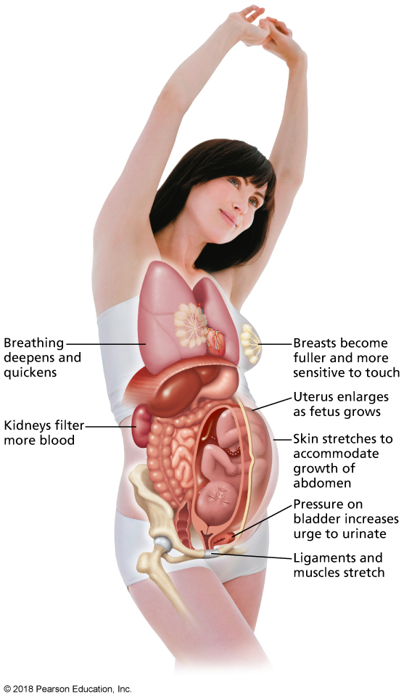
Changes in a Pregnant Woman’s Body
Notes:
FIGURE 11.10 Changes in a Pregnant Woman’s Body.

Slide 80
Pregnancy Terms
Embryo: The growing collection of cells that become a baby.
Placenta: Tissue that connects mother and baby.
Umbilical cord: Links the bloodstream of the placenta to that of the baby and enables the exchange of gases, nutrients, and wastes.
Amniotic fluid: Surrounds the developing fetus; aids in temperature regulation and allows the baby to move freely.
Fetus: The name given to the developing embryo 8 weeks after fertilization.

Slide 81
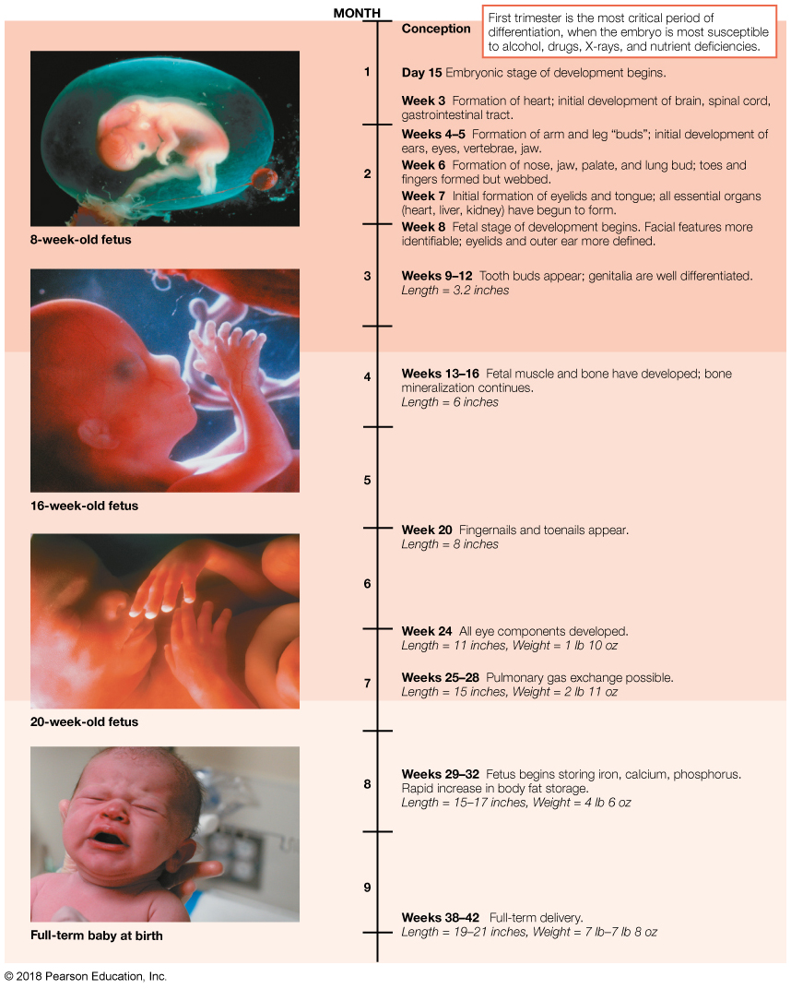
Stages of Embryonic and Fetal Development
Notes:
Figure 11.11 Stages of Embryonic and Fetal Development.

Slide 82
Pregnancy Terms: Complications
Ectopic pregnancy occurs when a fertilized egg implants within one of the fallopian tubes instead of the uterus; it is considered a medical emergency.
Miscarriage is a pregnancy that suddenly terminates on its own before the 20th week.
Hypertension: Preeclampsia is a serious health condition characterized by high blood pressure in pregnant woman.
Low birth weight: Less than 5 lb, 8 oz.

Slide 83
Pregnancy Terms: Complications (cont.)
Infant mortality rate: A calculation of the ratio of babies who die before their first birthday to those who survive until their first birthday.
Sudden infant death syndrome (SIDS): The sudden death of a seemingly healthy infant while sleeping.

Slide 84
Childbirth
Labor: The physical processes involved in giving birth.
Transition: The final phase of the first stage of labor, characterized by the dilation of the cervix and strong, prolonged contractions.
Apgar score: A measurement of how well a newborn tolerated the stresses of birth, as well as how well the neonate is adapting to the new environment.
Cesarean section (C-section): A surgical procedure involving the incision of a woman’s abdominal and uterine walls to deliver the baby.

Slide 85
Childbirth Options
Midwife
Hospital: Birthing rooms

Slide 86
Labor and Birth
Onset of labor:
Contraction; oxytocin is released.
First stage of labor:
12–14 hours.
Second stage of labor:
30 minutes to 3 hours.
Baby’s head crowns and baby is born.
Third stage of labor:
Expelling the placenta.
5–15 minutes to control bleeding.
Also cesarean section option (C-section).

Slide 87
Stages of Childbirth
Notes:
FIGURE 11.12 Stages of Childbirth. (a) The first stage is characterized by cervical dilation and contractions of the uterus that begin to move the baby toward the birth canal. (b) In the second stage, the woman pushes until the baby is born. (c) In the third stage, the placenta is expelled.

Slide 88
INFERTILITY

Slide 89
Infertility
Approximately 14% of couples in the United States, including 7.3 million American women, experience infertility, or the inability to conceive after trying for 1 year.
The problem becomes more prevalent with age.
Many treatment options are available.

Slide 90
Causes of Infertility
Women:
Blocked fallopian tubes.
A failure of ovulation.
Deformed uterus.
Uterine fibroids and other noncancerous growths.
Men:
Low sperm count.
Incorrectly formed sperm or poor sperm motility.
Prior infection.
Environmental exposure to substances that disrupt hormones in the body.

Slide 91
Infertility: Options for Couples
Surgery
Fertility drugs
Intrauterine insemination
In vitro fertilization (IVF)
Gamete intrafallopian transfer (GIFT)
Zygote intrafallopian transfer (ZIFT)
Intracytoplasmic sperm injection (ICSI)
Egg donation
Surrogate motherhood
Adoption
Preventive actions earlier in life that can protect later fertility

Slide 92
Video: New Pill to Help Women Get Pregnant Soon to Be Available Over the Counter

Slide 93
Video: New Pill to Help Women Get Pregnant Soon to Be Available Over the Counter
Discussion Questions
How does this supplement work?
What is the key ingredient in this supplement?
What are some of the causes of infertility that this supplement could NOT help?

Slide 94
Change Yourself, Change Your World
Personal choices:
Know yourself and your values.
Talk with your partner before intimacy.
Campus advocacy:
LGBT programs
CollegeTown
Visit your campus health services.
Consider supporting free condom distribution.

