Slide 1
Chapter 10: Social Relationships and Communication
Lecture Outlines by
Sloane Burke Winkelman
California State University, Northridge

Slide 2
Did You Know?
More than 1 billion people use Facebook every day.
More than 50% of unmarried Americans aged 15−24 lived with a partner outside of marriage. About 40% of those couples tie the knot within three years.
More than 20% of American adults over age 25 have never been married, more than double the number in 1960.

Slide 3
Learning Outcomes
LO 10.1 Identify the characteristics of effective communication.
LO 10.2 Understand how self-perception, early relationships, and gender roles influence relationships.
LO 10.3 Identify the benefit of healthy long-term friendships.
LO 10.4 Discuss different forms of intimate relationships and Sternberg’s Triangular Theory of Love.
LO 10.5 Describe at least three different types of committed relationships.
LO 10.6 Explain the factors that should be considered before starting a family.
LO 10.7 Discuss strategies for building and maintaining healthy relationships.

Slide 4
COMMUNICATION IN RELATIONSHIPS

Slide 5
Communication
Communication is the cornerstone of every successful relationship.
True communication can be challenging.
Effective communication is a skill that can be developed and improved.

Slide 6
Communicating Feelings
Self-disclosure: The sharing of honest feelings and personal information about yourself with another person.
Sharing feelings can leave us vulnerable and exposed, but to be close we must speak honestly and freely about what is on our minds.

Slide 7
Communication Skills
Certain strategies can be helpful, particularly when dealing with disagreements or other uncomfortable situations.
Stay focused.
Take responsibility.
Use “I” messages. Begin the discussion with “I feel.”
Listen effectively.
Be solution focused.
Step away if necessary.
Avoid jumping to conclusions or making quick judgments.
Resist antagonizing the other person.
Seek help if you need it.

Slide 8
Nonverbal Communication
Communication that is conveyed by body language.
Posture, physical reactions, yawning, crossing arms—these are some cues that can influence communication.

Slide 9
Being a Good Listener
Good listening requires concentration, focus, and attentiveness.
Be silent while another person is sharing his or her feelings or concerns.
Empathize with what the other person is saying.
Try to set aside any anger or resentment you may be feeling.
Make other people feel comfortable when they are speaking to you.
Give the speaker your undivided attention.

Slide 10
Resolving Conflicts
People handle conflict in different ways.
Conflict avoidance: The active avoidance of discussing concerns, annoyances, and conflict with another person.
Conflict resolution: Resolving a conflict in a manner that both people can accept and that minimizes future occurrences of the conflict.
Conflict escalation: Increasing conflict to a more confrontational, painful, or otherwise less comfortable level.

Slide 11
Effective Conflict Resolution
Strive to resolve conflict, rather than to “win.”
Voice your frustrations as soon as possible.
Approach the conflict as you would any other problem that needs to be solved.
Evaluate each possible solution, agree on an option, and make specific plans on how and when to implement it.
Communicate your concerns and opinions clearly, honestly, and directly, instead of expecting the other person to read your mind.
Listen to the other person’s feedback and summarize what you think you heard.
Postpone a discussion to an agreed upon time.

Slide 12
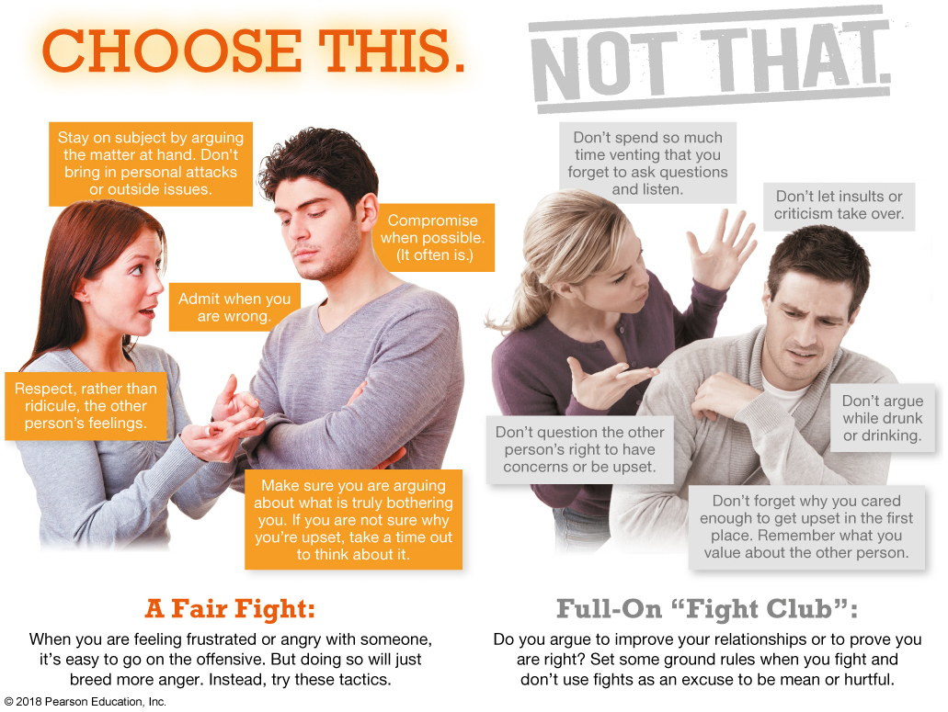

Slide 13
DEVELOPING RELATIONSHIPS

Slide 14
Self-Perception
How we relate to others depends in part on how we feel about ourselves.
People with low self-esteem are more likely to feel lonely and socially isolated.

Slide 15
Early Relationships
The first relationship ever experienced is the family relationship.
Attachment theory: The patterns of attachment in our earliest relationships with others form the template for attachment in later relationships.
A healthy family environment, with respect and nurturing, allows children to learn how to have strong relationships later in life.

Slide 16
Gender Roles
Behaviors and tasks society considers appropriate for men and for women.
Gender roles are often learned in childhood and continue into adulthood, affecting how we communicate.

Slide 17
FRIENDSHIPS

Slide 18
Friendships
Friendships are important for good emotional and physical health.
Research has shown that college students with lower levels of social support are more likely to experience mental health problems and have a sixfold greater risk of depression.
Loneliness is associated with stress and poor life satisfaction.

Slide 19
Maintaining Old Friendships
Friendships can be some of the longest and most fulfilling relationships of your life.
To help maintain friendships under the stress of everyday life
understand that you and your friends are changing.
don’t overwhelm old friends with information about your college life.
keep in touch.
don’t be afraid to reconnect.

Slide 20
INTIMATE RELATIONSHIPS

Slide 21
Intimacy
A sense of closeness with another person formed by being emotionally open and caring.
Sternberg’s Triangular Theory of Love: The type and intensity of love a couple experiences depend on the strength of the intimacy, passion, and commitment in their relationship.
These three factors combine to characterize seven different types of love.

Slide 22
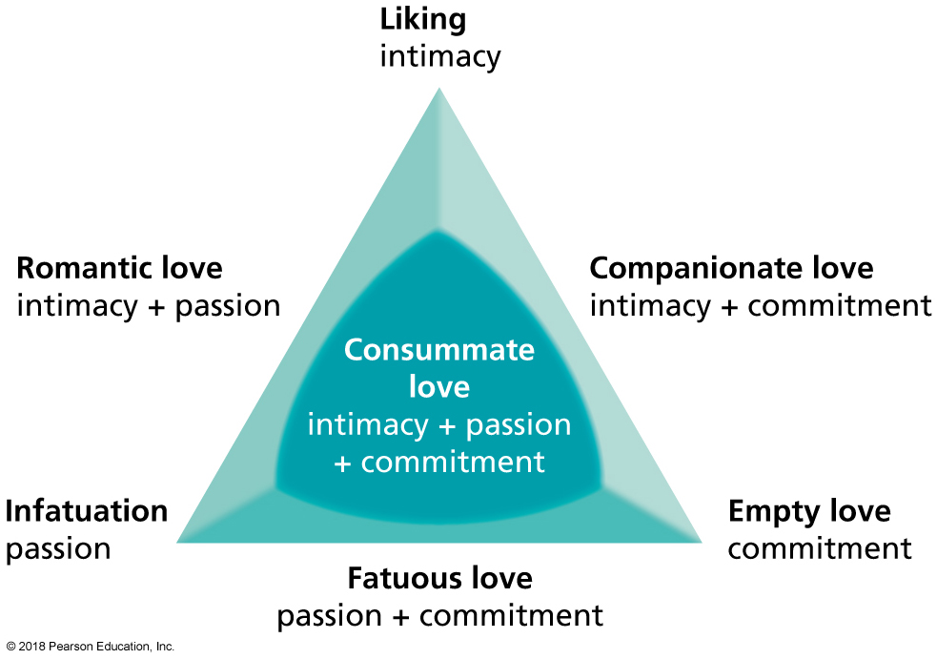
Sternberg’s Triangular Theory of Love
Notes:
FIGURE 10.1 Sternberg’s Triangular Theory of Love.
Source: Sternberg, R. J. (1986). “A Triangular Theory of Love.” Psychological Review, 93(2), 119–135. Reprinted with permission.

Slide 23
What Causes Attraction?
We tend to pick partners who are a lot like ourselves.
Assortative mating: The tendency to be attracted to people who are similar to us.
Who we are and how we behave influence attraction.
Similarity in personality appears to most influence whether the pair will be a happy one.

Slide 24
Dating
Spending time with another person on a one-on-one basis to determine if there is an attraction or desire to see more of each other.

Slide 25
Hooking Up
Casual, noncommittal, physical encounters that may range from kissing and “making out” to oral sex and intercourse.
Hooking up is often fueled by alcohol.
Negative effects include negative impact on psychological well-being and social status, regrets, decreased relationship skills, and sexual risk taking—including increased risk of STIs and unplanned pregnancy.

Slide 26
Online Dating
Online dating sites report millions of users each month.
Match.com
eHarmony
They provide a place where potential partners can both advertise themselves with a personal profile and view the profiles of others looking for partners.
Partners have the ability to build a relationship before a face-to-face encounter.
Use precautions when exploring online dating.

Slide 27
Video: One Woman’s Journey Through 100 Dates

Slide 28
Video: One Woman’s Journey Through 100 Dates
Discussion Questions
What were Elise’s reasons for doing her dating project?
Name some of the guidelines she used on her dates.
What is Elise’s advice to other daters?

Slide 29
Same-Sex Relationships
Long-term same-sex couples are just as committed and satisfied in their relationships as heterosexual married couples.
Such couples often face challenges due to disapproval and discrimination from society or family.
Homosexual: A person who is sexually attracted to someone of the same sex.
Heterosexual: A person who is sexually attracted to someone of the opposite sex.
Homophobia: Fear and hatred of homosexuals.

Slide 30
Healthy Relationships
Successful relationships are built on trust, respect, and communication.
No deep, intimate relationship is without challenges.
Cooperation, compromise, and commitment can help couples through troubled times.

Slide 31
Dysfunctional Relationships
Dysfunctional relationships can come in many forms.
They may include one or both partners being manipulative, controlling, mean, disrespectful, or even verbally or physically abusive.
Such relationship challenges are often learned in childhood when children observe how their parents relate to each other.

Slide 32
Signs of Dysfunctional Relationships
You focus on the other person at the expense of yourself.
You feel pressured to change to meet your partner’s ideals.
Your partner expects you to justify what you do and who you see, or you expect your partner to do so.
One of you makes all the decisions without listening to the other’s input.
You are afraid to disagree, and your ideas are criticized.
You lie to each other.
You feel stifled and trapped, unable to escape the pressures of the relationship.
You or your partner is addicted to drugs or alcohol.
Jealousy: The response to a threat to a relationship from an actual or imagined rival for a partner’s attention.

Slide 33
Physical Abuse
If a partner is physically threatening or abusive to you or your children, remove yourself and the children from the relationship as soon as possible.

Slide 34
When Relationships End
Many relationships eventually end despite our best efforts.
Recovering from a failed relationship takes time and effort.
Talk about it.
Focus on what is good about you.
Take care of yourself.
Let your emotions out.
Do things you normally enjoy.
Keep yourself busy.
Give yourself time to recover.

Slide 35
COMMITTED RELATIONSHIPS

Slide 36
Committed Relationships
Most adults value having a committed relationship with another person.
Committed relationships come in multiple forms:
Cohabitation
Marriage
Domestic partnerships

Slide 37
Cohabitation
The rate of cohabitation (unmarried couples living under the same roof) increased significantly during the last century.
It can allow time to get to know a partner before marriage, or it can be an end unto itself.
Issues of unwed pregnancies, poverty, and relationship instability must be addressed.
Those couples who do get married after cohabitating are more likely to get divorced.

Slide 38
Marriage
Marriage has practical implications, benefits, and obligations.
Benefits include better mental, physical, and financial health.
Half of couples married for the first time will end the relationship with divorce.
Some simply do not believe that marriage is a lifelong commitment.
As expectations for marriage go up, marital satisfaction goes down.

Slide 39
Domestic Partnerships
A legal arrangement in which a couple lives together in a long-term committed relationship and receives some, but not all, of the rights of married couples.
Legal benefits vary widely based on location.
Domestic partnership is an option for homosexual and heterosexual couples who have lived together for a length of time (usually more than a year).

Slide 40
Staying Single
In 2013, one national survey found that about 65% of Americans aged 18-34 had never been married.
Some prefer to focus on education and career.
Rising cohabitation rates mean that many people are choosing to remain legally single while still receiving the benefits of a committed relationship.
Women are much more financially independent and face less pressure to marry for economic stability.
Attitudes about childrearing have changed.
Single people are likely to have networks of important relationships that last years beyond many marriages.

Slide 41
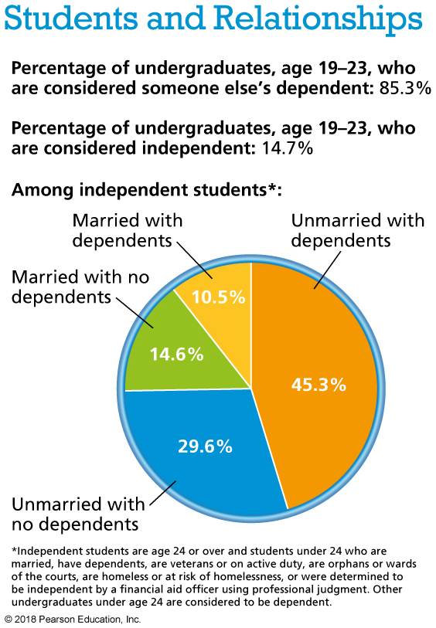
Notes:
Data from U.S. Department of Education. (2014). Profile of undergraduate students, 2011–2012. http://nces.ed.gov.

Slide 42
STARTING A FAMILY

Slide 43
Starting a Family
Birth rates in the United States are at an all-time low.
Women are waiting longer to have children, spacing births further apart, and ending fertility at earlier ages.
Nontraditional families—single-parent households, unmarried-couple households—are on the rise, with their number increasing sixfold since 1950.
In 2015, only 70% of U.S. children lived with two married biological parents.

Slide 44
Choosing to Have Children
Relationship changes.
Changes in relationships with family and friends.
Less time for yourself.
Your health.
Your finances.
Your child-care arrangements.
Parenting styles.

Slide 45
Stepfamilies
About 40% of all American marriages are a remarriage for at least one of the spouses, and many of these families include children from prior relationships.
Blended families have become commonplace in modern society.
Three fourths of divorced adults go on to remarry.
In 65% of these remarriages, one or both partners have children from a previous relationship.
It can take several years for family members to integrate, and the effort is not always successful.
Setting realistic expectations and encouraging open communication can help.

Slide 46
Single Parenthood
About 40% of children today are born to unmarried mothers
Most often, single parents are female.
One of the biggest hurdles faced by single mothers is economic hardship.
Research is mixed on whether being raised in a single-parent household is detrimental to children.

Slide 47
Characteristics of Happy Families
Commitment: They are dedicated to the family and promote one another’s happiness by being honest, faithful, and dependable.
Appreciation and affection: They care for one another and are not afraid to express it.
Positive communication: They are good talkers and good listeners.

Slide 48
Characteristics of Happy Families (cont.)
Time together: They spend quality time together as often as they can.
Spiritual well-being: They have hope, faith, and compassion, as well as shared ethical values.
The ability to manage stress and crises.

Slide 49
Change Yourself, Change Your World
Personal choices:
Stay true to who you are.
Respect others for who they are.
Learn to give and receive.
Lighten up.
Campus advocacy:
Keep the lines of communication open.
Initiate conversation
Words are not the most important part of human communication.
Empathize
Join a campus organization that promotes tolerance (NEADS, Campus Pride).
Explore new options.

