Slide 1
Chapter 1: Health in the 21st Century
Lecture Outlines by
Sloane Burke Winkelman
California State University, Northridge

Slide 2
Did You Know?
The current life expectancy at birth in the United States is 78.8 years.
Heart disease and cancer are responsible for nearly half of all deaths in the United States.
Poor nutrition, inadequate physical activity, obesity, tobacco use, and alcohol abuse are the factors most strongly linked to premature death.

Slide 3
Learning Outcomes
LO 1.1 Discuss the evolution of our current understanding of health.
LO 1.2 Identify and describe seven dimensions of health.
LO 1.3 Discuss health challenges across America and around the world.
LO 1.4 Classify determinants of health into six broad groups identifying the group that is most strongly within an individual’s control.
LO 1.5 Explain how predisposing, enabling, and reinforcing factors can promote or hinder behavior change.
LO 1.6 Compare three models of behavior change.
LO 1.7 List seven steps for achieving successful behavior change and two strategies for preventing relapse.

Slide 4
HEALTH MATTERS

Slide 5
What Is Health?
A state of well-being that encompasses physical, social, psychological, and other dimensions and is a resource for everyday life.
More than merely the absence of disease.
Lifestyle choices have a profound influence on health.
A disease is an alteration in body structure of biochemistry that is significant enough to cause the body’s regulatory mechanisms to fail. Symptoms may or may not be present.

Slide 6
Health Versus Wellness
Wellness is an active process through which people become aware of, and make choices toward, a more successful existence.
Your general direction on the continuum matters more than your specific point on it at any given time.

Slide 7
The Illness–Wellness Continuum
Notes:
FIGURE 1.1 The Illness–Wellness Continuum.
Your general direction on the continuum matters more than your specific point on it at any given time. Source: Adapted from “Illness–Wellness Continuum” from Wellness Workbook: How to Achieve Enduring Health and Vitality, 3rd edition, by John W. Travis, MD, and Regina Sara Ryan. Copyright © 1981, 1988, 2004 by John W. Travis. Adapted and reprinted with permission.

Slide 8
Dimensions of Health
Physical health: How well your body functions, and how well you care for it.
Intellectual health: A willingness to take on new intellectual challenges, openness to new ideas and skills, a capacity to think critically, and a sense of humor and curiosity.
Psychological health: Autonomy, self-acceptance, and the ability to maintain nurturing relationships and to pursue meaningful goals.
Spiritual health: Influenced by your beliefs and values and the way in which you express them.

Slide 9
Dimensions of Health (cont.)
Social health: The quality of interactions and relationships with others.
Environmental health: The quality of home, work, school, and social environments—as well as the health of our planet.
Occupational health: The quality of your relationship to your work.

Slide 10
Dimensions of Health and Wellness
Notes:
FIGURE 1.2 Dimensions of Health.
More than just the absence of disease, health encompasses multiple dimensions of life.

Slide 11
CURRENT HEALTH CHALLENGES

Slide 12
Health Across America
Life expectancy is the average number of years a person may expect to live.
The current life expectancy at birth in the United States is 78.8 years.
This is nearly 15 years longer than the life expectancy in 1940.

Slide 13
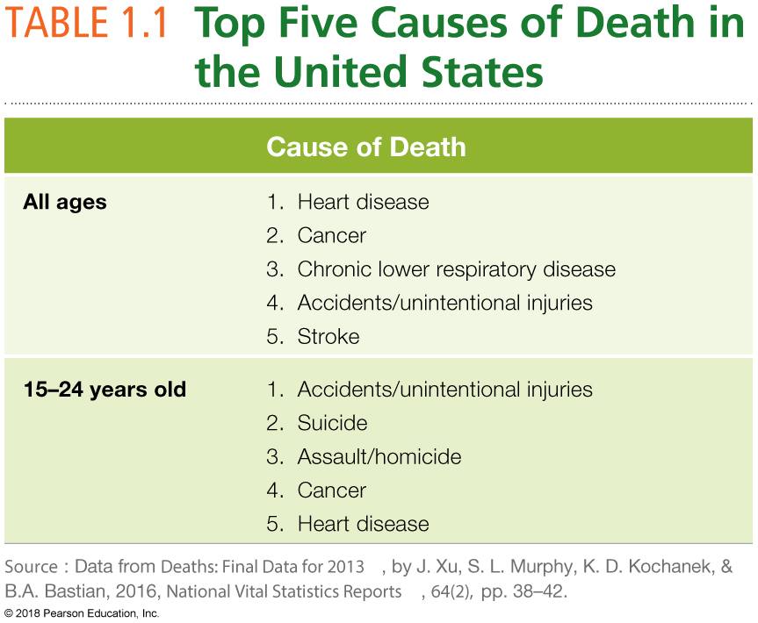

Slide 14
America’s Health Challenges
In 2012, just two chronic diseases—heart disease and cancer—were responsible for almost half (46.5%) of all deaths in the United States.
Our chronic disease morbidity—the rate of chronic disease within our population—is about 50%.
The CDC has identified four common behaviors that are responsible for most of the suffering and early death related to chronic disease:
Lack of physical activity
Poor nutrition
Tobacco use
Drinking too much alcohol

Slide 15
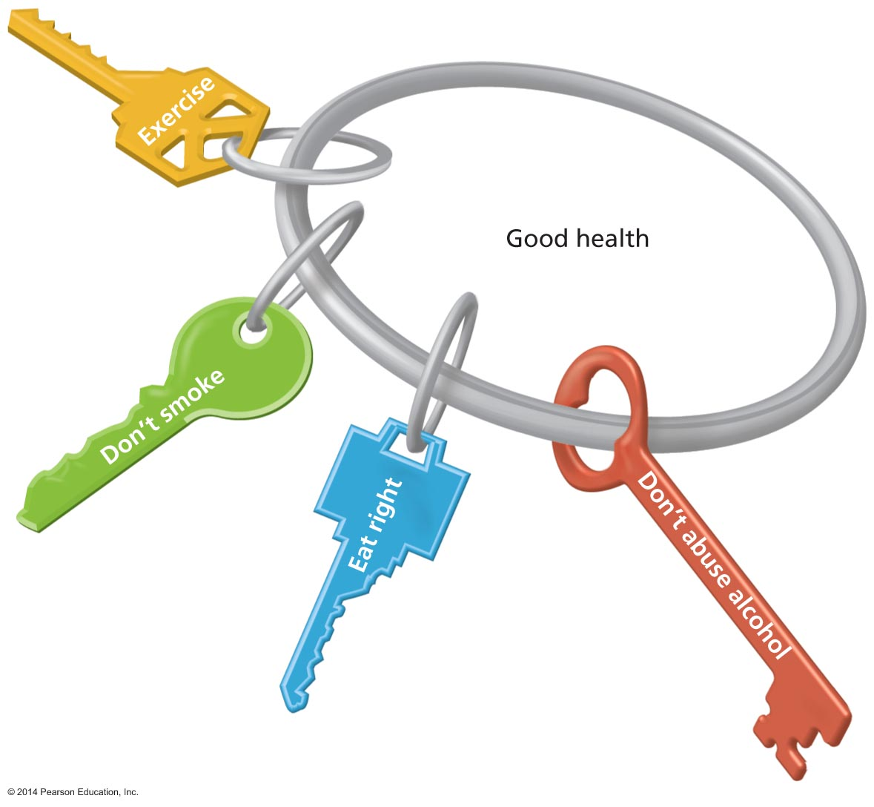
Four Keys to Good Health
Notes:
FIGURE 1.3 Four Keys to Good Health.
These four behaviors can significantly reduce your risk of chronic disease and early death.

Slide 16
The Healthy People Initiative
A federal initiative to facilitate broad, positive health changes in large segments of the U.S. population whose goals are revised every 10 years.
One of the primary goals of the Health People initiative is to achieve health equity—the attainment of the highest level of health for all people—and to eliminate health disparities—differences in the rate and burden of disease and the access to and qualify of health care among various population groups.

Slide 17
Health on America’s Campuses
Centers of higher learning, as microcosms of our larger society, have come to recognize that promoting students’ health helps the institution meet its goal of providing the best education possible.
Stress, sleep deprivation, poor nutrition, depression, anxiety, alcohol and tobacco use, and sexually transmitted infections are just a few of the health issues that can affect academic performance and achievement.
Healthy Campus is an offshoot of Healthy People specifically for college students.

Slide 18
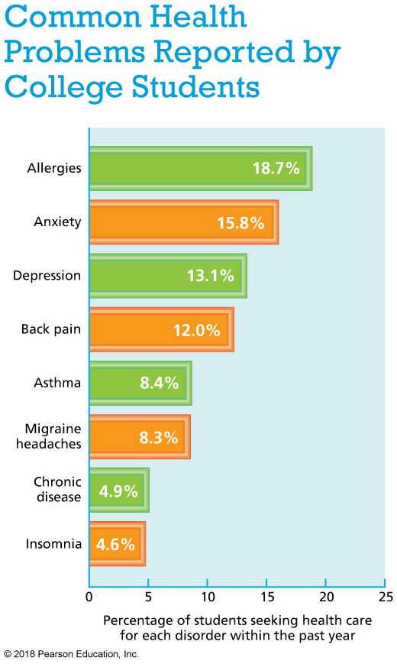
Notes:
Data from American College Health Association National College Health Assessment (ACHA-NCHA II) Reference Group Executive Summary, Spring 2015, by the American College Health Association, 2015, retrieved from www.acha-ncha.org.

Slide 19
Health Around the World
Limiting the spread of infectious diseases like Ebola and Zika are an urgent concern.
Nutritional deficiencies, cholera, HIV/AIDS, and drug-resistant TB are still an issue.
Chronic diseases such as heart disease, diabetes, and cancer are also a concern.

Slide 20
DETERMINANTS OF HEALTH

Slide 21
Determinants of Health
The range of personal, social, economic, and environmental factors that influence health status.
Determinants of health fall under six broad categories:
Biology and genetics
Individual behaviors
Social determinants
Physical determinants
Health services
Policy-making

Slide 22
Biology and Genetics
Deoxyribonucleic Acid (DNA): A compound in the nucleus of living cells that transfers genetic information.
Gene: A segment of DNA that codes for the assembly of a protein.
Sex: The biological and physiological differentiators between males and females have a powerful role in health.
Age: Children and the elderly can be more susceptible to certain health problems.

Slide 23
Biology and Genetics (cont.)
Race/ethnicity: Certain populations have a higher risk for certain diseases.
Health history: Past conditions may be still influencing your health today.
Family history: You and your children’s risk for developing some of the same diseases that other members of your family have (example depression).

Slide 24
Video: Your Medical History

Slide 25
Video: Your Medical History
Discussion Questions
Examine the importance of knowing your family’s medical history. Which diseases and disorders must we be aware of to determine our genetic predisposition to developing certain diseases and disorders?
Why is it important to know your family medical history? Cite specific reasons in your answer.
How do we begin the process of discovering family medical history? What methods can you employ when approaching family members regarding medical history?
Discuss specific questions you would ask about family members to determine your own risk.

Slide 26
Individual Behaviors
Five modifiable behaviors that are responsible for the majority of premature deaths in the United States:
Tobacco use
Poor diet
Physical inactivity
Alcohol abuse
Drug abuse

Slide 27
Social Determinants
Economic and societal conditions in which people live
Examples: Interpersonal and community relationships, discrimination, poverty, educational and job opportunities, transportation, and public safety
Status syndrome: The disparity in health status and rates of premature mortality between the impoverished and the affluent

Slide 28
Physical Determinants
Natural environment (e.g., plants, climate)
Built environment (buildings, spaces, products made by people)
Presence or absence of toxic substances and other physical hazards

Slide 29
Health Services
Availability and access to health services
Health literacy: The ability to evaluate and understand health information and make informed choices for your health care.
Reading, understanding, and following health instructions
Asking questions and analyzing information

Slide 30
Policy-Making
Policies at the local, state, and federal levels
Examples: Establishing speed limits, seat belt laws, and outlawing texting while driving

Slide 31
WHAT FACTORS INFLUENCE BEHAVIOR CHANGE?

Slide 32
What Factors Influence Behavior Change?
We often have a good idea of what choices we ought to be making but actually doing these things and achieving lasting behavior change is the hard part.

Slide 33
Factors That Can Help or Hinder Your Health Behavior
Predisposing factor: A physical, mental, emotional, or surrounding influence that affects the likelihood that a person will decide to change a current behavior.
Enabling factor: A skill, social support, or resource that makes it possible (or easier) to succeed in changing a targeted behavior.
Reinforcing factor: An influence that either rewards or opposes a change effort in progress.

Slide 34
How Does Behavior Change Occur?
Over many decades, public health researchers have proposed various models of processes by which they believe lasting behavior change happens.
The most established models are:
The transtheoretical model
Health belief model
Ecological model

Slide 35
Transtheoretical Model
Also called the Stages of Change model.
Model of behavior change that focuses on decision-making steps and abilities.
Notes:
FIGURE 1.5 The Transtheoretical Model of Behavior Change. Developed by James Prochaska, this model outlines six stages of behavior change.

Slide 36
Transtheoretical Model: Six Stages of Change
Precontemplation: Has no intention of addressing a problem in the next six months.
Contemplation: Acknowledges a problem; thinking about making a change within the next six months.
Preparation: Intends to make a change within one month and has a plan in mind.
Action: Modifies a behavior in an observable way.
Maintenance: Has maintained a behavior for six months or more and works to prevent relapse.
Termination: Successful behavior change.

Slide 37
The Health Belief Model
A model of behavior change that emphasizes the influence of personal beliefs on the process of creating effective change.
Identifies four factors as instrumental in explaining or predicting behavior change.

Slide 38
The Health Belief Model (cont.)
Perceived threat: You perceive a threat.
Perceived severity: You understand that this threat could have serious consequences in terms of pain, lost work time, financial loss, etc.
Perceived benefit: You believe that the benefits of making the behavior change will outweigh the costs, inconveniences, and other challenges and that the change is possible for you to make and maintain.
Cues to action: You have an experience that causes you to commit to making the change. For example, a young person at risk for diabetes might witness a parent attempting to cope following a foot amputation that resulted from the disease.

Slide 39
Ecological Models
The coordination of multiple factors at different levels, from individual to societal, promotes successful behavior change.

Slide 40
An Ecological Model of Behavior Change
Notes:
FIGURE 1.6 An Ecological Model of Behavior Change. The coordination of multiple factors at different levels, from individual to societal, promotes successful behavior change.

Slide 41
CHANGE YOURSELF, CHANGE YOUR WORLD

Slide 42
Personal Choices: Seven Steps
Step 1: Get informed.
Step 2: Set a SMART (Specific, Measurable, Attainable, Relevant, Time based) goal.
Step 3: Make a plan.
Step 4: Identify barriers and how you’ll overcome them.
Step 5: Recruit some support.
Step 6: Promise yourself rewards.
Step 7: Commit in writing.

Slide 43
Preventing Relapse
Relapse: A return to the previous state or pattern of behavior.
Cue control.
Counter-conditioning.

Slide 44
Campus and Community Advocacy
Working independently or with others to directly improve aspects of the social or physical environment or to change policies or legislation.
Get better informed about issues.
Meet with campus faculty or staff to share your concerns.
Use social networking to heighten awareness.
Write about the issue for campus news services.
Speak about the issue at campus gatherings.
Organize a letter-writing campaign to your dean of students.
Join a campus organization that is already working on the issue.

