Slide 1
Chapter 17: Aging Well
Lecture Outlines by
Sloane Burke Winkelman
California State University, Northridge

Slide 2
Did You Know?
Approximately 1 in every 7 people in the United States is age 65 or older.
About 43% of noninstitutionalized older people in the United States rate their health as very good or excellent.
The 55-and-older crowd is the fastest-growing age group on Facebook.

Slide 3
Learning Outcomes
LO 17.1 Discuss how life expectancy in the United States has increased in the past century.
LO 17.2 Describe the physical and psychosocial changes that typically accompany aging.
LO 17.3 Identify at least five key strategies for aging successfully.
LO 17.4 List four definitions of death, and explain how people develop a concept of death.
LO 17.5 Compare and contrast the available options when planning for the end of life.
LO 17.6 Describe the practical tasks and grieving process that follow the death of a loved one.
LO 17.7 Explain how to to support someone who is dying or grieving.

Slide 4
AGING IN THE UNITED STATES

Slide 5
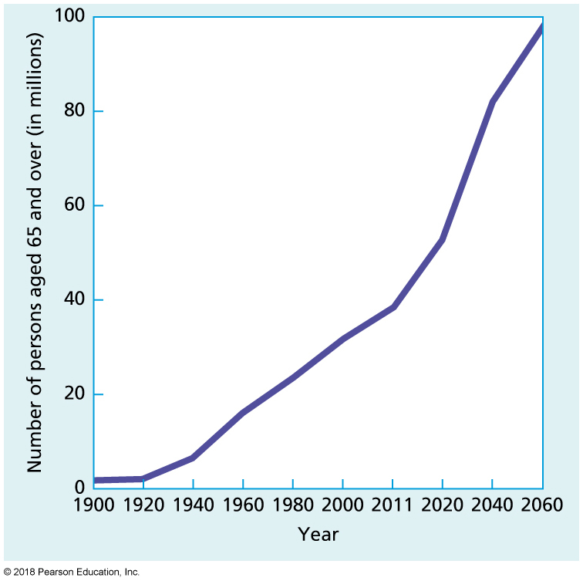
Number of Older People in the U.S. Population, 1900–2060
Notes:
FIGURE 17.1 Number of Older People in the U.S. Population, 1900–2060.
Source: Data from Administration on Aging. (2016). A profile of older Americans: 2014. www.aoa.acl.gov.

Slide 6
Trends in Health and Health Care
Key aspects of aging—health and wellness—are changing:
Most older people give a positive report on their overall health.
Most older Americans have at least one chronic health condition.
Older Americans use more health care than any other age group, and their out-of-pocket spending on health care averages more than $5,000.

Slide 7
Life Expectancy
The length of time a person can expect to live, usually measured in years.
Average life expectancy is 78.8 years.
United States comes in at number 43, with the top 15 countries experiencing a life expectancy of 82 years or more.

Slide 8
Gender and Longevity
The gender-based longevity gap, in which women generally live longer than men, is not unique to the United States.
A few critical reasons explain women’s longer lives:
Delayed cardiovascular risks.
Sex chromosomes.
Fewer risk-taking behaviors.
Lower rate of smoking.
More effective health management techniques.

Slide 9
WHAT HAPPENS AS YOU AGE?

Slide 10
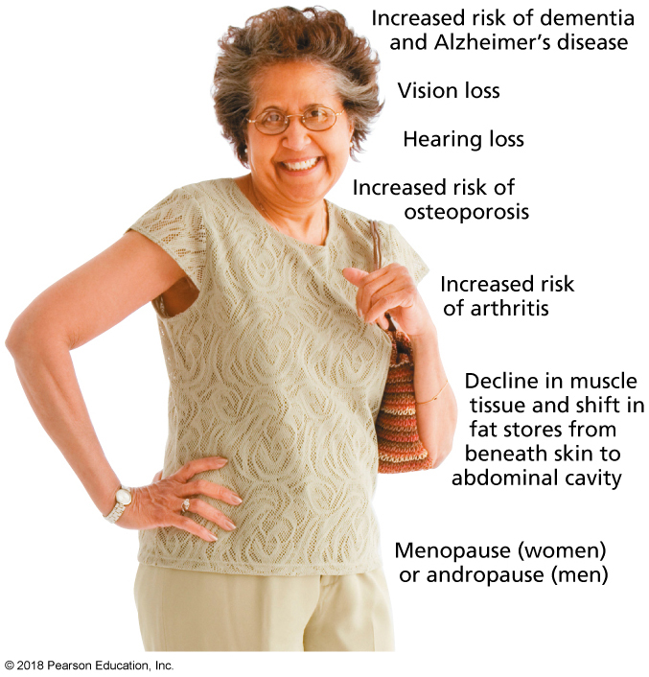
Physical Changes Due to Aging
Notes:
FIGURE 17.2 Physical Changes Due to Aging.

Slide 11
Hearing Loss
Presbycusis: Age-related hearing loss, which usually develops gradually, is often due to damage to or changes in the inner ear.
It varies from person to person.
Hearing loss should be tested and treated.
Mechanical devices and surgery may help with hearing loss.

Slide 12
Vision Loss
Presbyopia: Age-related decline in the ability to focus on objects up close, especially in low light.
Cataracts: Age-related vision disorder marked by clouding of the lens of the eye.
Glaucoma: Age-related vision disorder arising from an increase in internal eye pressure that damages the optic nerve and reduces peripheral vision.
Age-related macular degeneration (AMD): Vision disorder caused by deterioration of the macula, which reduces central vision.

Slide 13
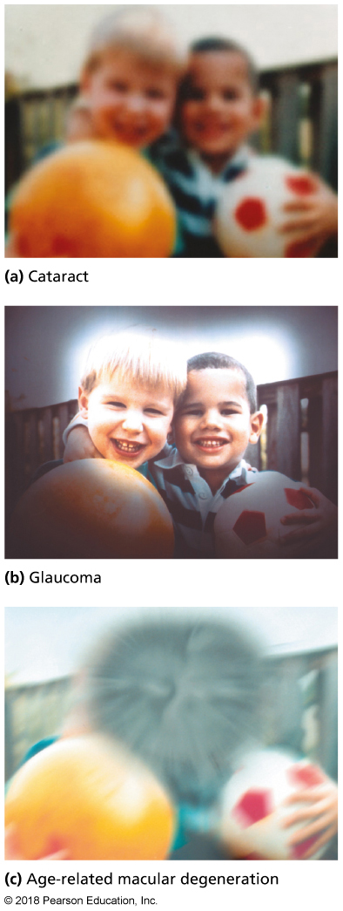
Vision Problems Common to Aging
Notes:
FIGURE 17.3 Vision Problems Common to Aging.

Slide 14
Chronic Diseases
Arthritis: Inflammation of one or more joints in the body, resulting in pain, swelling, and limited movement.
Affects 52 million adults—about 23% in the United States.
Osteoporosis: A disease characterized by low bone mass and deterioration of bone tissue, leading to fragile bones and an increased risk of fractures.

Slide 15
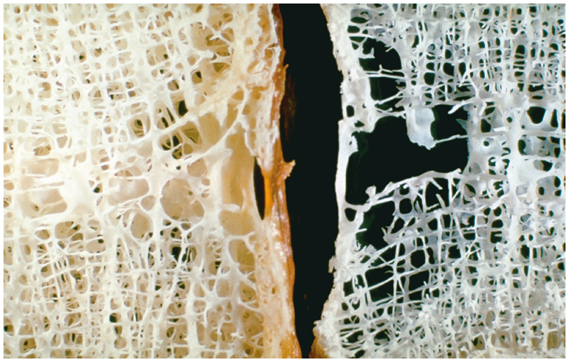
Effects of Osteoporosis on the Vertebrae of the Spine
Notes:
FIGURE 17.4 Effects of Osteoporosis on the Vertebrae of the Spine. Vertebral bone tissue of a person with osteoporosis (right) and of a healthy person (left).

Slide 16
Menopause
The permanent end of a woman’s menstrual cycle and reproductive capacity.
Some women may experience unpleasant side effects, which can be treated as follows:
Psychotherapy to help combat fears.
Hormone therapy (HT).
Vaginal estrogen.
Bone-building medications.
Antidepressants.
Avoiding hot flash triggers.
Quitting smoking and exercising regularly.

Slide 17
Andropause
Also known as male menopause.
Period marked by a decline in the male reproductive hormone testosterone and its resultant physical and emotional effects.
Symptoms:
Changes in sexual functioning.
Physical changes (increase in fat, decreased muscle strength).
Poor sleep quality (including insomnia or hypersomnia).
Depressed mood (depression, difficulty concentrating).
Increased risk of insulin resistance

Slide 18
Sexuality
54% of men and 31% of women over 70 remain sexually active.
Ageism is prejudice or discrimination against older adults.

Slide 19
Changes Affecting Cognition and Memory
Dementia is a group of symptoms caused by disorders that affect memory, cognitive function, personality, and social skills.
Alzheimer’s disease (AD) is a progressive, fatal form of age-related dementia.
Affects 5 million (1 in 8) people in the United States.
Risk factors:
Age.
Genetics.
Poor health.
Lifestyle factors.

Slide 20
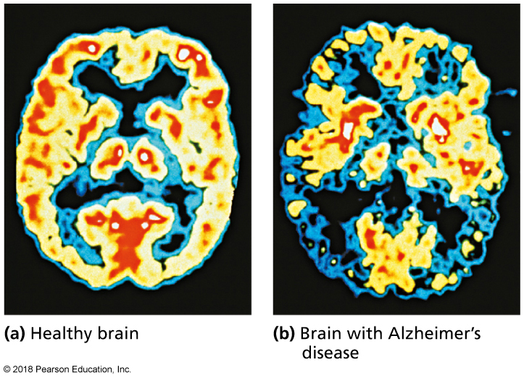
Brain Activity and Alzheimer’s Disease
Notes:
FIGURE 17.5 Brain Activity and Alzheimer’s Disease. Reds and yellows indicate high activity in tissues; blues and greens represent lower activity in tissues.

Slide 21
Psychosocial Changes
Various life changes can affect older adults:
Family changes (e.g., empty nest syndrome).
Changes in residence.
Changes in employment.
Economic changes.
Mood changes.
Substance abuse and polypharmacy (the use of multiple drugs that may potentially interact in dangerous ways).

Slide 22
WHAT ARE THE KEYS TO SUCCESSFUL AGING?

Slide 23
Physical Activity
Two hours and 30 minutes of moderate-intensity aerobic activity each week AND muscle strengthening activities OR
One hour and 15 minutes of vigorous-intensity aerobic activity OR
An equivalent mix of moderate- and vigorous-intensity aerobic activity AND muscle-strengthening activities

Slide 24
Good Nutrition
Reduce calorie intake by choosing nutrient-dense foods that are high in fiber.
Consume adequate calcium, iron, zinc, and vitamins D and B₁₂.
Limit sodium intake.
Make half of each day’s diet consists of colorful, high-fiber fruits and vegetables.
Choose whole grains.
Choose lean sources of protein.
Drink plenty of water to prevent constipation.
Limit alcohol intake: no more than one drink per day for women, and two drinks per day for men.

Slide 25
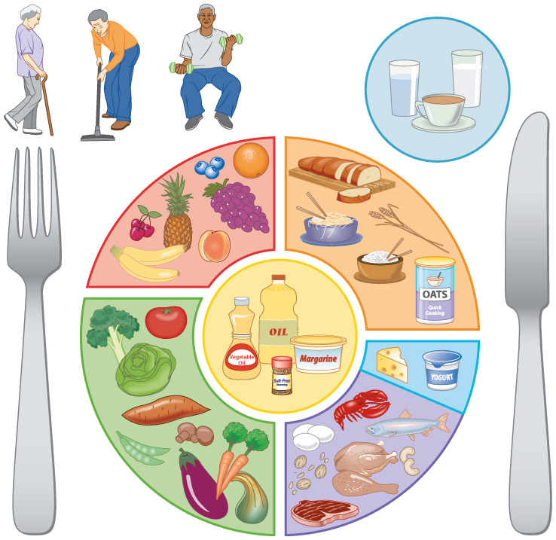
MyPlate for Older Adults
Notes:
FIGURE 17.6 A Nourishing Diet Contributes to Successful Aging. This adaptation of the USDA MyPlate illustrates nutritious food and fluid choices for older adults.

Slide 26
Other Factors for Successful Aging
Weight management
Avoiding tobacco
Mental exercise
Meaning, Purpose, and Connection

Slide 27
UNDERSTANDING DEATH AND DYING

Slide 28
What Is Death?
Brain death: Cessation of brain activity as indicated by various medical devices and diagnostic criteria.
Functional death: End of all vital physiological functions, including heartbeat, breathing, and blood flow.
Cellular death: End of all vital functions at the cellular level, such as cellular respiration and other metabolic processes.
Clinical death: A medical determination that life has ceased, according to medical criteria that combine aspects of functional and neurological factors.

Slide 29
How Do We Develop Our Concepts of Death and Dying?
Stage of development
Sociocultural factors

Slide 30
PLANNING FOR THE END OF LIFE

Slide 31
Complete Advanced Directives
Advance directives: Legal documents allowing a person to specify personal treatment preferences in case of a medical crisis.
Health-care proxy: A document that gives someone else the power to make health decisions on your behalf.

Slide 32
Completing Advance Directives
Living will: States a person’s wishes for medical treatment near the end of life.
Do not resuscitate (DNR) order: Instructs a person’s health-care provider not to restart a person’s heart or lungs.

Slide 33
Consider Organ Donation
If you are 18 or older, you can choose to be an organ donor.
Thousands (121,000 in 2013) of people in the United States are currently awaiting a donated organ.

Slide 34
Write a Will
A will is a legally binding document stating what should be done with a person’s property after death.
Estate: A person’s personal holdings, including money, property, and other possessions.
Intestate: Dying without leaving a legal will or similar document.
Most adults in the United States don’t have a will.
Wills vary greatly in complexity.

Slide 35
Research Your Options for End-of-Life Care
Palliative care focuses on reducing pain and suffering and caring for the whole person, rather than prolonging life or curing disease.
Home care is not always possible near the end of life, although most older Americans say they would prefer to die at home.
Hospital-based care is likely near the end of life.
Hospice care is a home-care program or facility that focuses exclusively on the dying and their loved ones, with the goal of providing comfort rather than facilitating a cure.

Slide 36
Clarify Your Beliefs and Values
Rational suicide: Action taken deliberately by a reasoned, terminally ill patient to hasten his or her own death.
Passive euthanasia: A failure to begin or to maintain an intervention that is necessary to sustain a patient’s life.

Slide 37
Video: The Conversation: A Family’s Private Decision

Slide 38
Video: The Conversation: A Family’s Private Decision
Discussion Questions
What are the benefits of having a conversation about end of life choices with your family? What are the drawbacks of not having this type of conversation?
Describe “The Conversation Project.”
Have you talked about end of life choices with your family members? If so, would you recommend it to others? If not, does this video inspire you to do so?

Slide 39
AFTER A DEATH

Slide 40
Autopsy
A medical examination of a corpse that primarily attempts to identify the cause of death.
Approximately 10% of U.S. deaths are followed by an autopsy.

Slide 41
Care of the Body
By law, bodies can be buried or cremated.
Burial can cost a few hundred to a few thousand dollars, depending on the preferences of the deceased or the family.
Cremated remains can be scattered, buried, or preserved in a memorial urn or box.
Cremated remains carry no environmental or health risk.

Slide 42
Planning a Service
Many survivors choose to hold one or more formal services:
Wake.
Funeral.
Memorial service.

Slide 43
Experiencing Grief
Disbelief, especially if a death is sudden or unexpected.
Yearning, reflecting the desire to have the person back.
Anger, directed at everything from the death itself to the events surrounding the death.
Depression, which pervades daily life as the reality of the death sets in.
Acceptance, blending together the joys of the person’s life and the changes following loss into a new perspective.

Slide 44
Effects of Grief on Health
Death of a spouse or close family member is widely acknowledged as one of the top stressors a human being can experience.
Effects of grief on health may include:
External symptoms.
Cardiac symptoms.
Psychosocial symptoms.
Social support is key for a grieving person.

Slide 45
Change Yourself, Change Your World

Slide 46
Supporting a Loved One Who Is Dying
Denial: The patient refuses to accept the validity of the diagnosis.
Anger: May be directed at the diagnosis, physician, family members, self, or God.
Bargaining: Attempting to avoid or delay death by service or repentance or service to others.
Depression: May be either brief or prolonged; may be marked by withdrawal from loved ones.
Acceptance: The patient stops rejecting or fighting the diagnosis.

Slide 47
Campus Advocacy
Approximately 3 million students are older than age 35.
Reach out to older students to learn more about them.
Join AMF (Actively Moving Forward).

