Slide 1
Announcements
Exam 2 – Next week!
Opening on 10/19, through 10/25
Review content from chapters 4, 5, and 6 (with more on chapters 4 and 6)
Attend most heavily to theories and models discussed in class lectures
Also feel comfortable with many terms/competencies discussed in chapter 6 lecture, guest speaker presentations of Dillon Waggoner and Ellen Lucas
Resume and Career/Character Skills Assignments
Due October 25th
New video posted from Ellen Lucas, discussing career/character skills assessment tools (links to an external BOX folder – let me know if problems!)
Informational interview assignment presentation coming from me next week!
Don’t forget – ethics discussion board response to a peer due tomorrow!

Slide 2
The Health Education Specialist: Roles, Responsibilities, Certifications, & Advanced Study
Chapter 6

Slide 3
Quality Assurance in Professions
Quick Journal Writing:
In what areas of “work” do professionals need special licensure?
Why is this necessary?
Necessary to provide confidence
Ensure that product or service will meet given requirements
To keep from creepers like this guy -

Slide 4
Credentialing
Individual or professional preparation program
Meets specified standards, established by credentialing body
Gives awardee a formal recognition
Accreditation, licensure, certification

Slide 5
Accreditation
Public recognition
Accrediting body grants to an institution
Council for Education on Public Health
Meets very specific requirements
Self study & report, site visit
IUPUI, IU-Bloomington are ACCREDITED undergraduate public health programs, Purdue is NOT.

Slide 6
Licensure
Agency or govt. (usually state) grant permission
Indiana Professional Licensing Agency
To individuals to practice a profession
Deeming those licensed have specific standards of competence

Slide 7
Certification
Professional org. grants recognition to an individual
Upon completion of a curriculum
Can demonstrate a standard of performance

Slide 8
The certification of Health Educators occurred in response to:
Growing marketplace interest in & demand for health education
Professional organizations = concerned about professional standards & quality assurance
Universities = caught between marketplace, professional organizations, & their institutions

Slide 9
History
National Task Force on the Preparation & Practice of Health Education
Established in 1978
Verify & refine role of Health Educators
Create a curriculum framework
Entry-Level Framework, 1985
First CHES exam given - 1990
Graduate-Level Framework, 1999
CUP Model, 2006 (competencies update project)
HE Job Analysis Model, 2010

Slide 10
National Commission for Health Education Credentialing, Inc.
Est. 1988
3 main purposes
Certify HE specialists
Promote professional development
Strengthen professional education

Slide 11
CHES
Certified Health Education Specialist
Master CHES (M-CHES)
Worked in the field for a minimum of five years, passes the MCHES exam
Eligibility:
BS/MS/PhD = HE major & official transcript

Slide 12
Overall Benefits of CHES
Establishes national standard
Attests to individual’s knowledge & skills
Assists employers in ID qualified HE practitioners
Sense of pride & accomplishment
Promotes continued professional development

Slide 13
Benefits of CHES: To the Employer
Provides 1 measure of competence
Marketing tool
Evaluation of employment applications
Delineates scope of practice
Enhances agency image

Slide 14
Benefits of CHES: To the Profession
Enhance prestige & image
Promotes value of profession
Increases external verification & accountability
Defines roles & functions

Slide 15
Benefits of CHES: To the Institution & Program
A large number of students of a program who receive their CHES following graduation:
Increases respectability
Enhances prestige & image
Enhances reputation
Increases recruitment potential

Slide 16
Benefits of CHES: To the Practitioner
Increases respectability
Establishes proprietary right to practice
Enhances professionalism
Provides competitive edge in job search
Enhances opportunities for promotion
Facilitates self-eval of knowledge & skills
Improves mobility of practitioner
Increases commanded salaries
Promotes knowledge & skills through continuing ed requirement

Slide 17
National Commission for Health Education Credentialing, Inc.
1541 Alta Drive, Suite 303
Whitehall, PA 18052-5642
1-888-624-3248
www.nchec.org

Slide 18
Competencies of Health Educators
Your curriculum and the CHES questions match to specific competencies established as significant by the profession:
Area I: Assess Needs, Resources and Capacity for Health Education/Promotion
Area II: Plan Health Education/Promotion
Area III: Implement Health Education/Promotion
Area IV: Conduct Evaluation and Research Related to Health Education/Promotion
Area V: Administer and Manage Health Education/Promotion
Area VI: Serve as a Health Education/Promotion Resource Person
Area VII. Communicate, Promote, and Advocate for Health, Health Education/Promotion, and the Profession

Slide 19
National Health Educator Competencies Update Project
6 year study (1998-2004)
3 levels of practice (entry, advanced 1, advanced 2)
NCHEC reviewed CUP findings – revised the CHES exam

Slide 20
Academic Degrees
Undergraduate Degrees = BA, BS
Master’s Degrees = MA, MS, MSPH, MPH
Doctoral Degrees = PhD, EdD, DrPH

Slide 21
Assessing Graduate Programs
Reputation of institution
Reputation of department
Alumni
Affiliations, contracts, grants

Slide 22
Ethics & Health Education/Promotion
Chapter 5

Slide 23
Ethics Activity
Let’s Chat
2 sample scenarios – can someone briefly describe each?
What makes coming to a comfortable decision difficult across each case?
What factors did you consider as you came to your decision in the case you selected?
What about the case? Your own personal values/ethics? Your own previous experiences?
Was there other information about the situation that you would’ve liked to have known?

Slide 24
The key take away -
There are MANY situations and contexts within the field of health education and promotion where your own personal and professional ethics will be challenged.
There are no perfect guidebooks and rules for how to react in said cases – every person is different, every situation is different.
BUT –
There are some processes that might help you engage in more thoughtful and reasoned decision-making, AND
The professional code of ethics for health educators can help guide (and protect) you as you face these difficult moments.

Slide 25
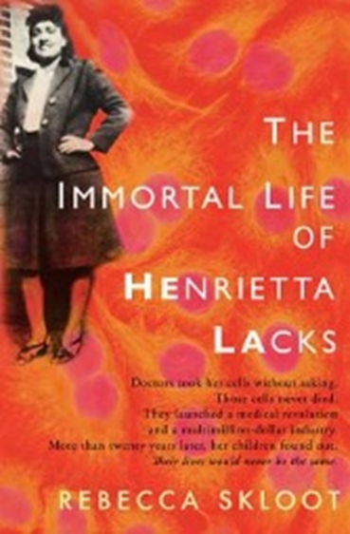
Ethical Theories
Formalism = Every act is either right or wrong, regardless of situation or context, based on moral duty (individual ethics)
Consequentialism = Do the ENDS justify the means? (common good)
One case of formalism vs. consequentialism – the story of Henrietta Lacks

Slide 26
Basic Principles for Common Moral Ground
Value of Life
Goodness (Rightness)
Beneficence
Non - Maleficence
Justice (Fairness)
Truth Telling (Honesty)
Individual Freedom (Equality Principle or Principle of Autonomy)

Slide 27
When making ethical decisions, we need a sense of:
Place
Time
Identity
Social Relationships
The Ideal
The Concrete
Seriousness

Slide 28
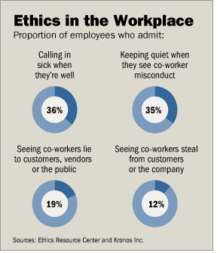
Professional Ethics & Health Education
Advocating actions that are right/wrong
General workplace behavior
Professional socialization – teaches us appropriate professional behavior
Research ethics
http://www.nature.com/news/controversial-patient-consent-proposal-left-out-of-research-ethics-reforms-1.21330

Slide 29
Ethical Issues & Health Education
Obligations:
Between professionals & clients
To 3rd parties
Between professionals & employers
To the profession

Slide 30
Ethical Issues - Health Educators & Clients
Blaming the victim
Try to change people rather than the environment
Use public policy or coercive strategies to change health behavior
Overemphasize behavior change
Educate public on the concept of risk – which may take away personal freedoms

Slide 31
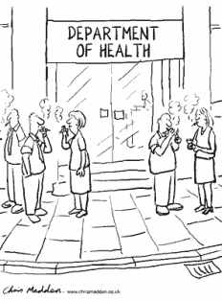

Slide 32
Steps in Ethical Decision Making
Define problem, ID ethical issues, seek answers to ?s
ID who will be affected
Ultimate goals & ideals
ID alternatives (viable courses of action)
Consider consequences of each alternative

Slide 33
Steps in Ethical Decision Making (Continued)
Consider the nature of the alternatives
Reflect on yourself
Reflect on society & your environment
Apply the categorical imperative (overarching rules for morals and ethics, applied in the same way across all cases)
Choose & act on your choice & monitor & evaluate the results

