Slide 1
Chapter 4, Day 2 Planning Models

Slide 2
Planning Models Give us insight into the program planning process
Just a sample of them today – a variety of others are discussed in your textbook:
PRECEDE/PROCEED
Social Marketing Assessment & Response Tool (SMART)
See CYNERGY and MATCH in your textbook

Slide 3
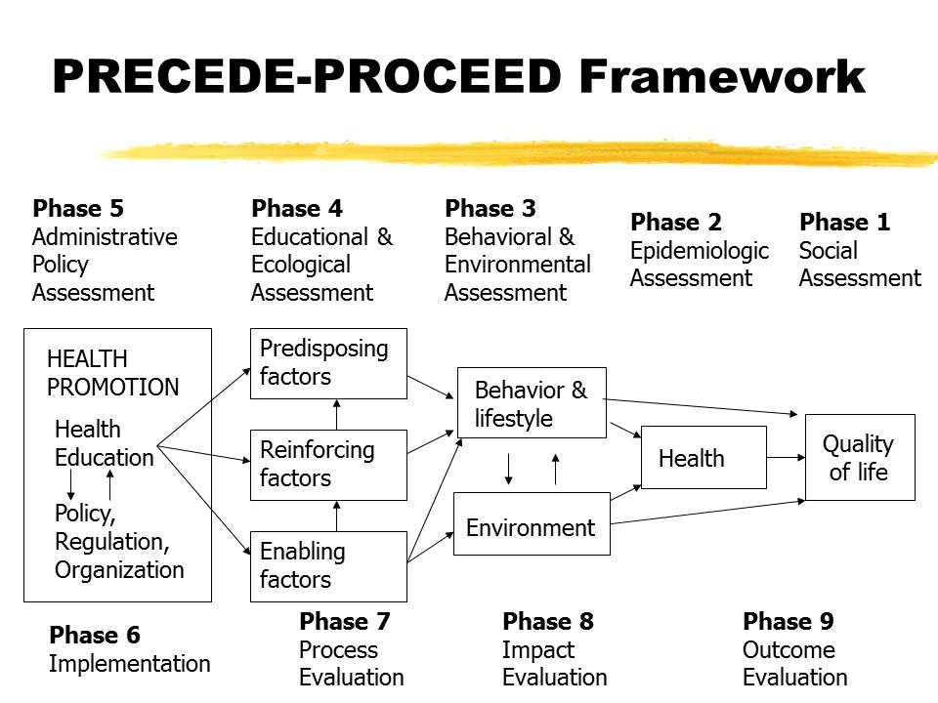
PRECEDE-PROCEED Model

Slide 4
PRECEDE (Green et al., 1980)
Predisposing
Reinforcing &
Enabling
________ in
Educational
Diagnosis &
Evaluation

Slide 5
PROCEED (Green & Kreuter, 1991)
______
Regulatory &
___________
Constructs in
Educational &
Environmental
Development

Slide 6
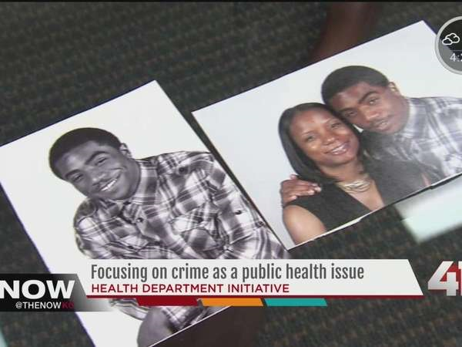
Phase 1: ____________
Economic & social indicators
Quality of life (crime, unemployment)

Slide 7
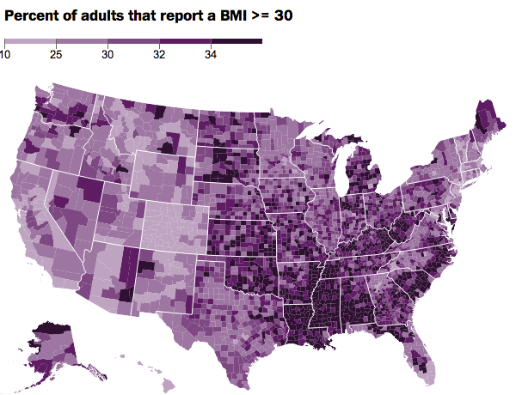
Phase 2: ___________ Assessment
Describe health problem in a defined population

Slide 8
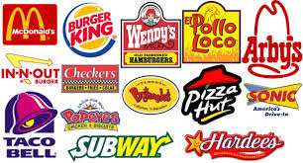
Phase 3: ___________ Assessment
Identify health-related behaviors linked to health problem
Identify the factors related to health behavior -

Slide 9
(1) ________ Factors
Enhance susceptibility or likelihood of beginning a behavior
What are some of these for physical activity?

Slide 10
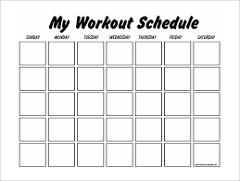
(2) __________ Factors
Facilitate or make possible a behavior

Slide 11
(3) ___________ Factors
Encourage repetition of a behavior
Provide continuing reward/punishment
What are some potential reinforcing factors with physical activity in mind?
What keeps you motivated to continue?

Slide 12
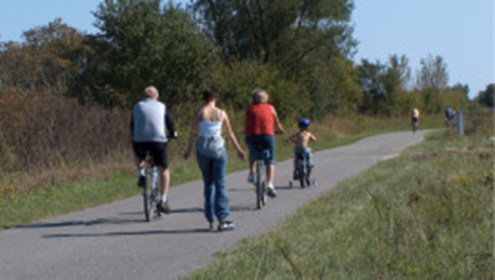
Phase 4: Ecological Assessment
Assessment of factors in social & physical environment that interact with behavior

Slide 13
Phase 4a: Intervention Alignment
Matching appropriate interventions with changes & outcomes

Slide 14
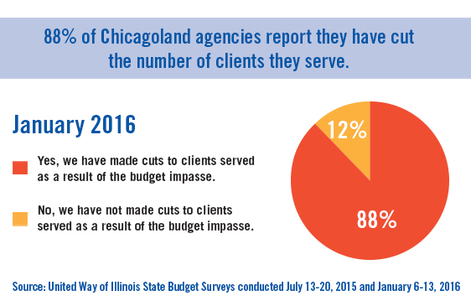
Phase 4b: ____ Assessment
Analyze policies, resources, & circumstances
Facilitate or hinder program development

Slide 15
Phase 5: Implementation
Converting program objectives into action

Slide 16
Phase 6: Process Evaluation
Policies, materials, personnel, performance, quality of practice or services
“_________________________?”
How many brochures have been passed out? How many people attended our classes?

Slide 17
Phase 7: Impact Evaluation
Assess immediate result of the program
Knowledge, attitudes, & behavior
Often gathered through _______________

Slide 18
Phase 8: Outcome Evaluation
Ultimate objectives
Changes in health & social benefits & quality of life
May not be completed for years
Long-term effects
_________________________

Slide 19
SMART Model
_______
_______
_______
_______
_______
Social marketing – using marketing principles (standard advertising ideas) to change health behavior

Slide 20
SMART Model
1 = Preliminary Planning
2 = Consumer Analysis
3 = Market Analysis
4 = Channel Analysis
5 = Develop Interventions, Materials, & Pretest
6 = Implementation
7 = Evaluation

Slide 21
Phase 2: Consumer Analysis
Target audience is viewed as a “________” of health behavior
ID consumer wants, needs, & preferences

Slide 22
Phase 3: Market Analysis
Identify __________
What are the “competitors” to a college sexual health campaign?

Slide 23
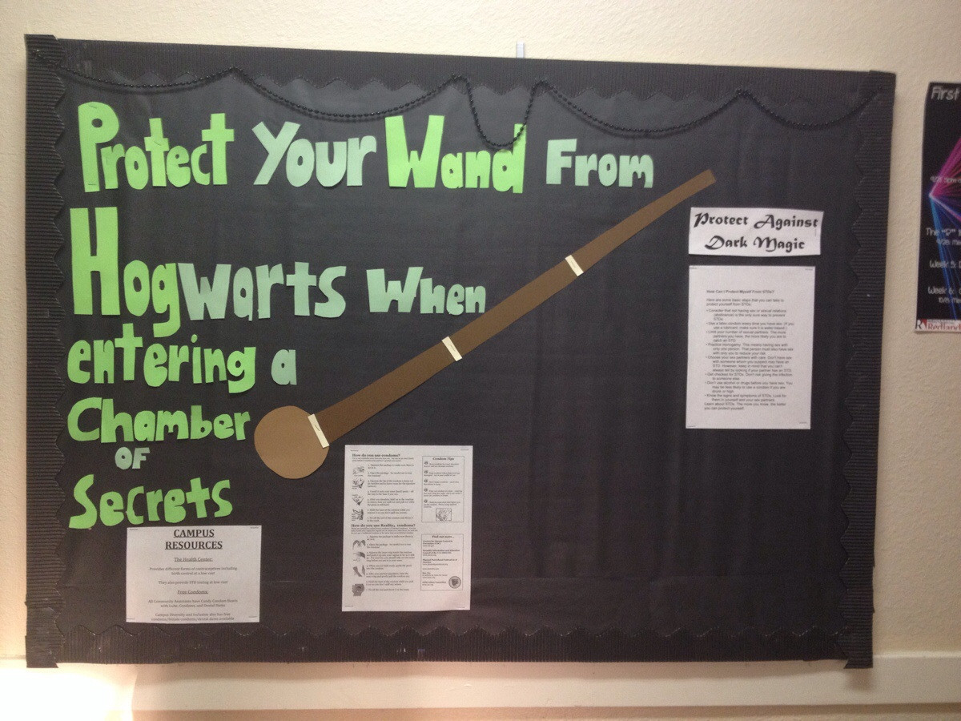
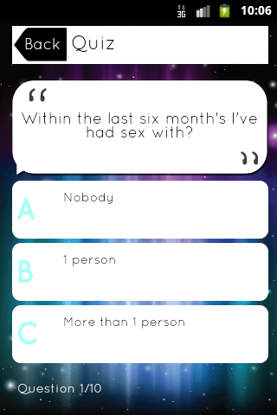
Phase 4: Channel Analysis
ID best communication channels
ID program partners

