Slide 1
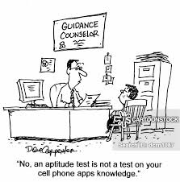
Resume and Character skills assessment assignment presentation
HSC 200
Dr Jones
September 2020

Slide 2
Basic assignment details
These are TWO separate assignments (resume & character career assessment) due on the same date to the same CANVAS folder (you’ll turn them in together, as one document)
To Canvas by 11:59 PM on Sunday, October 25th
Worth a total of 30 points (20 points for the resume, 10 points for the character career skills assessment)
Assignment descriptions and submission folders for each posted to Canvas, in the assignment description module and assignment submission folder module
These assignments are the first that I’ll review of the entire semester (but really, the first of many others) – set a high standard for your work!

Slide 3
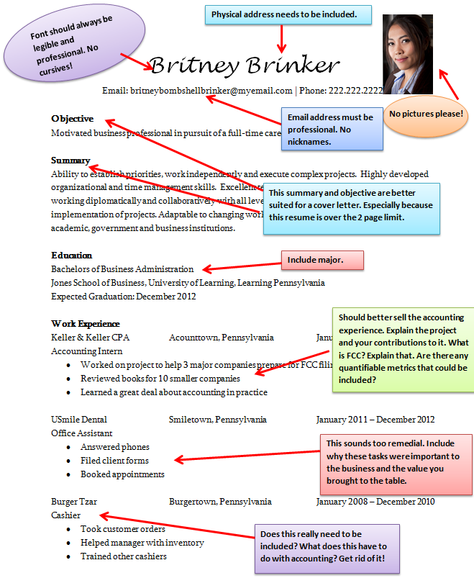
But…why?
Skills Assessment tells you what kind of work to look for, resume helps you get that work…
Remember those ‘career aptitude’ tests you may have taken in high school?
How might your results on these sort of assessments indicate what kinds of health education professional work you should be engaging in? Where you’d be most successful? Where you’d find the most enjoyment?
Do I really need to establish the importance of a good resume?
Your key to internships, jobs, and general life success!
Some of you likely have one already created, but perhaps lacking in depth/detail for actual professional employment post-college

Slide 4
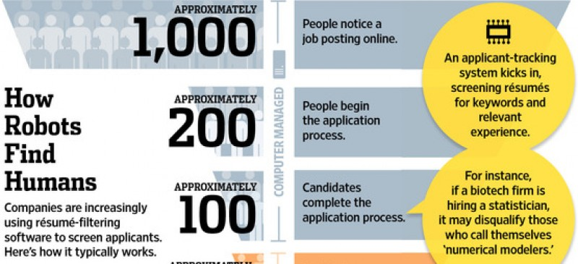
Pop Quiz!
On average, how long does a recruiter take to scan a resume?
6 seconds!!!

Slide 5
Career/character/personality assessment
Watch the guest speaker video presentation: Guest Speaker - Counseling Center Character Assessment (to be posted to Canvas across the week of Sept 28/Oct 5)
Identify a career/character/personality assessment tool, such as VIA, Myers-Briggs, Stages of Career Development, 16 Personalities, SIGI 3, etc.
Simply searching the name of any of these tools into Google should take you to the assessment tool. You can also access the Myers-Briggs assessment through the Career Center webpage at: https://www.bsu.edu/about/administrativeoffices/careercenter/tools-resources/personality-types.
Take the test. Take a screen shot of your completed instrument and attach it to your reflection.
Write a reflection of your results.

Slide 6
What to include in the reflection -
First Paragraph – Introduce each topic covered in your paper (introductory paragraph)
Second Paragraph - Discuss the assessment tool that you selected for the assignment. Include the name, length, and a description of what the assessment measures. Explain how you found the assessment tool.
Third Paragraph – Provide a rationale for your selection of the assessment tool. Why did you select the assessment tool? How do you think it will assist in your career or character or personality development?
Fourth Paragraph – Discuss the results of the assessment.
Fifth Paragraph – Describe how you plan to use the results to enhance your career or character or personality development as a Health Education Specialist.
Last Paragraph – Summarize each topic discussed in your paper (summary paragraph)

Slide 7
The fifth paragraph is most important!
How will the results enhance your career AS A HEALTH EDUCATION SPECIALIST (not a nurse, psychologist, business entrepreneur, etc.)?
The goal is to establish:
That you’ve learned something about the work of health education specialists (use information from what you’ve read and heard in lecture)
That you understand what your results mean
That you can apply what you learned about yourself to the work of health education specialists…
For example, if you’re a pretty introverted person – would you be better at RESEARCH (running data, designing research assessment tools by yourself) rather than someone who is a HEALTH COACH (who has to engage with other people that they don’t know pretty much every day)

Slide 8
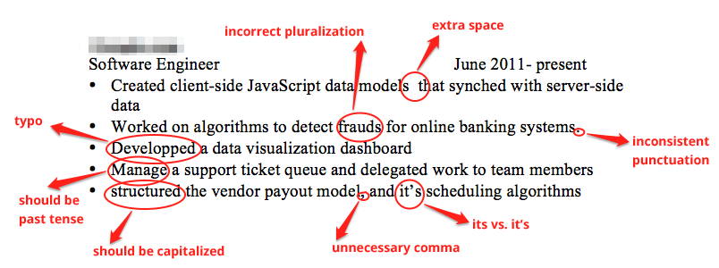
Remember good writing principles -
Use an easy to read, 12 point font with maximum one inch margins (you may use .5 inch margins) on the top, bottom, and sides of the document. Check and correct the default margins if necessary. Use double spaced type.
Create multiple drafts, edit your work –
Edit for writing mechanics (grammar, capitalization, punctuation)
Language should be professional – no slang/jargon
Cite sources, if you use information from the textbook or the web –
Follow the outline!
Writing Center on campus –
See link in “course resources” module on Canvas

Slide 9
Grading rubric

Slide 10
Part 2 – resume!
Prepare/update your resume, using guidelines from presentations from the Career Center guest speaker (see next week’s video interview on Canvas!), insight from the career center, and your own personal experience.
Submit your resume to VMock, a resume review service, now available through your Cardinal Career Link. Dillon (our career center representative) will walk you through how to log in and submit your work in the guest speaker presentation next week.
VMock will provide you with direct feedback on your resume, including a benchmark score. You will need to SCREENSHOT OR SAVE A COPY OF THE PAGE WITH YOUR FEEDBACK and YOUR ORIGINAL SCORE.
Using the feedback from VMock, make appropriate edits to your resume. If you have any questions regarding the feedback, do feel free to reach out to me, or the career center representative.
Re-submit an updated copy of your resume to VMock. If you’ve made the suggested edits, your benchmark score should improve (even if just minimally, it’s improvement!). AGAIN, SCREENSHOT OR SAVE A COPY OF YOUR UPDATED VMOCK SCORE.
On Sunday, October 25, you will need to turn in:
Your resume (in final draft form)
Your original feedback and score from VMock
Your updated score from VMock

Slide 11
How do I get started with my resume?
Watch presentation from Dillon (our career center rep) posted to our Canvas site next week – he provides a ton of examples, templates, and good advice.
Check out the assignment description – there’s a sample resume on the last page using good formatting.
Use me for help! I’ve reviewed many, many resumes during my time in this class and others.
I’m a stickler for –
Good organization (look at your margins, how you indent items, how you bold items, sentence structure, etc.)
Proofreading – there should be NO errors. This is a surefire way to get your resume thrown in the trash during an internship or job interview.

Slide 12
Resume “Do’s” from the Pros -
Include:
Name and accurate contact information, including LinkedIn website link
Make sure contact info is current, persistent, and professional.
Education Experience (school, major, minor)
RELEVANT work experience
Find a way to make the less relevant applicable to your position…
Volunteering, community service, internships

Slide 13
Miscellaneous Advice
Don’t use overused, vague clichés
Team player, strong work ethic, excellent communication skills
INSTEAD be specific, with examples
Describe a problem you solved, a team project and its results, how your communication skills produced something meaningful, how you went above and beyond
USE NUMBERS when possible
How many people you managed, how many materials you distributed, how many individuals saw your work or visited an event you ran

Slide 14
Other more arguable advice…
Don’t put your date of graduation (which shows that you’re entry level) or your GPA (unless it is relatively high)
DO tailor your language to the information in the job position description
Sometimes their search algorithms will ONLY pull up those resumes using the language they put forward in the preferred or required skills section
Focus on accomplishments instead of duties
Keep it to one page only – add a line at the bottom (references available upon request)

Slide 15
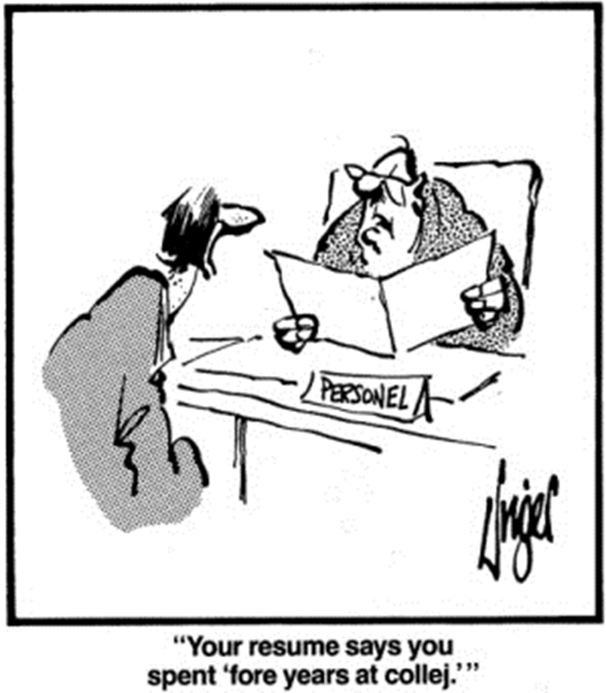
PROOFREAD YOUR WORK!!!

Slide 16
The writing here should be very close to perfect -
Points will be deducted for:
Lack of effort/not college-level work
Poor grammar/spelling/poor sentence construction/”writing as you speak”
Incorrect margins, font, and spacing
Reads like a first or rough draft – lack of editing & revising
Did not follow requested format
Missing required sections
Incomplete information
Inadequate depth/thoughtful preparation
Unprofessional appearance
The ONE PAGE document should take a lot of effort – with multiple drafts and edits, review by others, review by me, etc.

Slide 17
Grading rubric

Slide 18
Questions? Comments?
Let me know –
I’m here for you – in office hours, by email, virtual chat!

