Slide 1
Live Lecture 2: Chapter 2 – History of HE & P
Dr Jones
HSC 200
Fall 2020

Slide 2
Today’s Plan
Course Announcements
Review/Finish Chapter 1
I moved quickly at the end of lecture last week – let’s go back a bit!
Chapter 2
History of Health Education and Promotion

Slide 3
Course announcements
Keep up with Professional Development hours!
See additional announcements regarding career center workshops, etc.
What’s on deck for the weeks to come:
Next Live Lecture: Tuesday, Sept. 15 at 10 AM
Recorded Presentation: Resume and Character Assessment Assignment (to be posted next week)
Exam 1 (Chs. 1 – 3): Week of Sept. 21
Video Interview w/ Dillon Waggoner from the Career Center (also week of Sept. 21)
Questions during lecture – unmute yourself!
I don’t always see comments. If you comment, I’ll likely get back to you by email after lecture!
Any questions?!

Slide 4
Basic Assumptions of Health Education
Theories & principles of disease occurrence can be understood & explained
Changes in individual & societal health behaviors & lifestyles will affect health status positively
Individuals, families, small groups, & communities can be taught to assume responsibility for their health, & consequently change their health behaviors & lifestyles
Appropriate prevention strategies can be developed

Slide 5
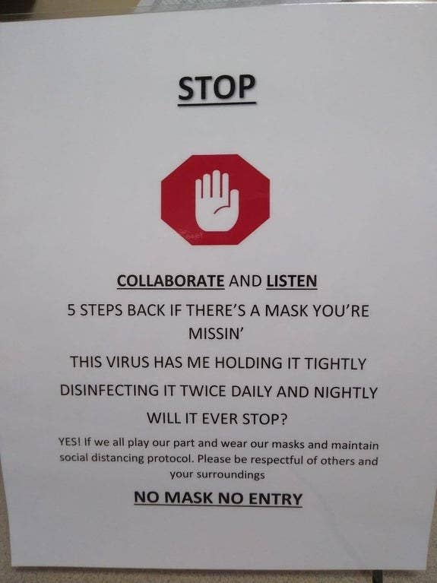
There are many times when the “assuming responsibility” principle is challenged…

Slide 6
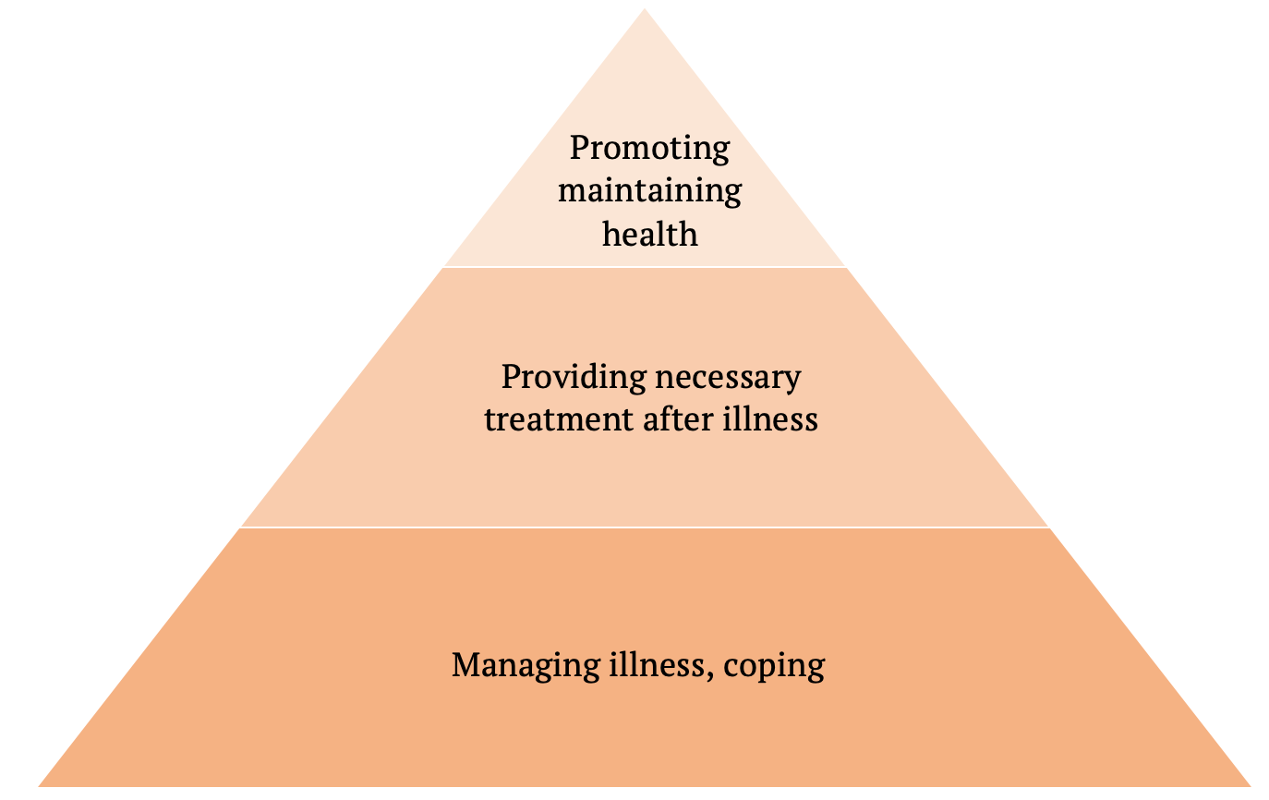
Criticisms of Prevention
Idealistic
Impractical & intangible
Cannot measure
Only long range in nature
Costs too much
Worthwhile, but we need to take care of more immediate things first

Slide 7
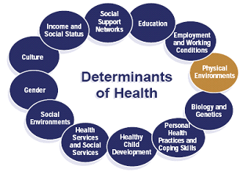
Health Education also appreciates MANY Determinants of Health
Genetics
Health Behavior
Social Circumstances
Environmental Conditions
Health Services

Slide 8
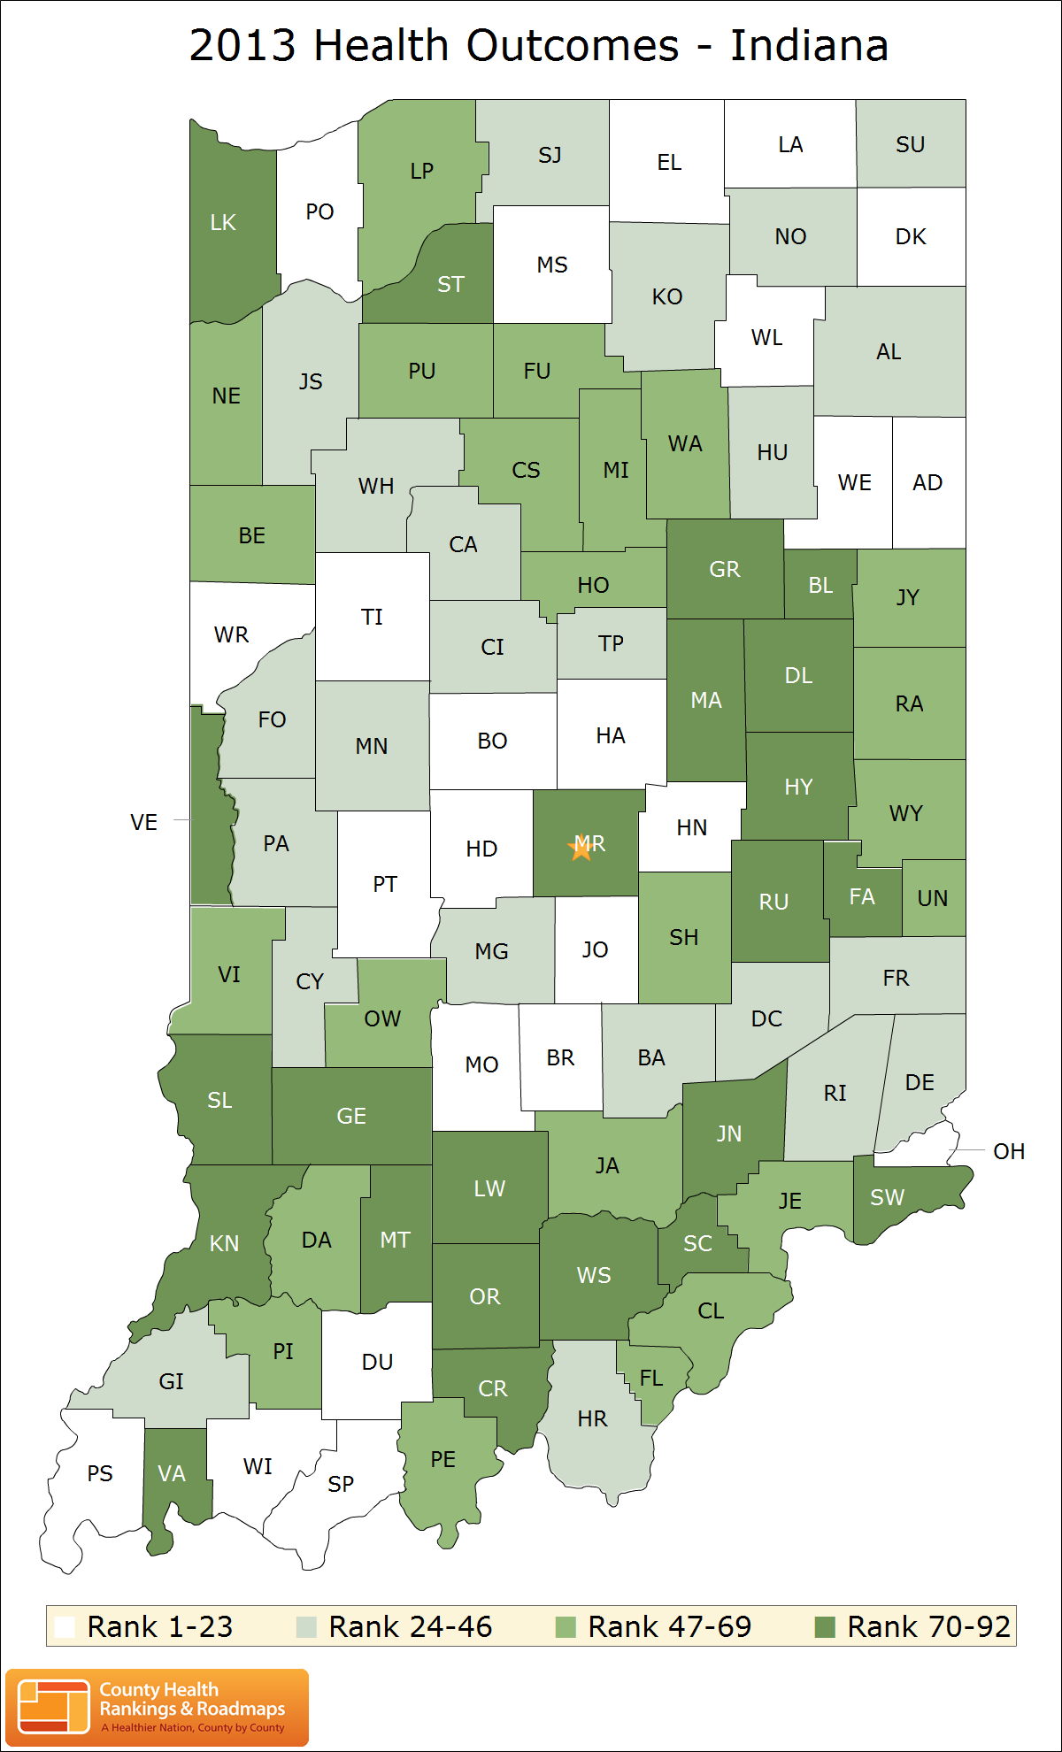

Slide 9
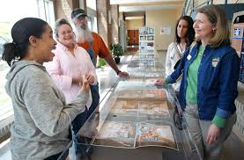
Health Education also values Participation & Ownership
Active involvement of target population
Identity, plan, & implement programs to address their health problems
Population feels responsible for the program
Empowerment – encourage community to gain control of their lives

Slide 10
Questions?

Slide 11
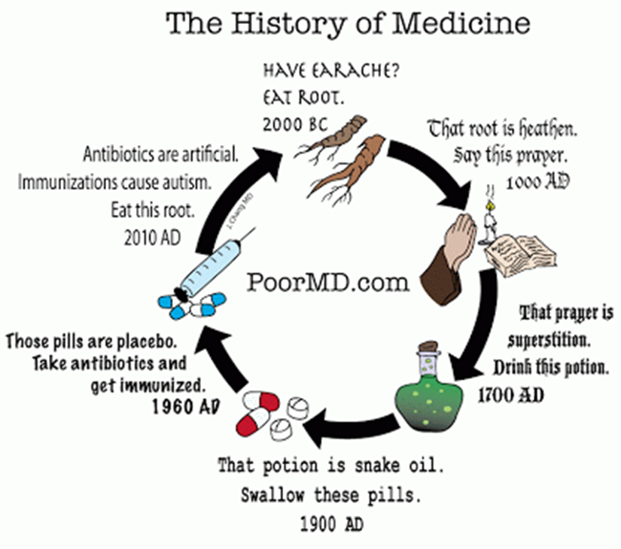
Chapter 2 – LOTS of HISTORY
Not that history isn’t exceptionally important, BUT…
Dr. J’s mini-lecture on medical history
We’ll pick back up with the book on page 56, Healthy People Initiatives and Public Health Standards

Slide 12
Free-Writing
You’ve developed a sore throat, a stuffy nose, a fever, and the chills. Walk me through your steps for feeling better.

Slide 13
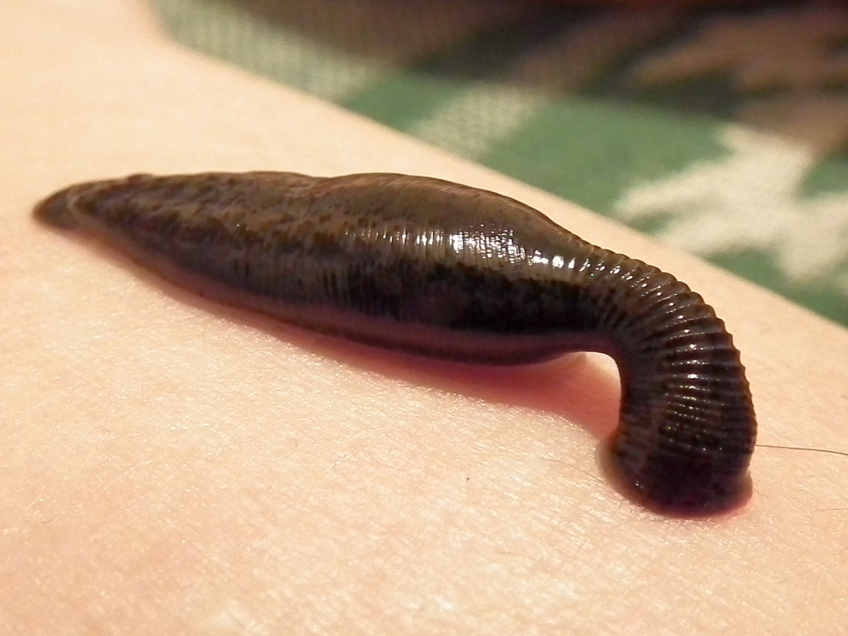
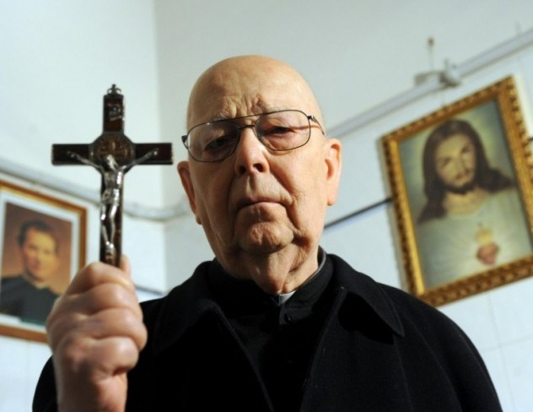

Slide 14
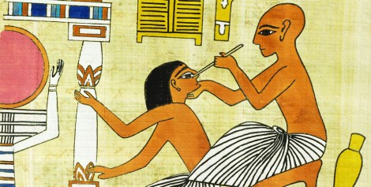
Ancient medicine
Angient Egypt
2000 BC
Religio-empirical medicine
Combines spiritualism & physical study
Holy healers, but recognized that illness was physical

Slide 15
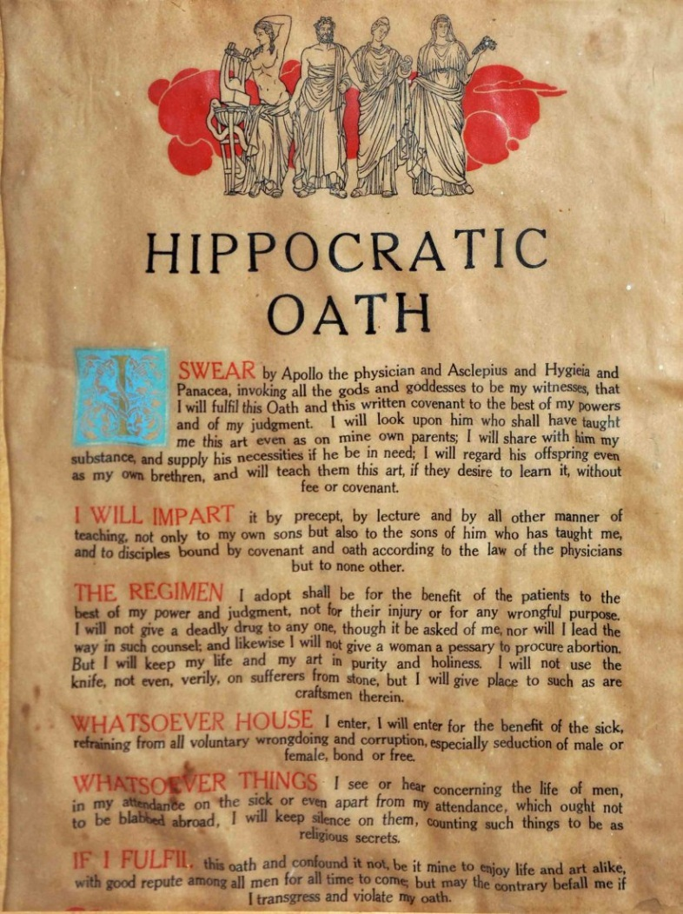
Ancient medicine
Hippocrates “Father of Scientific Medicine”
460 – 370 BC
Hippocratic Oath – Guide for ‘Morally-Sound’ Medicine
“give no deadly medicine”
“I will not divulge, as reckoning that such to be kept secret”
Rational/Empirical Medicine
Disease is best understood by careful observation and logical analysis (not spiritual); Doctors are scientists, not spiritualists

Slide 16
Medieval Religion & Health
Middle Ages (500 – 1450 AD)
Renewed interest in Medical Spiritualism (gods, spirits, ghosts)
Prayer & faith as treatment
A ban on secular medicine & surgeons (cutting the body as interfering on God’s work)
Barber surgeons
Science & Magic: Exorcisms
Still see influence of church on health today

Slide 17
Renaissance Philosophy
1300s-1600s
Descartes: Importance of VERIFICATION
How does this impact modern medicine?
‘Biomedical’ Approach
Dualism
The soul is separate from the body, and it lies predominately in the brain
Seen today is separation between mental health and physical health
But, increasing recognition of connection
How?

Slide 18
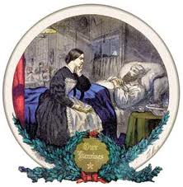
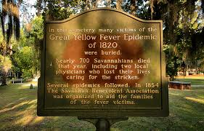
Health care & “New world”
Influx of uncommon diseases and epidemics
Malaria, dysentery, measles
Treated through home remedies, as doctors still prescribed to Hippocratic methods
Increased role of women in healthcare

Slide 19
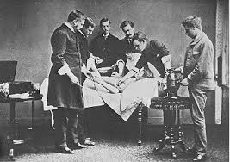
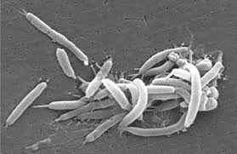
Orthodox medicine
Stemming from Industrial Revolution and Influx of workers in cities, industrial injuries
First hospitals for increased demand
Orthodox practitioners (educated) vs. Sectarians (folk)
Acceptance of Pasteur’s Germ Theory: disease is caused by micro-organisms

Slide 20
A resurgence of Sectarian Medicine?
How many of you:
Have been to a chiropractor?
Have used a herbal remedy to treat an illness?
Yoga?
Supplements?
Do you view this form of treatment as less credible or less effective than other forms?
$34 BILLION a year being spent on alternative medicines (Scientific American, 2010)
Why do you think sectarian medicine is making a return?

Slide 21
Jumping forward to today
Biomedical or sectarian?
Resurgence of focus on “evidence-based” practice, especially in health education and promotion
Shortage of family practice physicians, increased numbers in specialties. Why?
Legislation to improve health of the population
Medicare (for the disabled)
Medicaid (for the poor)
Patient Protection and Affordable Care Act, maybe?

Slide 22
Healthcare Today: What are the Major Problems?
Excessive bureaucracy (administrative costs)
Too much hospital care that could be avoided with better preventative care
Duplicated tests, unnecessary testing
Lack of medical information technology
Inequities between classes in access
It costs less to provide ongoing care than to wait until health deteriorates

Slide 23
Healthy People
The first major recognition of the importance of healthy lifestyles in promoting health and well-being
Shift from standard, biomedical, “primary care” model to recognition of prevention, lifestyle changes
Began in 1980, and has been released every ten years, setting objectives for the coming decade.
Preventing disease & improving people’s quality of life
Vision: “a society in which all people live long, healthy lives”
Captured in “leading health indicators”

Slide 24
HP 2020 National Health Objectives
Eliminate preventable disease, disability, injury & premature death
Achieve health equity, eliminate disparities, & improve the health of all groups
Create social & physical environments that promote good health for all
Promote healthy development & healthy behaviors across every stage of life

Slide 26
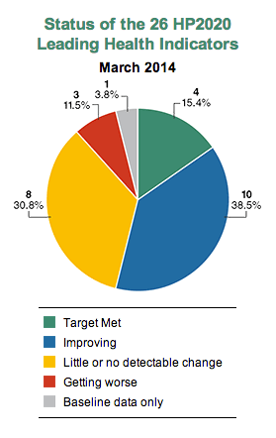
Healthy People 2020 - 2030
HP 2020 was last fully evaluated in 2014 for mid-term outcomes
They are currently evaluating final outcomes
HP 2030 still in final stages of development

Slide 27
6 Categories of Behavior
On page 57-58, there are 42 different “topic areas” (within 26 health indicators) for HP 2020
There’s no way I can expect you to know all 42
So, let’s instead focus on the top SIX areas this semester…
What health-related behaviors cause the most mortality & disability?

Slide 28
Here they are!
Injuries
Unhealthy Diet
Poor Sexual Health
Lack of Physical Activity
Tobacco Use
Alcohol and
Drug Use

Slide 29
Questions???
Enjoy the week!

