Slide 1
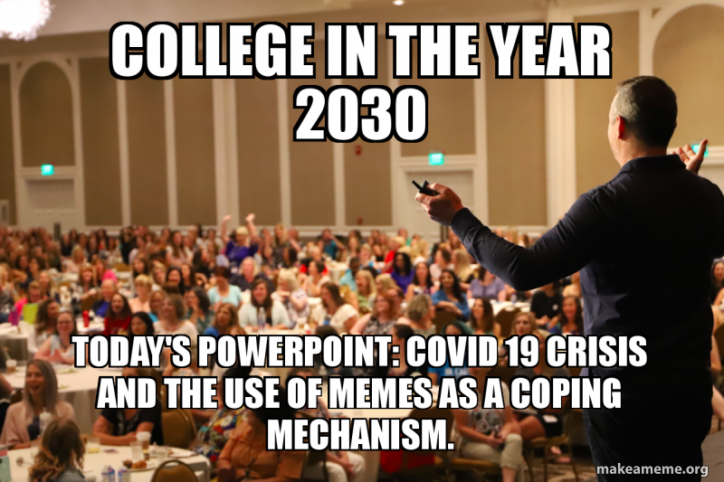
Welcome to HSC 200: Fall 2020
Christina Jones, PhD
Office:
HB 534

Slide 2
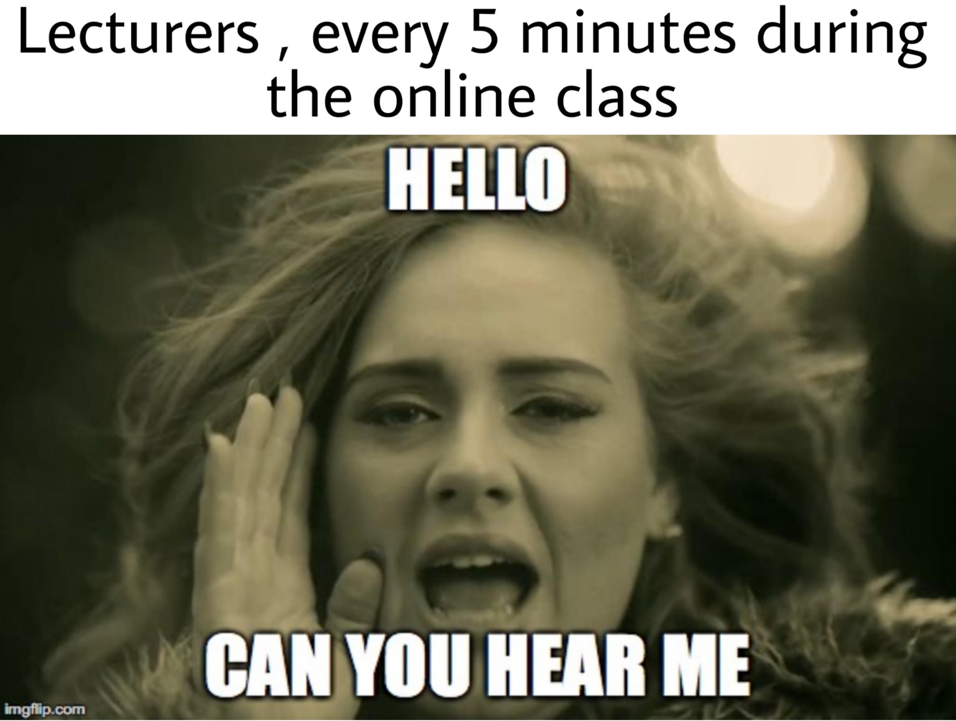
All of my presentations are narrated –
If the audio doesn’t automatically play, you may need to click the speaker icon at the bottom right corner of each slide to play the audio!

Slide 4
Goals for today:
Introduce course through the syllabus and major assignments
Review course schedule
Expectations for your participation and general course layout
Introduce myself!
What’s on deck for next week

Slide 5
Syllabus

Slide 7
Course Requirements
Exams (3)
50 points each
A mix of multiple choice, true/false, matching, and open response
All completed online
No need for lock down browser
Open book and note, but not collaborative
But, there will be a time restriction for each, which you’ll be aware of upon opening the first page of the exam.
Just FYI: Exam 1 and Exam 2 take place early in the semester, covering about 3-4 chapters each. Exam 3 takes place during final exam week, covering a larger portion of content.

Slide 8
Attendance & Participation – Discussion Board
Four Discussion Board posts will be completed -
All Discussion Board original posts are due by Sunday evenings, and responses (2) are due by following Wednesday evening (see schedule for dates)
“Getting to Know You” Discussion Board Original Post = 5 points
Ethics Activity Discussion Board Original Post = 5 points; Response to Peer = 2.5 points
Health Educators as Role Models Discussion Board Original Post = 5 points; Response to Peer = 2.5 points
Literature in Health Education Discussion Board = 5 points

Slide 9
Attendance & Participation – Live Lectures
While there will be 12 “live” , one-hour lectures offered throughout the semester (during our standard course time from the previous schedule, on alternating Tuesdays/Thursdays at 10 AM), you will only be required to attend SIX of these “live” lectures.
You may attend more than 6, but you will receive 30 points for your minimal attendance in 6 lectures (5 pts/lecture).
Choose 6 lectures that you KNOW you can attend, in full, without interruption.
If you perceive this to be a difficulty for you based upon work, family, or technology conflicts, you MUST communicate these concerns to me no later than Monday, September 7th, so that we can arrange for an alternative participation option. If you fail to communicate these barriers to me following this date, I will assume that your lack of attendance is of your own accord, and appropriate attendance points will be deducted. The choice of which 6 to attend is entirely your choice!
If you’re attending a synchronous “live” class session, please be on time, prepared to participate, and give your full attention.

Slide 10
Attendance & Participation – Live Lectures
If you choose to not attend a specific lecture, you are still responsible for viewing the video-recorded session in a timely fashion, as the content will be used for exams and assignments throughout the semester.
Recorded sessions will be posted in the “Recorded Lectures” folder within 24 hours following the live lecture. Due to Canvas space restraints, recorded lectures will only be available for each corresponding unit of class content.
The link to use for each lecture will be posted in the “Live Lecture Links” folder on Canvas at least 24 hours before the lecture is set to take place. All lectures will be conducted using WebEx.
Attendance will be taken during each class session, at around the 10 minute mark of the session, using the “participants” information provided by the web tool. I will also take attendance again at the very end of the session. Participation and attendance points will be based on your presence during the entire session, on the SIX days where you’re attending for attendance points.
If you’re not present at the beginning AND the end of the session when I take attendance, you won’t be provided points for that session. Technology problems will NOT be accepted as an excuse for your absence at the start/end of the session. If they do take place, remember, you ONLY need to attend SIX sessions for your points. Use another session to supplement your missed points!

Slide 11
Live Lecture – Expectations
You will need to attend using a computer, where I can identify your attendance using your name rather than a phone number call in, for the SIX sessions where you’re receiving your attendance points. You’ll also need to be sure to log in with your real name – no nicknames (Darth Vader, perhaps?)!
Stay focused. Please stay engaged in class activities. Close any apps on your device that are not relevant and turn off notifications.
Turn on your video when possible. It is helpful to be able to see each other, just as in an in-person class. If you have limited internet bandwidth or no webcam, it is ok to not use video. If you're unable to find an environment without a lot of visual distractions, it is also ok to turn off your video.
Keep it clean. Don't share anything you wouldn't put up on the projector in class!

Slide 12
Live Lecture - Expectations
Mute your microphone when you are not talking. This helps eliminate background noise. Use a headset when possible. If you own headphones with a microphone, please use them. This improves audio quality.
Be in a quiet place when possible. Find a quiet, distraction-free spot to log in. Turn off any music, videos, etc. in the background.
Stay on topic. Use the chat window for questions and comments that are relevant to class. The chat window is not a place for socializing or posting comments that distract from the course activities. If you fill it up with random comments, I will be unable to sort through the information quickly to address students' real questions/concerns about the course.
No disrespect or hate speech. Just like in our in-person class, respectful behavior is expected.

Slide 13
Written/Oral Assignments
Writing/Oral Assignments = 65 points
Career Skills Assessment and Reflection = 10 points
Resume (draft, review, and final) = 20 points
Professional Health Education Organization Presentation = 15 points
Informational Interview and Reflection = 20 points
More details on each will be provided in their respective assignment narrated presentations throughout the semester. See schedule for due dates!

Slide 14
Final Portfolio
Final Portfolio = 40 points
Log of Professional Development Hours = 10 points
Reflection on Professional Development Hours = 10 points
Guest Speaker Portfolio (notes and reflection) = 20 points

Slide 15
Completing your hours -
A full, narrated presentation on expectations for this assignment and your hours will be posted next week.
A representative from Student Voluntary Services will also be speaking with me in a video interview, which I’ll record and post – providing suggestions for health volunteering in-person and virtually.
But, in the meantime – Add this to your calendar!
Student Voluntary Services ONLINE Recruitment Fair
Wednesday, September 2nd – Using Zoom
Agencies will be split into categories - Each category will have a morning and an afternoon session to present to any students who log on to their session. Each category session will be 45 – 60 minutes in length.

Slide 16
Other Miscellaneous
Course total: 310 Points
See syllabus for full grading scale.
Grades (and feedback) will be updated frequently and provided solely through Canvas.
Type all assignments, with standard formatting (Times New Roman 12 pt. font, double-space, with 1 inch margins)
Late assignments are accepted with a penalty.
Assignments will receive a 10% cumulative penalty for each 24-hour period (including weekends and holidays) they are late.
Assignments turned in after 5 calendar days will receive a zero grade.

Slide 17
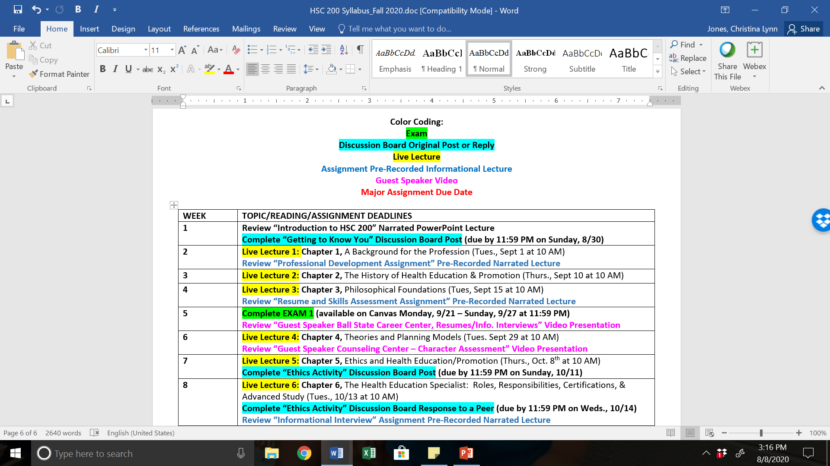

Slide 18
My Philosophy -
It’s college, you’re an adult, so act like one…
Take responsibility for your own actions, and the ways in which your actions impact others around you
If you don’t want to be policed or treated “like a child” – then consider now how YOUR actions might impact your class performance (regardless of my teaching style, content, etc.)
In the real world, there will be no attendance or rules about how to use your time at work…but there also won’t be study guides or lecture slides, nor will your boss care as much about firing you as I do about seeing you pass.
I want to see you succeed, seriously. Really. I promise.

Slide 19
Advice from my past students
Come to class!
Coming to class doesn’t equal texting, checking Facebook, etc. Engage, and take lots of notes.
Read! No, really. Please read. PLEASE!?!
Come to office hours EARLY for help
I want to help you!
It will be imperative that you communicate with me EARLY and OFTEN regarding your projects.

Slide 20
Who am I?
How long have I been an Indiana resident?
Where is my hometown?
What do I drive?
What do I do in my spare time?

Slide 21
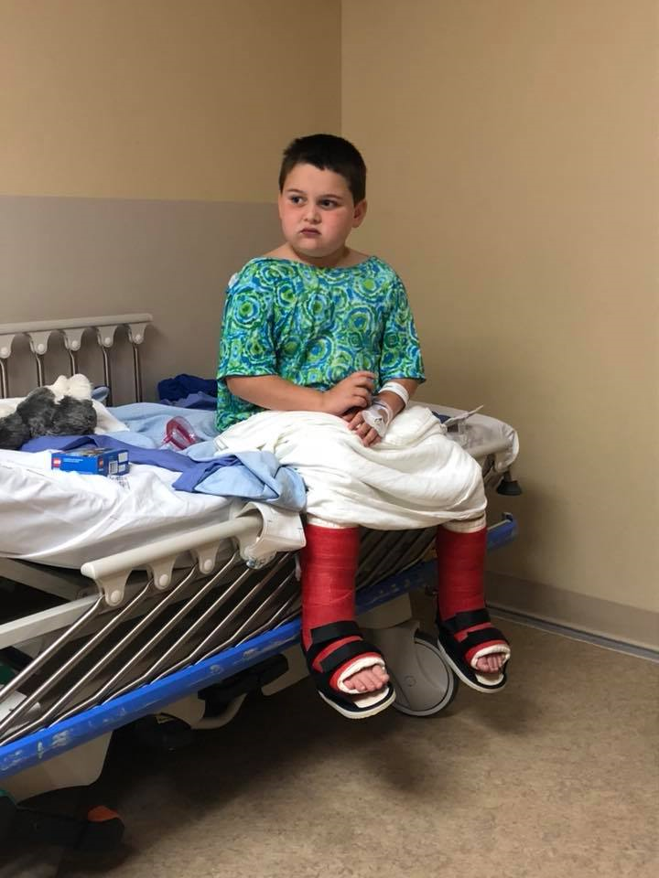
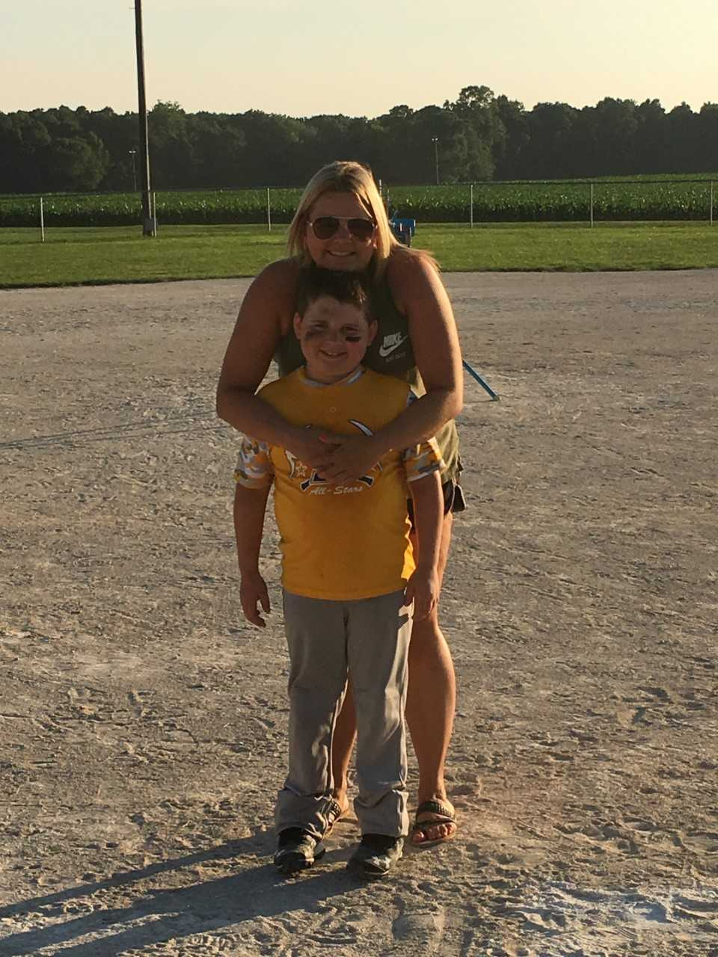
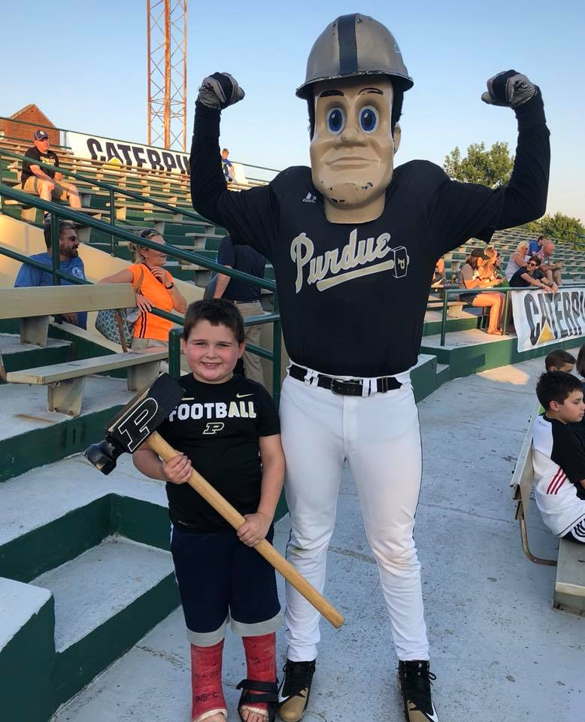

Slide 24
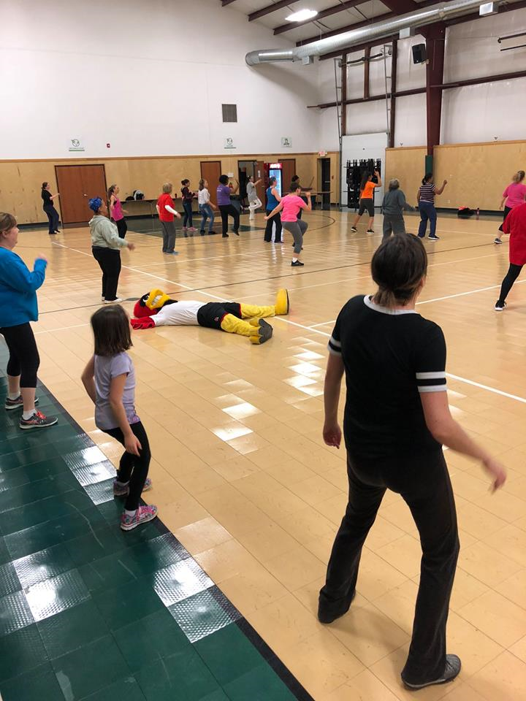

Slide 25
About you!
Complete “Getting to Know YOU” discussion board post by 11:59 PM on Sunday, August 30th

Slide 26
For NEXT week:
Live Lecture 1: Chapter 1, A Background for the Profession - Tuesday, Sept 1 at 10 AM
Review “Professional Development Assignment” Pre-Recorded Narrated Lecture on your own time

