Slide 1
Chapter 12: Preventing Infectious Diseases and Sexually Transmitted Infections
Lecture Outlines by
Sloane Burke Winkelman
California State University, Northridge

Slide 2
Did You Know?
Each year in the United States, 5–20% of the population gets the seasonal flu, resulting in 200,000 hospitalizations and, on average, 49,000 deaths.
About 20 million people in the United States are infected each year with a sexually transmitted infection, and half of those cases occur in young people aged 15–24.
Approximately 13% of the people in the United States infected with HIV do not realize it.

Slide 3
Learning Outcomes
LO 12.1 Identify the causes of infectious diseases and recognize how they are transmitted.
LO 12.2 Describe how the body’s immune response works against infections and how immunization protects individuals and communities.
LO 12.3 Discuss the most common infectious diseases, their effects, and how to treat them.
LO 12.4 List common sexually transmitted infections (STIs), their causes, risk factors, symptoms, and treatment.
LO 12.5 Understand how to prevent infectious diseases and sexually transmitted infections.

Slide 4
Infectious Disease Terms
Infection: The invasion of body tissues by microorganisms that use the body’s environment to multiply and cause disease.
Pathogen: An agent that causes disease.
Reservoir: The natural environment for any particular pathogen, where it accumulates in large numbers.
Host: A person, plant, or animal in which or on which pathogens live and reproduce.
Chain of Infection: A group of factors necessary for the spread of infection.
Carrier: A person who is infected with a pathogen and does not show symptoms but who is infectious.

Slide 5
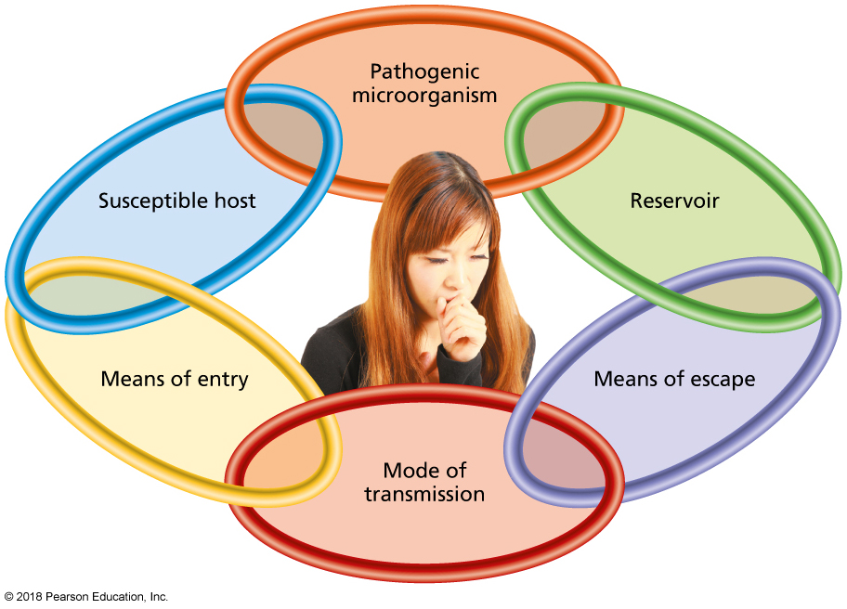
How Are Infections Spread?
Notes:
FIGURE 12.1 Chain of Infection. To cause infection, a pathogen such as a cold virus has to have a reservoir, such as a college student’s body, in which to multiply and a means of escape, such as a cough. This enables the virus to be transmitted—for instance, by air to another student’s eyes (the means of entry). If the student is susceptible—that is, if he or she has no immunity to the particular virus—he or she will experience infection.

Slide 6
Direct Transmission
Contact with infected people
Contact with infected animals

Slide 7
Indirect Transmission
Touching contaminated objects
Breathing airborne pathogens
Bites from infected insects
Vector: An animal or insect that transports pathogens from one point to another.
Drinking or eating contaminated water or food

Slide 8
PROTECTING AGAINST INFECTIONS

Slide 9
Protecting Against Infections
Your skin!
The body’s immune response:
The body’s cellular and chemical defenses against pathogens.
The inflammatory response is a response to damaged body tissues that is designed to kill any pathogens in the damaged tissue, promote healing, and prevent the spread of infection to other parts of the body.

Slide 10
The Body Protects Against Infections
Antigen: A tiny region on the surface of an infectious agent that can be detected by B cells and T cells.
Antibodies: Proteins released by B cells that bind tightly to infectious agents and mark them for destruction.
Acquired immunity: The body’s ability to quickly identify and attack a pathogen that it recognizes from previous exposure.

Slide 11
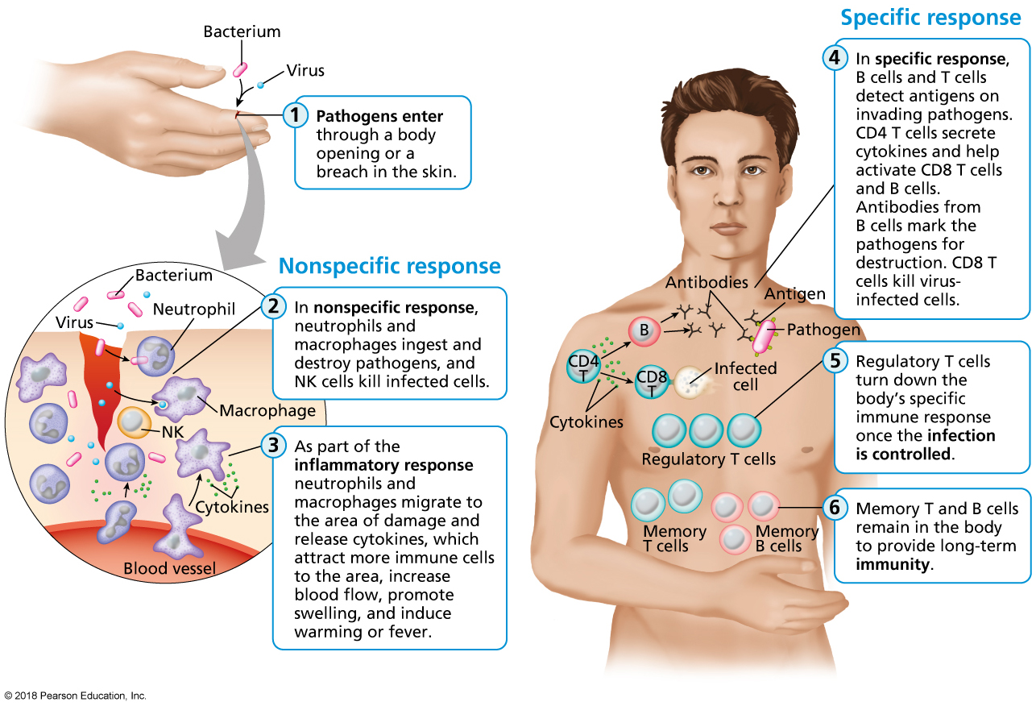
Your Body’s Immune Response
Notes:
FIGURE 12.2 Your Body’s Immune Response.

Slide 12
Immunization
Immunization: The creation of immunity to a pathogen through vaccination or through the injection of antibodies.
Acquired immunity: The body’s ability to quickly identify and attack a pathogen that it recognizes from previous exposure. In some cases, acquired immunity leads to lifelong protection against the same infection.
Herd immunity: The condition where greater than 90% of a community is vaccinated against a disease, giving it little ability to spread through the community.

Slide 14
Immune Disorders: Allergies
Allergies occur from abnormal immune system reactions to substances that are otherwise harmless.
More than 50 million people in the United States have allergies.
There are many strategies for coping with allergies.

Slide 15
Immune Disorders: Allergies (cont.)
Anaphylactic shock occurs when the release of histamine and other chemicals into the body leads to a drop in blood pressure, tightening of airways, and possible unconsciousness and even death.

Slide 16
Immune Disorders: Asthma
Asthma is a chronic constriction and inflammation of the airways, which makes breathing difficult and causes shortness of breath, wheezing, coughing, and chest tightness.
Allergic asthma (e.g., pollen, venom, peanuts)
Intrinsic asthma (exercise or cold)
Nearly 1 in 10 school-aged children has asthma.

Slide 17
INFECTIOUS DISEASES

Slide 18
Infectious Diseases
Even with advances in modern medicine, infections remain the world’s leading killer of children and young adults.
Infectious disease costs the United States more than $120 billion per year.

Slide 20
Viral Infections
A virus is a microscopic organism that cannot multiply without invading body cells.
Colds: More than 200 viruses cause cold symptoms.
Influenza is a group of viruses that cause the flu, a contagious respiratory condition.
A pandemic is a worldwide epidemic of a disease.
Mononucleosis is a viral disease that causes fatigue, weakness, sore throat, fever, headaches, swollen lymph nodes and tonsils, and loss of appetite.

Slide 21
Viral Infections (cont.)
Hepatitis is an inflammation of the liver that affects liver function.
Jaundice—often seen in hepatitis—is a yellowing of the skin, mucous membranes, and sometimes the whites of the eyes caused by liver malfunction.
Hepatitis A, the most widespread form, is contracted by consuming microscopic amounts of feces from contaminated, fruits, vegetables, and ice cubes.
Hepatitis B is transmitted through sexual contact.
Hepatitis C is typically spread through sharing syringes and can also be passed on by unsterilized tattoo needles and piercing equipment or sexual contact.

Slide 22
Bacterial Infections
Bacteria (singular: bacterium) are single-celled microorganisms that invade a host and reproduce inside that host.
Harmful bacteria release toxic enzymes and chemicals.
Antibiotic resistance occurs when a bacterium is able to overcome the effects of an antibiotic through a random mutation, or change in the bacterium’s genetic code.

Slide 23
Bacterial Infections: Meningitis
Bacterial meningitis can be life-threatening.
Adolescents and young adults account for nearly 1/3 of all cases of bacterial meningitis in the United States.
College students—especially those living in dormitories—are at moderately increased risk.
CDC recommends that all youths aged of 11–18 receive the meningococcal vaccine.
Several states now require that students receive a meningococcal vaccine before entering college or university.

Slide 24
Bacterial Infections: Staphylococcal Infections
Toxic shock syndrome is a rare, serious illness caused by staphylococcal bacteria that begins with severe flu symptoms but can quickly progress to a medical emergency.
Methicillin-resistant Staphylococcus aureus (MRSA) is a bacterial strain that is resistant to the broad-spectrum antibiotics commonly used to treat staphylococcal infections.

Slide 25
Other Bacterial Infections
Streptococcus infections (strep throat).
Lyme disease is passed through the bite of infected deer ticks and blacklegged ticks.
Pneumonia is the number one cause of death among children.
Tuberculosis (TB) is caused by the bacterium Mycobacterium tuberculosis.

Slide 26
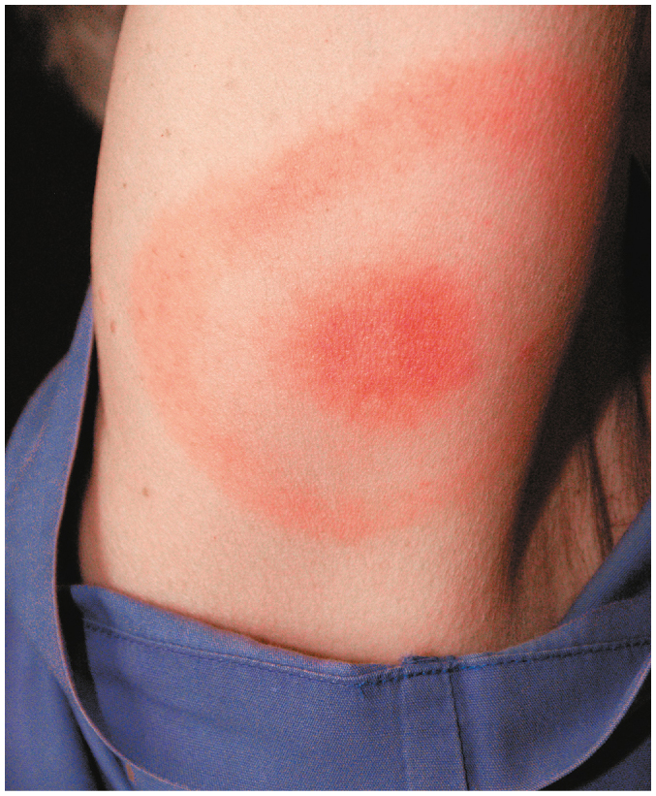
Lyme Disease “Bull’s-Eye” Rash
Notes:
FIGURE 12.3 Lyme Disease “Bull’s-Eye” Rash.

Slide 27
Fungal Infections
Fungi are multicellular or single-celled organisms that obtain their food from organic matter—in some cases, human tissue.
Types of fungal infections:
Yeast infections
Diaper rash
Thrush
Nail bed infections

Slide 28
Protozoan Infections
Protozoa are single-celled parasites that rely on other living things for food and shelter.
Malaria is a serious protozoan disease that causes fever and chills, which appear in cycles.
In some cases, malaria can be life-threatening.
Malaria is the cause of death for nearly 1 million people every year.

Slide 29
Parasitic Worm Infections
Parasitic worms (helminths) are multicellular creatures that compete with the host’s body for nutrients.
Examples are tapeworms and pinworms.
These infections are common among travelers, refugees, migrant workers, children, and the homeless.
Worms are found in poorly cooked meat or contaminated water.

Slide 30
Video: Measles on the Rise

Slide 31
Video: Measles on the Rise
Discussion Questions
In what year was the United States initially declared to be free of measles?
What are two important factors that have caused measles to reappear in the United States?
What is the key reason why some American parents have opted not to vaccinate their children against the measles?
Why was the statement by the advocacy group Autism Speaks, supporting vaccination against measles, so important?
How many doses of measles vaccine are recommended for college students?

Slide 32
SEXUALLY TRANSMITTED INFECTIONS

Slide 33
Sexually Transmitted Infections (STIs)
Infections transmitted mainly through sexual activity, such as vaginal, anal, or oral sex.
Worldwide, nearly 1 million people acquire an STI every day.
There are approximately 20 million new cases of STIs every year in the United States, costing the U.S. health-care system nearly $16 billion.
The CDC estimates that while 15- to 24-year olds represent only 25% of the sexually active population, they account for half of all new STI cases.

Slide 34
Risk Factors for STIs
Having unprotected vaginal, anal, or oral sex.
Having sex with multiple partners, especially strangers, and not discussing STIs before sex.
Exchanging sex for drugs or money.
Participating in sex while drunk or high on drugs.

Slide 35
Risk Factors for STIs (cont.)
Coming into direct skin-to-skin contact with someone who has an STI.
Injecting drugs or steroids with dirty needles or syringes.
Sharing needles for tattoos and body piercings.
Failing to be vaccinated against human papillomavirus (HPV) or hepatitis B.

Slide 36
Sexual Conduct and Risk
Only abstinence provides 100% protection from STIs.
Relations with monogamous partners who have been tested and are free from infection can minimize risk.
Protected sex can minimize risk of transmission and infection.
Unprotected vaginal, anal, and oral sex carry significant risk.
Before sex, it’s important to discuss STIs and past sexual history with the potential sexual partner.

Slide 37
HIV and AIDS
Human immunodeficiency virus (HIV) is the most serious of all sexually transmitted pathogens.
HIV accounts for more than 1.2 million deaths worldwide every year.
HIV infections severely damage the body’s immune system.
Infected individuals become vulnerable to opportunistic diseases—infections and other disorders that take advantage of the person’s weakened immune system.

Slide 38
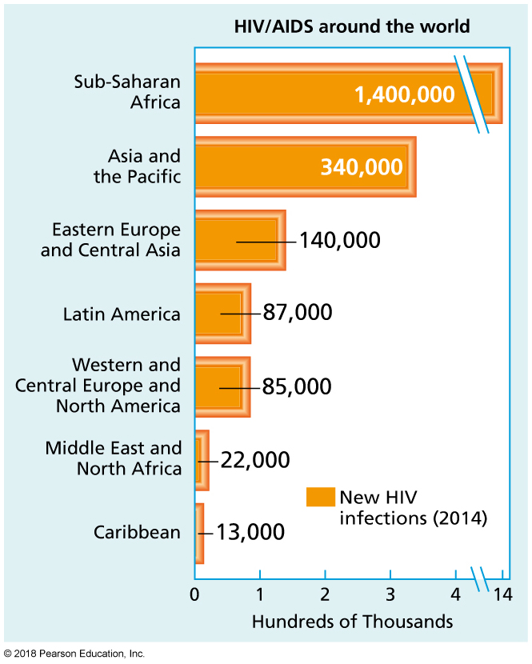
HIV/AIDS Around the World
Notes:
FIGURE 12.4 HIV/AIDS Around the World.
Source: Data from Joint United Nations Programme on HIV/AIDS (UNAIDS) and World Health Organization (WHO). (2015). AIDS by the numbers 2015. www.unaids.org.

Slide 39
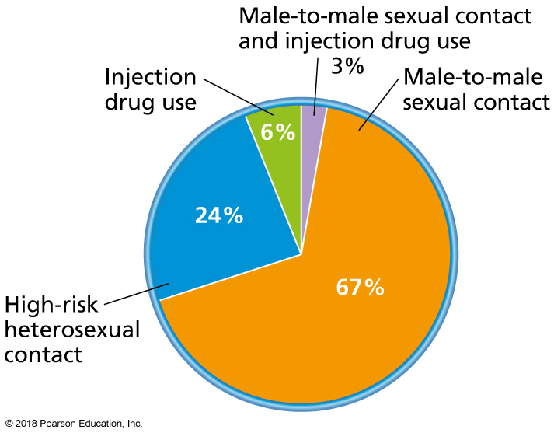
Transmission Categories for New HIV/AIDS Cases in Adolescents and Adults in the United States
Notes:
FIGURE 12.5 Transmission Categories for New HIV/AIDS Cases in Adolescents and Adults in the United States.
Source: Data from Centers for Disease Control and Prevention. (2015). HIV/AIDS: Statistics overview. www.cdc.gov.

Slide 40
HIV Testing and Treatment
The CDC estimates that 15% of the people in the United States who are infected with HIV do not realize it.
The CDC recommends that all people between the ages of 13 and 64 be tested for HIV at least once during a routine doctor’s visit.
To avoid getting HIV/AIDS, keep the blood, seminal fluid, vaginal fluids, and breast milk of an infected person from entering your vagina, penis, anus, mouth, and breaches in your skin.
The surest way to protect yourself from HIV is to avoid any sexual behavior that could transmit the disease.

Slide 41
Treatment of HIV and AIDS
Antiviral therapies can slow immune system deterioration.
Reverse transcriptase inhibitors, protease inhibitors, and fusion inhibitors have been shown to be effective in combinations as a highly active antiretroviral therapy (HAART).
The life expectancy of a person newly affected with HIV is approaching that of most uninfected people.
A 39-year-old person entering care today can expect to live to age 63.

Slide 42
Hepatitis B
More than 50 times as infectious as HIV.
Most commonly spread through unprotected sex.
Can also be spread through sharing needles, razors, or syringes with an infected person.
Symptoms generally occur 2–3 months after infection and involve abdominal and joint pain, nausea, dark urine, weakness and fatigue, and jaundice.

Slide 43
Genital Herpes
Extremely contagious.
Affects 17% of adults aged 14–49 in the United States.
More than 80% of infected people do not realize they are infected because they are asymptomatic or their symptoms are mild or mistaken for something else.

Slide 44
Genital Herpes (cont.)
Two types:
Herpes simplex virus type 2 (HSV-2): Genital herpes is usually caused by HSV-2.
Herpes simplex virus type 1 (HSV-1): Most often responsible for cold sores around the mouth.
The herpesvirus stays in the body forever, lying dormant in nerve cells until the next recurrence.
Treatment focuses on alleviating symptoms.

Slide 45
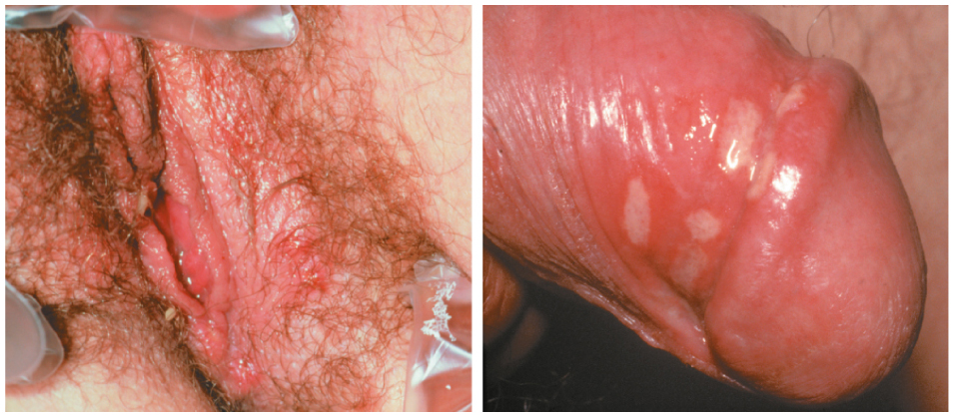
Genital Herpes Sores
Notes:
FIGURE 12.6 Genital Herpes Sores.

Slide 46
Human Papillomavirus
HPV causes all types of warts, wherever they may be on your body.
There are more than 100 types of HPV.
More than 40 types can infect the genitalia, although only four types are responsible for most genital HPV infections.

Slide 47
Human Papillomavirus (cont.)
HPV infection is the most commonly reported STI on college campuses.
Most sexually active Americans will become infected with HPV at some point in their lives.
An estimated 79 million people in the United States are currently infected with HPV, and 14 million new cases occur each year.
An HPV vaccine is now available for both males and females.

Slide 48
Genital Warts
Notes:
FIGURE 12.7 Genital Warts.

Slide 49
Chlamydia
Caused by the bacterium Chlamydia trachomatis.
Symptoms usually develop within 1–3 weeks of infection.
Extremely common in the United States.
In 2014, more than 1.4 million diagnosed.
The infection can be spread during vaginal, anal, or oral intercourse and can be passed from mother to newborn baby during childbirth.

Slide 50
Chlamydia (cont.)
Male symptoms: Burning sensation while urinating, discharge from the penis.
Female symptoms: Abnormal vaginal discharge, pain during urination.

Slide 51
Gonorrhea
“The clap.”
Common and highly contagious STI caused by the bacterium Neisseria gonorrhoeae.
Most commonly affects teenaged girls and men aged 20–24.
Spread through contact with an infected penis, vagina, anus, or mouth.

Slide 52
Gonorrhea (cont.)
Most women experience no symptoms at all, or mistake symptoms for a bladder or yeast infection.
Pelvic inflammatory disease (PID) can occur, causing pain and infertility.
Men may have sore testicles, colored penile discharge, or a burning sensation while urinating.
Men can be left sterile.
Without treatment, bacteria can spread to the blood or joints, which can be life-threatening.
Antibiotics can often clear up an infection.

Slide 53
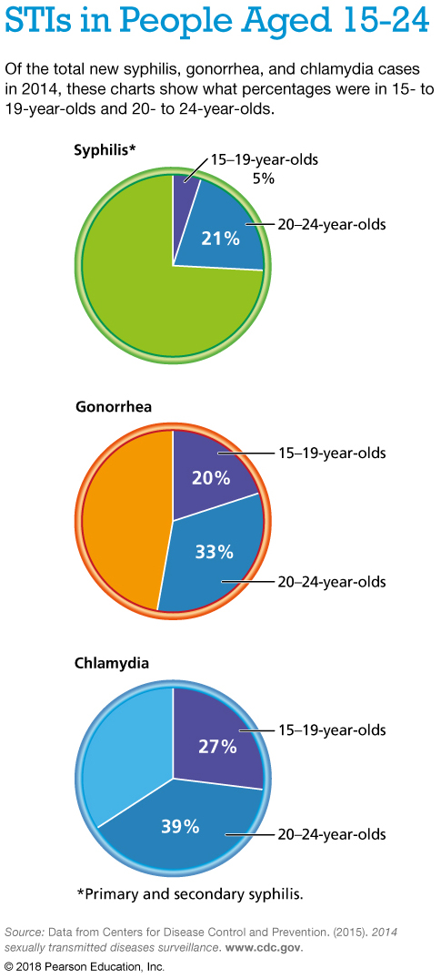

Slide 54
Pelvic Inflammatory Disease (PID)
PID is an infection of a woman’s uterus, fallopian tubes, and other reproductive organs that occurs when bacteria travel up from the vagina and spread.
Bacteria can turn normal tissue into scar tissue, which can result in chronic abdominal pain, ectopic pregnancy, and infertility.
PID affects an estimated 750,000 women in the United States every year, causing infertility in 10–15%.
PID is caused by bacteria, especially the bacteria associated with two of the most common STIs: chlamydia and gonorrhea.

Slide 55
Syphilis
Syphilis is caused by the bacterium Treponema pallidum.
The bacteria can enter the body through irritated skin or mucous membranes, including the vagina, anus, penis, lips, and mouth.
In 2014, 20,000 cases were reported in the United States.
Climbing steadily each year.

Slide 56
Three Stages of Syphilis
Stage 1: 10 days to 3 months after infection, primary syphilis appears. A painless sore called a chancre appears where the bacteria entered the body—around the genitals, inside the vagina or rectum, or on the lips or mouth.
Stage 2: Secondary syphilis. Symptoms may include a rash on the hands or feet, neck, head, or torso; wart-like growths around the genitals; and grayish sores in the mouth. Hair loss may occur. The infection then enters a latent stage, which lacks symptoms and can last for years.
Stage 3: Tertiary stage. This stage can also lead to severe problems with the heart, brain, and eyes, causing blindness, paralysis, brain damage, dementia, and even death.

Slide 57
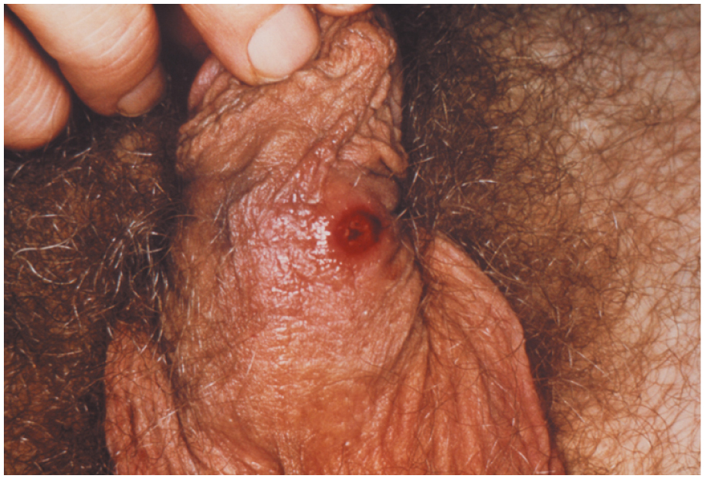
A Syphilis Chancre
Notes:
FIGURE 12.8 A Syphilis Chancre.

Slide 58
Pubic Lice and Scabies
Pubic lice and scabies are usually transmitted through sexual contact.
Can be spread through contact with clothing, towels, sheets, or toilet seats that have been used by an infected person.
The major symptom is itching, especially during the night.
The pests themselves do not spread disease, but excessive scratching of the skin can cause a bacterial infection.
Easily diagnosed with a doctor’s visit.
Prescribed creams or lotions can usually clear up these conditions, although an oral medication may be used for cases that are more difficult to treat.
Notes:
FIGURE 12.8 A Syphilis Chancre.

Slide 59
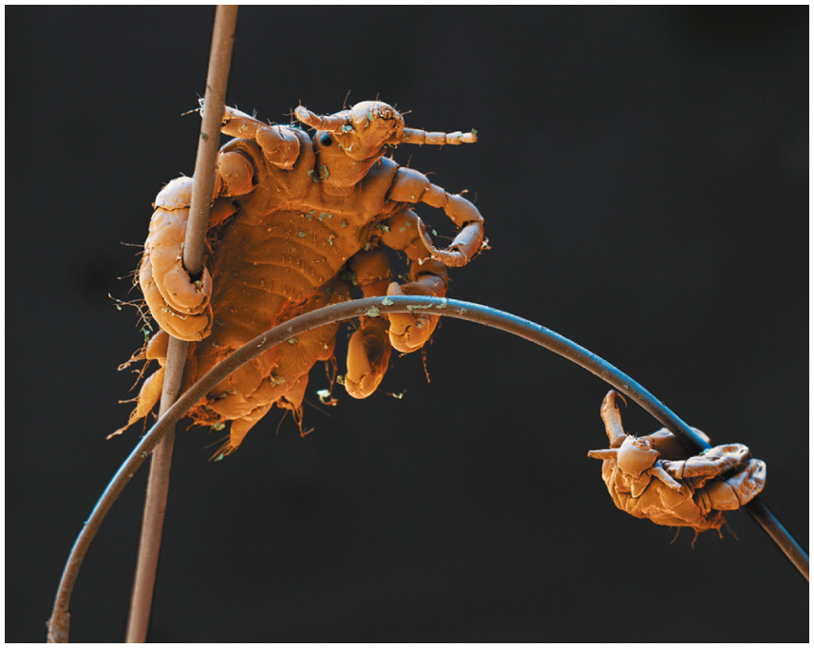
Pubic Lice
Notes:
FIGURE 12.9 Pubic Lice.

Slide 60
Trichomoniasis
Caused by a protozoa called Trichomonas vaginalis.
A very common STI in young women, but can also affect men.
More than 3.7 million Americans are believed to be infected.
Symptoms include painful urination, pain during intercourse, vaginal itching and irritation, and a greenish-yellow, strong-smelling vaginal discharge.
Men rarely experience symptoms; if they do, symptoms include irritation inside the penis and slight discharge.
Trichomoniasis can be cured with oral antibiotics.

Slide 61
Change Yourself, Change Your World
Personal choices:
Get vaccinated.
Use condoms.
Get tested.
Get treated.
Campus advocacy:
Stay home if you are ill.
Encourage your friends to check their immunization status and get the annual flu vaccine.
Work with your student health center to organize an STI awareness event.

