Slide 1
Chapter 9: Alcohol and Tobacco use and Abuse
Lecture Outlines by
Sloane Burke Winkelman
California State University, Northridge

Slide 2
Did You Know?
Alcohol is a factor in about 60% of fatal burn injuries, drowning, and homicides; 50% of severe trauma injuries and sexual assaults; and 40% of fatal motor vehicle crashes, suicides, and fatal falls.
About 25% of U.S. college students have never had a drink at all.
One out of every five deaths In the United States is caused by a smoking-related illness.
Secondhand smoke, laden with toxic chemicals, is responsible for almost 50,000 smoking-related deaths each year.

Slide 3
Learning Outcomes
LO 9.1 Discuss alcohol use in the United States.
LO 9.2 Describe how the body absorbs and metabolizes alcohol.
LO 9.3 Describe the short-term and long-term health effects of alcohol use.
LO 9.4 Explain how alcohol affects behavior.
LO 9.5 Recognize the types and signs of alcohol abuse.
LO 9.6 Identify alcohol abuse treatment options and prevention strategies.

Slide 4
Learning Outcomes (cont.)
LO 9.7 Discuss tobacco use in the United States.
LO 9.8 List the short-term and long-term health effects of tobacco use.
LO 9.9 Identify a range of tobacco products.
LO 9.10 Outline strategies for quitting smoking.
LO 9.11 Describe how to promote a smoke-free environment on campus.

Slide 5
ALCOHOL USE IN THE UNITED STATES

Slide 6
Alcohol in the United States
Half of adults in the United States drink alcohol: 57% of men versus 47% of women.
Among persons aged 12–17, incidence of alcohol use is about 13%.
Caucasians have the highest rate of alcohol use among any racial or ethnic group.
Setting the legal drinking age at 21 (a law established in 1984) led to positive effects on health; increased safety; decreased traffic crashes, crash fatalities, and suicides; and decreased consumption.

Slide 7
Alcohol Use and Binge Drinking on Campus
An estimated 74.5% of college students nationwide have tried alcohol, and 29.9% report binge drinking.
Binge drinking: A pattern of drinking alcohol that results in a blood alcohol concentration of 0.08 or greater.
Five or more alcoholic drinks within 2 hours for men.
Four or more alcoholic drinks within 2 hours for women.
The binge drinking rate is highest among young adults aged 18–24.

Slide 8
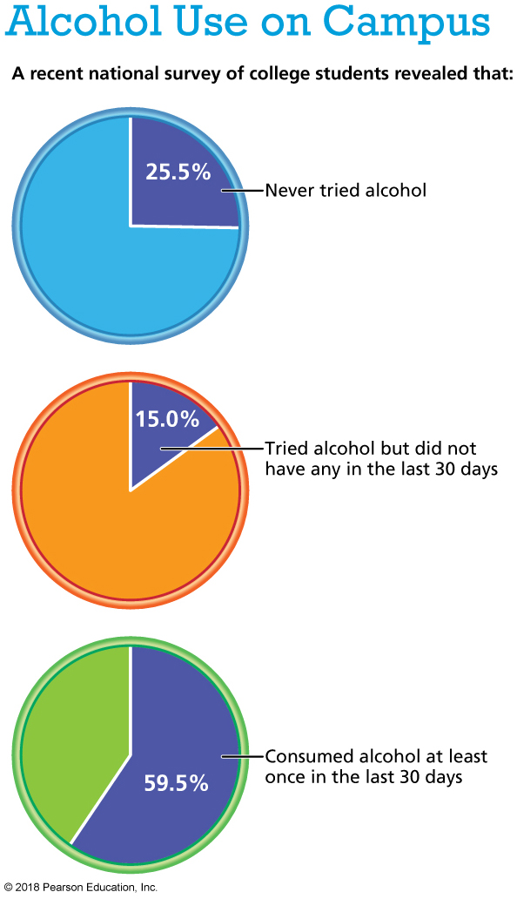
Notes:
Data from ACHA-NCHA II: Undergraduate reference group executive summary, fall 2015, by the American College Health Association, 2016.

Slide 9
Binge Drinking
Binge drinking is considered one of the most significant health risk behaviors among college students.
It is most common in athletes, sports fans, fraternity and sorority members, and extremely social students.
Alcohol is a factor in about 60% of fatal burn injuries, drowning, and homicides; 40% of fatal motor vehicle crashes; and 50% of severe trauma injuries and sexual assault.
Binge drinking can lead to drunk driving, violence, vandalism, risky sex, forced sex, and poor academic performance.

Slide 10
Why Students Drink
Motivations can be grouped into four categories:
Coping: To avoid problems.
Conformity: To gain peer acceptance.
Enhancement: To induce a positive mood.
Social: To make parties and outings more enjoyable.

Slide 11
THE MAKEUP OF ALCOHOL

Slide 12
Alcohol
Alcohol is a chemical substance that is toxic to the body.
Ethyl alcohol (ethanol) is the intoxicating ingredient in beer, wine, and distilled liquor.
Proof value is a measurement of alcoholic strength, corresponding to twice the alcohol percentage (13% alcohol equals 26 proof).

Slide 13
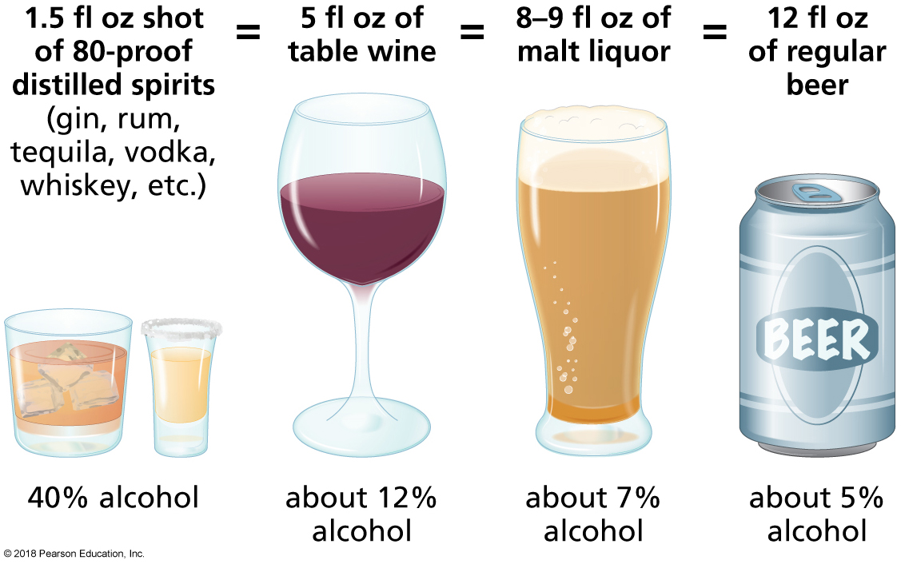
Alcohol: “Standard” Serving Sizes
Notes:
FIGURE 9.1 “Standard” Serving Sizes.
A 1.5-ounce shot of liquor, 5-ounce glass of wine, 8- to 9-ounce malt liquor, and 12-ounce can of beer are all considered “standard” servings because they contain approximately the same amount of alcohol: 14 grams (½ ounce). Remember that not all beers, wines, and liquors are created equal. Some contain higher concentrations of alcohol than others.

Slide 14
HOW THE BODY ABSORBS AND METABOLIZES ALCOHOL

Slide 15
Alcohol Absorption and Metabolism
Absorption: The process by which alcohol passes from the stomach or small intestine into the bloodstream.
Metabolism: The breakdown of food and beverages in the body to transform them into energy.

Slide 16
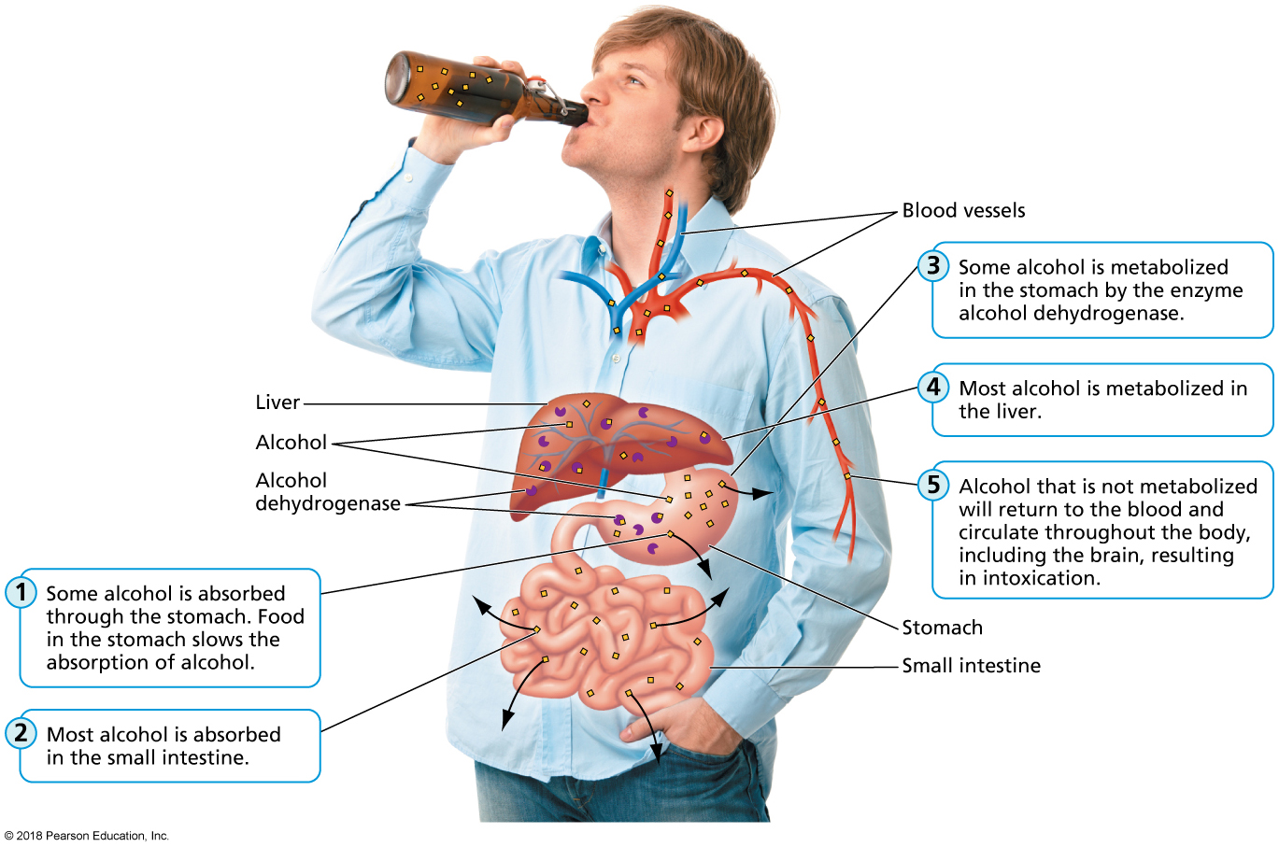
Alcohol Absorption and Metabolism (cont.)
Notes:
FIGURE 9.2 Alcohol Absorption and Metabolism.
Alcohol is absorbed into the bloodstream through the stomach and small intestine. Metabolism takes place in the stomach and in the liver.
Source: Adapted from Blake, Joan Salge, Nutrition and You, 2nd ed., ©2012. Reprinted and electronically reproduced by permission of Pearson Education, Inc., Upper Saddle River, New Jersey.

Slide 17
Blood Alcohol Concentration (BAC)
The amount of alcohol present in blood, measured in grams of alcohol per deciliter of blood.
BAC can be affected by several factors:
How much and how quickly you drink.
What you drink.
Sex, age, weight, and physical condition.
Food intake.
Medications.

Slide 18
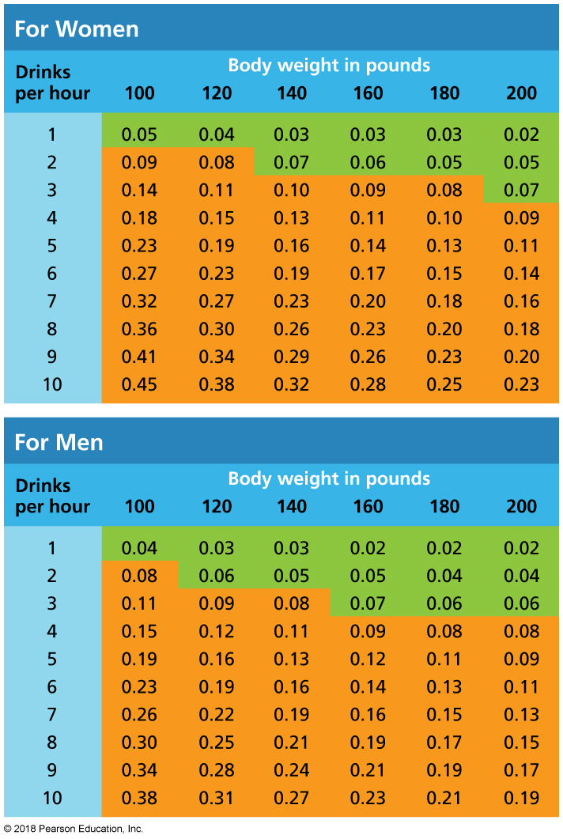
Blood Alcohol Concentration (BAC) (cont.)
Notes:
FIGURE 9.3 Blood Alcohol Concentration (BAC) Tables.
The orange areas indicate legal intoxication.
Source: Adapted from “Alcohol Impairment Charts,” by Pennsylvania Liquor Control Board’s Bureau of Alcohol Education, published by the Pennsylvania Liquor Control Board, with data gathered from The National Clearinghouse for Alcohol and Drug Information, Substance Abuse, and Mental Health Services Administration. Adapted with permission.

Slide 19
THE EFFECTS OF ALCOHOL ON THE BODY

Slide 20
Intoxication
Alcohol intoxication is the state of physical and/or mental impairment brought on by excessive alcohol consumption (BAC of 0.08% or greater).
In a basic sense, it is another term for being drunk.
Symptoms of intoxication vary depending on the individual.

Slide 21
Intoxication (cont.)
Symptoms of intoxication progress with increased BAC:
Relaxation and exhilaration (0.03%).
Decreased fine motor skills (0.06%).
Slowed reaction time, poor muscle control, slurred speech, and wobbly legs (0.09%).
Loss of self-restraint and impaired ability to reason (0.12%).
Blurred vision and unclear speech (0.15%).
Difficulty staying awake (0.18%).
Deep sleep or stupor (0.30%).
Deep coma and danger of death (0.50%).

Slide 22
IMMEDIATE EFFECTS OF ALCOHOL ON THE BODY

Slide 23
Immediate Effects of Alcohol on the Body
In addition to the effects of intoxication, other short-term effects can include the following:
Dehydration.
Gastrointestinal problems.
Sleep disturbances.
Alterations in the metabolic state of the liver and other organs.
Hangover: Withdrawal symptoms including headache and nausea caused by an earlier bout of heavy drinking.

Slide 24
Alcohol Poisoning
Dangerously high level of alcohol consumption, resulting in depression in the central nervous system, slowed breathing and heart rate, and compromised gag reflex.

Slide 25
Alcohol Poisoning (cont.)
Signs include mental confusion, vomiting, seizures, slow or irregular breathing, low body temperature, pale or bluish skin, and inability to rouse.
Call 911 immediately if a person you suspect of having alcohol poisoning
is unconscious and you cannot rouse him or her even by shaking.
has consumed other drugs.
is experiencing seizures.
is injured.
has a respiration rate of fewer than eight breaths per minute.
is experiencing shallow or irregular breathing (10 seconds or more between breaths).

Slide 26
Long-Term Effects of Alcohol on the Body
Chronic, heavy use of alcohol has been linked to
cancer of the liver, breast, esophagus, mouth, larynx, and throat.
cardiovascular disease.
liver disease:
Fatty liver
Alcoholic hepatitis
Alcoholic cirrhosis
neurological effects: learning, memory, and brain damage.

Slide 27
Alcohol and Pregnancy
Ingesting alcohol during the first trimester of pregnancy can cause miscarriage.
Fetal alcohol syndrome: A pattern of mental and physical birth defects found in some children of mothers who drank excessively during pregnancy.
Facial abnormalities
Retarded growth
Permanent intellectual and behavioral problems

Slide 28
Health Benefits of Alcohol?
There is some evidence that people who regularly consume small amounts of alcohol may have a decreased risk of coronary heart disease, high blood pressure, and stroke compared to people who do not drink at all.
More research is needed.

Slide 29
THE EFFECTS OF ALCOHOL ON BEHAVIOR

Slide 30
Drinking and Driving
In 2013, nearly 10,000 people died in alcohol-related car crashes in the United States—about one every 52 minutes.
College students are disproportionately affected by drunk driving, with one fourth having driven under the influence.
In a single year, 1,825 students aged 18–24 died from alcohol-related car crashes and unintentional injuries.
Alcohol use alters judgment, vision and hearing, and reaction time.

Slide 31
Alcohol and Sexual Activity
Engaging in sexual intercourse while intoxicated can lead to
unplanned sexual activities (reported by 21% of college students who had too much to drink).
lack of protection while having sex, leading to possible exposure to STDs such as AIDS or hepatitis B and unplanned pregnancy.
Heavy drinking increases a woman’s likelihood of becoming a victim of sexual assault or date rape.

Slide 32
ALCOHOL ABUSE

Slide 33
Alcohol Abuse
Alcohol abuse: Drinking alcohol to excess, either regularly or on individual occasions, resulting in disruption of work, school, or home life and causing interpersonal, social, or legal problems.
Alcoholism (alcohol dependence): A physical dependence on alcohol to the extent that stopping drinking brings on withdrawal symptoms.

Slide 34
Alcoholism
At least three of the following symptoms during a one-year period:
Tolerance
Withdrawal symptoms
Loss of control
Desire or inability to quit
Overwhelming time commitment
Interference with life
Continued use

Slide 35
Risk Factors for Alcoholism
Self-medicating is using alcohol or drugs to cope with sadness, grief, pain, or mental health problems.
Genetic, physiological, psychological, and social factors play a part in determining susceptibility:
Having a parent who abused alcohol
Low self-esteem
Impulsiveness
A need for approval

Slide 36
Risk Factors for Alcoholism (cont.)
Peer pressure
Poverty
Being a victim of physical or sexual abuse
Persons under a great deal of chronic stress sometimes self-medicate with alcohol.

Slide 37
Common Profiles of Alcoholics
Alcoholism knows no demographic boundaries.
Five types of alcoholics are most prevalent:
Young adult subtype
Young antisocial subtype
Functional subtype
Intermediate familial subtype
Chronic severe subtype

Slide 38
ALCOHOL ABUSE: TREATMENT AND PREVENTION

Slide 39
Treatment Options
Medications
Alcohol counseling or “talk therapy”
Self-help groups
Intensive treatment programs

Slide 40
Dealing with Relapse
Returning to drinking after a period of sobriety.
Research from the National Institute on Alcohol Abuse and Alcoholism reveals that 20 years after the onset of alcohol dependence, about three fourth of individuals were fully recovered.

Slide 41
Reducing Your Risk of Problem Drinking
Personal choices:
Pace and space (sip slowly).
Include food.
Shuffle things up (don’t just drink).
Helping a friend:
Be informed.
Use “I” statements.
Don’t judge or interrupt.
Don’t expect your friend to seek help after just one discussion.
Campus advocacy:
BACCHUS Network.
Students Against Destructive Decisions.

Slide 42
SMOKING IN THE UNITED STATES

Slide 43
Smoking in the United States
Each year, 480,000 people in the United States die prematurely because of smoking-related illnesses.
In the United States, one in every five deaths is due to smoking.
About 25% of college students have tried smoking, and 2.7% report smoking daily.

Slide 44
Why Do Some Students Smoke?
Genetics.
Family and peer exposure.
Age at initiating smoking.
Psychosocial factors.
Desire to lose weight.
Role of media and advertising.

Slide 45
WHAT’S IN A CIGARETTE?

Slide 46
What’s in a Cigarette?
50% shredded tobacco leaf.
30% reconstituted tobacco (made from other parts of the tobacco plant, such as the stem).
20% expanded tobacco (tobacco that has been “puffed up” like popcorn and functions as “filler”).
Nearly 600 additives with a wide range of functions.
Some additives are used to hide the taste of tobacco.
Ammonia boosts the delivery of nicotine into the lungs and bloodstream.

Slide 47
What’s in a Cigarette? (cont.)
Nicotine is an alkaloid derived from the tobacco plant that is responsible for smoking’s psychoactive and addictive effects.
When a cigarette is smoked
it releases more than 60 carcinogenic (cancer-causing) chemicals.
it releases arsenic, formaldehyde, hydrogen cyanide, benzene, and carbon monoxide.
tar—a sticky, thick brown residue—forms when tobacco is burned and its chemical particles condense.

Slide 48
EFFECTS OF SMOKING ON HEALTH

Slide 49
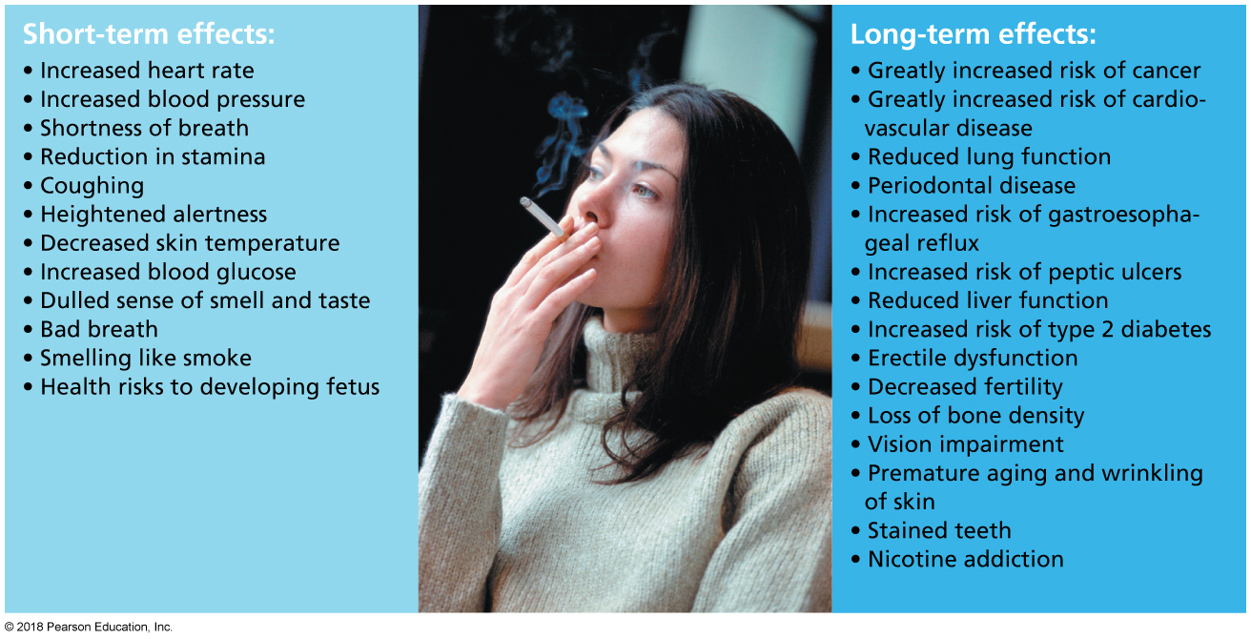
Short- and Long-Term Health Effects of Smoking
Notes:
FIGURE 9.5 Short- and Long-Term Health Effects of Smoking.

Slide 50
Smoking and Pregnancy
When a pregnant woman smokes, so does her unborn baby.
Babies born to women who smoke are two to three times more likely to die of sudden infant death syndrome than babies born to women who don’t smoke.
They are more likely to be born prematurely.
They are more likely to weigh less than 5.5 pounds at birth, increasing their risk for illness or death.
Smoking while pregnant has been linked to miscarriages and stillbirths.

Slide 51
Secondhand Smoke
The smoke to which nonsmokers are exposed when someone has been smoking nearby:
It contains more than 250 chemicals known to be toxic or capable of causing cancer.
Some chemicals are present in higher concentrations in secondhand smoke than in the smoke inhaled by the smoker.
A combination of sidestream smoke and mainstream smoke:
Sidestream smoke is smoke emanating from the burning end of a cigarette or pipe.
Mainstream smoke is exhaled smoke.

Slide 52
Health Effects of Secondhand Smoke
Irritation of the eyes, nose, throat, and lungs.
Chest pain, coughing, and production of excessive phlegm.
Premature death and disease.
Among nonsmokers, a 25–30% increased risk of heart disease.
Lung cancer.
Respiratory illness, including asthma, in children.
Ear infections in children.
Sudden infant death syndrome in some babies.

Slide 53
OTHER FORMS OF TOBACCO

Slide 54
Other Forms of Tobacco
Cigars: Contain the same addictive, toxic, cancer-causing substances that cigarettes do.
Clove cigarettes: No evidence that they are any safer than cigarettes.
Bidis: Not safer than cigarettes.
Smokeless “spit” tobacco: Associated with an increased risk of cancer and leukoplakia.
Leukoplakia: White spots on the mucous membranes in the mouth that may become cancerous.
Frequently found in snuff and chew users in their 20s.
Electronic cigarettes: Battery-operated devices that deliver nicotine in vapor form.

Slide 55
Video: GMA Investigates Liquid Nicotine

Slide 56
Video: GMA Investigates Liquid Nicotine
Discussion Questions
What are the dangers of liquid nicotine?
Why might liquid nicotine appeal to children?
What are the symptoms of sickness from nicotine?

Slide 57
GETTING HELP TO QUIT SMOKING

Slide 58
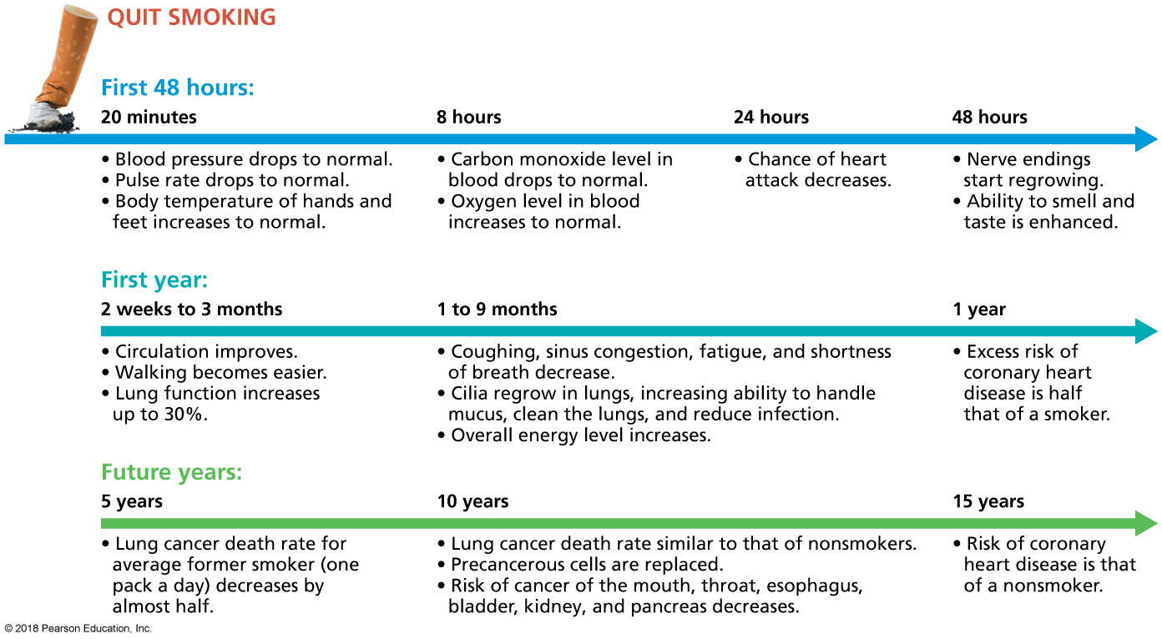
Benefits of Quitting Smoking
Notes:
FIGURE 9.6 Benefits of Quitting Smoking. The health benefits of quitting smoking begin the moment you stop.

Slide 59
Treatment Options
Nicotine replacement therapies: Gum, inhalers, nasal sprays, lozenges, and patches.
Prescription drugs: Chantix and Zyban.
Residential, individual, or group therapy and education and support groups.

Slide 60
Dealing with Relapse
Smokers commonly experience withdrawal symptoms when they first quit smoking.
Difficulty concentrating, a negative mood, and the urge to smoke.
Symptoms usually peak within one to two weeks.
Relapse can occur months or even years after quitting.
Any smoking increases the likelihood of a full relapse.

Slide 61
Change Yourself, Change Your World
Personal choices:
Prepare to quit.
Identify a support system.
Identify triggers.
Learn your options.
Campus advocacy:
See the American College Health Association’s policy.
Prohibit smoking, sales and advertising, provide accessible treatment programs, prohibit athletics programs from accepting funding from tobacco companies, prohibit the university from holding stocks in or accepting donations from the tobacco industry.

