Slide 1
Chapter 4: Sleep, Your Body, And Your Mind
Lecture Outlines by
Sloane Burke Winkelman
California State University, Northridge

Slide 2
Did You Know?
More than half of all American teens and adults say they experience a sleep problem almost every night.
About 15% of American adults say they sleep fewer than 6 hours on weeknights.
Americans aged 19–29 have the latest bedtime of any age group—on average, 2 minutes before midnight.

Slide 3
Learning Objectives
LO 4.1 Describe the stages of a full night’s sleep.
LO 4.2 Identify the benefits of ample sleep and the risks of sleep deprivation.
LO 4.3 Discuss a variety of factors that influence sleep.
LO 4.4 Define and describe insomnia, sleep apnea, and parasomnias.
LO 4.5 Discuss the clinical diagnosis and treatment of sleep disorders.
LO 4.6 Identify strategies for improving the quantity and quality of your sleep.

Slide 4
What Is Sleep?
Sleep is a physiologically prompted, dynamic, and readily reversible state of reduced consciousness essential to human survival.

Slide 5
What Is Sleep? (cont.)
Regions and rhythms of sleep
Sleep is generated and maintained by structures in all three primary regions of the brain:
The brain stem.
The diencephalon.
The cerebrum.

Slide 6
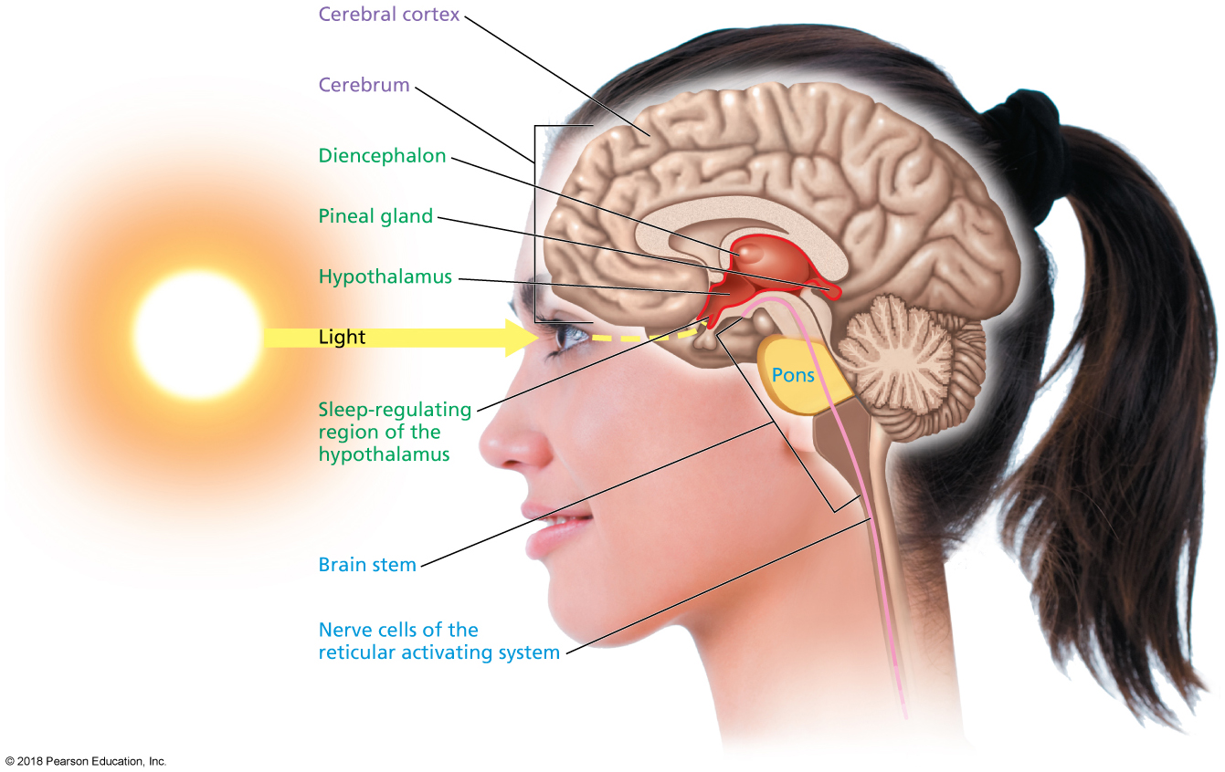
Brain Regions and Structures Involved in Sleep
Notes:
FIGURE 4.1 Brain Regions and Structures Involved in Sleep.

Slide 7
What Is Sleep? (cont.)
The brain stem is the lowest part of the brain and contains several specialized nerve cells.
The reticular activating system (RAS) helps regulate sleep.
The pons sends signals to initiate REM sleep.

Slide 8
What Is Sleep? (cont.)
The diencephalon is a region of the brain stem and contains two structures especially important to sleep:
The hypothalamus.
The pineal gland.
Both structures help regulate the body’s circadian rhythm.
Circadian rhythm: The body’s distinctive 24-hour pattern of wakefulness and sleep.

Slide 9
What Is Sleep? (cont.)
The cerebrum consists of the tissue located immediately beneath your skull.
The cerebral cortex is the outermost surface.
It is the thinking area of the brain.
Different stages of sleep can be distinguished in the patterns of its electrical activity.

Slide 10
What Is Sleep? (cont.)
Stages of sleep
Non-REM (NREM) sleep: Type of restful sleep during which the rapid eye movement characteristic of dreaming does not typically occur
NREM sleep has four stages.
Stage 1: Falling asleep; lasts just a few minutes.
Stage 2: Light sleep; majority of time is spent in this stage.
Stages 3 and 4: Beginning of deep sleep, then deep sleep; breathing and pulse lower even more.
Stage 5: Deep Sleep

Slide 11
Characteristic Brain Waves for Each Stage of Sleep
Notes:
FIGURE 4.2 Stages of Sleep. Drowsiness is followed by four stages of NREM sleep and a fifth stage of REM sleep. Brain activity gradually slows and lengthens in NREM sleep, only to speed up again in REM sleep.

Slide 12
What Is Sleep? (cont.)
REM sleep: Type of wakeful sleep during which rapid eye movement and dreaming occur
This fifth stage of sleep is prompted by signals from the pons in the brain stem.
Muscle movement is inhibited in all but three groups: respiratory system, inner ear, and eyes.
Cycles of sleep in which the stages of sleep shift in order and length throughout the night.

Slide 13
Sleep: How Much and Why It Matters
Sleep debt: An accumulated amount of sleep loss that develops when the amount of sleep you routinely obtain is less than the amount you need.
On average, people who sleep at least 7 hours a night experience greater longevity.
Several other studies have also shown that a moderate increase in sleep duration (to more than 8 hours) improves not only alertness and performance but also mood.

Slide 14
Sleep: How Much Is Enough?
Most adults need 7 to 9 hours of sleep each night to feel alert and well rested. Less than 7 hours is referred to as short sleep, whereas more than 9 hours is considered long sleep.
1 in 5 American adults experiences very short sleep—less than 6 hours—on weeknights.
Average number of hours American adults sleep on weeknights is 6.8 (short sleep).

Slide 15
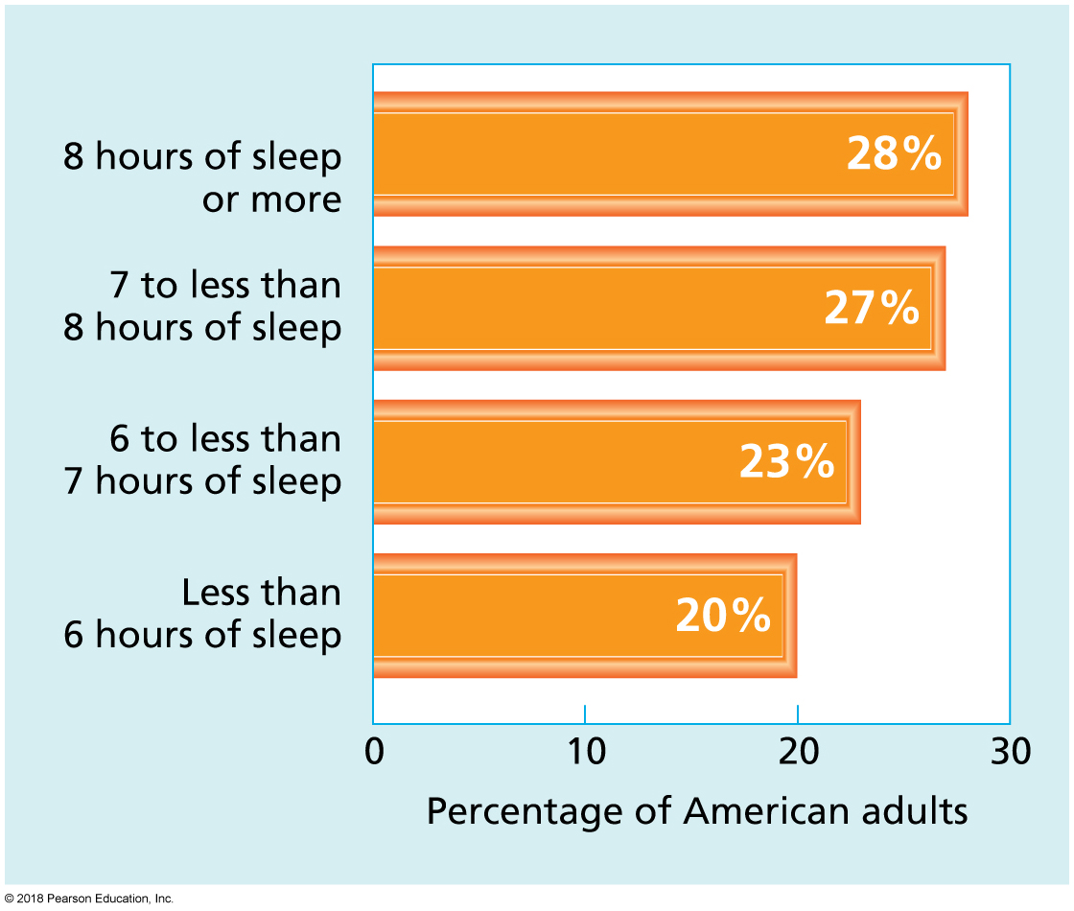
Sleep in America
Notes:
FIGURE 4.4 Sleep in America. Only 28% of American adults get 8 or more hours of sleep a night.
Source: Data from the 2009 Sleep in America Poll: Health and Safety, from the National Sleep Foundation website, 2009.

Slide 16
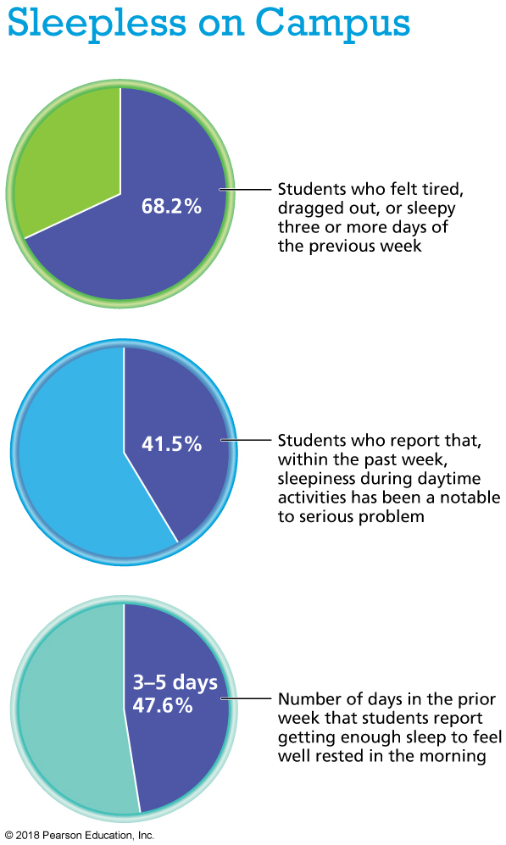
Sleepless on Campus
Notes:
Source: American College Health Association. (2015). ACHA-NCHA II: Undergraduate reference group executive summary, spring 2015. www.acha-ncha.org.

Slide 17
Why Is Ample Sleep Important?
Health effects:
Short sleep reduces your immune system’s effectiveness, and increases the risk of chronic disease and depression.
Effects on academic performance:
Sleep is closely related to college students’ learning capacity.
Sleep after studying dramatically improves recall in a process called memory consolidation.
Risk for traumatic injury.

Slide 18
Video: Dozing and Driving

Slide 19
Video: Dozing and Driving
Discussion Questions
What methods can be used to quell drowsiness while driving?
What should the consequences be for those who cause accidents from drowsy driving?
List the symptoms of dozing while driving.

Slide 20
Which Factors Influence Sleep?
Biology and genetics:
Genetic, gender, and ethnic differences in sleep patterns all exist, but environmental and behavioral factors are considered more important.

Slide 21
Which Factors Influence Sleep? (cont.)
Individual behaviors:
Avoid pre-sleep use of technology.
Such devices can be “alerting.”
Backlit screens can disturb your circadian rhythm.
Avoid eating a full meal before going to bed due to GERD.
Spicy foods can raise body temperature.
Avoid stimulants—smoking, caffeine, stimulant medications.
Alcohol may interfere with your second sleep cycle.
Factors in the environment—for example, noise, lighting, shift in work hours, and travel.

Slide 23
Sleep Disorders
Insomnia literally means “no sleep.”
A condition characterized by difficulty falling or staying asleep, a pattern of waking too early, or poor-quality sleep.
Primary insomnia: Almost always a result of stress.
Secondary insomnia: Most common; result of substance abuse or other medical disorder.
Snoring: A ragged, hoarse sound that occurs during sleep when breathing is obstructed.

Slide 24
Sleep Disorders (cont.)
Sleep apnea: A disorder in which one or more pauses in breathing occur during sleep.
There are two types:
Obstructive sleep apnea: The airway collapses or becomes blocked; most common.
Central sleep apnea: The brain doesn’t send the correct signals to the respiratory muscles.
Diagnosis is made through a physical exam or a polysomnogram.
Treatments differ depending on the severity.

Slide 25
Obstructive Sleep Apnea
Notes:
FIGURE 4.5 Obstructive Sleep Apnea. (a) During normal sleep, the airways at the back of the mouth and throat remain open. (b) In obstructive sleep apnea, tissues at the back of the mouth and throat are collapsed, blocking the airways. (c) CPAP generates a wave of air that continuously presses against the sleeper’s tissues, keeping the airways open.

Slide 26
Sleep Disorders (cont.)
Narcolepsy: A disorder in which the brain fails to regulate sleep–wake cycles normally.
Parasomnias:
Sleep terrors.
Sleepwalking.
Sleep bruxism (clenching or grinding your teeth).
Nocturnal eating.
REM behavior disorder (RBD).
Restless legs syndrome (RLS).

Slide 27
Getting Help for a Sleep Disorder
Many campuses are proactively addressing sleep deprivation:
Starting classes later.
Instituting quiet hours in the dorm.
Holding sleep strategy seminars and workshops.

Slide 28
Getting Help for a Sleep Disorder (cont.)
If sleep problems persist beyond one month, it’s time to see your doctor.
You may be referred to a sleep clinic.
Sleep medications are not generally recommended because of their highly addictive nature.
Cognitive-behavioral interventions can be effective in changing behaviors that contribute to troubled sleep.
They include muscle relaxation, deep breathing, and “worry control.”

Slide 29
Getting Help for a Sleep Disorder (cont.)
Complementary and alternative therapies:
Herbal therapies are not harmful, but have not been proven helpful.
Melatonin supplements show promise.
Various forms of physical activity can significantly improve sleep.

Slide 30
Change Yourself, Change Your World
Personal choices:
Investing in sufficient, regular sleep will pay off with improved academic performance and health.
Self-monitor your sleep.
Improve your ability to fall asleep and stay asleep.

