Slide 1
Chapter 5: Nutrition
Lecture Outlines by
Sloane Burke Winkelman
California State University, Northridge

Slide 2
Did You Know?
The average person in the United States consumes 23 teaspoons of added sugars every day.
A meal consisting of a McDonald’s Big Mac, large fries, and small iced mocha contains 1,340 calories, 13% of which are from saturated fat.
Eight foods cause more than 90% of all food allergies: milk, eggs, peanuts, tree nuts, soy, wheat, fish, and shellfish.

Slide 3
Learning Outcomes
LO 5.1 Describe the six classes of nutrients and explain their functions in the body.
LO 5.2 Discuss the potential benefits and concerns related to consumption of functional foods and dietary supplements.
LO 5.3 Demonstrate how to use the DRIs, MyPlate, and other resources to design a healthful diet.
LO 5.4 Describe ways to reduce your risk for foodborne illness, manage food allergies and intolerances, and avoid environmental contaminants.
LO 5.5 Identify strategies for making nutritious, inexpensive choices when shopping, cooking, and eating out.

Slide 4
WHAT ARE NUTRIENTS?

Slide 5
Nutrients
Chemicals the body derives from food and requires for energy, growth, and survival.
During digestion, the food you eat is broken down into nutrients that are small enough to be absorbed into the bloodstream.

Slide 6
Nutrients (cont.)
Six major classes of nutrients are found in food:
Carbohydrates
Fats (more appropriately called lipids)
Proteins
Vitamins
Minerals
Water

Slide 7
Energy and Calories
Macronutrients
Nutrients your body needs in relatively large quantities:
Carbohydrates
Fats
Proteins
Water
Carbohydrates, fats, and proteins are known as energy-yielding nutrients.
They provide you with the energy needed to move, think, and survive.

Slide 8
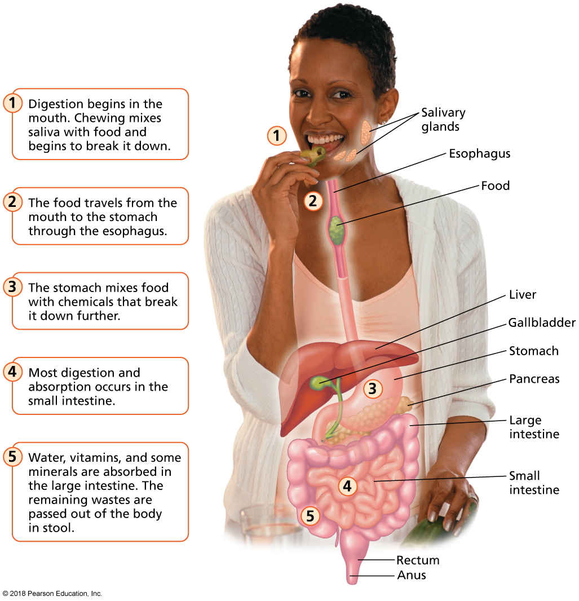
The Digestive Process
Notes:
FIGURE 5.1 The Digestive Process. Digestion is the process of breaking food down into nutrients that can be used by the body for energy.

Slide 9
Calorie
A common term for kilocalorie (kcal), a calorie is the amount of energy required to raise the temperature of 1 kilogram of water by 1 degree Celsius.
Energy nutrients differ in calorie content.
Vitamins, minerals, and water provide no energy.

Slide 10
Carbohydrates
A macronutrient class composed of carbon, hydrogen, and oxygen, which serves as the body’s universal energy source.
Two categories of carbohydrates:
Simple: 1–2 sugar molecules
Complex: Chains of multiple sugar molecules; commonly called starches but also come in two non-starch forms—glycogen and fiber
Sugar molecules are the basic building blocks of carbohydrates.

Slide 11
Simple Carbohydrates
Constructed from just one or two sugar molecules.
This means they are more easily digested.
Often known simply as sugars, six of which are important in nutrition:
Glucose, fructose (fruit sugar), galactose, maltose, sucrose (table sugar), lactose (milk sugar)
The average U.S. adult consumes an estimated 76.7 pounds of added sugars each year.

Slide 12
Simple Carbohydrates (cont.)
The most basic unit of carbohydrates, consisting of one or two sugar molecules.
Your body is unable to distinguish between natural sugars and added sweeteners.

Slide 13
Complex Carbohydrates
Made up of chains of multiple sugar molecules.
Take longer to digest.
Often called starches, except for
Glycogen: A storage form of glucose in animal tissues.
Fiber: A nondigestible component of plants.
Found in a variety of plants (grains, legumes, vegetables, fruits).

Slide 14
Facts About Fiber
Fiber passes through the intestines without being digested or absorbed. It has many health benefits:
Weight control
Bowel health
Cardiovascular health
Blood glucose control

Slide 15
Fiber Sources and Recommendations
Found naturally in grains, legumes, fruits, vegetables, nuts, and seeds.
Recommendations vary by gender and age:
Men should consume 38 grams daily.
Women should consume 25 grams daily.
Persons 50 years and older should consume 30 grams (men) and 21 grams (women) daily.

Slide 16
Choose Whole Grains
Unrefined grains, or whole grains, consist of three parts: bran, germ, and endosperm.
Examples: Rolled oats, popcorn, brown rice, whole wheat, rye, and quinoa.
The bran and germ contain vitamins, minerals, fiber, phytochemicals, and antioxidants.
Help maintain body functions.
May reduce risk of certain diseases.
Refined grains include only the endosperm, so they have less fiber and fewer nutrients.
Examples: White bread, most pasta, white rice, most baked goods.

Slide 17
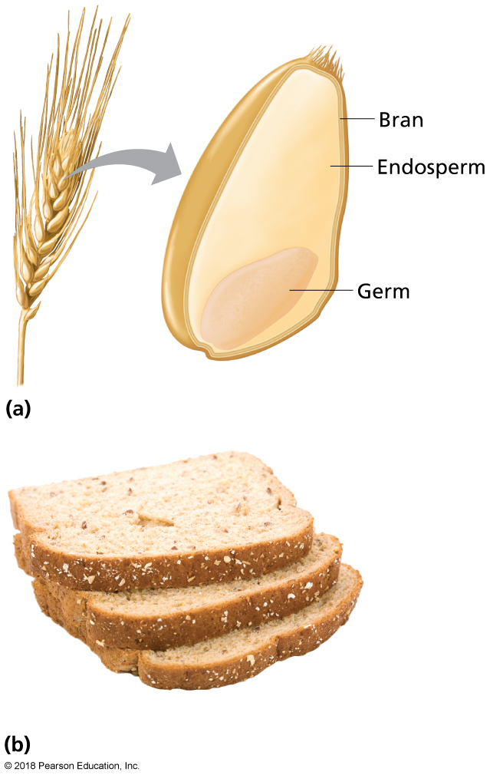
Whole Grains
A whole grain includes the bran, endosperm, and germ. Whole-wheat bread is an excellent source of whole grain.
Notes:
FIGURE 5.2 Whole Grains. (a) A whole grain includes the bran, endosperm, and germ. (b) Whole wheat bread is an excellent source of whole grain.

Slide 18
Video: Grain Labels Do Not Reflect “Whole” Truth

Slide 19
Video: Grain Labels Do Not Reflect “Whole” Truth
Discussion Questions
How can we raise consumer awareness that there is a discrepancy between the marketing of grain products and the actual contents of grain products for consumption?
How can companies be held to a better standard to be more honest regarding the contents of products?
Provide an argument for the need for the FDA to define whole grains.

Slide 20
Does Glycemic Index Matter?
Glycemic index (GI): A value indicating the potential of foods to raise the level of glucose (a simple sugar) in the bloodstream.
Foods with a high GI may increase a person’s risk for type 2 diabetes, weight gain, and acne.

Slide 21
Recommended Carbohydrate Intake
Adults aged 19 years of age or older should consume an absolute minimum of 130 grams of carbohydrates each day.
Adults should consume approximately half of their total daily calories as carbohydrates.

Slide 22
Fats
Fats (also known as lipids) are a group of substances that are not soluble in water.
They help the body absorb fat-soluble vitamins.
They cushion and insulate the organs.
They add flavor and tenderness to foods.
Fats are the most concentrated energy source in the diet (9 calories per gram).
Lipids supply your body with energy both during activity and during sleep.

Slide 23
Fats Are One of Three Types of Food Lipids
Two other lipids are present in foods.
Phospholipids: Least common dietary lipids. Found in peanuts, egg yolks, and some processed foods.
Cholesterol: An animal sterol found in the fatty part of animal-based foods such as meat and whole milk.
You don’t need to consume cholesterol or phospholipids in your diet, as both are produced by the body.

Slide 24
Fats (cont.)
Dietary fats are more precisely known as triglycerides.
These compounds contain the chemical glycerol attached to three fatty acid chains.
Depending on the structure of the chains, one of three fats is formed:
Saturated fats
Unsaturated fats
Trans fats
Most fatty foods contain all three types of fats.

Slide 25
Saturated Fats
Fatty acid chains that are saturated with hydrogen.
Solid at room temperature.
Found in animal products, dairy products, and tropical oils.
Can increase the level of low-density lipoprotein (LDL) cholesterol in the blood.
A high level of LDL and/or total blood cholesterol is a major risk factor for heart disease, increases stroke risk, and can lead to a heart attack.

Slide 26
Saturated Fats (cont.)
Ice cream, unfortunately, is loaded with saturated fat.

Slide 27
Unsaturated Fats
Fatty acid chains that have one or more areas not saturated with hydrogen.
Typically liquid at room temperature.
Often referred to as oils.
Generally come from plant sources.
There are two types:
Monounsaturated (examples: canola oil, peanut oil, nuts, avocado).
Polyunsaturated (examples: corn oil, soybean oil, safflower oil); also considered an essential fatty acid (EFA)

Slide 28
Avoid Trans Fats
Hydrogenation changes unstable, unsaturated oils into more stable, saturated solid fats called trans fats.
Occur almost exclusively in processed foods—vegetable shortening, commercially prepared baked goods, and snack foods.
Should be avoided.
Linked to high blood pressure, heart disease, stroke, and other health problems.

Slide 29
Recommended Fat Intake
Fats should make up between 20% and 35% of total calories.
Trans fat intake should be kept to an absolute minimum.
Saturated fats: Less than 7–10% of calories, or about 140–200 calories in a 2,000 calorie/day diet.
Omega-6 fatty acids: About 14–17 g per day for men and about 11–12 g per day for women.
Omega-3 fatty acids: About 1.6 g per day for men and about 1.1 g per day for women.

Slide 30
Proteins
Protein is a macronutrient that helps builds cells and tissues, including muscle, bone, skin, and blood.
Found in both animal and plant sources.
Many sources of protein are high in cholesterol and saturated fat.

Slide 31
The Role of Amino Acids
Eleven amino acids can be produced by the body.
Nine essential amino acids must be consumed from food.
Complete proteins supply all amino acids in adequate amounts.
Meat, fish, poultry, dairy products, soy.
Incomplete proteins lack some essential amino acids.
Legumes, grains, vegetables, seeds.
Combinations of plant proteins can yield complete proteins.

Slide 32
Recommended Protein Intake
Recommended RDA: 10–35% of caloric intake.
Intake above or below this range increases the risk of some chronic diseases.
Few people in the United States suffer from protein deficiencies.
Amino acids: Nitrogen-containing compounds that are the building blocks of protein.

Slide 33
Vitamins
Compounds with no energy value of their own that are needed by the body in small amounts for normal growth and function.
They regulate body processes such as blood-cell production, nerve function, digestion, and skin and bone maintenance.
They help chemical reactions take place.

Slide 34
Vitamins (cont.)
Humans need 13 vitamins.
The fat-soluble vitamins A, D, E, and K dissolve in fat and can be stored in the body’s fatty tissues.
The water-soluble vitamins dissolve in water, and excess amounts are generally excreted from the body in urine.
These include vitamin C and the B-complex vitamins (thiamin, riboflavin, niacin, pantothenic acid, B₆, biotin, folic acid, and B₁₂).
Adequate amounts should be consumed daily.
Vitamin D can be manufactured in the skin with adequate sun exposure (5–30 minutes between10:00 a.m. and 3:00 p.m.).

Slide 35
Vitamins (cont.)
Vitamins can be obtained in various amounts through eating:
Fruits
Vegetables
Whole grains
Meat and dairy products
Vitamin deficiencies in persons living in the United States are rare.
Excess consumption from supplements can lead to unpleasant side effects.

Slide 36
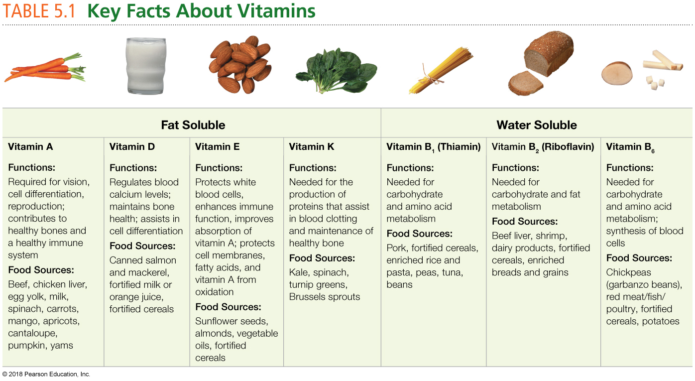
Notes:
Source: Adapted from Thompson, Janice, Melinda Manore, and Linda Vaughan, The Science of Nutrition, 4th ed., © 2017, pp. 294–295. Reprinted and electronically reproduced by permission of Pearson Education, Inc., Upper Saddle River, New Jersey.

Slide 37
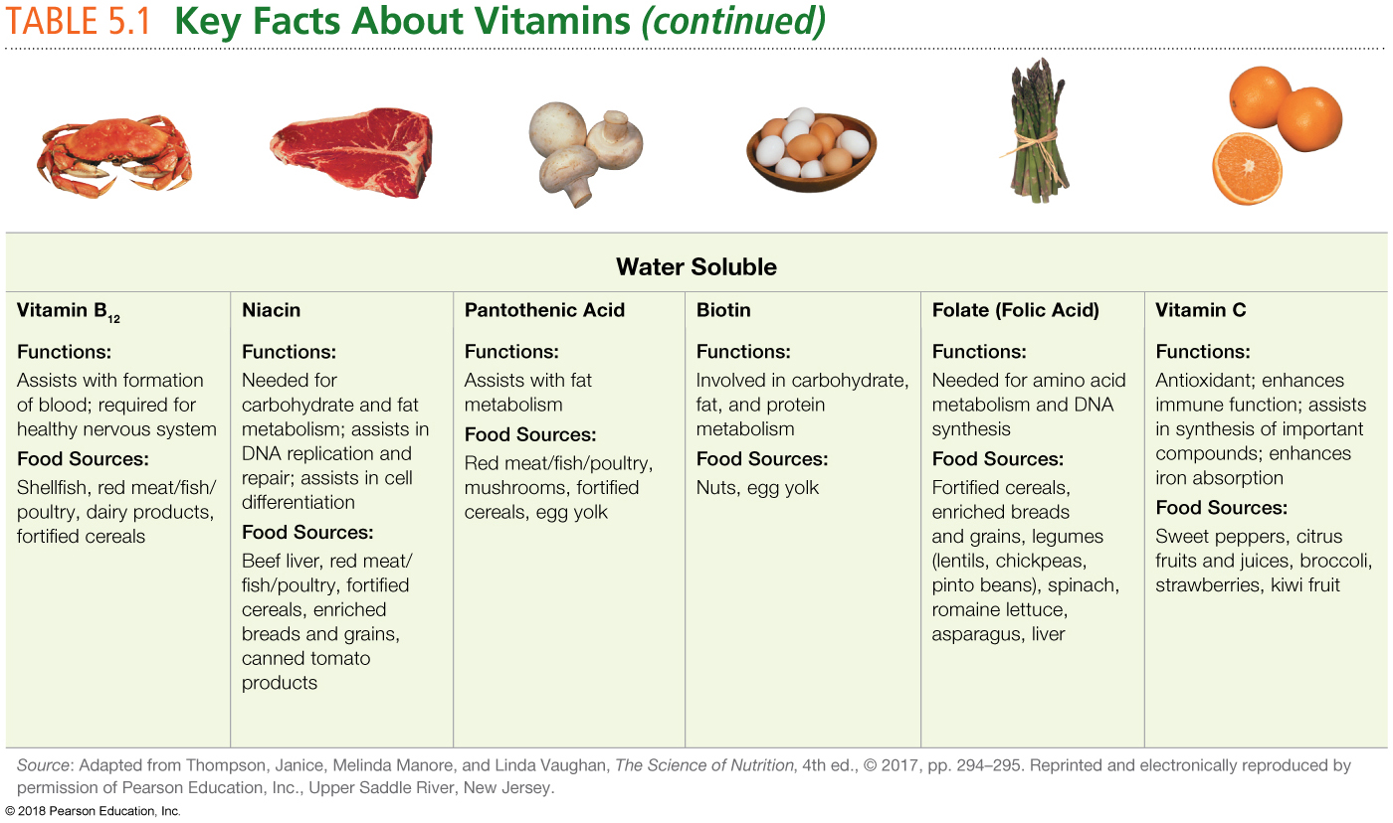

Slide 38
Minerals
Elements needed by the body to regulate functions and provide structure.
Minerals in your diet come from a wide variety of plant and animal foods, and even from the water you drink.
A varied diet fulfills most mineral needs.
Supplements are not recommended for most healthy people, but may be necessary for some populations.

Slide 40
Water
Necessary for life; you can live for only a few days without water.
Dispersed throughout the body.
Vital to body functions:
Nutrient digestion
Absorption
Transportation
Also lubricates tissues, regulates body temperature, provides moisture to skin and other tissues, carries wastes out of the body, and contributes to a feeling of fullness when consumed with a meal.

Slide 41
Sources of Water
Bottled water
Sports beverages
Milk and milk substitutes
Sweetened beverages
Beverages containing caffeine

Slide 42
Recommended Water Intake
Women: Nine cups (2.2 liters) per day
Men: 13 cups (3 liters) per day

Slide 43
What About Functional Foods and Dietary Supplements
Functional foods are foods thought to confer health benefits beyond those provided by their basic nutrients.

Slide 44
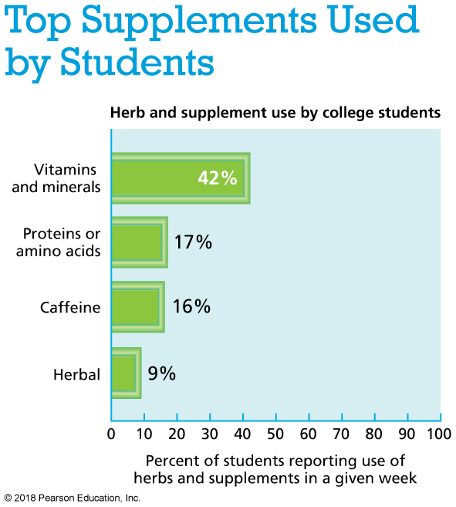
Notes:
Data from “Patterns of dietary supplement use among college students” by H. R. Lieberman, B. P. Marriott, C. Williams, et al., 2015, Clinical Nutrition, 34(5), 976–985. doi: 10.1016/j.clnu.2014.10.010.

Slide 45
OTHER HEALTHFUL SUBSTANCES IN FOOD

Slide 46
Phytochemicals
Naturally occurring plant substances thought to have disease-preventing qualities and health-promoting properties.
Sources include fruits, vegetables, legumes, nuts, seeds, and grains.
Provide non-essential nutrients:
Carotenoids
Flavonoids
Organosulfur compounds

Slide 47
Antioxidants
Oxidation reactions: Everyday body-functioning chemical reactions.
Antioxidants: Compounds in food that help protect the body from harmful molecules called free radicals.
Free radicals start chain reactions that can damage cells.
Environmental factors can contribute to free radical production.
Free radical damage has been linked to health problems:
Cancer
Heart disease
Alzheimer’s dementia
Parkinson’s disease
Arthritis

Slide 48
Antioxidants (cont.)
Free radical damage can be neutralized by antioxidants:
Vitamins C and E and beta-carotene
Selenium (a mineral)
Phytochemicals
Antioxidants stabilize free radicals.
Sources:
Fruits and vegetables
Whole grains
Nuts
Legumes

Slide 49
Probiotics and Prebiotics
Probiotics are living, beneficial microbes that develop naturally in fermented dairy food such as yogurt, buttermilk, and kefir and fermented vegetables.
Help maintain digestive functions and promote health.
Prebiotics are nondigestible food ingredients that benefit human health by stimulating the growth and/or activity of beneficial bacteria in the large intestine.

Slide 50
Video: Coconut: How Healthy Is the Superfood?

Slide 51
Video: Coconut: How Healthy Is the Superfood?
Discussion Questions
What are some potential drawbacks to using coconut products?
Under what circumstances might it be beneficial to use coconut products?
Explain why people who exercise often might want to drink coconut water.

Slide 52
WHAT TOOLS CAN HELP YOU EAT RIGHT?

Slide 53
Dietary Reference Intakes (DRIs)
A set of energy and nutrient recommendations for supporting good health.
Estimated Average Requirement (EAR)
Recommended Dietary Allowance (RDA)
Adequate Intake (AI)
Tolerable Upper Intake Level (UL)
Estimated Energy Requirement (EER)
Acceptable Macronutrient Distribution Range (AMDR)

Slide 54
Food Labels
Use the Nutrition Facts panel to learn:
Serving size and servings per container.
Calories and calories from fat.
List of nutrients and Percent Daily Value (% DV): The percentage that a serving of the food would contribute to daily needs based on a 2,000-calorie diet.
Footnote for Daily Values.

Slide 55
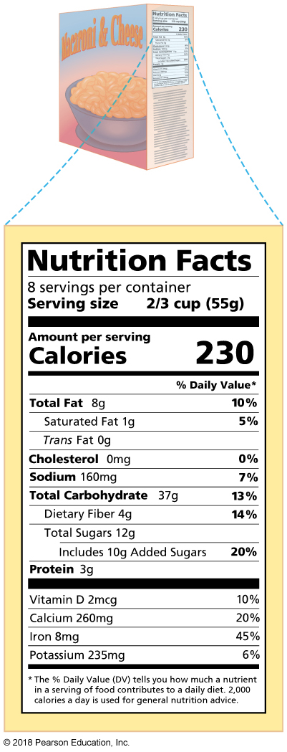
Read Food Labels Wisely
Notes:
FIGURE 5.4 Read Food Labels Wisely. When reading a Nutrition Facts panel, note the serving size, calories per serving, and nutrients per serving.

Slide 56
Video: Changes Coming to Nutrition Labels

Slide 57
Video: Changes Coming to Nutrition Labels
Discussion Questions
Explain the changes being made to calorie information on nutrition labels and the reasons for those changes.
What are some examples of foods for which serving size amounts will change?
How might these changes affect a person’s food choices?

Slide 58
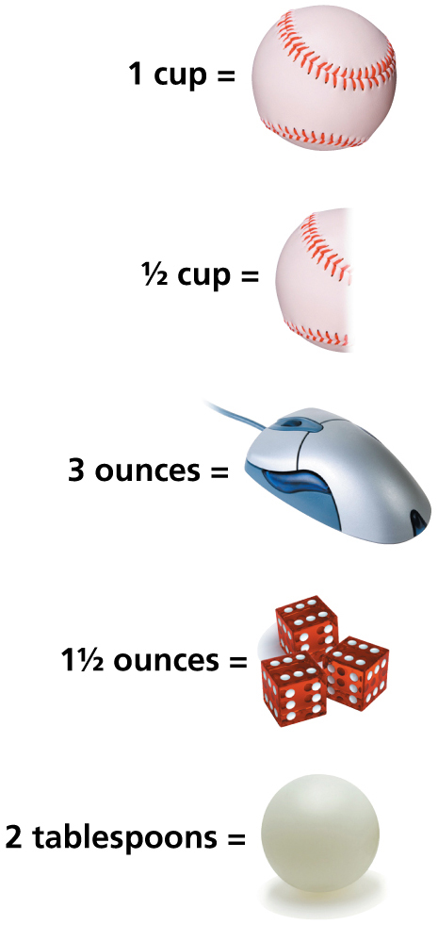
Estimating Serving Sizes
Notes:
FIGURE 5.5 Estimating Serving Sizes. Comparing food amounts to common household items can help you estimate the serving sizes of your foods.

Slide 59
Dietary Guidelines for Americans
MyPlate
Learn about different foods and food groups.
Analyze your current diet and physical activity level.
Get a personalized daily food plan.
Find tips for healthy eating and for increasing physical activity.
Learn how to plan healthful menus.
Get information on how to lose weight.

Slide 60
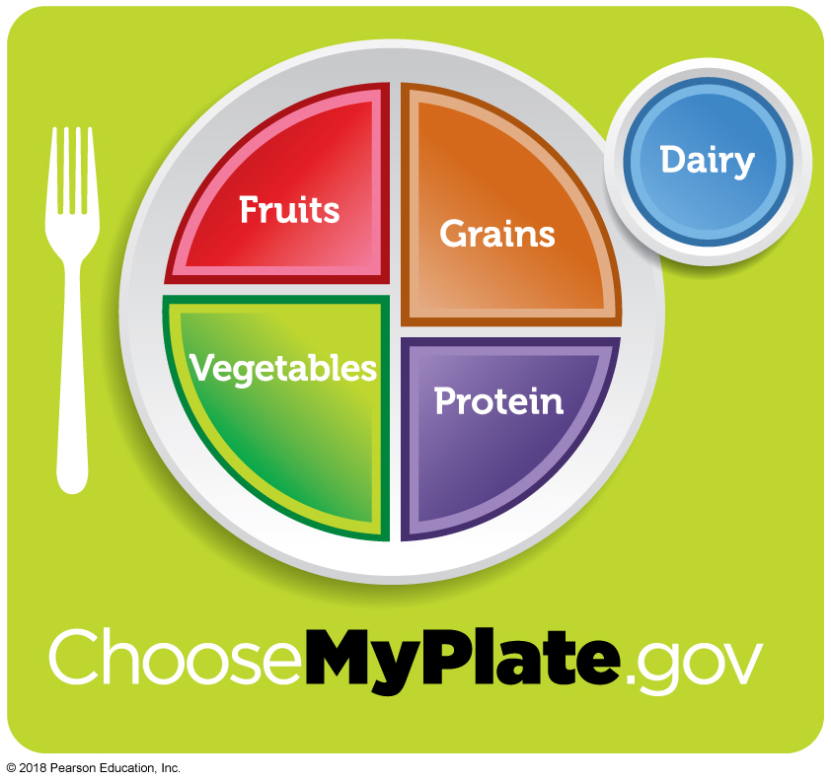
The USDA’s MyPlate
Notes:
FIGURE 5.6 The USDA’s MyPlate. To generate your personalized MyPlate plan, visit www.choosemyplate.gov.

Slide 61
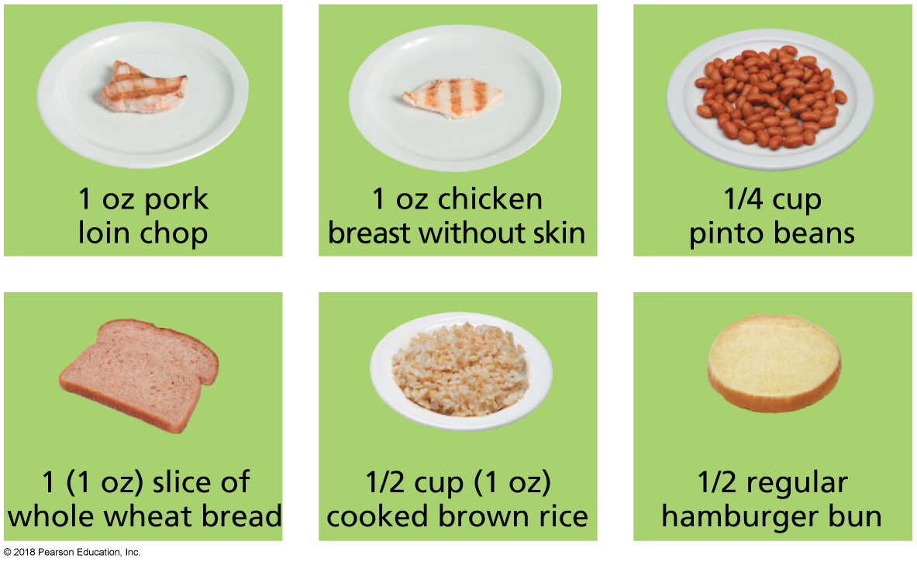
What’s an “Ounce-Equivalent”?
Notes:
FIGURE 5.7 What’s an “ounce-equivalent”?
Here are sample 1-“ounce-equivalent” servings of various meats, beans, and grains.

Slide 62
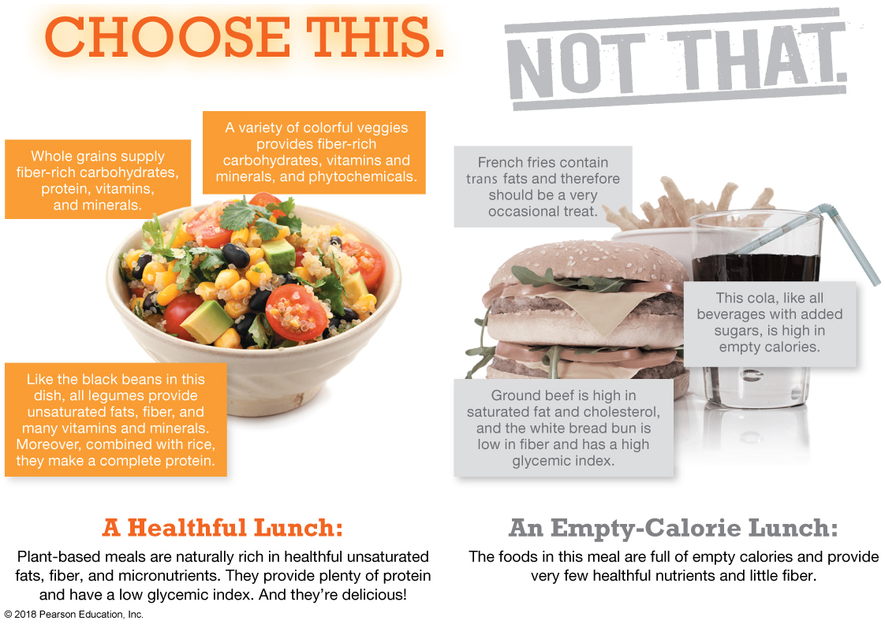

Slide 63
IS OUR FOOD SUPPLY SAFE?

Slide 64
Foodborne Illness
Also known as food poisoning.
Illness caused by ingesting foods or beverages contaminated with pathogenic microorganisms or their toxins.
Animal protein foods (poultry, eggs), sponges, dish towels, cutting boards, wooden utensils, and human hands are common hosts for foodborne bacteria.
Campylobacter
Salmonella
E. coli
Effects can include fever, diarrhea, vomiting, dehydration, and death.

Slide 65
Reducing Your Risk for Foodborne Illness
Clean. Wash your hands, utensils, and cutting boards with warm water and soap before and after contact with raw red meat, poultry, seafood, and eggs.
Separate. Use different cutting boards and utensils for raw meat and foods that won’t be cooked.
Cook. Use a food thermometer to make sure that meat is cooked to a temperature that is safe for eating (above 140ºF).
Chill. Refrigerate leftover food within two hours.

Slide 66
Food Allergies and Intolerances
Food allergy: An adverse reaction of the body’s immune system to a food or food component.
It is estimated that millions of people in the United States have a food allergy.
Symptoms include swelling of the lips or throat, digestive upset, skin hives, breathing problems, and anaphylaxis (the most severe response, which causes most of the symptoms within minutes of exposure).
Anaphylaxis can progress to anaphylactic shock, which is usually fatal.

Slide 67
Food Allergies and Intolerances (cont.)
Eight foods cause more than 90% of all food allergies: milk, eggs, peanuts, tree nuts, soy, wheat, fish, and shellfish.
Food labels are required to identify these products.
Food intolerances: Adverse food reactions that don’t involve the immune system.
Reactions generally develop over a prolonged time.
The most common is lactose intolerance, the inability to properly digest the milk sugar lactose.
Gluten intolerance should not be confused with celiac disease.

Slide 68
Food Residues
Food residues are chemicals that are not naturally part of the food, but remain in the food despite cleaning and processing:
Pollutants
Pesticides

Slide 69
CHANGE YOURSELF, CHANGE YOUR WORLD

Slide 70
Personal Choices
Think smart when making choices.
Eat smart when eating out.
Shop smart when money is tight (legumes, canned tuna, lean meats, poultry and fish, whole grains, frozen vegetables, fresh and frozen fruits).

Slide 71
Campus Advocacy
Buying unhealthy foods encourages the sale of unhealthy foods.
Make friends with the staff at your dining hall or campus eateries and encourage nutritious, locally grown food choices.
Find out who is in charge of vending machines and request healthier foods to be included.
Join the National Student Campaign Against Hunger and Homelessness.

