Slide 1
Chapter 16: Your Environment, Your Health
Lecture Outlines by
Sloane Burke Winkelman
California State University, Northridge

Slide 2
Did You Know?
The global population increases by about 214,000 people every day.
The Arctic Ocean is expected to become free of summer ice by 2050.
Every day, every person in the United States creates about 4.4 pounds of trash.

Slide 3
Learning Outcomes
LO 16.1 Define environmental health and explain why it is a global concern.
LO 16.2 Explain how the world’s expanding population stresses the environment.
LO 16.3 Describe the effects of air pollution and climate change on health and the global environment.
LO 16.4 Identify the contaminants that most commonly enter a community’s water supply.
LO 16.5 Discuss management of municipal and hazardous waste.

Slide 4
Learning Outcomes (cont.)
LO 16.6 Analyze your home environment for potential sources of pollution.
LO 16.7 Identify factors that contribute to hearing loss.
LO 16.8 Identify potential sources of harmful levels of radiation.
LO 16.9 Explain how to improve environmental health in your community.

Slide 5
OVERVIEW OF ENVIRONMENTAL HEALTH

Slide 6
Environmental Health
Environmental health is the discipline that addresses all the physical, chemical, and biological factors external to individual human beings, especially those that influence human health.
Pollution is contamination of the natural environment as a result of human activities.
An ecosystem is a dynamic collection of organisms and their nonliving surroundings that functions as a unit.

Slide 7
Defining Your Environment
Health factors are influenced by the following:
The features of the natural world that surround you.
The human-made (or built) environment.
Social aspects, including socioeconomic status and factors in the community.
All humans share one global environment.

Slide 8
Environmental Health Is a Global Issue
The U.S. Environmental Protection Agency (EPA) protects human health and safeguards the natural environment (air, water, land).
Although the immediate ecosystem may be protected, global environmental protection is lacking.
The global effect of purchases we make in the United States can be costly.

Slide 9
Evolution of Environmental Health
A movement toward environmental health began more than a century ago.
Public health organizations began to develop policies to protect general health and welfare.
New concerns emerged about the effects of pesticides on health.
DDT, in particular, became a concern with the publication of Rachel Carson’s book Silent Spring.
The Intergovernmental Panel on Climate Change (IPCC) focuses on studying health effects of global climate change.

Slide 10
Toward Sustainability
Sustainability is the ability to meet society’s current needs without compromising future generations’ abilities to meet their own needs.
It includes policies for ensuring that certain components of the environment are not overtaxed, depleted, or destroyed.

Slide 11
Video: China Smog Creates What Some Call a King of Respiratory Nuclear Winter

Slide 12
Video: China Smog Creates What Some Call a King of Respiratory Nuclear Winter
Discussion Questions
According to the World Health Organization, what air quality index is considered safe? What was the air quality index in Beijing at the time of this report?
What causes the smog in China?
Does China’s poor air quality affect Americans? Explain your answer.

Slide 13
OVERPOPULATION

Slide 14
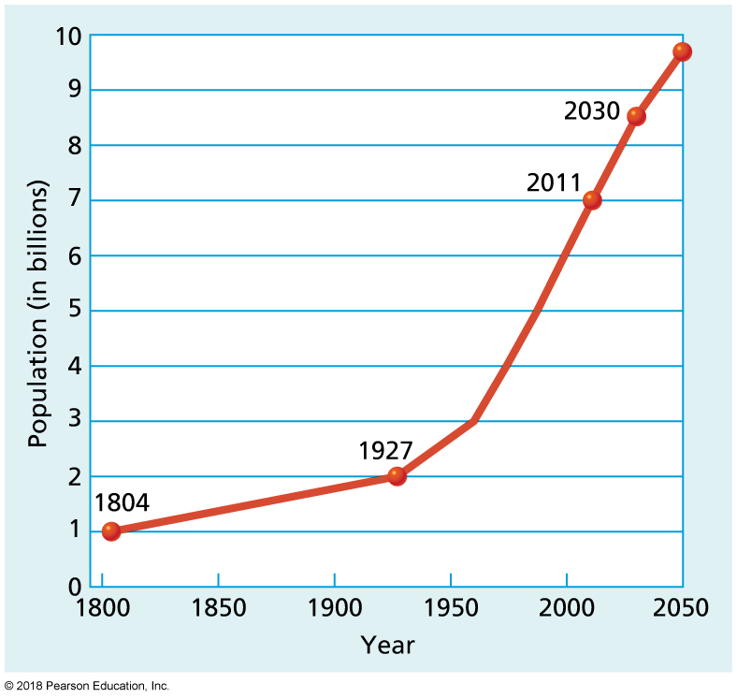
World Population Growth in Billions
Notes:
FIGURE 16.1 World Population Growth in Billions.
Source: Data from Population Division of the United Nations Department of Economic and Social Affairs. (2015). World population prospects: The 2015 revision, Figure 2, page 2. www.unfpa.org.

Slide 15
Factors Contributing to Population Growth
At the time of the United States’ founding, the world population was approximately 1 billion people.
In 2011, it reached 7 billion.
The number is estimated to exceed 9 billion by 2050.
Human demands on the environment continue to increase.
Some countries practice population control.
Ecological footprint: The collective impact of an entity on its resources, ecosystems, and other key environmental features.
Globalization: The interaction and integration of regional phenomena on a global scale.

Slide 16
AIR POLLUTION AND CLIMATE CHANGE

Slide 17
Air Pollution
Air provides the oxygen and carbon dioxide that support human, animal, and plant life.
Ozone shields us from excessive sunlight.
Naturally occurring greenhouse gases allow solar heat to reach the planet.
This delicately balanced system has been disrupted by the burning of fossil fuels, among other practices.

Slide 18
Evidence for Climate Change
The global temperature record shows an average warming of about 0.78C (1.4F) over the past century.
Arctic sea ice has been declining an average of 13.4% per decade.
Global sea level has risen by about 14 centimeters (5.5 inches) over the past century.
Worldwide, precipitation has increased by nearly 0.25 centimeters (about 0.1 inch) per decade over the past century.
The frequency, intensity, and duration of North Atlantic hurricanes have all increased in the past three decades

Slide 19
Environmental Phenomena Associated with Air Pollution
Air pollution causes several broad environmental phenomena:
Smog.
Global warming and climate change—a sustained increase in the Earth’s temperature due to an increase in the greenhouse effect resulting from pollution.
Thinning of the ozone layer.
Production of acid rain.

Slide 20
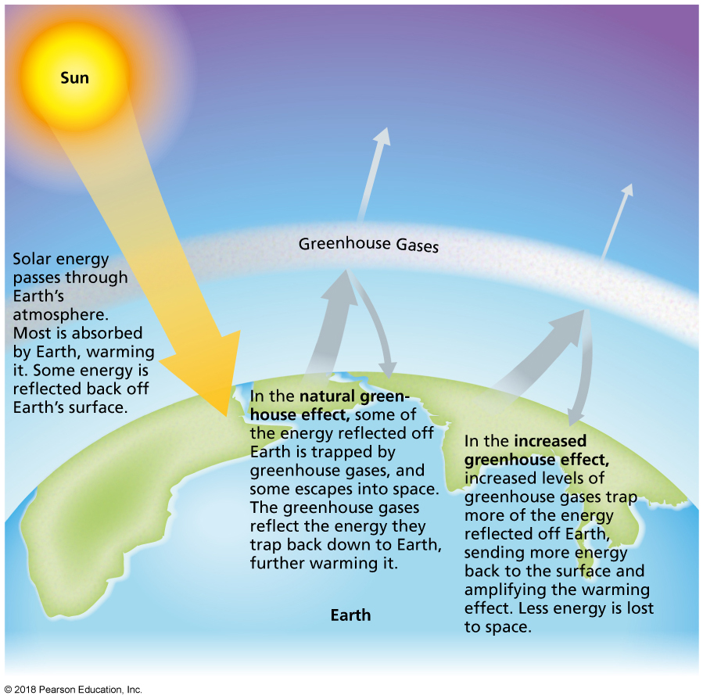
The Greenhouse Effect
Notes:
FIGURE 16.2 The Greenhouse Effect.

Slide 21
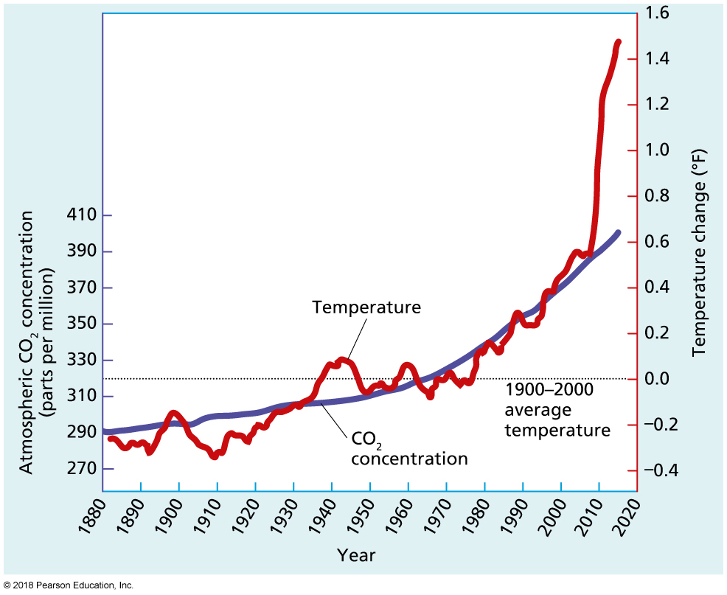
Increase in Global Surface Temperature and in Atmospheric CO₂ Levels, 1880–2015
Notes:
FIGURE 16.3 Increase in Global Surface Temperature and in Atmospheric CO₂ Levels, 1880–2015. The increase in temperature and atmospheric CO₂ levels parallels the burning of fossil fuels.
Source: Data from World Meteorological Organization. (2015, November 9). Greenhouse gas bulletin, no. 11. www.wmo.int; and U.S. Environmental Protection Agency. (2016, February 24). Climate change indicators, Figure
2: Temperatures worldwide, 1901–2014. www3.epa.gov.

Slide 22
WATER POLLUTION

Slide 23
Water Pollution
Water supports almost all aspects of life on Earth.
Drinking water is derived from surface-level fresh water and groundwater.
Only about 1% of water in the world is accessible.
By the year 2025, half of the world’s population will be living in water-stressed areas.

Slide 24
Pollutants Found in Water
Arsenic
Lead
Dioxins
Agricultural Chemicals

Slide 25
Is Bottled Water Worth It?
In 2014, second largest category of all beverages.
Water can be obtained from community water systems and private wells.
Bottled water is hugely popular, but it is important to consider the purchase carefully.
It tends to be more expensive than tap water.
It is not necessarily cleaner or safer than tap water.
Some brands are made from tap water!
Bottle recycling presents issues in some communities.
Certain terms and definitions are required when labeling bottled water.

Slide 26
LAND POLLUTION

Slide 27
Land Pollution
Municipal solid waste (MSW): Nonhazardous garbage or trash generated by industries, businesses, institutions, and homes.
Communities are encouraged to do their part to lessen the impact of garbage on the environment:
Reduction.
Reuse.
Recycling.
Composting.

Slide 28
Hazardous Waste and Its Management
Hazardous waste consists of garbage or byproducts that can pose a hazard to human health or the environment when improperly managed.
Hazardous e-waste is generated by the production or disposal of electronic or digital devices.
Superfund is a federal program that funds and carries out emergency and long-term identification, analysis, removal, and cleanup of toxic sites.

Slide 29
POLLUTION AT HOME

Slide 30
Pollutants in Food and Beverages
Bioaccumulation: The process by which substances increase in concentration in the fat tissues of living organisms as the organisms take in contaminated air, water, or food.
Biomagnification: The process by which certain contaminants become more concentrated in animal tissue as they move up the food chain.
Contaminants that have leached into products from packaging are sometimes consumed, such as a pollutant called bisphenol A (BPA), found in plastics.

Slide 31
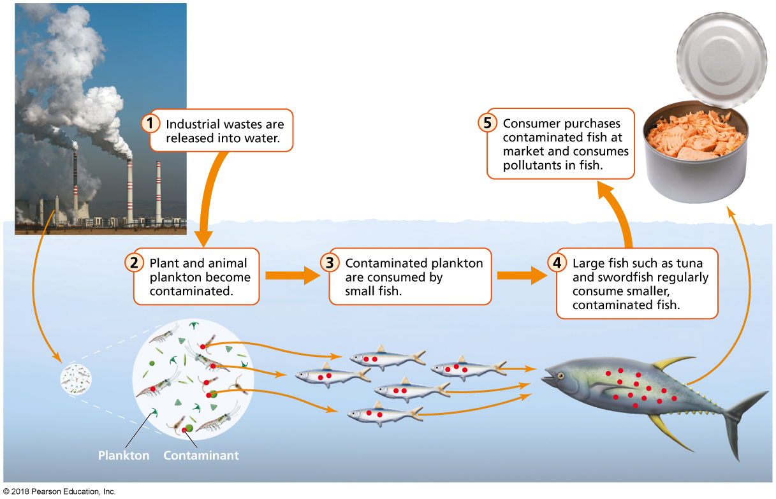
Biomagnification
Notes:
FIGURE 16.5 Biomagnification. The concentration of contaminants increases as animals higher and higher in the food chain consume contaminated animal tissue. Biomagnification can increase the concentration of pollutants like mercury in fish that we commonly eat, like tuna.
Source: Thompson, J., Manore, M., & Vaughan, L., The science of nutrition, 4th edition. © 2017. Printed and electronically reproduced by permission of Pearson Education, Inc., Upper Saddle River, NJ.

Slide 32
Pollutants in Indoor Air
Aspects of the home environment may release toxic fumes or other contaminants into indoor air:
Toxic fumes (e.g., paint, insulation materials).
Smoke from fireplace, tobacco, mold spores, lead dust, rodent droppings, dust mites, and pet dander.
Asbestos.
Radon.
Carbon monoxide (CO).
Volatile organic compounds (VOCs).

Slide 33
Health Effects of Pollutants at Home
Biomonitoring: Analysis of blood, urine, tissues, and so forth to measure chemical exposure in humans.
Endocrine disruptor: A substance that stops the production or blocks the use of hormones in the body and that can have harmful effects on health or development.
Neurotoxin: A substance that interferes with or harms the functioning of the brain and nervous system.
Body burden: The amount of a chemical stored in the body at a given time, especially a potential toxin in the body as the result of environmental exposure.

Slide 34
NOISE POLLUTION

Slide 35
Noise Pollution
About 1 of every 3 adults aged 65 to 74 and half of adults over age 65 are hearing-impaired.
Decibel: The unit of measurement used to express sound intensity.
Protect your hearing when possible.
Give your ears a break from your earbuds and high volumes. Follow the 60/60 rule: 60% volume, 60 minutes per day.
Wear protective devices at concerts.
Step outside, away from noisy environments, to give your ears a break.
Use protective headgear if you work around noise.

Slide 36
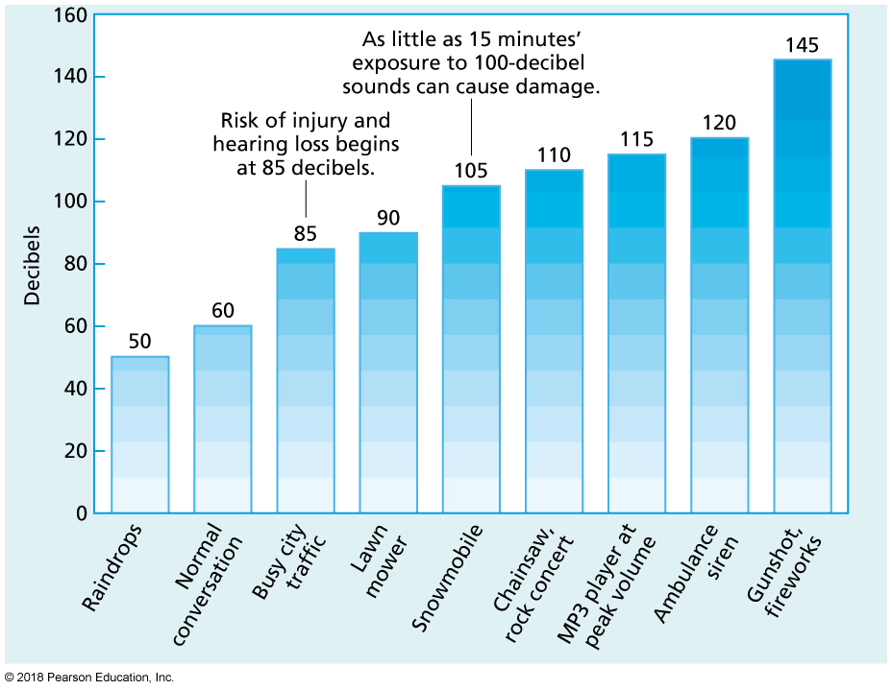
Decibel Levels of Common Noises
Notes:
FIGURE 16.6 Decibel Levels of Common Noises. Noise-related hearing damage can be caused not only by high decibel levels but also by prolonged exposure to noises above 85 decibels.
Source: Data from Oregon Health & Science University (2013). Decibel exposure time guidelines. www.ohsu.edu; and National Institute on Deafness and Other Communication Disorders (2010, June 7). Common sounds. www.nih.gov.

Slide 37
RADIATION

Slide 38
Radiation
Radiation is energy that travels in the form of rays, waves, or particles.
Types of radiation:
Non-ionizing radiation (microwaves, radio waves).
Ionizing radiation (UV rays from the sun, X-rays).
We are all exposed to radiation, but only some forms are harmful, such as UV radiation and X-rays.
Exposure to some types of radiation can lead to cancer and miscarriages.
Higher levels of exposure can lead to radiation sickness.

Slide 39
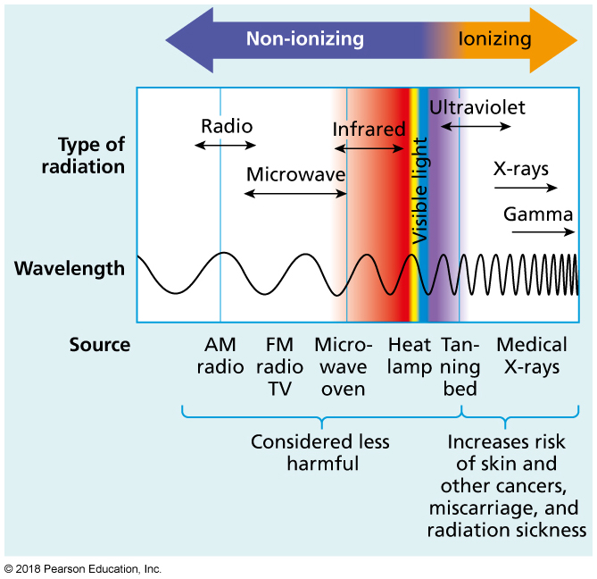
The Electromagnetic Spectrum and Sources of Radiation
Notes:
FIGURE 16.7 The Electromagnetic Spectrum and Sources of Radiation.
Non-ionizing radiation is considered less harmful than ionizing radiation. Source: Adapted from Environmental Protection Agency. (2012, August 7). Radiation protection: Ionizing & non-ionizing radiation. www.epa.gov.

Slide 40
What Can You Do to Reduce Your Exposure to Radiation
Watch your sun exposure.
Skip the tanning salon.
Use a headset or the speaker feature when talking on your cell phone.
Work with your doctor and dentist to limit your exposure to X-rays and other imaging devices that use radiation.
Test your home for radon.

Slide 41
Change Yourself, Change Your World
Write to your national and state legislatures, as well as your governor, asking them to support solutions to climate change.
Write articles for your local and campus media outlets to promote solutions to climate change.
Host a movie night with friends and screen a documentary with an environmental theme.
Use social networking sites to let friends know what you’ve been doing to clean up your community and how they can get involved, too.

